Slide 1
Chapter 1 – Sets

Slide 2
Chapter 1 - Sets
Learning Intentions
After this unit of learning, you will be able to:
Understand the concept of a set.
List elements of a set.
Demonstrate the understanding of set notation and terminology.
Represent elements of a set in a 2-set Venn diagram.
Find the cardinal number, set difference, union and intersection of a set.
Solve 2-set problems.

Slide 3
Introduction to Sets
A set is a well-defined collection of objects. ‘Well-defined’ means we know exactly what it is.
The set of even numbers from 1 to 11 is well-defined. The set of good music is not, because the meaning of ‘good’ music will vary for different people.
The objects that make up a set are called elements or members.
You can describe a set in two ways:
(a) Written method: Set $W$ is the set of days of the weekend
(b) List method: Days of the weekend = {Saturday, Sunday}
or $W$ = {Saturday, Sunday}

Slide 4
Introduction to Sets
When listing a set, remember:
(a) Represent each set with a capital letter.
(b) Use {curly brackets}.
(c) Put a comma in between each element.
(d) List each element only once.
(e) The order of the elements does not matter.

Slide 7
Introduction to Sets
Example 1
List the elements of the set 𝐻, the letters in the word ‘hippopotamus’.
Solution
$$H=\left\{h, i, p, o, t, a, m, u, s\right\}$$
(Remember, you only list each element once.)
Example 2
Describe the following set in words.𝑀 = {$x$, $y$, $z$}
Solution
The set 𝑀 is the last three letters of the alphabet.

Slide 8
Elements ∈ ∉
The symbol $∈$ shows that something is an element of a set.
The symbol $∉$ shows that something is not an element of a set.

Slide 9
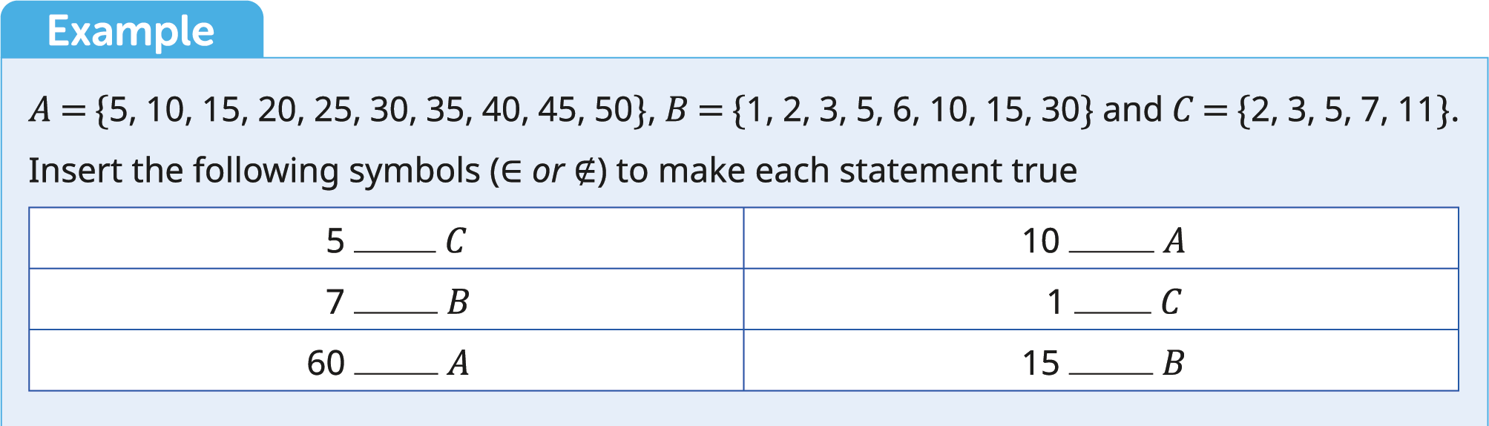

Slide 10
Elements ∈ ∉
Example
𝐴 = {5, 10, 15, 20, 25, 30, 35, 40, 45, 50}, 𝐵 = {1, 2, 3, 5, 6, 10, 15, 30} and 𝐶 = {2, 3, 5, 7, 11}. Insert the following symbols (∈ or ∉) to make each statement true.
Solution
$$5∈C$$ | $$10∈A$$
$7∉B$ | $1∉C$
$60∉A$ | $$15∈B$$

Slide 11
Null Set ∅
A null set or an empty set is a set with no elements. The symbol for a null set is $∅$ or $\{\}$.

Slide 13
Null Set ∅
Example
List the elements of the set 𝐴, the numbers in the alphabet.
Solution
𝐴 = { }

Slide 14
Cardinal Number #
The cardinal number of a set is the number of elements in the set. We use the symbol $\#$ for cardinal number.

Slide 17
Cardinal Number #
Example 1
(a) List the elements of the set 𝑀, the months of the year beginning with M.
(b) What is the cardinal number of the set 𝑀?
Solution
(a) 𝑀 = {March, May}
(b) #𝑀 = 2
Example 2
𝑆 = {5, 10, 11, 45, 67}, 𝐽 = {6, 7, 8, 9, 12, 67}
(a) Find #𝑆 and #𝐽
(b) Find #𝑆 + #𝐽
Solution
(a) #𝑆 = 5 and #𝐽 = 6
(b) #𝑆 + #𝐽 = 5 + 6 #𝑆 + #𝐽 = 11

Slide 18
Equal Sets
Sets are said to be equal if they contain exactly the same elements.
The order of these elements does not matter.

Slide 19
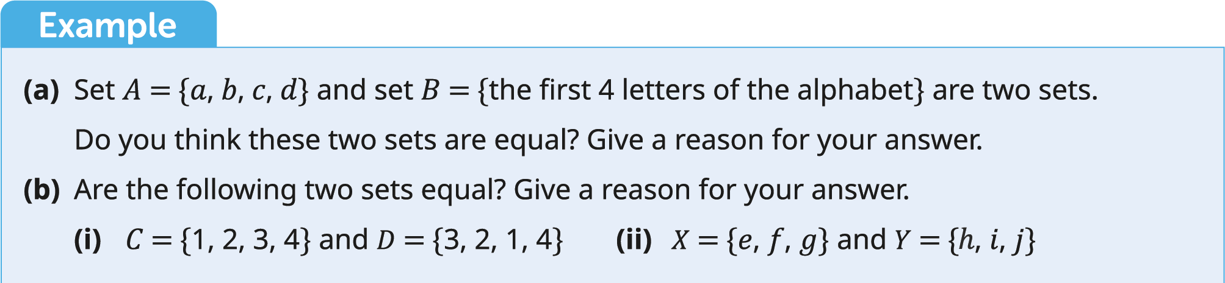

Slide 20
Equal Sets
Example
(a) Set 𝐴 = {𝑎, 𝑏, 𝑐, 𝑑} and set 𝐵 = {the first 4 letters of the alphabet} are two sets. Do you think these two sets are equal? Give a reason for your answer.
(b) Are the following two sets equal? Give a reason for your answer.
(i) 𝐶 = {1, 2, 3, 4} and 𝐷 = {3, 2, 1, 4} (ii) 𝑋 = {𝑒, 𝑓, 𝑔} and 𝑌 = { , 𝑖, 𝑗}
Solution
(a) 𝐴 = {𝑎, 𝑏, 𝑐, 𝑑} and 𝐵 = {𝑎, 𝑏, 𝑐, 𝑑}
Yes, sets 𝐴 and 𝐵 are equal. They contain the same elements.
(b) (i) Yes, they are. They contain the same elements; the order in which they appear does not matter.
(ii) 𝑋 and 𝑌 are not equal. They do not contain the same elements.

Slide 21
Subsets ⊂ ⊄
Set 𝐴 is a subset of set 𝐵 if all elements of 𝐴 are also elements of 𝐵.
We use the symbol ⊂ to denote subset and ⊄ to denote not a subset.
A subset can be described as a set within a set.
It is important to note that:
Every set is a subset of itself.
A null set is a subset of all sets.

Slide 22
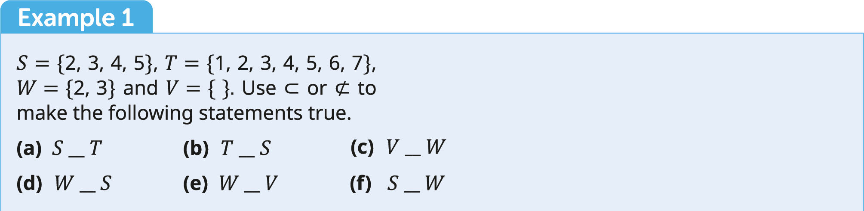

Slide 24
Subsets ⊂ ⊄
Example 1
𝑆 = {2, 3, 4, 5}, 𝑇 = {1, 2, 3, 4, 5, 6, 7}, 𝑊 = {2, 3} and 𝑉 = { }.
Use ⊂ or ⊄ to make the following statements true.
(a) $S__T$ (b) $T__S$ (c) $V__W$
(d) $W__S$ (e) $W__V$ (f) $S__W$
Solutions
(a) $S⊂T$ (b) $T⊄S$ (c) $V⊂W$
(d) $W⊂S$ (e) $W⊄V$ (f) $S⊄W$

Slide 25
Subsets ⊂ ⊄
Example 2
(a) List all the subsets of the set {𝑎, 𝑏, 𝑐}.
(b) How many subsets are there in total?
Solutions
(a) { }, {𝑎}, {𝑏}, {𝑐}, {𝑎, 𝑏}, {𝑎, 𝑐}, {𝑏, 𝑐}, {𝑎, 𝑏, 𝑐}
(b) There are 8 subsets.

Slide 26
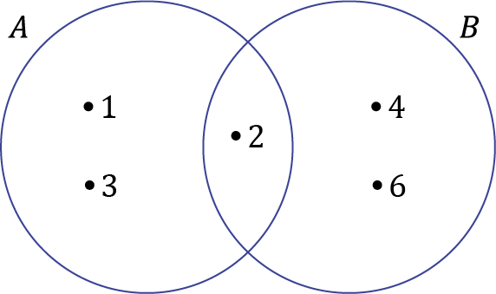
Venn Diagrams
To illustrate a Venn diagram, we use circles or ovals.
We represent each element in the Venn diagram with a dot in front of the element.
Do not repeat an element in the Venn diagram.
Example: $A=\left\{1, 2, 3\right\}$ and $B=\{2, 4, 6\}$.
To represent these on a Venn diagram we will need two circles or ovals.
We can see that the element 2 is common to both sets. Therefore, 2 is placed where the ovals overlap.

Slide 27
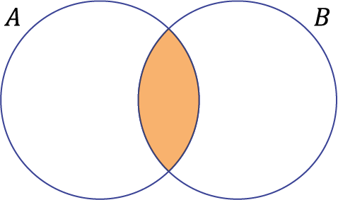
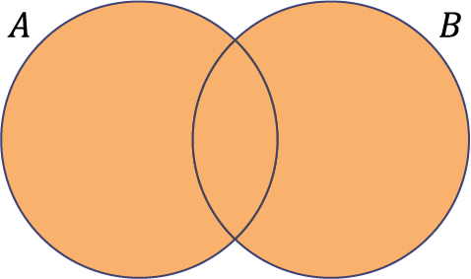
Intersection and Union
The intersection of two sets 𝐴 and 𝐵 is the set of the elements that are in both 𝐴 and 𝐵.
We write the intersection as $A∩B$.
The union of sets 𝐴 and 𝐵 is the set of elements in 𝐴 or 𝐵.
We write the intersection as $A∪B$.

Slide 28
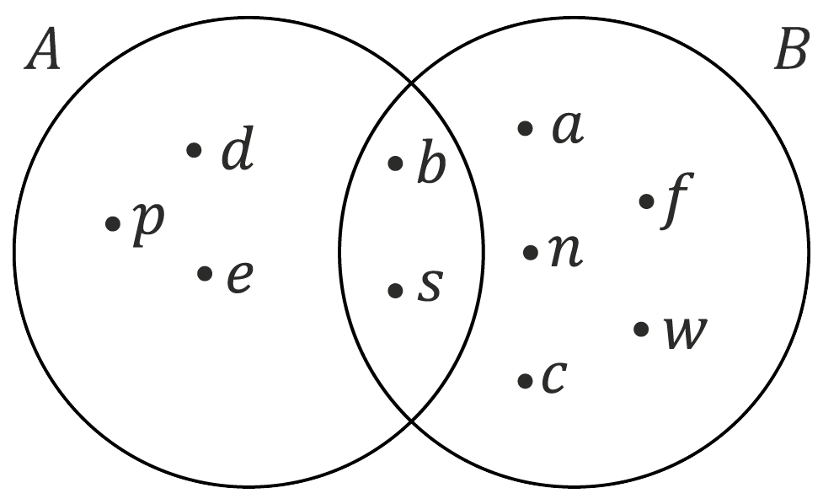

Slide 29
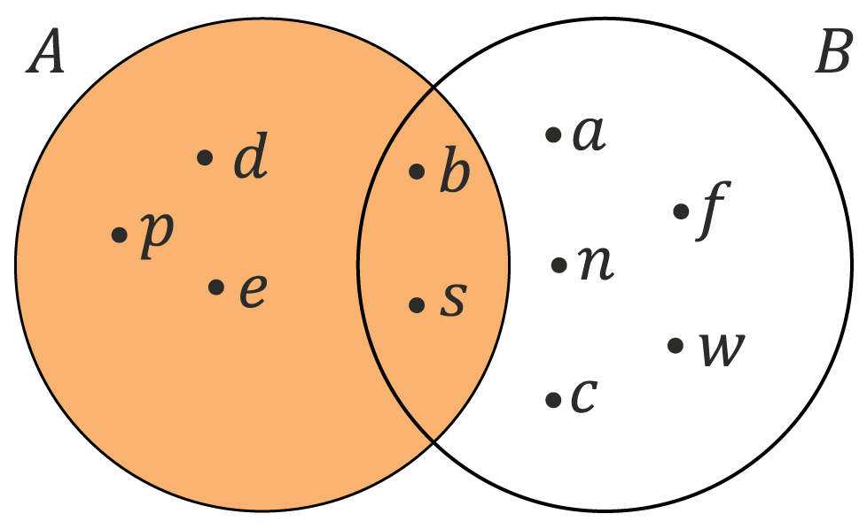
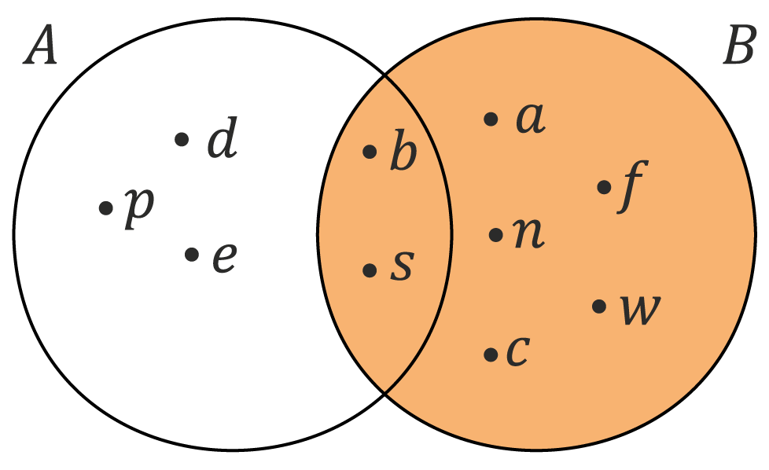
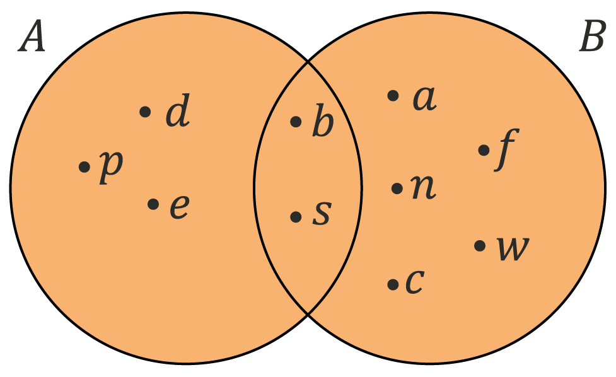
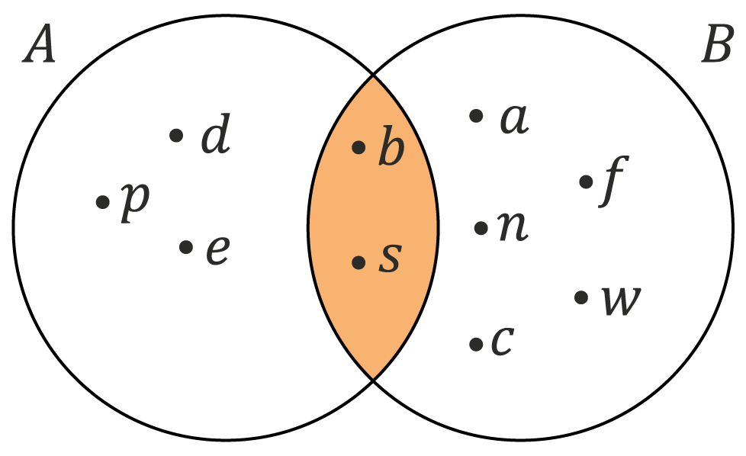
Solution
(a) $A=\{p, d, e, b, s\}$
(b) $B=\{b, s, a, n, c, f, w\}$
(c) $A∪B=\{p, d, e, b, s, a, n, c, f, w\}$
(d) $A∩B=\{b, s\}$

Slide 30
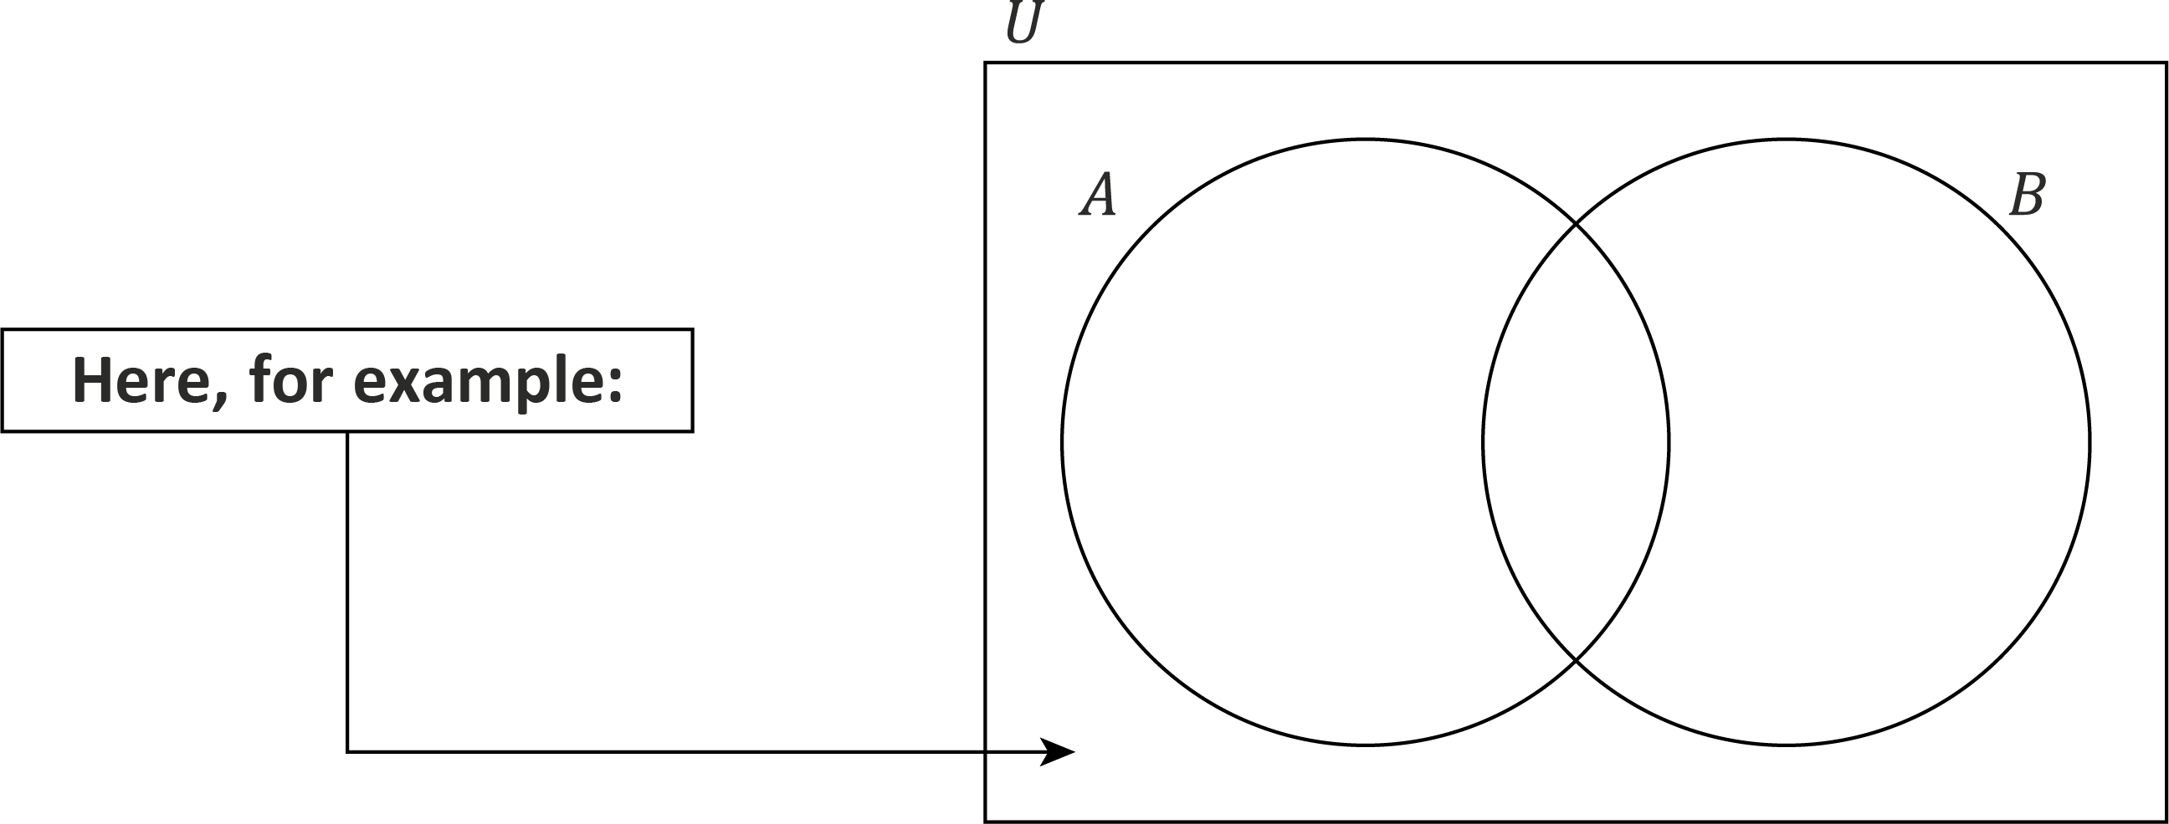
Universal Set $U$
The universal set represents all elements in a given question.
The universal set is denoted as $U$.
We use a rectangle to represent the universal set in a Venn diagram.
When there is an element that is not in set 𝐴 or 𝐵, we place it outside the circles but within the rectangular box.

Slide 31
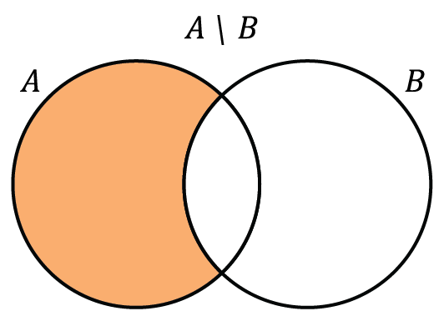
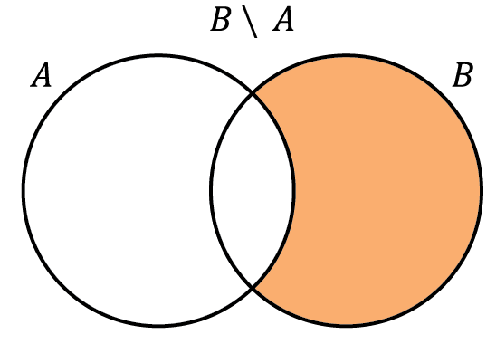
Set Difference $∖$
$A∖B$ means the elements in $A$ but not in $B$.
$B∖A$ means the elements in $B$ but not in $A$.

Slide 32
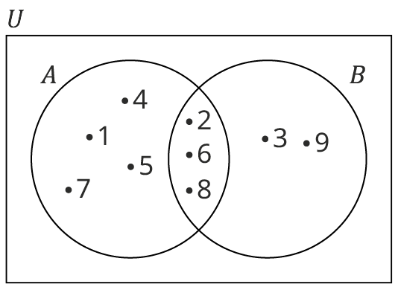

Slide 33
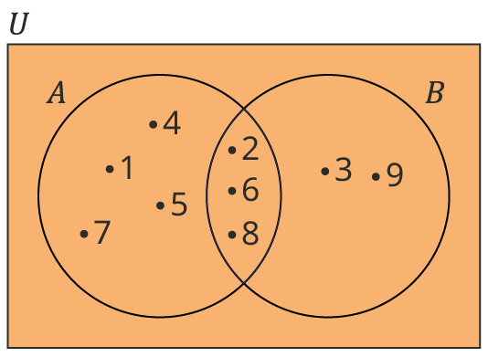
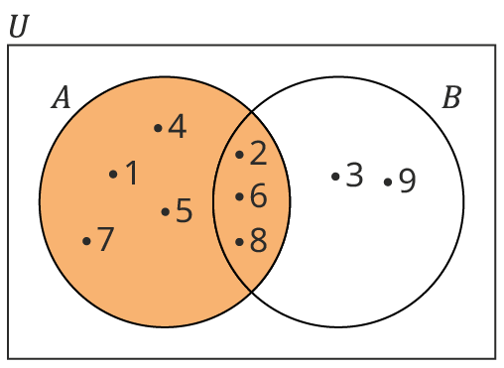
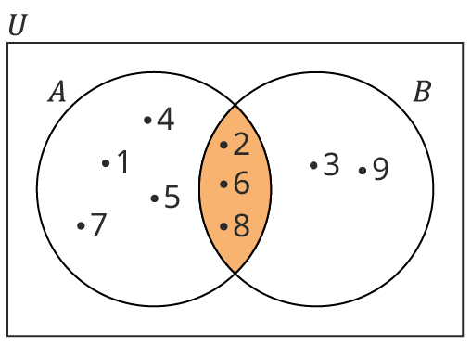
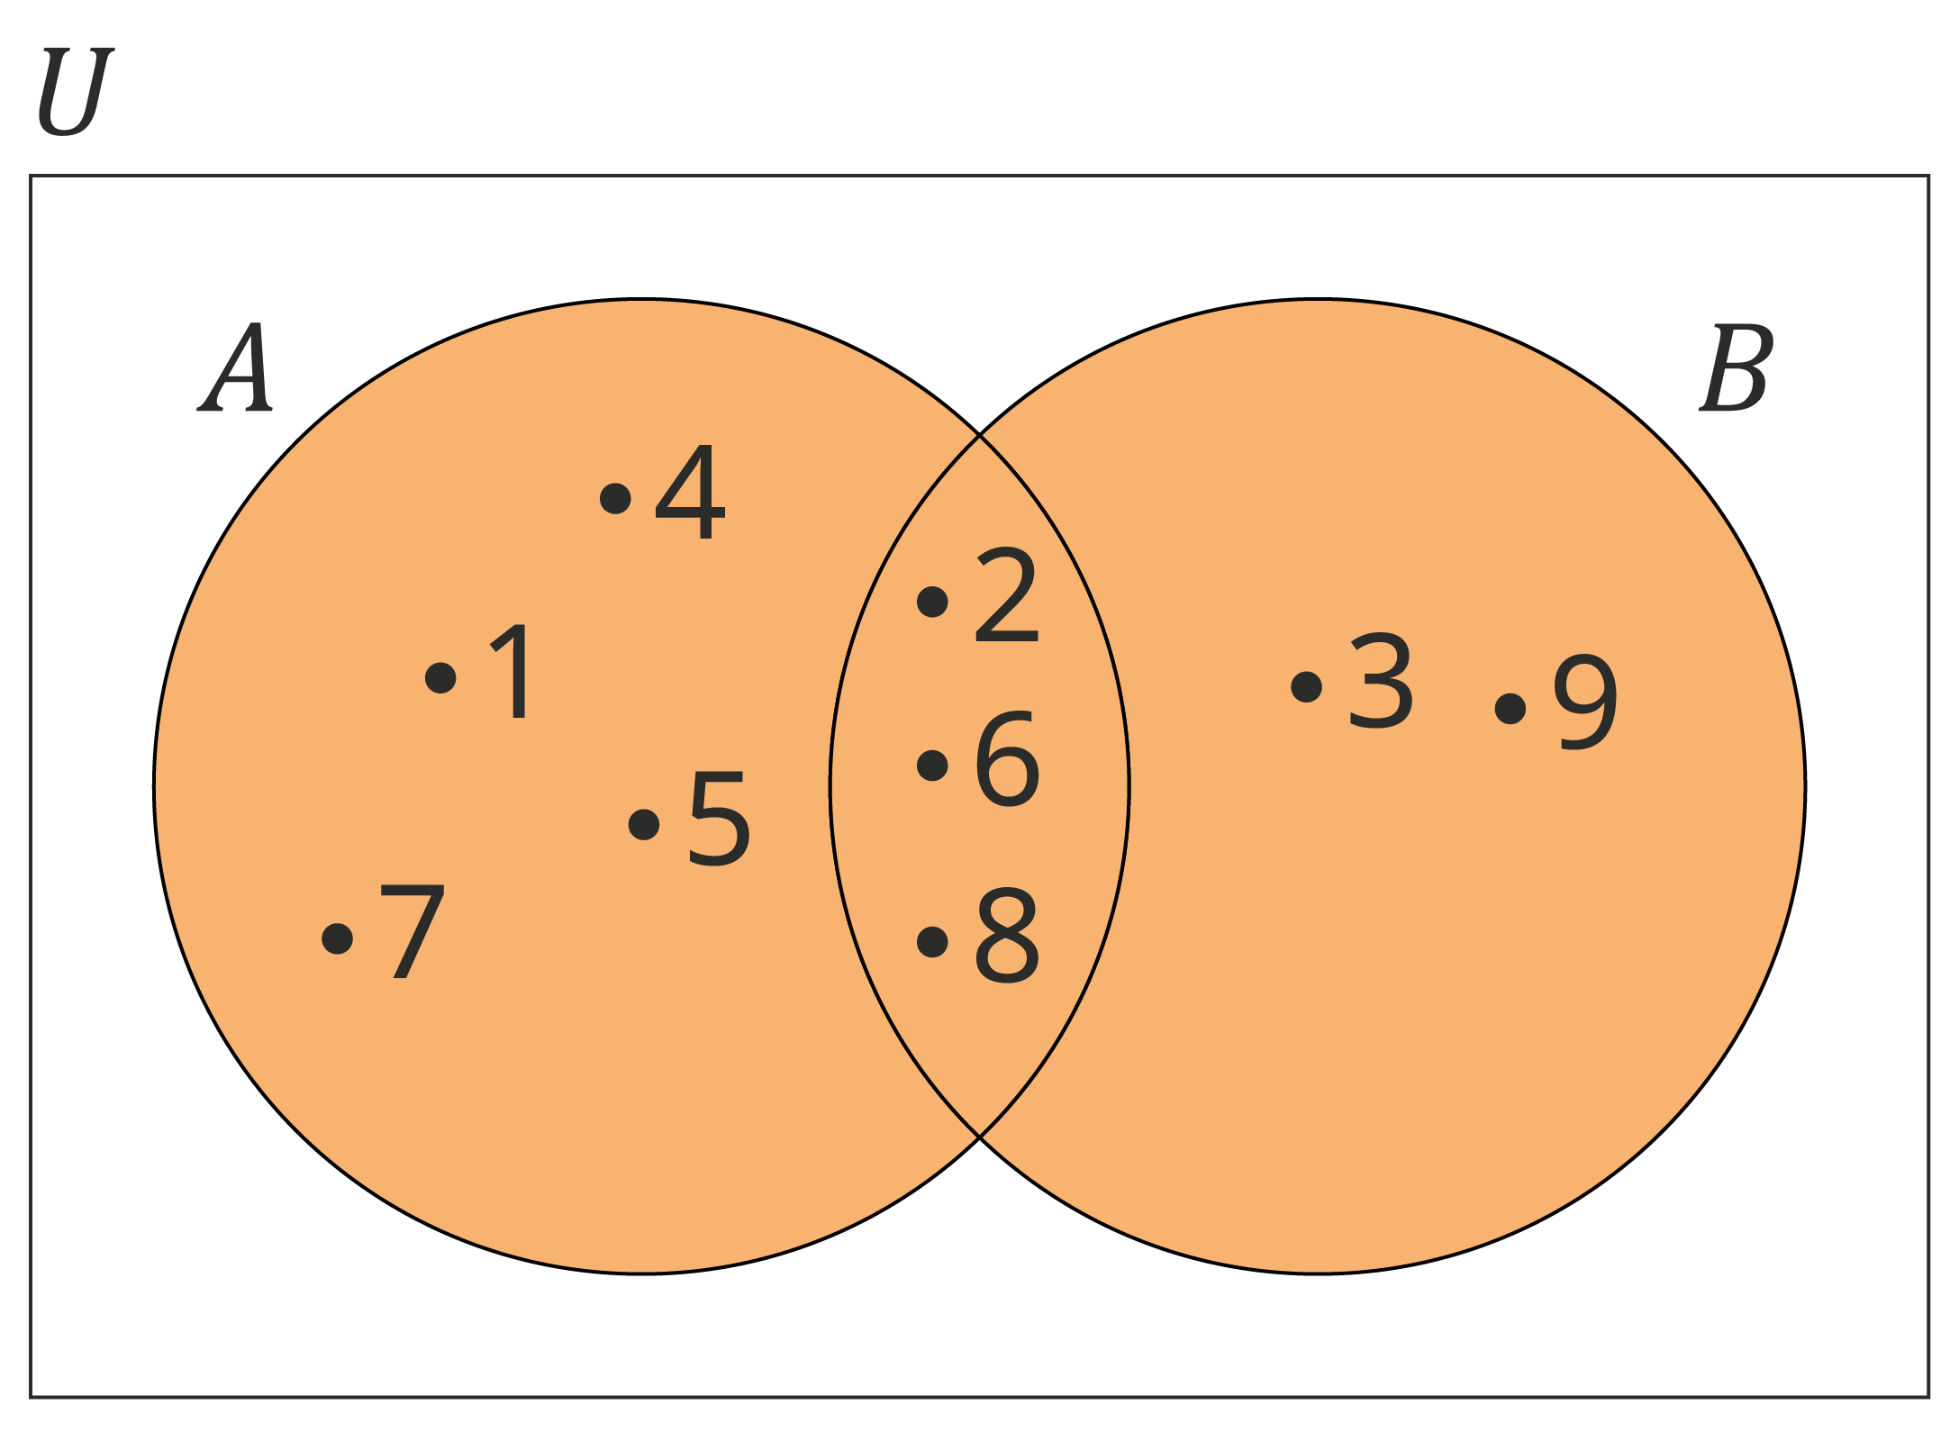
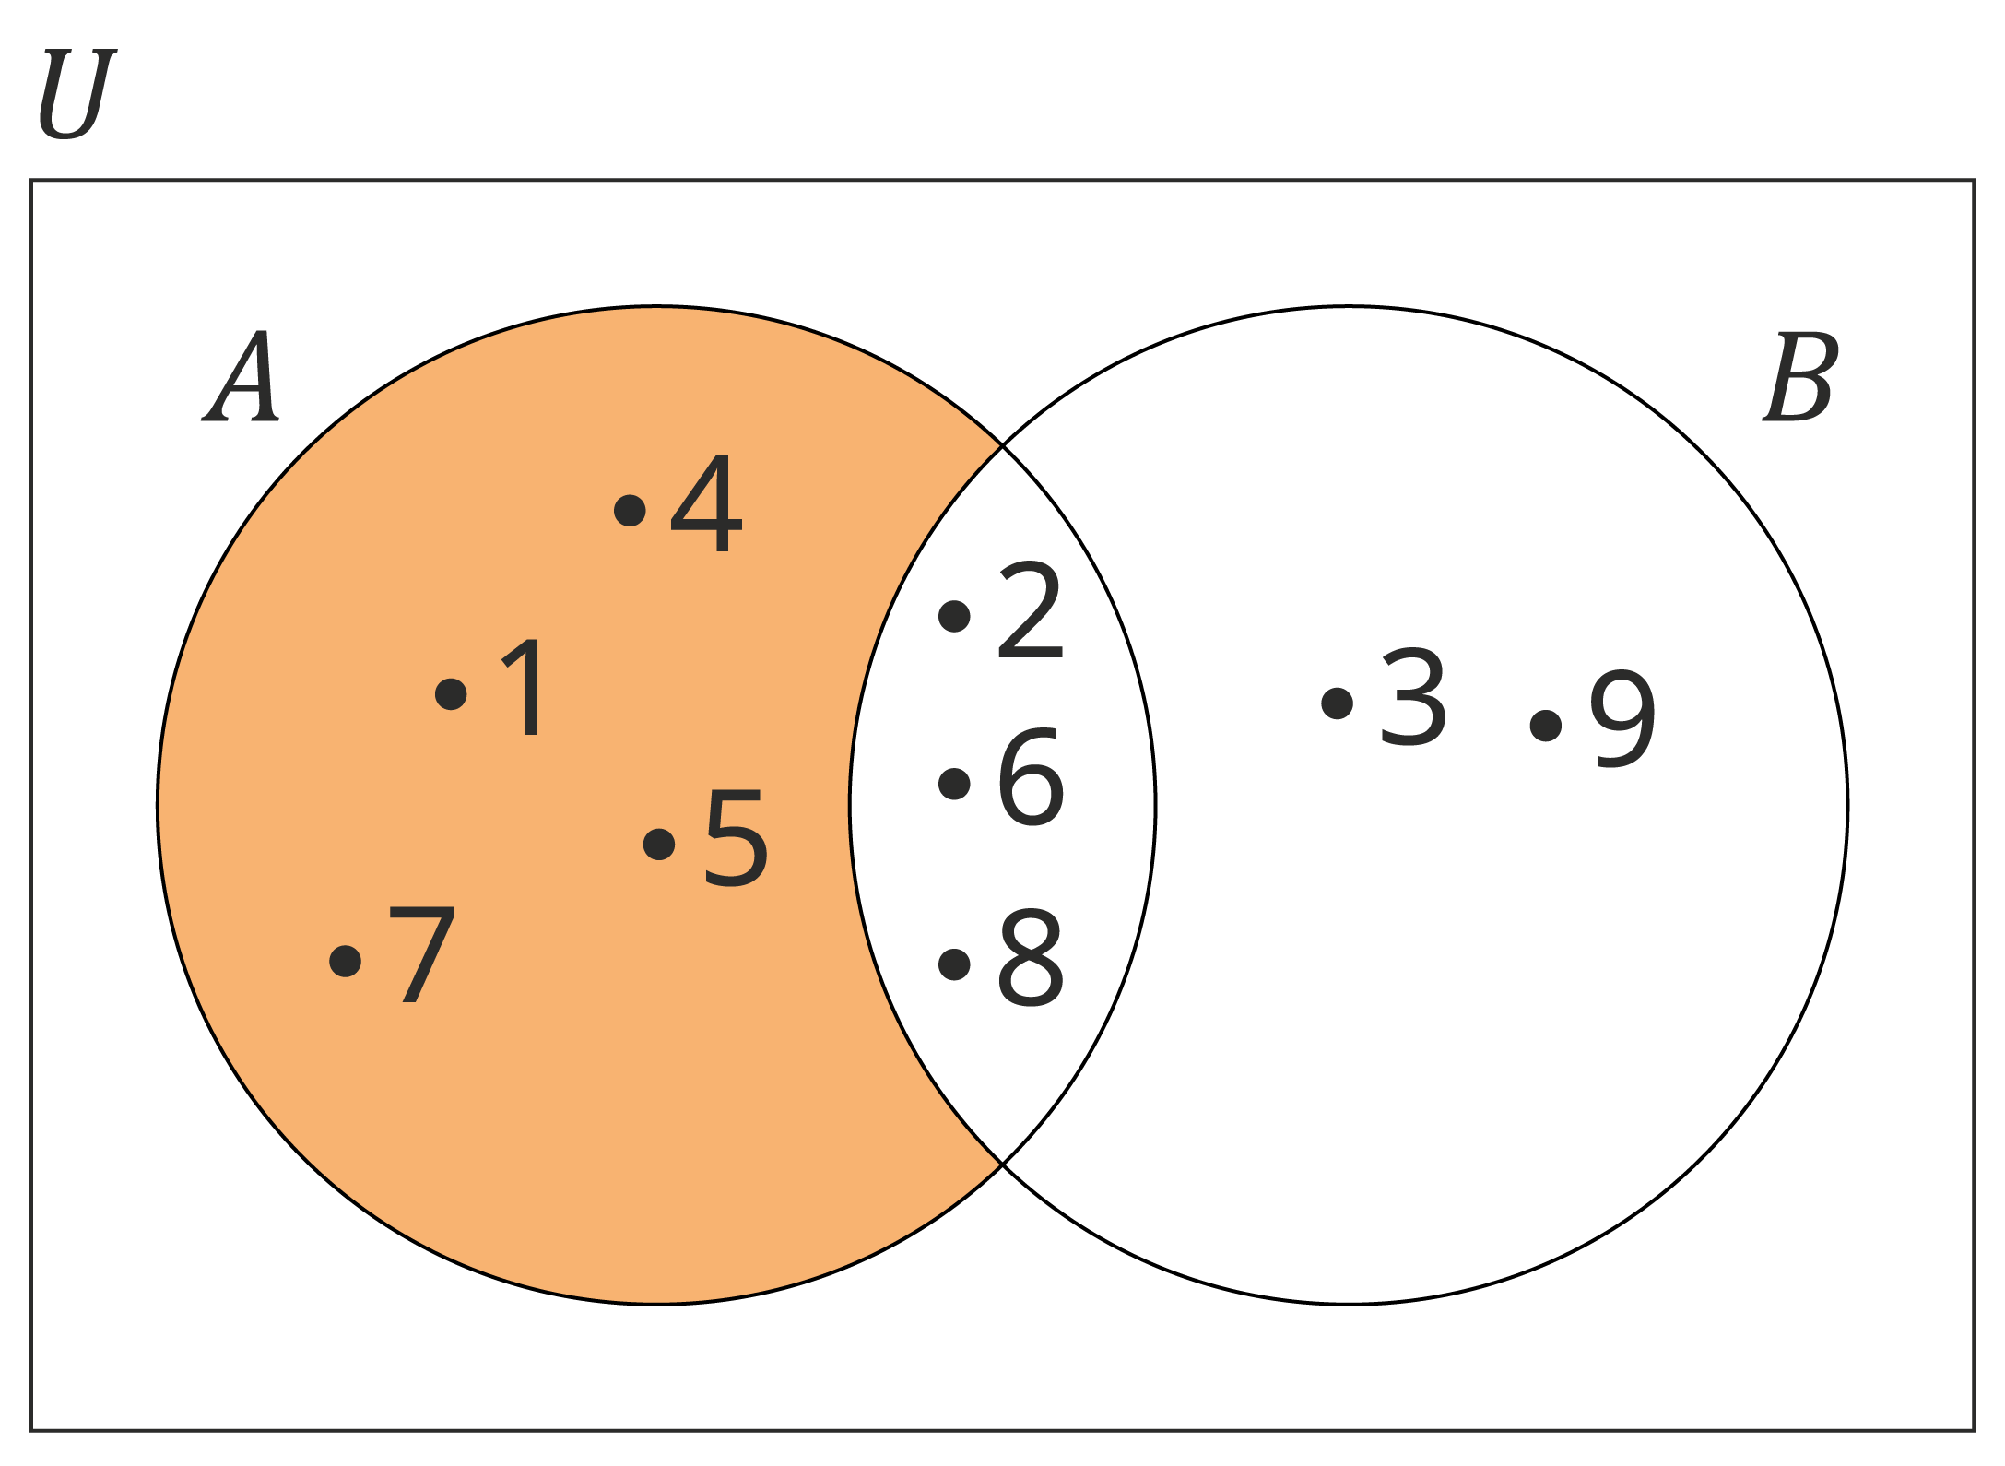
Solution 1
(a) $U=\{1, 2, 3, 4, 5, 6, 7, 8, 9\}$
(b) $A=\{1, 2, 4, 5, 6, 7, 8\}$
(c) $A∩B=\{2, 6, 8\}$
(d) $A∪B=\{1, 2, 3, 4, 5, 6, 7, 8, 9\}$
(e) $A∖B=\{1, 4, 5, 7\}$

Slide 35
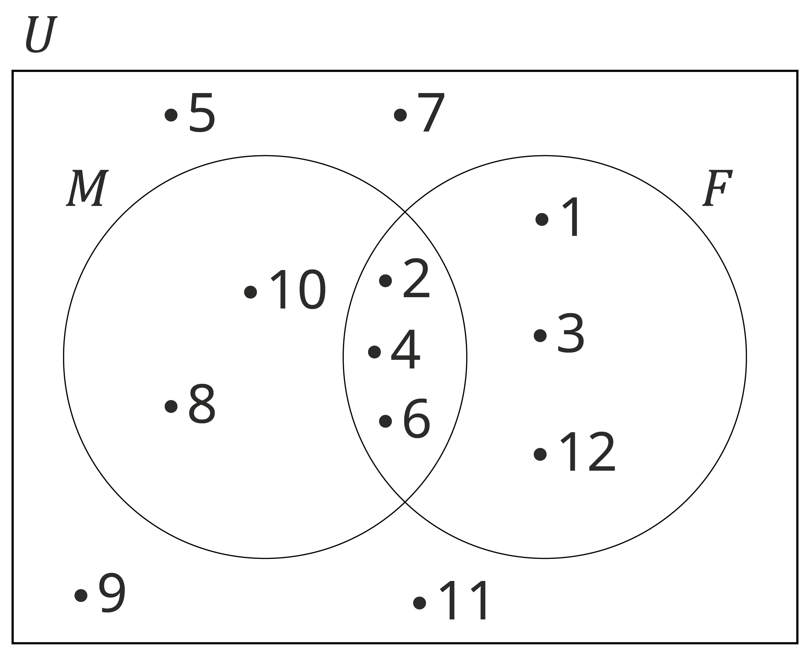
Solution 2
Step 1: Fill in the intersection.
$M∩F=\left\{2, 4, 6\right\}$
Step 2: Fill in the rest of $M$ and $F$.
$M∖F=\left\{8, 10\right\}$
$F∖M=\left\{1, 3, 12\right\}$
Step 3: Check that you have included all elements from the universal set.
$U∖(M∪F)=\left\{5, 7, 9, 11\right\}$
These elements are not in sets 𝑀 or 𝐹 but they are in the universal set. We place them in the region between the circles and the rectangle.

Slide 36
Problem Solving with Sets
When problem solving, we can use the cardinal numbers of sets in a Venn diagram.
We do not use a dot when illustrating cardinal numbers. We just write the number of elements.
Recap of symbols
Symbol | Meaning
𝑈 | Universal set
𝐴 ⋂ 𝐵 | In 𝐴 and 𝐵
𝐴 ⋃ 𝐵 | In 𝐴 or 𝐵
𝐴 \ 𝐵 | In 𝐴 only
𝐵 \ 𝐴 | In 𝐵 only

Slide 37
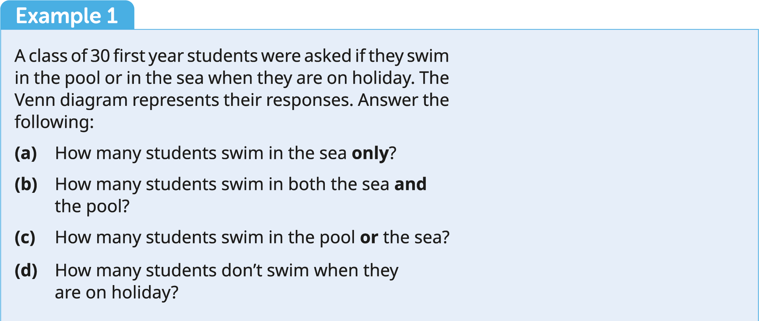
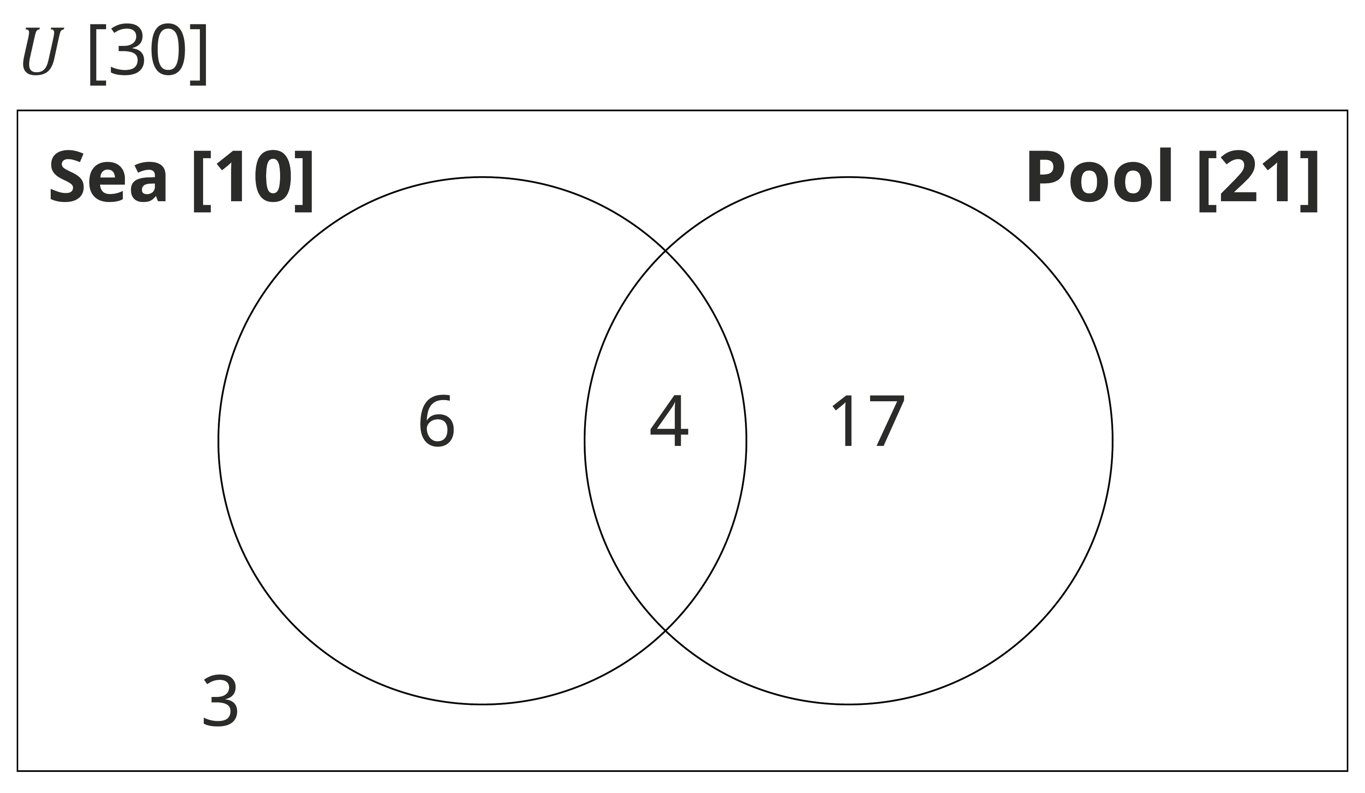

Slide 38
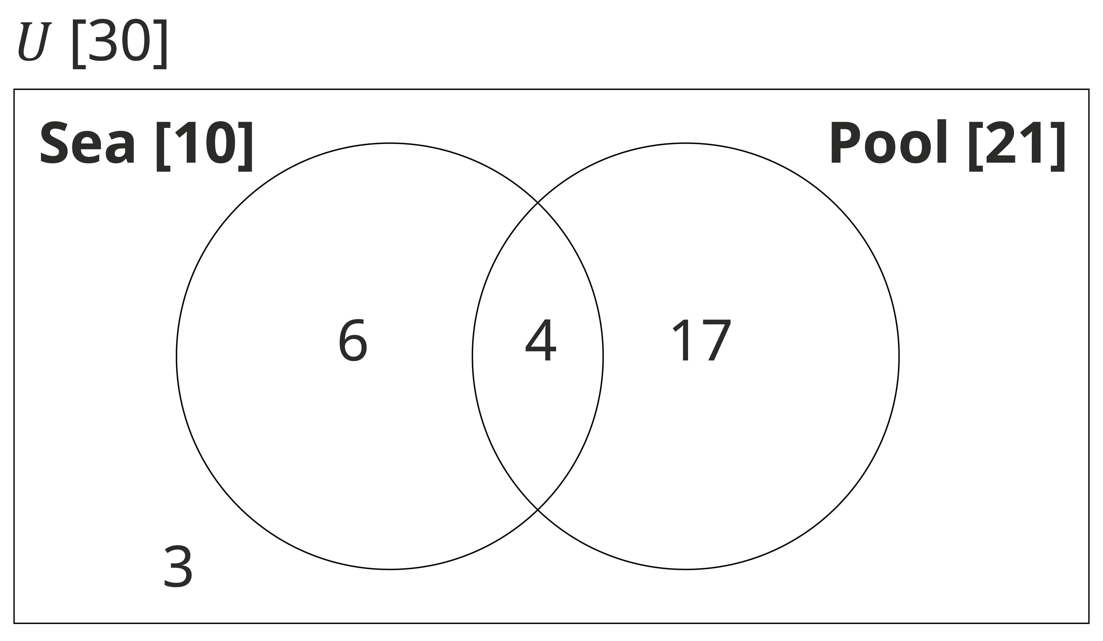
Solution 1
(a) 6 students swim in the sea only.
(b) 4 students swim in both the sea and the pool.
(c) 27 students swim in the sea or the pool.
(d) 3 students don’t swim when they are on holiday.

Slide 40
Equal Sets
Example 2
A group of 54 students were asked if they played soccer or Gaelic football. 30 played soccer. 36 played Gaelic football. 10 played neither. How many students played both?
Solution
𝐴 =30 + 36 + 10 = 76. But, there are only 54 students.
The difference must be an overlap of the two sets.
So, 76 − 54 = 22 students played both

Slide 42
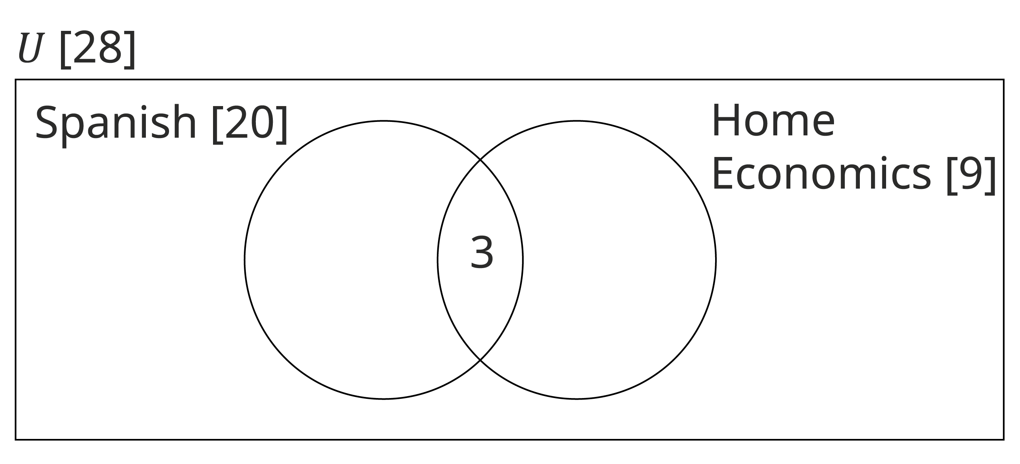
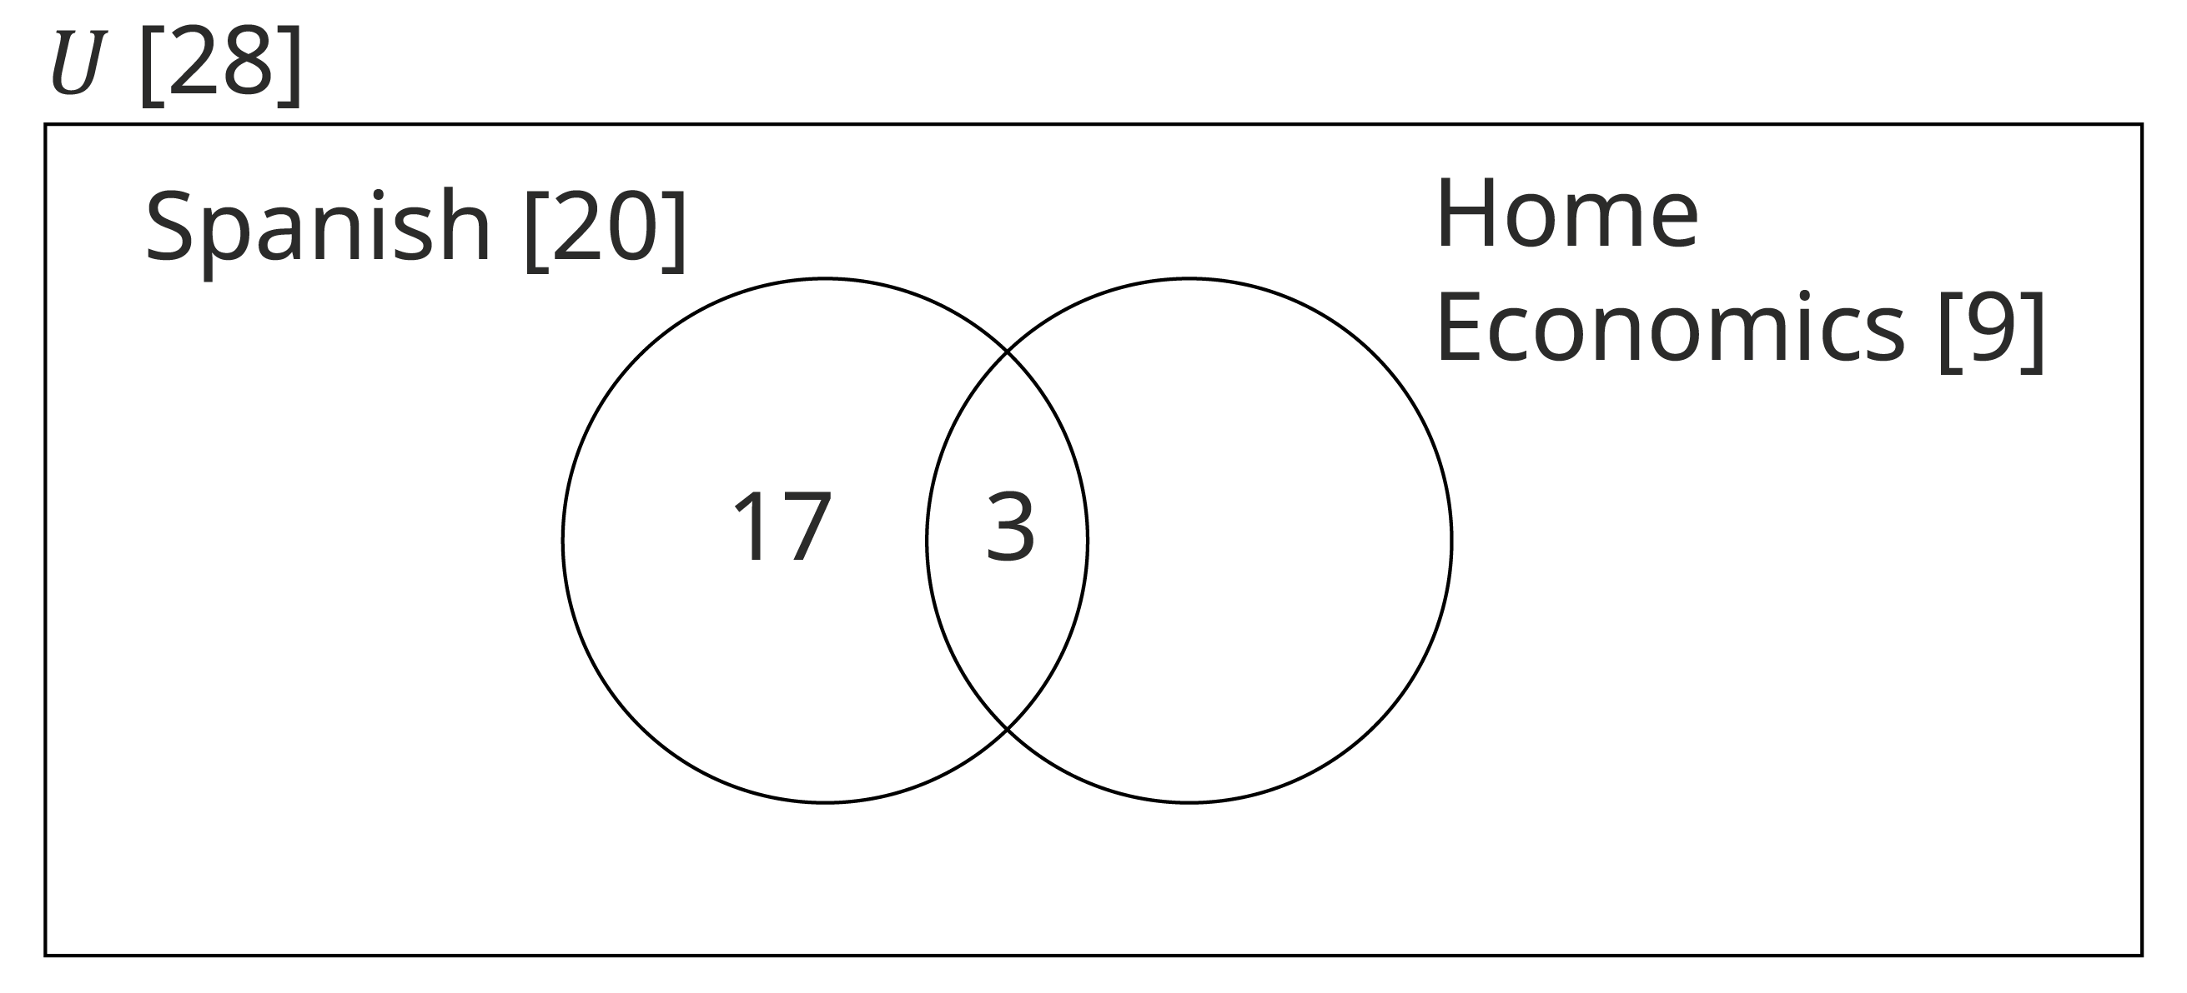
Example 3
In a class of 28 students, 20 study Spanish, 9 study home economics and 3 study both. Illustrate this information on a Venn diagram.
Solution
Step 1: Start with the middle if possible. We know that 3 students study both Spanish and home economics.
Step 2: Spanish only
20 students study Spanish. 3 of them study both. We only count each element once. So, the number of students who study Spanish only is 20 − 3 = 17

Slide 43
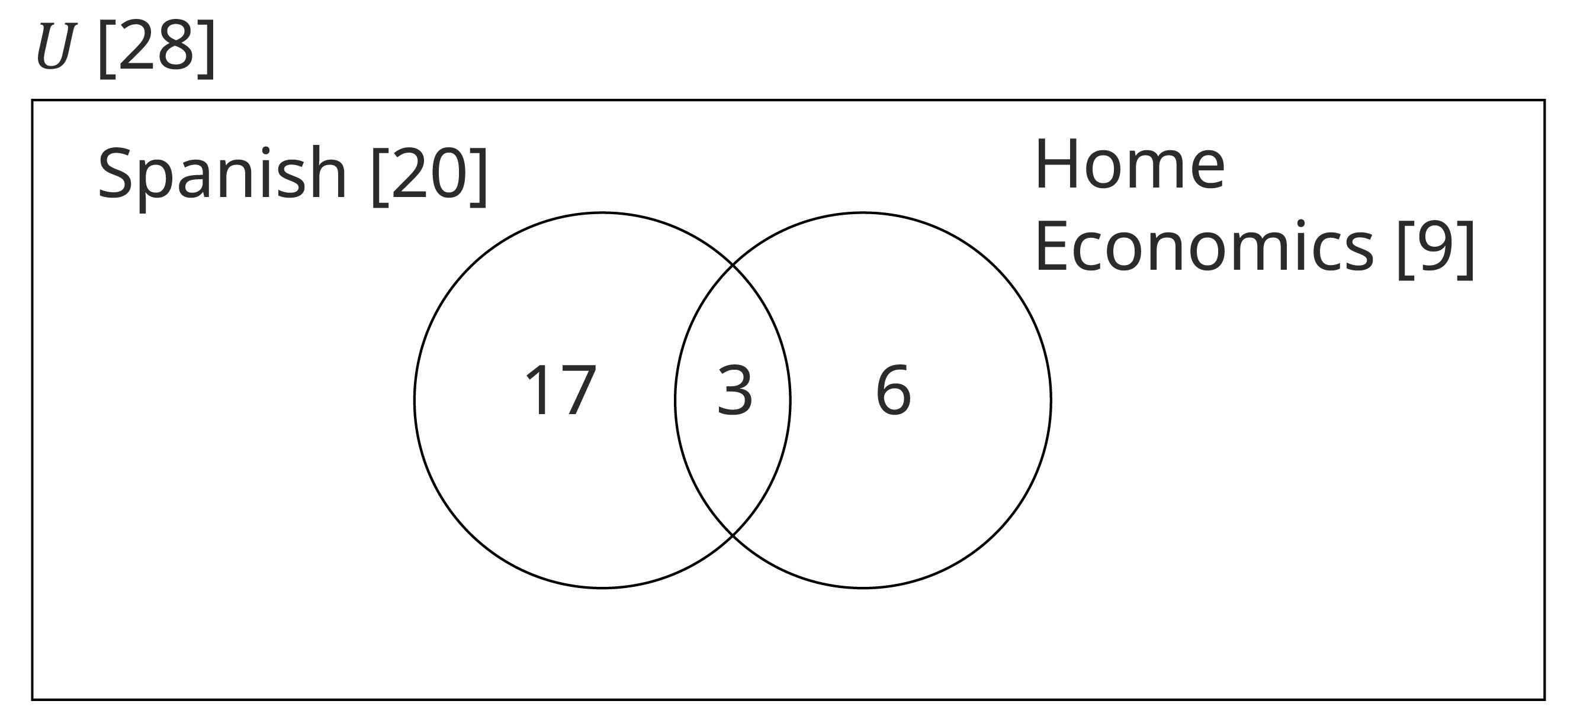
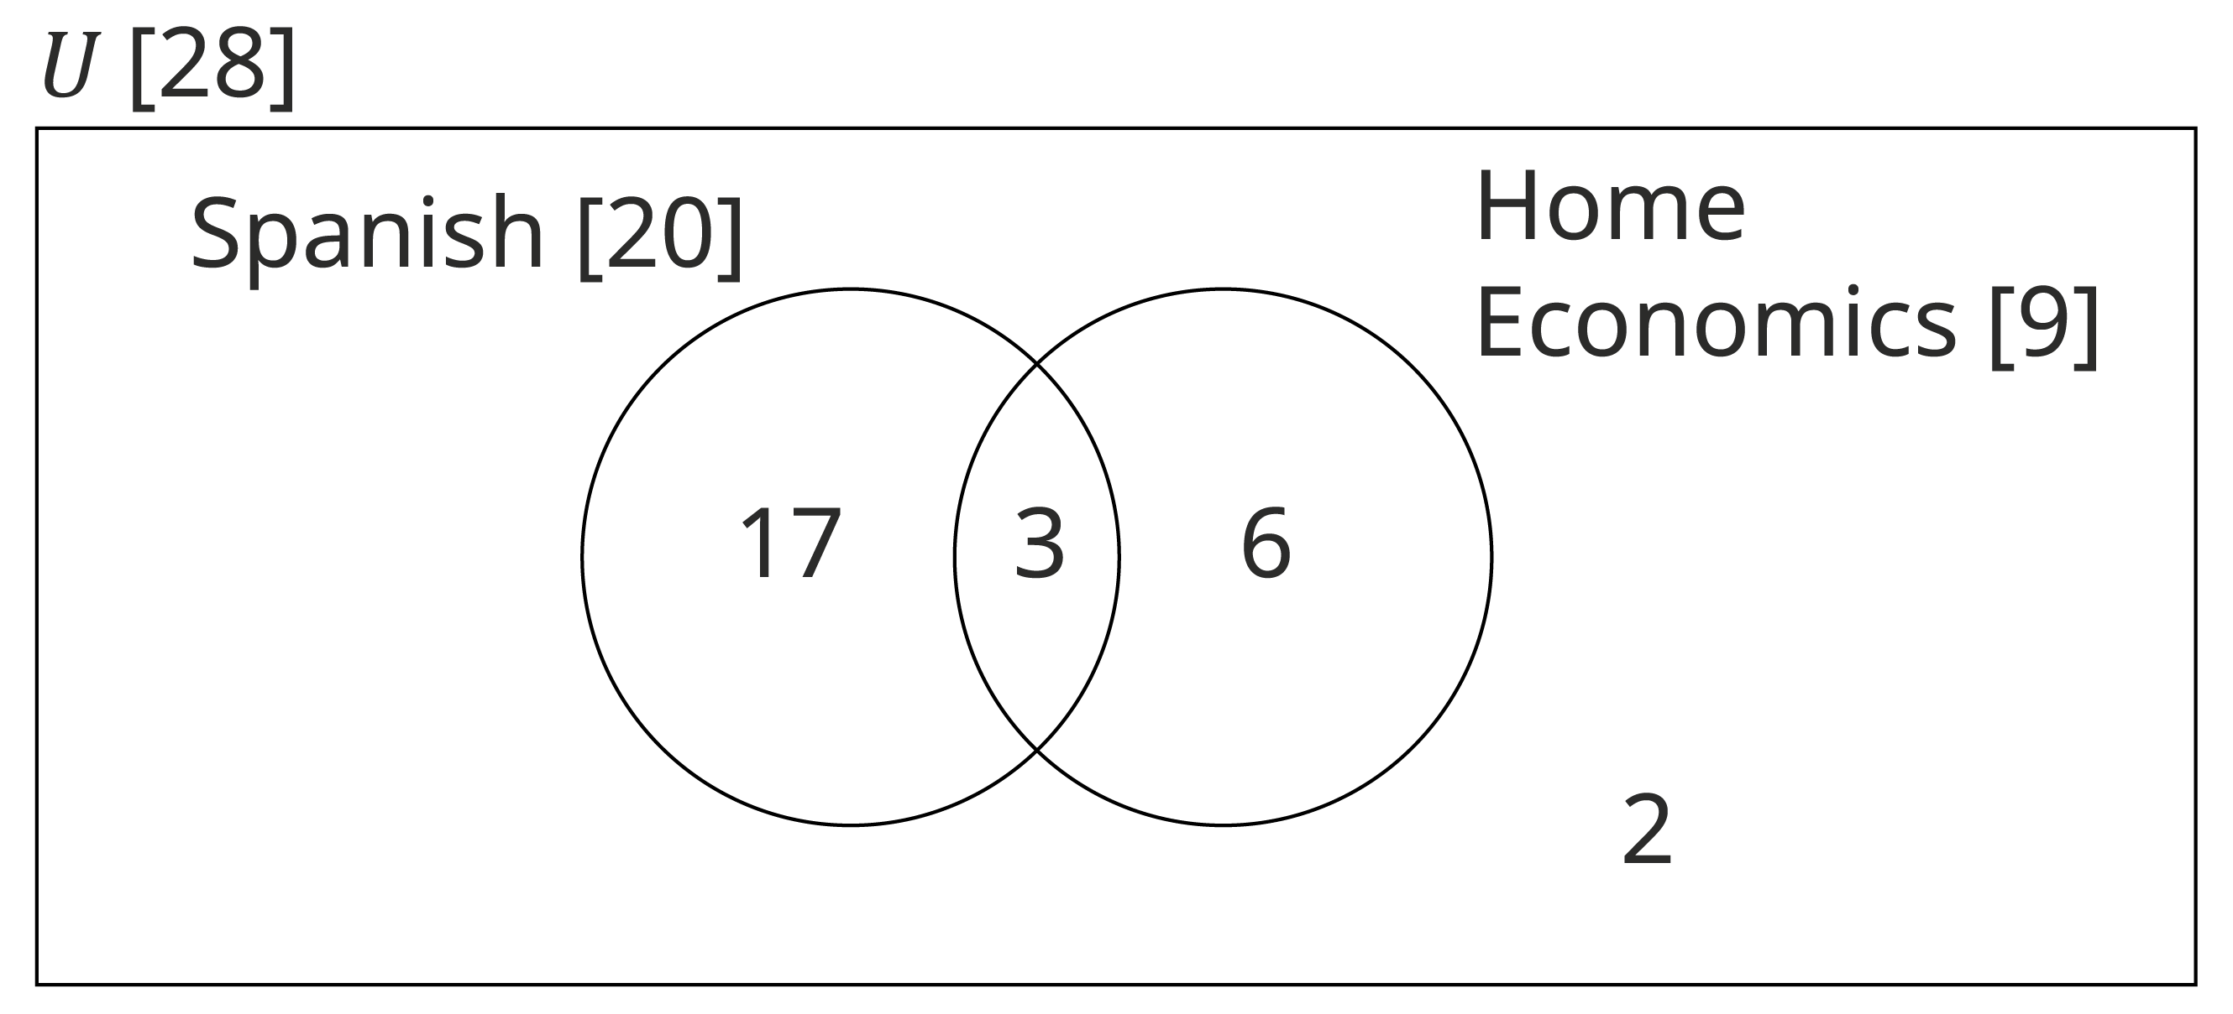
Example 3
Solution - continued
Step 3: Home economics only
9 students study home economics.
3 study both. So, the number that study home economics only is 9 − 3 = 6
Step 4: Neither
Add up all of the students already included. 3 + 17 + 6 = 26 students. However, there are 28 in the class. So that means that 2 study neither.

