Slide 2
What does it mean to have a belief?
Having a belief means having trust or faith in something or someone you cannot see nor have proof for.
To live a happy and meaningful life, people use their beliefs as a guide or a pathway.
Some people’s beliefs are very strong and play an important role in their everyday life. Others may struggle to explain their beliefs.
Some beliefs are based in or come from religions while others have nothing to do with God/Gods.

Slide 3
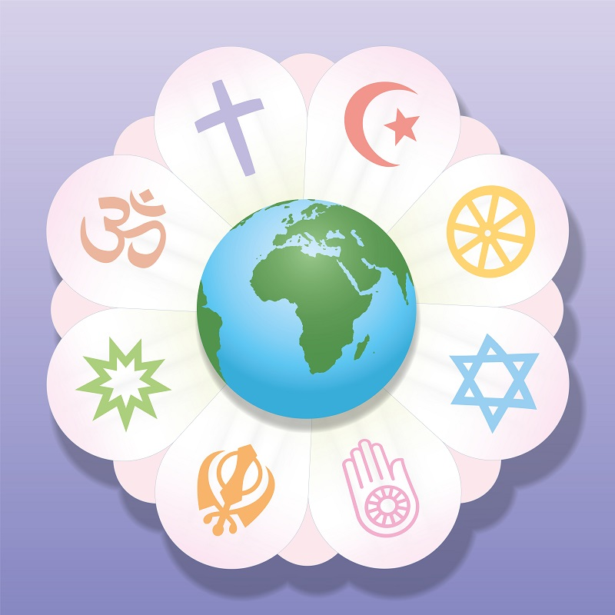
Religious belief
Religious belief means to believe in and worship some higher power or God/Gods.
There are many different religions found all over the world today.
In the past, Christianity was the main religion found in Ireland.
Modern Ireland is now home to people of many different religions and cultures, including Islam and Hinduism.

Slide 4
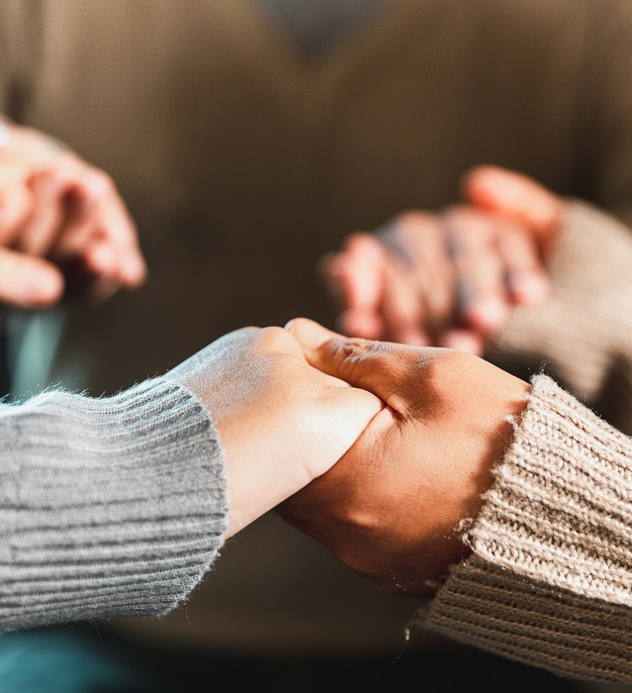
Religious belief
As people of different beliefs live and work side by side, it is important that we all have some understanding of the main religious beliefs found in Ireland today. Understanding the beliefs of others helps us to respect the role religion plays in their lives.
Even if we do not have a religious faith ourselves, we can still learn about what others believe in.

Slide 5
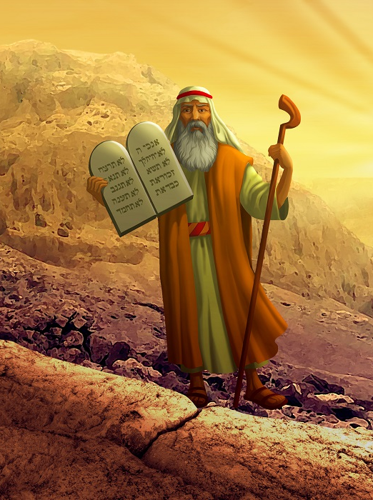
Judaism
Key Beliefs
Judaism was founded around 1800 BCE in Israel by Abraham.
God made a covenant, or promise, with Abraham. If he was faithful to God, Abraham would become the father of many.
He was to travel to a land called Canaan. This became known as the Promised Land.

Slide 6
Judaism
Key Beliefs
Abraham’s people were known as the Israelites. They suffered greatly over the years and were made slaves by the Egyptians.
A shepherd called Moses saw a burning bush one day that was not getting burnt by the fire. God’s voice then told Moses to help the Jewish people to escape slavery in Egypt. The escape is called the Exodus.
God gave Moses the Ten Commandments.

Slide 7
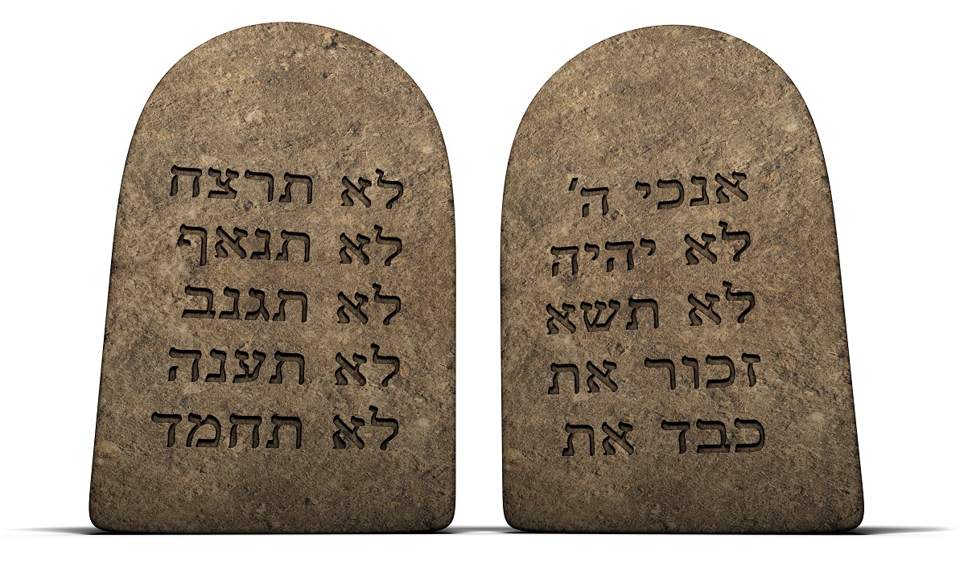
Judaism
Key Beliefs
The Ten Commandments were the second covenant God made with the Jewish people. They were to follow these rules and remain faithful to him. They are the Jewish moral code.
As time went on, the people began to forget their covenant with God. So, God sent prophets to help them. A prophet is a person called by God to receive an important message and preach it to the people. Jeremiah and Isaiah are two examples of prophets.

Slide 8
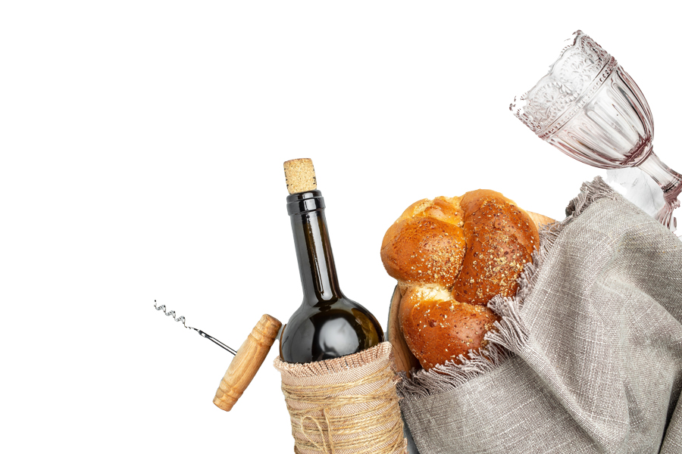
Judaism
Key Beliefs
There are certain rules about what foods can be eaten and how they should be prepared. Jewish people eat food that is kosher, which means ‘clean and pure’. According to Jewish law, an animal must be killed in a certain way for it to be kosher. Pork and shellfish are not kosher.
The Sabbath begins on a Friday evening at sunset and ends at the same time the following day. It is a family event.

Slide 9
Christianity
Key Beliefs
Christianity is also a monotheistic religion.
It was founded around 2,000 years ago by Jesus Christ, who was born to a couple named Joseph and Mary in a town called Bethlehem.
Jesus Christ is the Son of God. He grew up in Nazareth in the province of Galilee, which was ruled by the Romans.

Slide 10
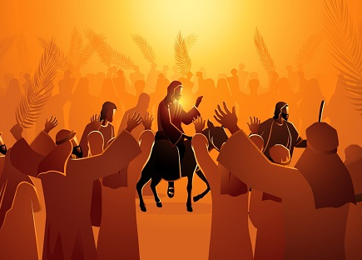
Christianity
Key Beliefs
Jesus went on to travel through Palestine with a group of followers, known as the 12 apostles, preaching and teaching. He told stories, performed miracles, and showed people a new way of living.
After coming into conflict with different groups, Jesus was sentenced to death and was crucified.
Christianity began in Palestine in 33 CE, after the death of Jesus.

Slide 11
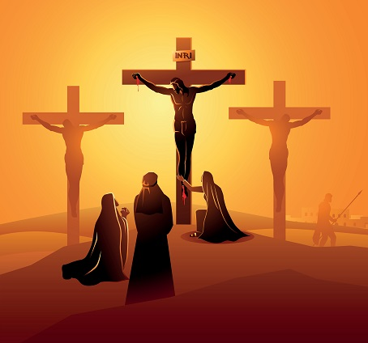
Christianity
Key Beliefs
Jesus died on the cross so that those who believe in him will be forgiven their sins.
Jesus rose from the dead and appeared to witnesses. Christians believe that this shows God’s power over life and death.
Forty days after his resurrection, Jesus was taken up into heaven, body and soul. (This is called the Ascension.)

Slide 12
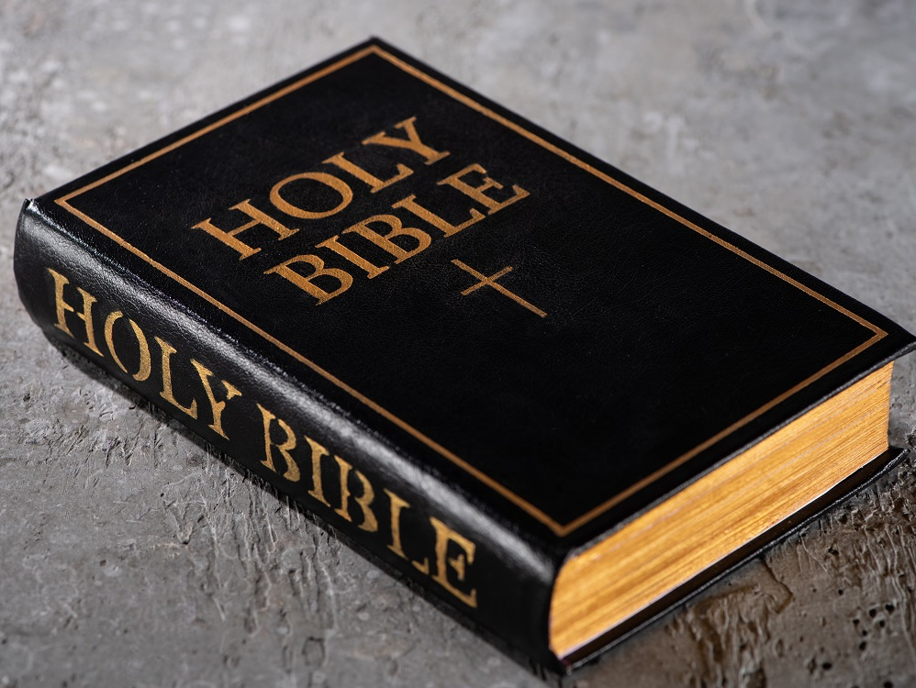
Christianity
Key Beliefs
Jesus promised that he would stay with his followers, so after he went to heaven, he sent the Holy Spirit to guide them.
The Bible is the sacred text which Christians believe is the word of God. The New Testament was written by men who were inspired by the Holy Spirit.
People who belong to Christianity are seen as ‘the Church’. They are God’s body on Earth, a community of believers.

Slide 13
Islam
Key Beliefs
The followers of Islam are called Muslims.
Islam was founded in the seventh century and is monotheistic.
The Muslim God is called Allah.
Islam also shares a common root with Judaism through the prophet Abraham.
Muhammad was the last and greatest prophet sent by Allah to guide his people on the right path.

Slide 14
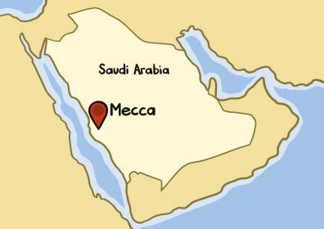
Islam
Key Beliefs
Muhammad was born in Mecca, a city in what is now Saudi Arabia. After seeing greed and fighting all around him, he went to a cave to pray. Muhammad received a revelation from Allah when the Angel Gabriel appeared to him.

Slide 15
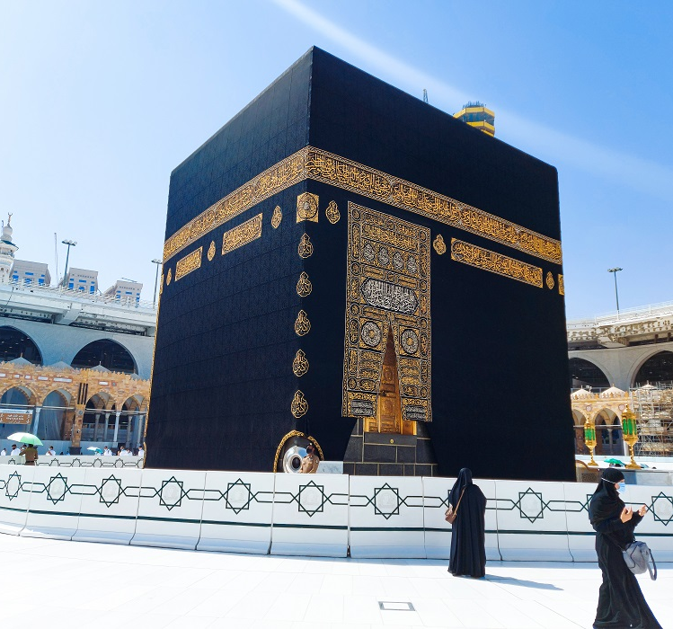
Islam
Key Beliefs
The Kaaba is a black stone building in Mecca, built by Abraham. It is Islam’s holiest shrine. Wherever they are in the world, Muslims face towards the Kaaba when they pray.

Slide 16
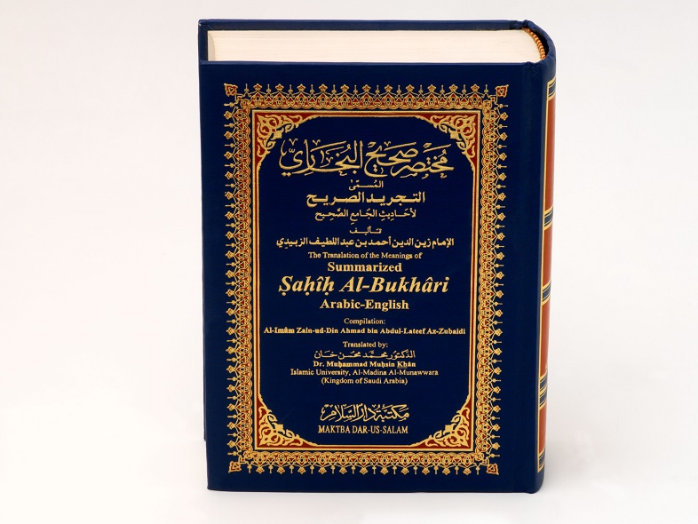
Islam
Key Beliefs
The Qur’an is the sacred text of Islam. Muslims believe it is the word of Allah.
It contains their beliefs and moral codes. The Six Articles of Faith are things Muslims must believe in:
One God
Angels
Prophets
Holy scriptures
Day of Judgement or the afterlife
God’s will or fate.

Slide 17
Islam
Key Beliefs
The Five Pillars of Islam are the moral code containing practices Muslims must perform to live a proper life. The Five Pillars of Islam are:
Shahadah (creed)
Salah (prayer)
Zakat (charity)
Sawm (fasting)
Hajj (pilgrimage)

Slide 18
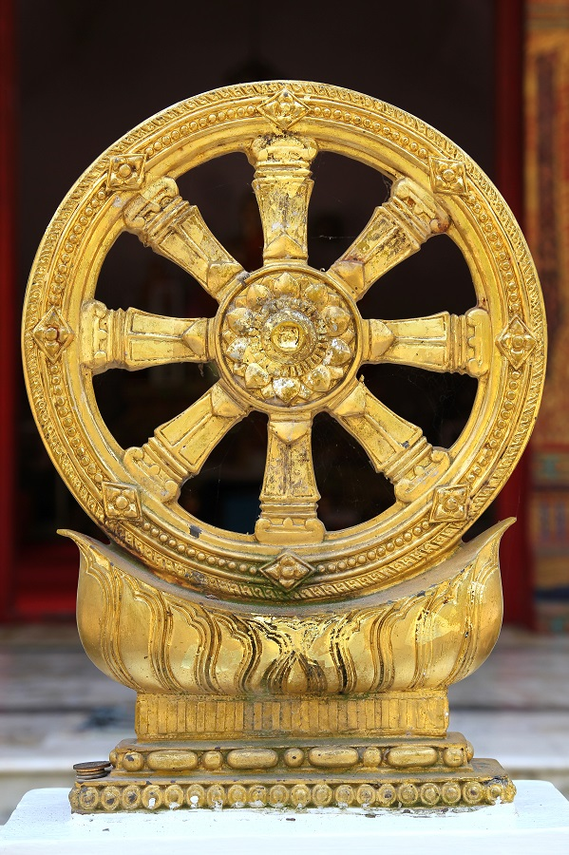
Buddhism
Key Beliefs
Buddhism began in the north of India around the fifth or sixth century BCE.
Buddhism was founded by a man called Siddhartha Gautama, who later became known as the Buddha.
Siddhartha was a wealthy prince, but he left his palace to see what the real world was all about. On his journey he saw an old man, a sick man and a dead man.

Slide 19
Buddhism
Key Beliefs
He realised that life was full of suffering. Then he met a monk who owned nothing but was happy and content.
Siddhartha began to live a life of prayer and fasting with some monks. He was searching for answers to the questions about life.
One day, as he was meditating under a tree, he felt enlightened. He believed that people were never happy with what they had and that this caused them suffering.

Slide 20
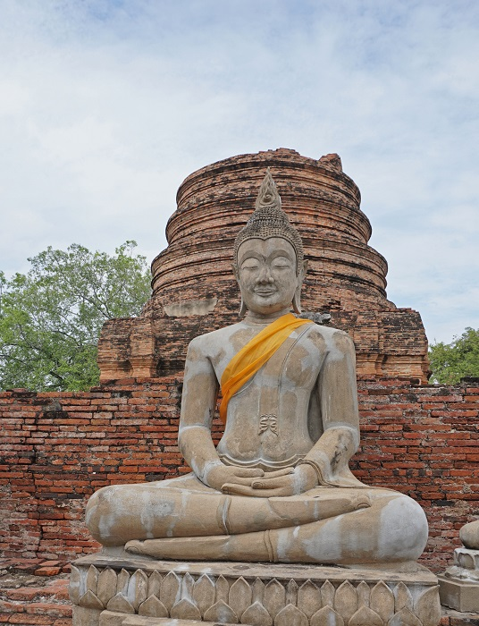
Buddhism
Key Beliefs
The Middle Way means finding happiness between extreme luxury and extreme hardship. It is about living a balanced life.
Nirvana is being in a state of perfect happiness and peace. It is a feeling of freedom from desire and suffering. Nirvana can be reached by following the Four Noble Truths, the Eightfold Path and the Five Precepts.

Slide 21
Buddhism
Key Beliefs
The Four Noble Truths:
Life is full of suffering. People cannot be permanently happy.
The main causes of suffering are desire and greed.
People can reach nirvana by not being greedy and selfish towards others.
The Middle Way is the path to true happiness.

Slide 22
Buddhism
Key Beliefs
The Eightfold Path is the guide for following the Middle Way:
Right view (think about what we are doing with our lives).
Right intention (be compassionate rather than selfish).
Right speech (speak the truth and avoid gossip).
Right action (help others, do not harm living things or the environment).
Right work/livelihood (do something useful, avoid jobs which harm others).
Right effort (be positive and honest in our thoughts).
Right mindfulness (be aware of what you feel, think and do).
Right concentration (calm your mind by practising meditation and focusing on the present moment).

Slide 23
Buddhism
Key Beliefs
The Five Precepts is a moral code that contains the basic rules for living a good life:
Do not harm or kill living things.
Do not take things unless they are given freely.
Be content with a simple way of life.
Do not speak unkindly or tell lies.
Do not abuse drugs or drink alcohol.

Slide 24
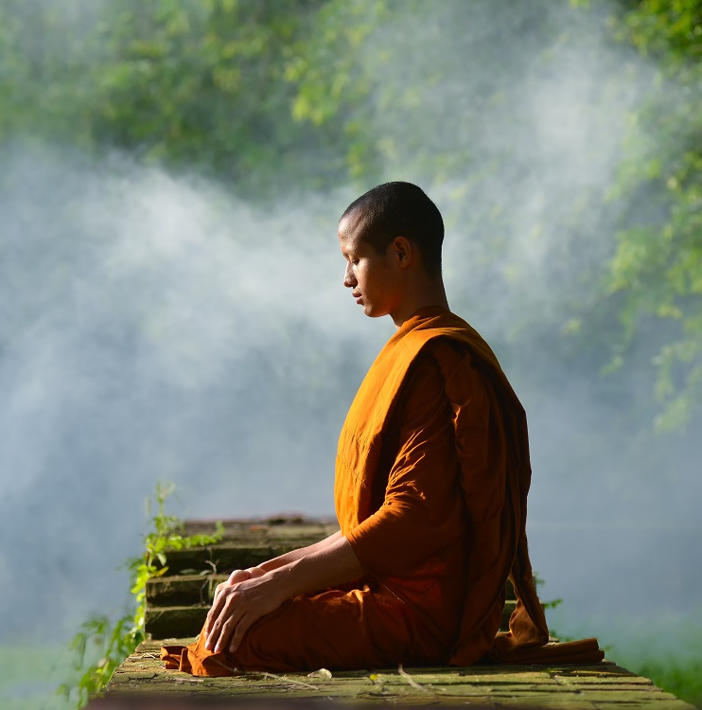
Buddhism
Key Beliefs
People go through many cycles of birth, living, death and rebirth (reincarnation). After many cycles a person may reach nirvana if they practise the Eightfold Path and the Five Precepts.

Slide 25
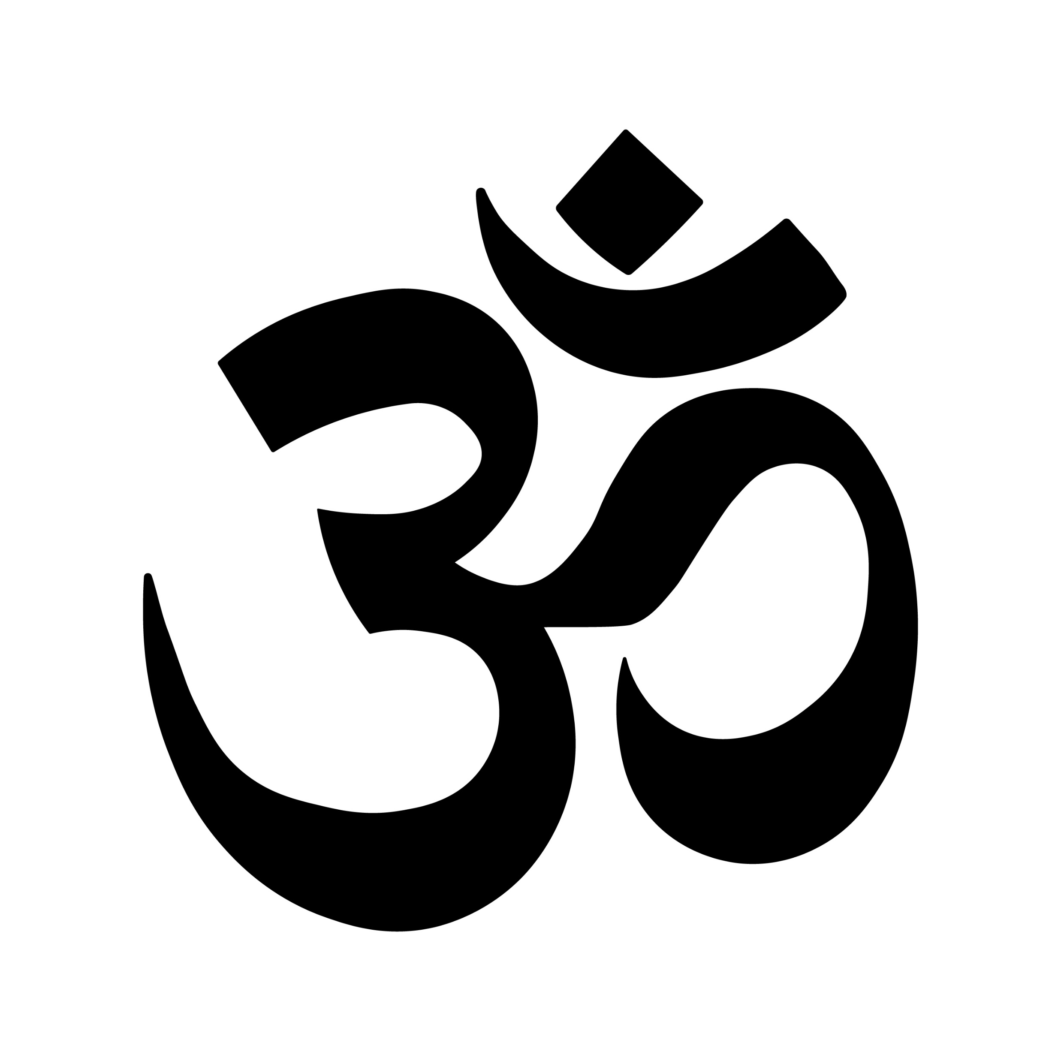
Hinduism
Key Beliefs
Hinduism was founded in India in 2000 BCE. This makes it the oldest of the major world religions.
The Brahman is a supreme soul or spirit that has no shape or form. Everything in the universe flows from this.
There are many Hindu Gods and Goddesses. It is an example of polytheism, which means believing in more than one God.

Slide 26
Hinduism
Key Beliefs
The Gods and Goddesses represent different parts of Brahman’s power and character. The three most important Gods are:
Brahma is the God who created the world.
Shiva is the God who destroys and rebuilds.
Vishnu is the God who protects people from evil and wrongdoing.

Slide 27
Hinduism
Key Beliefs
Hindus believe that they must always do what is right and correct. This is known as dharma. Every form of life and every group of people has its own dharma.
Samsara is the belief that when you die your soul is reborn in another body as an animal or a person. You are reborn over and over until you become perfect.

Slide 28
Hinduism
Key Beliefs
Karma means that when you do good, good will come your way, and if you do bad, then bad will follow you.
The Vedas are the Hindu scared texts. These teach and guide Hindus on how they should live.

Slide 29
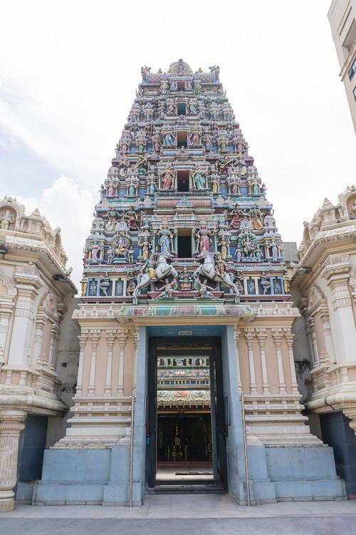
Hinduism
Key Beliefs
Most Hindus have a shrine or small altar in their home dedicated to their favourite God or Goddess. They pray and meditate at it and often burn incense and light candles.
Most Hindus are vegetarians because of their belief in reincarnation. Cows are very special as their milk gives nourishment.

Slide 30
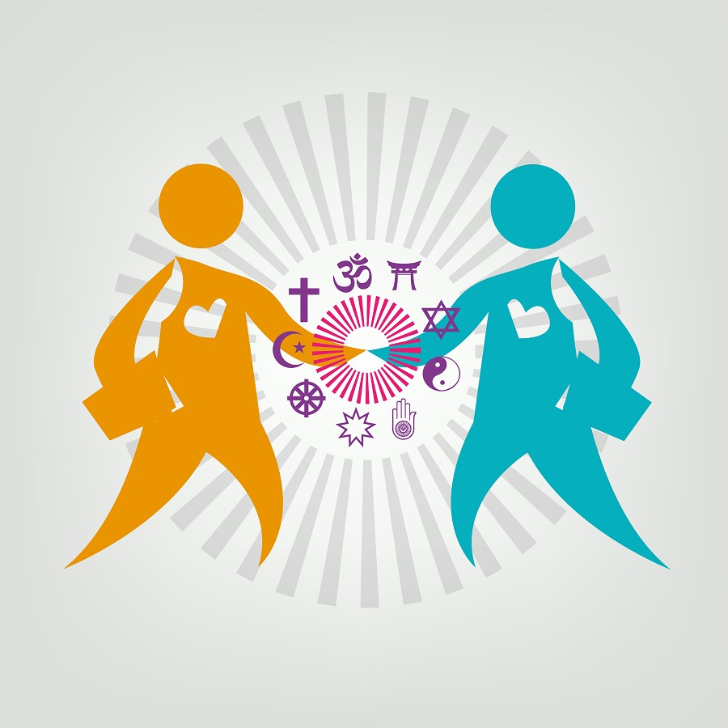
Reminder: Interfaith dialogue
Interfaith dialogue involves the communication and discussion between people from different world religions.

Slide 31
Image credits
Shutterstock
Alamy

