Slide 1
HOUSEHOLD BUDGETS
4

Slide 2
Learning intentions
When you have completed this chapter, you will be able to:
Explain what a budget is and outline the benefits of preparing household budgets
Prepare a household budget
Differentiate between net cash, opening cash and closing cash
Identify a balanced budget, a budget deficit and a budget surplus
Explain the financial consequences of budget deficits and budget surpluses
Outline measures to deal with a budget deficit or surplus
Use tables and graphs to illustrate key elements and trends in a household budget.

Slide 3
What is a household budget?
A budget is a financial plan of expected future income and expenditure.

Slide 4
Why prepare a budget?
Budgets help people to live within their means.
It encourages people to think about their spending.
Identify months when there are a lot of bills and expenses.
Allow people to plan for large items of future expenditure and help them save for these items.
A budget will show how much cash the household expects to have left over at the end of each time period. This is called their net cash.

Slide 5
A household budget
A household budget combines the income and expenditure plans we looked at in Chapters 2 and 3.
Once you have noted your income and expenditure, you need to calculate the difference to see whether your plan will show a surplus or a deficit at the end of the month.

Slide 6
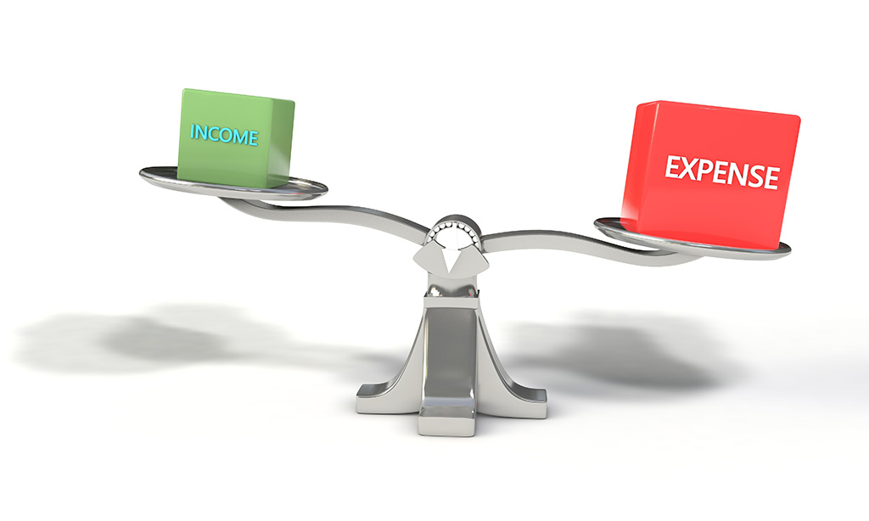
A household budget
A budget surplus occurs when income is greater than expenditure.
A budget deficit occurs when income is less than expenditure.

Slide 7
WILSON HOUSEHOLD BUDGET
 | JANUARY | FEBRUARY | MARCH | TOTAL
PLANNED INCOME | € | € | € | €
James Wilson – Salary
1,700
1,700
1,700
5,100
Louise Wilson – Salary
1,900
1,900
1,900
5,700
Child Benefit
500
500
500
1,500
A. TOTAL INCOME
4,100
4,100
4,100
12,300

Slide 8
WILSON HOUSEHOLD BUDGET
 | JANUARY | FEBRUARY | MARCH | TOTAL
 | € | € | € | €
PLANNED EXPENDITURE
Fixed
Mortgage
1,100
1,100
1,100
3,300
House insurance
640
640
Motor tax
140
140
Motor insurance
60
60
60
180
Subtotal
1,300
1,800
1,160
4,260

Slide 9
WILSON HOUSEHOLD BUDGET
 | JANUARY | FEBRUARY | MARCH | TOTAL
 | € | € | € | €
PLANNED EXPENDITURE
Irregular
Household costs
850
850
850
2,550
Light and heat
210
190
400
Telephone
70
110
70
250
Car running costs
140
140
140
420
Subtotal
1,270
1,100
1,250
3,620

Slide 10
WILSON HOUSEHOLD BUDGET
 | JANUARY | FEBRUARY | MARCH | TOTAL
 | € | € | € | €
PLANNED EXPENDITURE
Discretionary
Entertainment
120
120
120
360
Presents
40
80
120
Holidays
1,750
1,750
Subtotal
160
120
1,950
2,230

Slide 11
WILSON HOUSEHOLD BUDGET
 | JANUARY | FEBRUARY | MARCH | TOTAL
 | € | € | € | €
A. TOTAL INCOME
4,100
4,100
4,100
12,300
B. TOTAL EXPENDITURE
2,730
3,020
4,360
10,110
Net cash (A – B)
1,370
1,080
(260)
2,190
Opening cash
150
1,520
2,600
150
Closing cash
1,520
2,600
2,340
2,340

Slide 12
Creating the household budget
Step 1: Subtract total expenditure (B) from total income(A) to calculate net cash.
Step 2: Add opening cash to net cash to calculate closing cash.
Step 3: Closing cash for one month becomes the opening cash for the next month.

Slide 13
Household budgets
A balanced budget refers to a situation where income exactly equals expenditure.

Slide 14
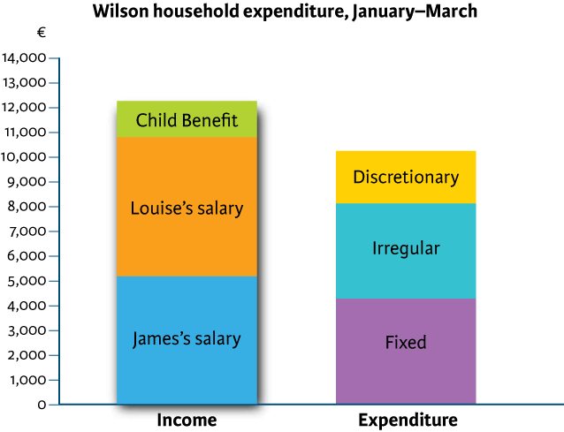
Household budgets
A budget surplus occurs when income is greater than expenditure.

Slide 15
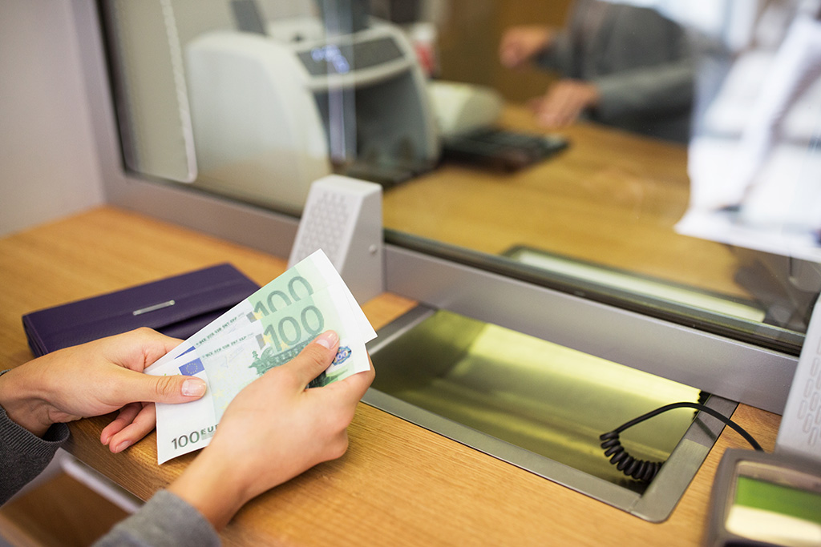
Dealing with a budget surplus
Save or invest it until it is needed.
Use it to repay a loan.
Use it to fund some extra expenditure.

Slide 16
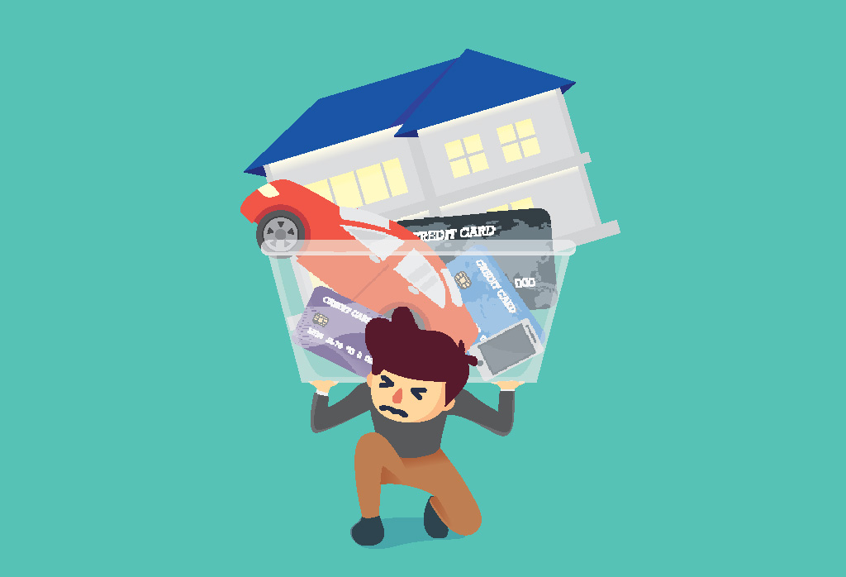
Household budgets
A budget deficit occurs when income is less than expenditure.

Slide 17
Dealing with a budget deficit
Increase income, e.g. work overtime.
Reduce expenditure.
Avail of credit/borrowing to make up the shortfall.

Slide 18
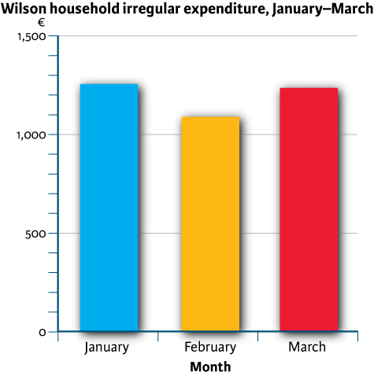
Analysing a budget
Analysing a budget means looking at it closely to understand the key trends and patterns in the budget.

Slide 19
Recap and review
Can you:
Explain what a budget is and outline the benefits of preparing household budgets?
Prepare a household budget?
Differentiate between net cash, opening cash and closing cash?
Identify a balanced budget, a budget deficit and a budget surplus?
Explain the financial consequences of budget deficits and budget surpluses?
Outline measures to deal with a budget deficit or surplus?
Use tables and graphs to illustrate key elements and trends in a household budget?

Slide 20
Image credits
Shutterstock

