Slide 1
UNIT 1 – FICTION

Slide 2
What Is Fiction?
Fiction is the telling of stories that are in some way imaginary.
A writer imagines and creates a world and characters and shares it with their readers.

Slide 3
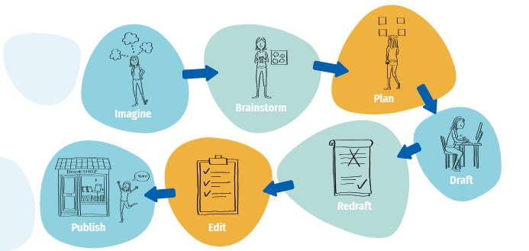
How to craft a good story
A good story is crafted through a process that includes:
brainstorming → planning → drafting→ redrafting →editing

Slide 4
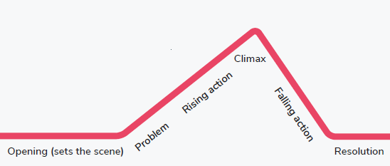
Plot
The plot of a story is the events that happen within the story.
Some stories follow a straightforward plot line.

Slide 5
Plot (contd.)
Opening: Meet characters; setting introduced
Problem: Sets story in motion
Rising action: Action and tension continues to rise
Climax: Conflict comes to a head
Falling action: Action calms down
Resolution: Conflict is dealt with

Slide 6
Narrative Perspective
The narrative perspective of a story is the point of view from which the story is told.

Slide 7
Common perspectives
First person
Third-person limited
Third-person omniscient

Slide 8
First person
First-person perspective is when the story is told by one character in that character’s voice.
You can recognize a first-person perspective when a character uses the words ‘I’ and ‘we’.
I looked at Grandmother in her big brass bed. She looked different somehow, changed, or aged, or something. Grandmother shifted from side to side in the bed. It looked like she was nervous.

Slide 9
Third-person limited
Third-person limited perspective is when an external narrator is telling the story from one character’s point of view.
The narrator knows all the thoughts and feelings of this one character only.
Little Red Riding Hood thought that there was something off about her grandmother today. Her grandmother shifted nervously in the bed. She let out what could only be described as a growl. Little Red Riding Hood blinked in shock.

Slide 10
Third-person omniscient
The narrators are all-seeing and all-powerful.
This type of narrator has access to the thoughts and feelings of all characters in the story.
The wolf licked his lips, salivating at the thought of devouring the little girl. Little Red Riding Hood thought to herself that there was something not entirely right about her grandmother. Meanwhile, the huntsman ran as fast as his legs could carry him, worried that he was far too late.

Slide 11
The narrative perspective affects how believable or reliable you will find a narrator.
Reliable narrator

Slide 12
Reliable narrator
For example, a story written in the first person from the perspective of a particular character will be less reliable than a story written from the third person omniscient perspective.

Slide 13
First-person narrator
They may present themselves in the best possible light and only tell their side of the story.
They have to infer the thoughts and feelings of other characters, and their viewpoint can be coloured by their attitudes and beliefs.

Slide 14
Third-person omniscient narrator
In contrast to a first-person narrator, a third-person omniscient narrator is able to present the thoughts and feelings of any character, both positive and negative.
They can tell every side of the story.

Slide 15
Setting
The setting of a story is where all the action happens.
It is the specific place, timeframe and world where the story happens.

Slide 16
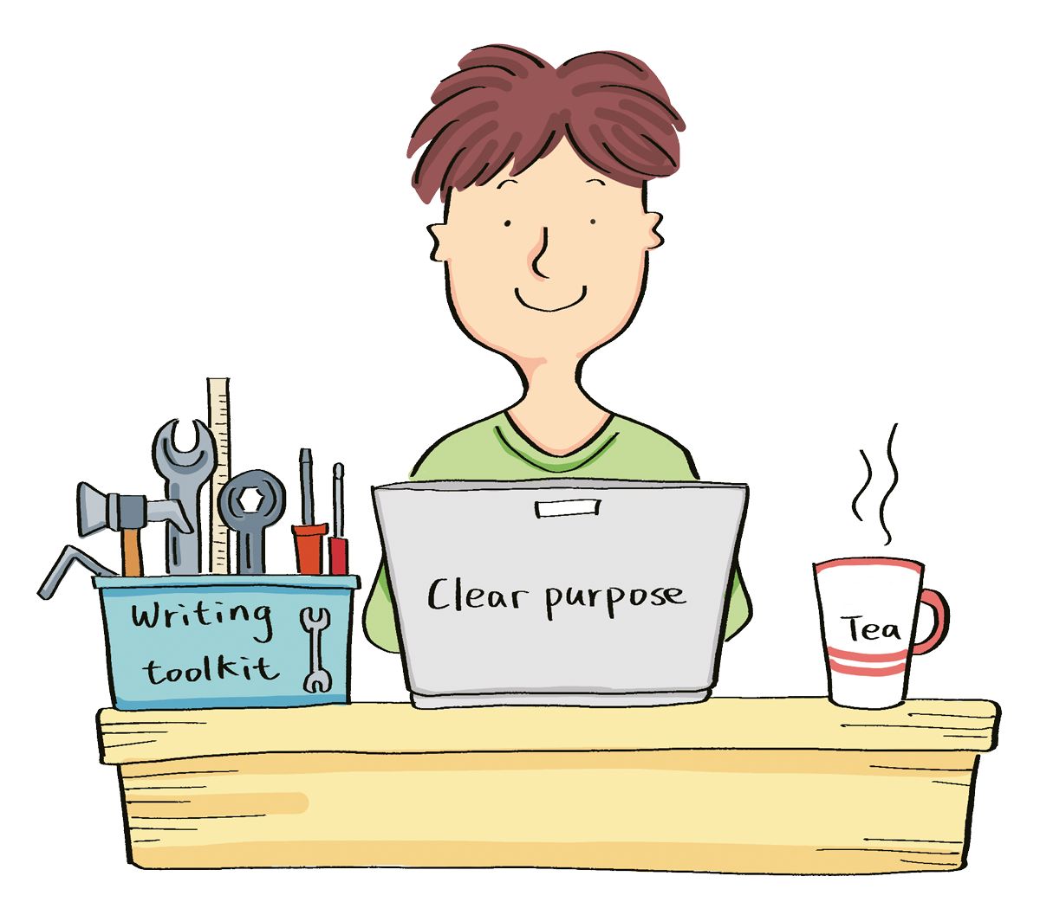
Crafting a setting
One of the ways a writer can craft an engaging setting is through using the five senses:
Smell
See
Hear
Touch
Taste.
Here are some interesting ways a writer could use the five senses to engage the reader in the world of the text …

Slide 17
Smell
What does it not smell like?
Strangely, the stable did not smell like horses.
It did not smell like hay or manure or hard work.
Link the smell to a memory
The salty sea air wafted through the window and Sarah remembered summer at her grandmother’s.
Link the smell to an emotion
She walked into the kitchen to the smell of fresh bread baking; she had to swallow her grief quickly.
Use nouns or verbs to describe a smell
She smelled like home.

Slide 18
See
Describe specific colours or use colour as a symbol
The woman’s ashen grey face told them all they needed to know.
Describe how the light affects things in the setting
The rickety table was illuminated by a stream of light sneaking in through a tear in the blind.
Zoom in and describe specific details of objects within the scene
The necklace on the dresser was broken and rusting.
Link what you see to emotions
The doll’s house was arranged meticulously. Her heart broke into two at the sight of it.

Slide 19
Hear
Describe the sound first, then reveal its source
A loud banging echoed around the dungeon; the prisoner was awake again.
A sound that is unexpected or surprising for the setting
A gunshot cut through the birdsong and trees.
Describe a sound but do not reveal exactly what it is
Something rumbled in the distance; it sounded hungry, angry and louder with every second.
Describe a sound that a character has imagined
Somebody was calling her, softly and gently. She would go into the night and find it.

Slide 20
Touch
Describe specific textures in detail
The chair was decorated in a circus of stains, each with their own distinctive texture.
Describe the temperature of people or things
The floor was ice cold like a frozen lake.
Describe the vibrations of something
The room was buzzing; it seemed alive.
Link touch to a memory or emotion
He touched the soft velvet curtain and was immediately transported back to his childhood.

Slide 21
Taste
Taste something that is a smell
Gasping for air, she swallowed the filthy smog and ashes.
Taste is subjective. Use taste to reveal something about a character
The steak was barely cooked, but she ate it without flinching.
Reveal something about character by revealing a taste craving
He needed to feed. Something big and juicy.
Link the taste to a memory or emotion
The melting mashed potato reminded her of Granny.

Slide 22
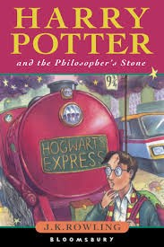
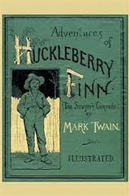
Character
A character is the person who appears in the story.
The craft of creating a character is called characterisation.

Slide 23
Crafting a character
There are several ways to craft a character. You can describe the person’s:
Appearance
Actions
Feelings
Other people’s reactions
Here are some interesting ways to describe a character …

Slide 24
Appearance
Describe their eyes or mouth in detail: colour, movement, anything unusual
Lily’s eyes smiled back. Big pools of sparkling blue, uncoloured by the evils of the world she would have to live in.
Describe the clothes they are wearing in detail: where they bought them, the fabric texture, the condition of them
Violet swept into the room draped in a luxurious fur coat that must have cost more than my entire house.
Describe their voice in detail: tone, pitch, other characters’ reaction to it
Ms Naylor’s voice was like honey. As soon as she began to speak, I knew it would be fine.
Describe their hands: nails, cleanliness, scars, veins, worn, nail varnish
Her hands betrayed her age, despite the flaming red nails and the extravagant rings.

Slide 25
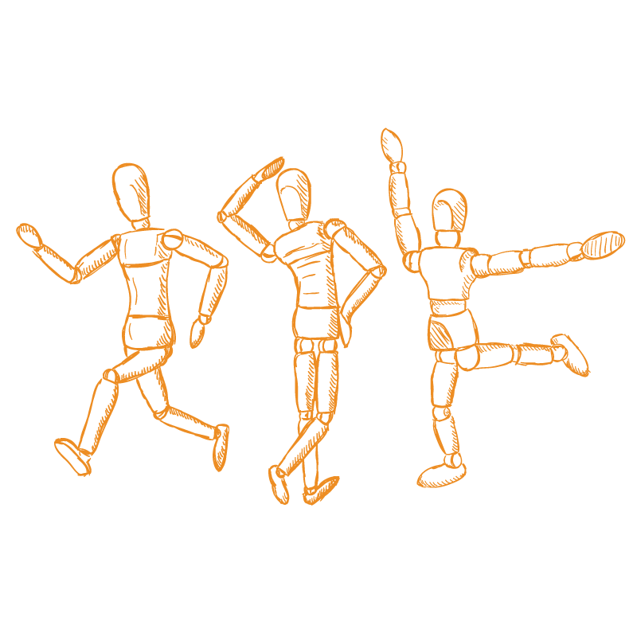
Actions
How the character or a part of the character moves strangely, revealing something about them
Looking down at his hands, she realised that she had never seen them shaped any other way than in a tight fist.
A strange action the character does repeatedly that reveals something about them
His leg never stopped moving. At times he placed his hand on his knee to steady it, but it was futile.
How a character does not react to a situation
Bombs rained down, so near them, they could taste the gunpowder. He continued reading his newspaper, unperturbed.
How a character can do something nobody else can do
I never saw her leave a room without every man, woman and child falling in love with her.

Slide 26
Feelings
Angry: biting lip, red face, sweaty, pacing back and forth, heart beating quickly
Fuming, she stumbled back upstairs. Her cheeks burned with rage and she bit her lip so hard she began to bleed.
Embarrassed: red face or cheeks, wanting to disappear, covering face, teary-eyed, flushed red all over
Alice stepped back behind her sister, bending her head to look at the floor again. She did not want them to see the flames engulfing her cheeks.
Bored: watching clock, slouching, sighing, rolling eyes, tapping something, staring into space
Tapping his pencil on the blank page, Alfie sighed again, and again.
Shy: looking down, speaking too low, lack of eye contact, blushing, hands in pockets, fidgeting, hiding
Conor never looked her in the eye. He rooted his hands in his pockets as if he were anchoring himself.

Slide 27
Other people’s reactions
The character’s relationship with their family
Not one of the O’Connors turned to look at Eoghan when he walked into the room. It was as if he was a ghost or, worse still, like he did not exist at all.
How others react when the character enters the scene
A cold breeze blew through the room suddenly, and they knew he was coming. They braced themselves with every shred of bravery they could muster.
The character’s relationship with others with less power than them
Mrs Spillane barely looked at them. It was as if they did not exist. And maybe in her bitter mind, they did not.
How other characters notice or do not notice the character
Maybelline scrubbed, swept, wiped, polished and dusted, shielded by the invisibility cloak of her race.

