Slide 1
CHAPTER 13
GEOGRAPHIC SKILLS

Slide 2
 | Outline of topics
 | Topic 13.1 Interpreting Graphs Topic 13.2 Weather Maps and Charts Topic 13.3 Geographical Skills Practice

Slide 3
Topic 13.1 Interpreting Graphs
Bar Charts
Geographers use graphs to understand and highlight patterns from numerical data and to draw conclusions on trends from several different fields.
A geographer must be able to interpret variety of graphs:
Bar charts
Pie charts
Trend line graphs
Scatter graphs
Population pyramids
Climographs
Choropleth maps

Slide 4
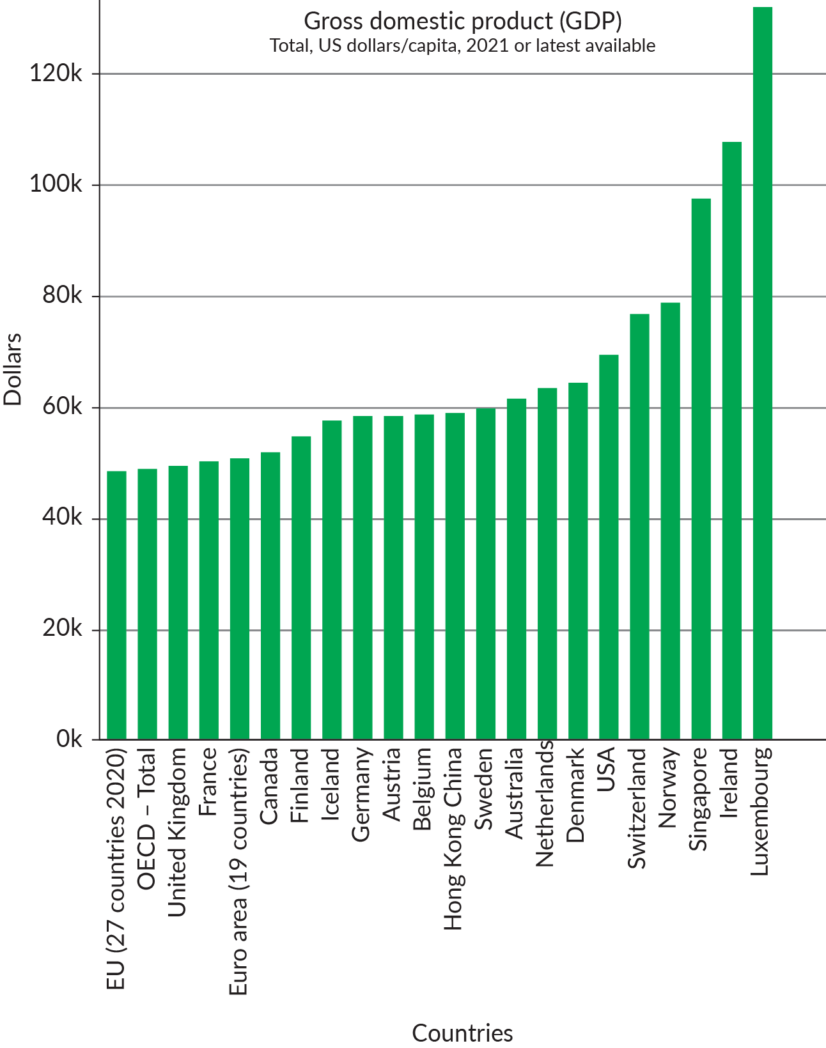
Topic 13.1 Interpreting Graphs
Bar Charts
A bar chart visually represents data grouped together as rectangular bars.
The x-axis of a bar chart displays the type of data being displayed while the y-axis displays a numerical value for that piece of data.

Slide 5
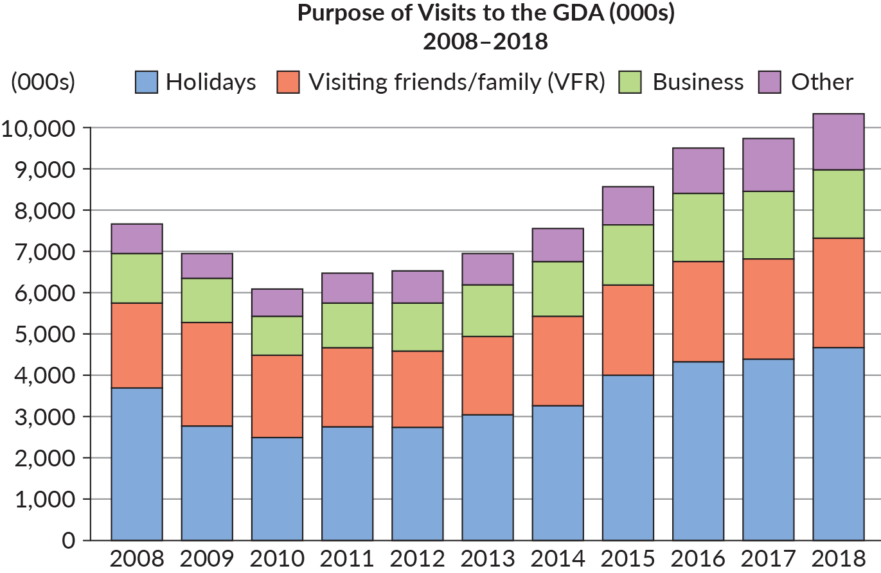
Topic 13.1 Interpreting Graphs
Bar Charts
Stacked Bar Chart
Stacked bar charts are used to display a number of different pieces of data. Stacked bar charts split each rectangular bar to provide a more detailed breakdown of information.

Slide 6
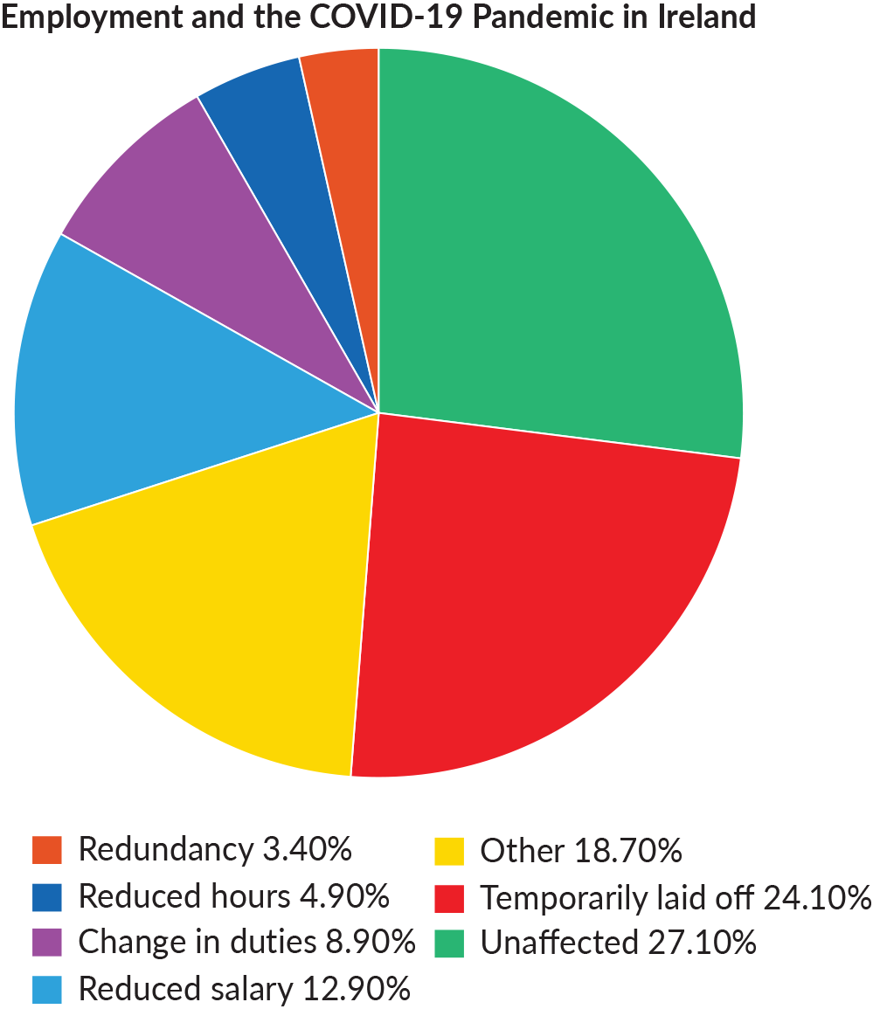
Topic 13.1 Interpreting Graphs
Pie Charts
Pie charts often show percentages as a circle divided into segments.
For example, the pie chart to the right displays how employment was affected during the COVID-19 pandemic in Ireland.

Slide 7
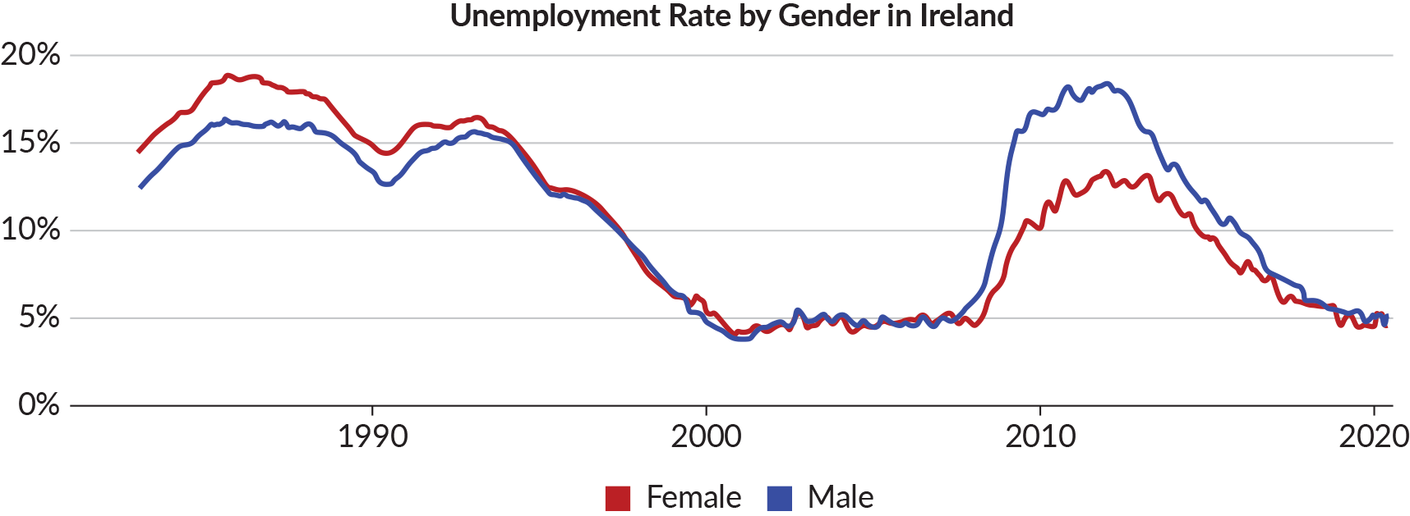
Topic 13.1 Interpreting Graphs
Trend Line Graphs
Trend line graphs display how data or information has changed over time. Geographers often use them to plot population data.

Slide 8
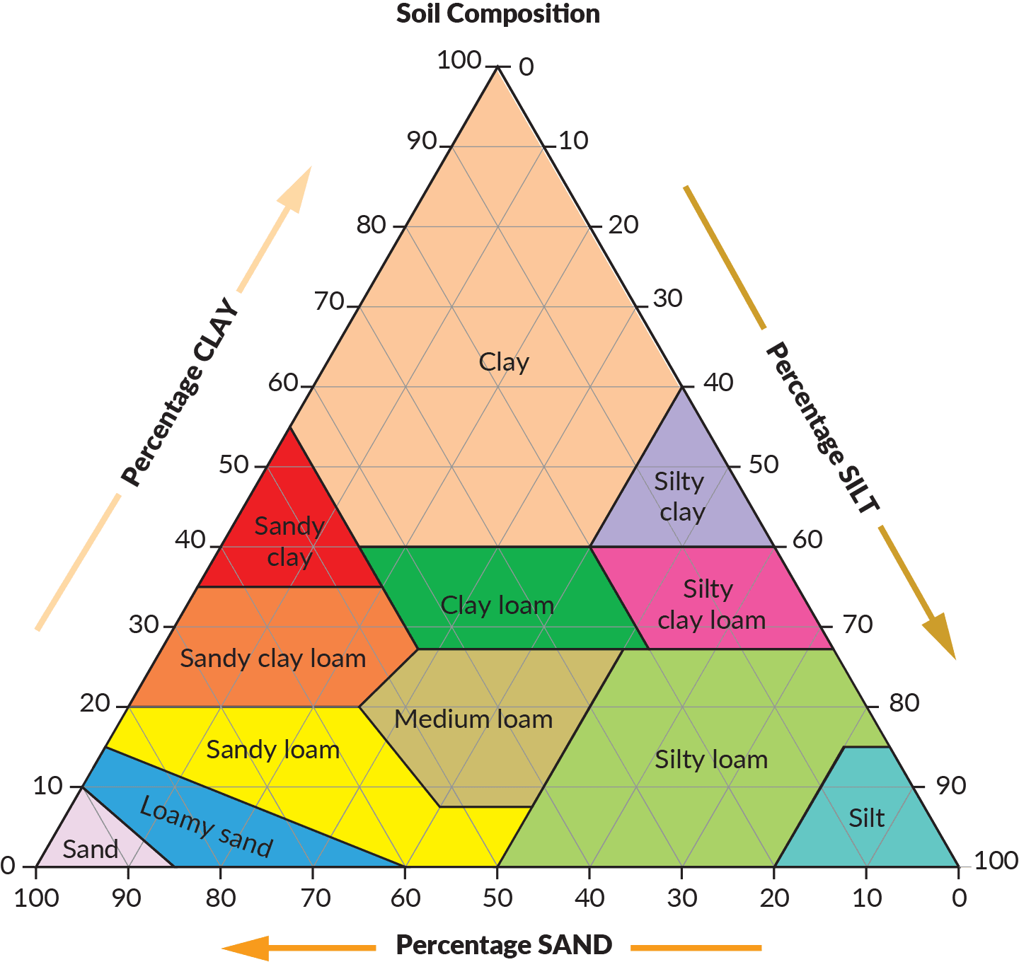
Topic 13.1 Interpreting Graphs
Triangle Graphs
Triangle graphs are often used in geography to demonstrate the relationship between three sets of data.

Slide 9
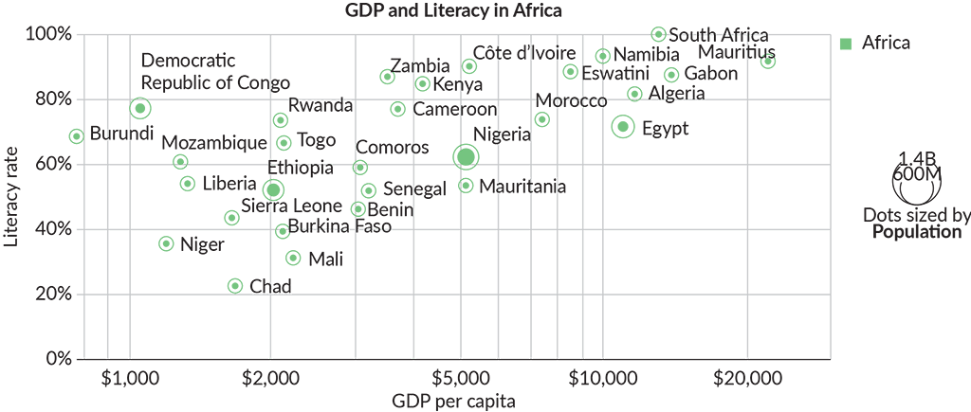
Topic 13.1 Interpreting Graphs
Scatter Graphs
Scatter graphs demonstrate the relationship or correlation between two sets of data. Scatter graphs can highlight positive or negative correlation between the two data sets.

Slide 10
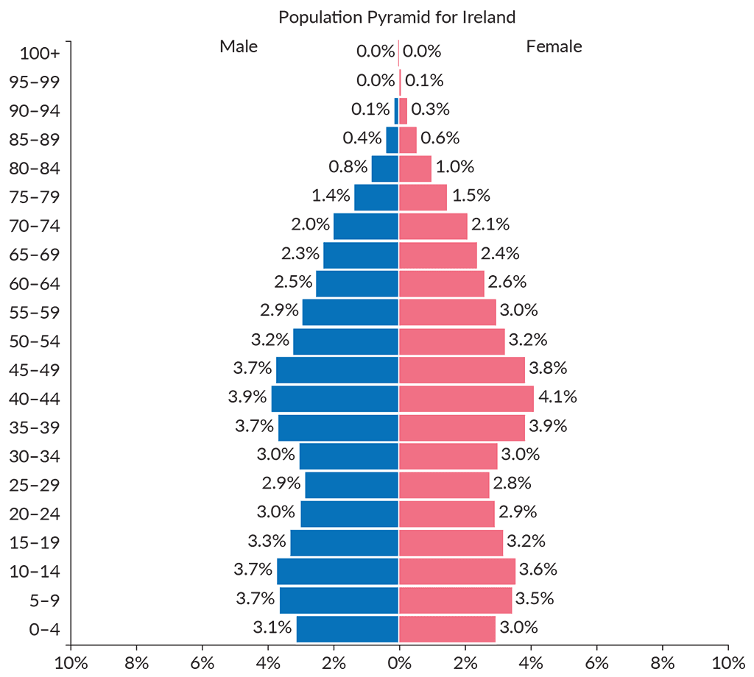
Topic 13.1 Interpreting Graphs
Population Pyramids
Population pyramids are bar charts that demonstrate the population dynamics of a region.

Slide 11
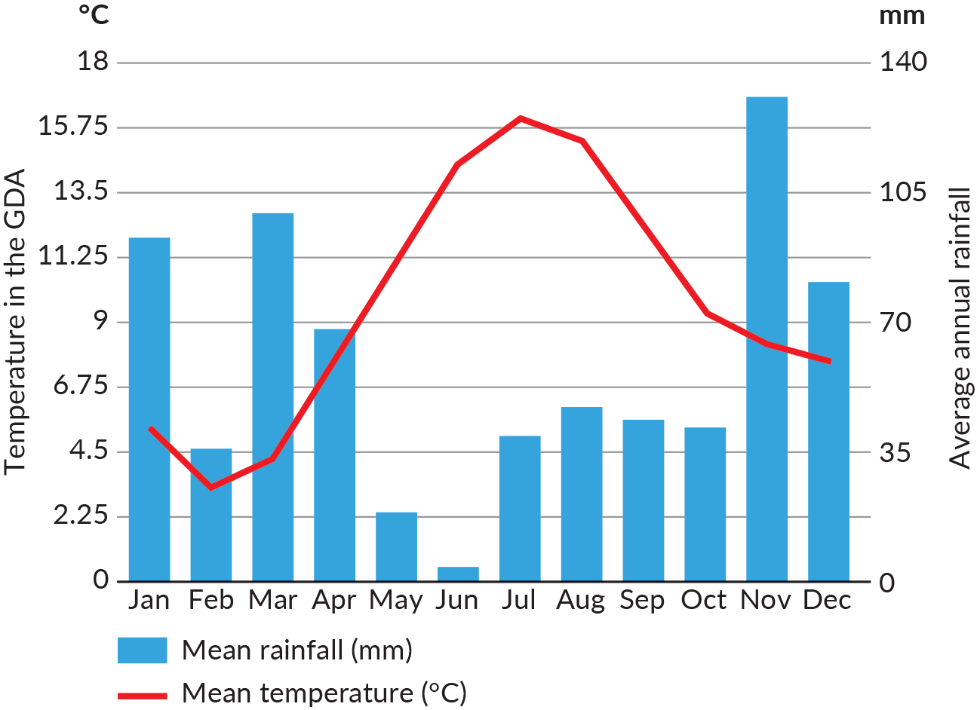
Topic 13.1 Interpreting Graphs
Climographs
A climograph is a visual representation of two climatic conditions such as temperature and precipitation.

Slide 12
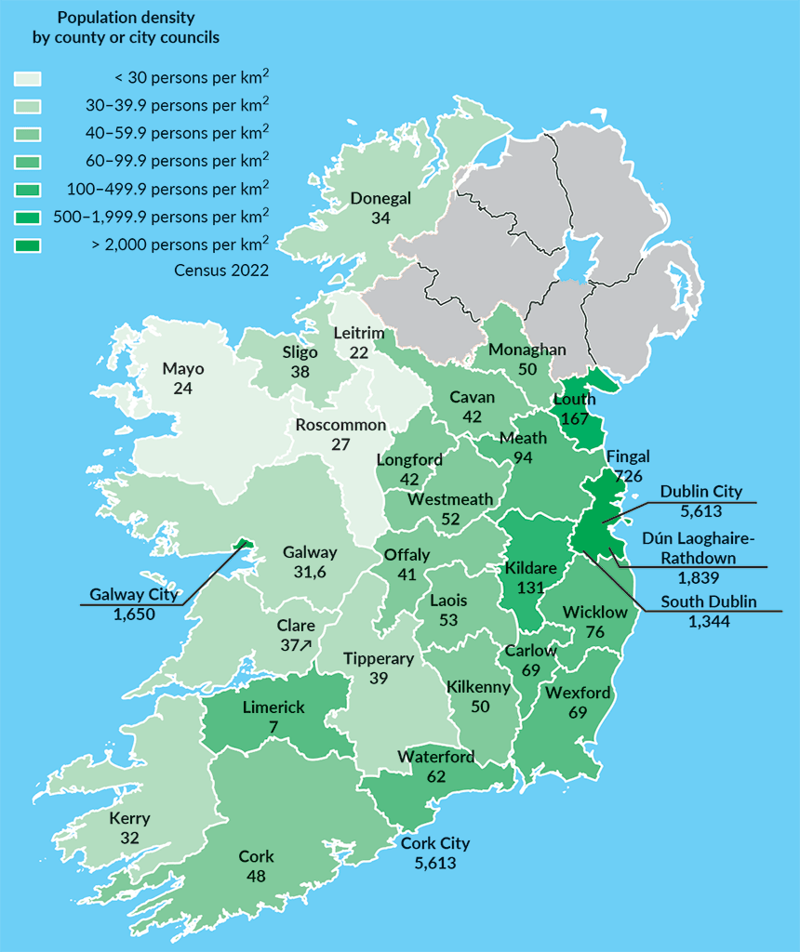
Topic 13.1 Interpreting Graphs
Choropleth Maps
Choropleth maps use different colours and shading to demonstrate data on a map.
Darker shades on choropleth maps often represent higher data while lighter shades represent lower data.

Slide 13
Topic 13.2 Weather Maps and Charts
Weather maps can be defined as any map or chart that shows the meteorological conditions at any given time over a specific area.
Meteorologists study temperature, atmospheric pressure, wind and moisture to produce weather maps and charts.
Meteorologists produce synoptic weather charts to provide a summary of the current weather conditions.
These charts demonstrate how pressure patterns, fronts and wind direction/speed will evolve over the coming days in an area.

Slide 14
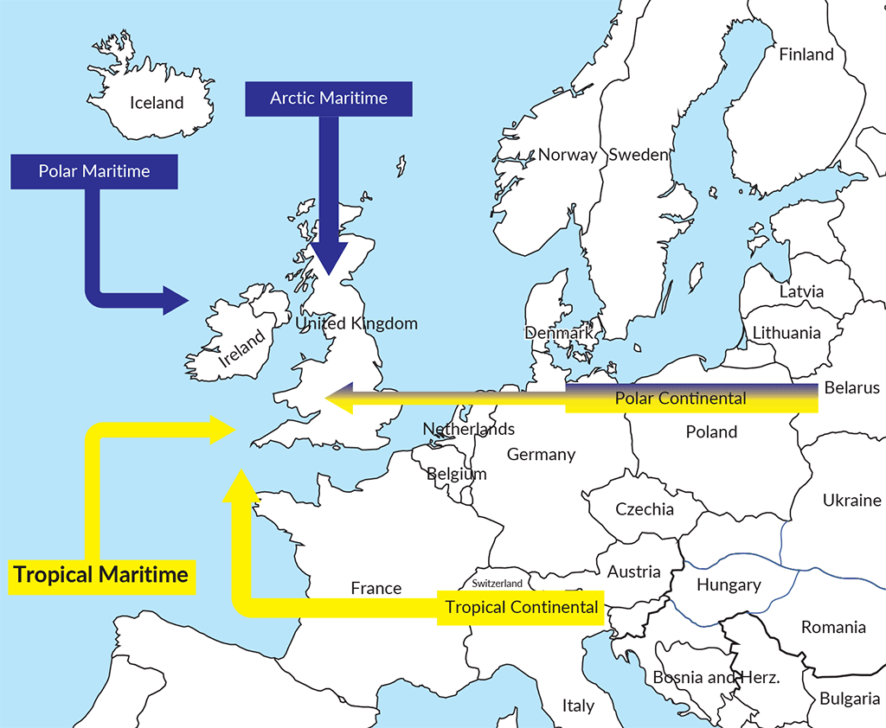
Topic 13.2 Weather Maps and Charts
Air Masses
An air mass is a large volume of air in the atmosphere that has consistent characteristics of temperature and moisture.
The main air masses that influence Ireland’s weather and climate are the Polar Maritime, Arctic Maritime, Tropical Maritime, Tropical Continental and Polar Continental.

Slide 15
Topic 13.2 Weather Maps and Charts
Weather Fronts
A weather front is the boundary between two air masses.
Weather conditions are extremely unpredictable and changeable at weather fronts as warm air often comes into contact with cold air.
The three most common weather fronts displayed on synoptic weather maps are:
Cold fronts
Warm fronts
Occluded fronts

Slide 16
Topic 13.2 Weather Maps and Charts
Weather Fronts
Cold Fronts
A cold front occurs where a cold air mass is advancing and pushing underneath warm air.
Warm Fronts
A warm front occurs when a warm air mass is advancing and rising over cold air.
Occluded Fronts
An occluded front occurs when a warm air mass becomes trapped between two cold air masses.

Slide 17
Topic 13.2 Weather Maps and Charts
Depressions and Anticyclones
Areas of low pressure are known as depressions or cyclones, while areas of high pressure are called anticyclones.

Slide 18
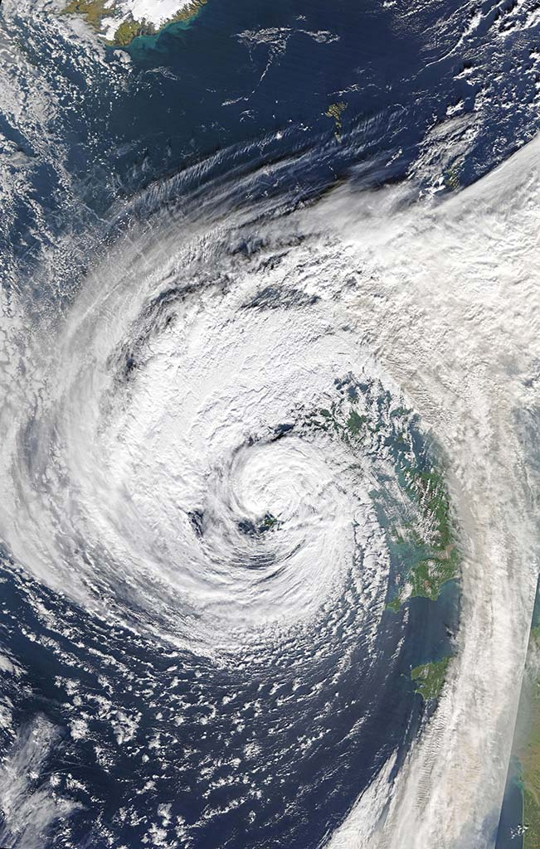
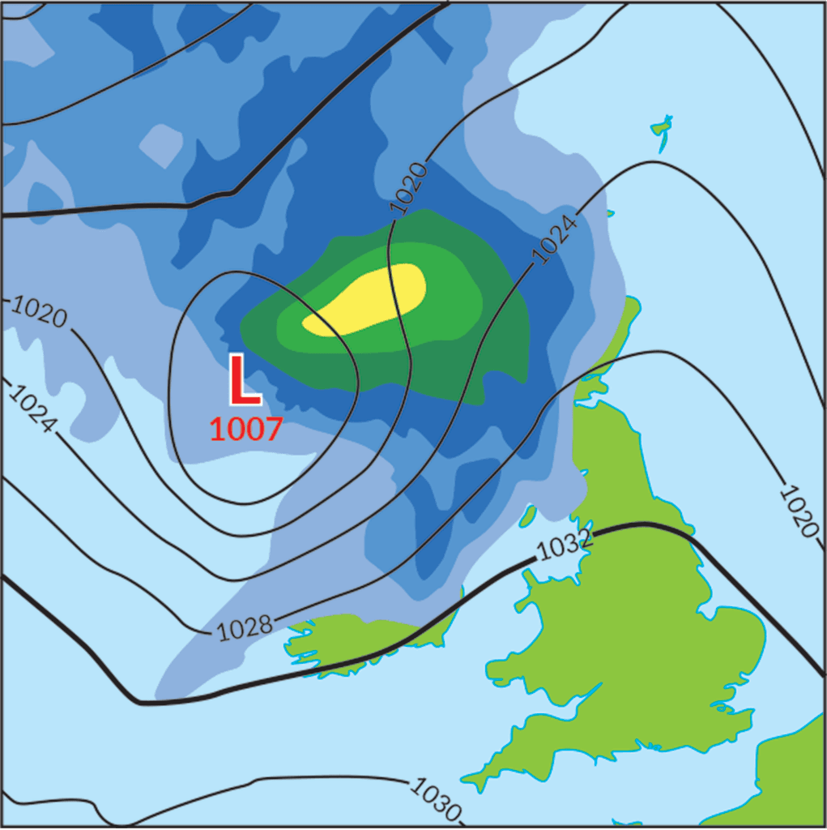
Topic 13.2 Weather Maps and Charts
Depressions and Anticyclones
Depression
Formation | Weather Conditions | Cloud Cover | Weather Map
Forms as a result of low atmospheric pressure caused when warm air masses rise from the surface. | Changeable weather conditions that are often characterised by cloudy, windy conditions with heavy precipitation. Marked on a synoptic weather map by an ‘L’.

Slide 19
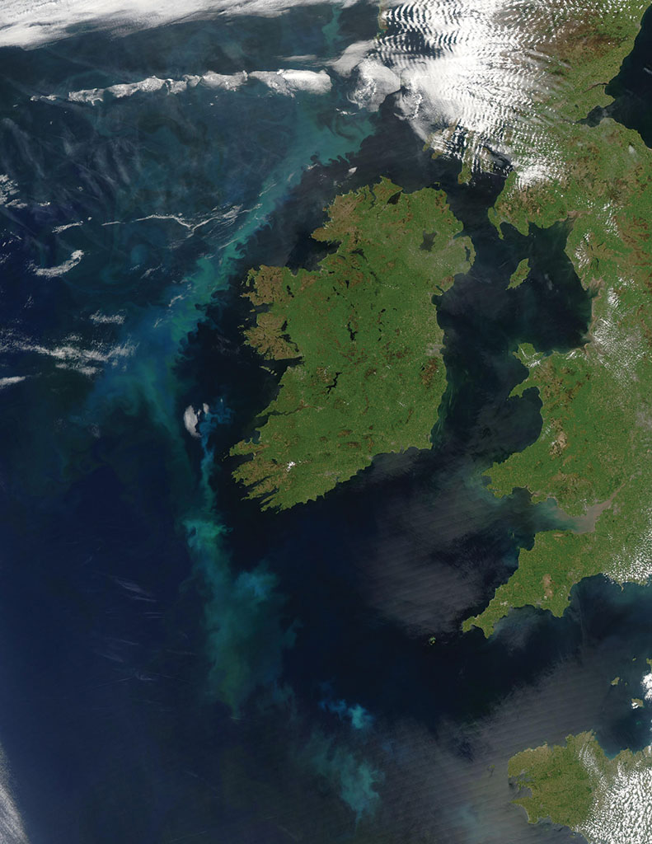
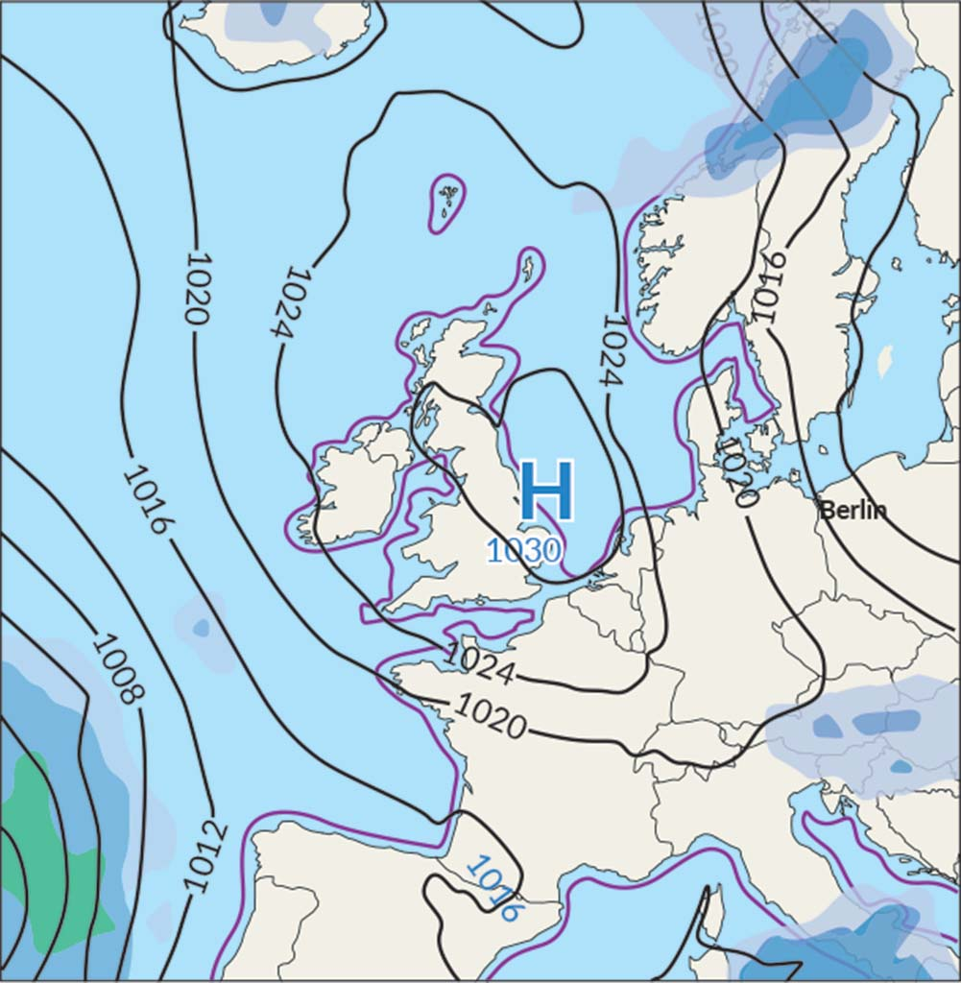
Topic 13.2 Weather Maps and Charts
Depressions and Anticyclones
Anticyclone
Formation | Weather Conditions | Cloud Cover | Weather Map
Forms as a result of high atmospheric pressure caused when cold air masses push down on the surface of the Earth. | Consistent settled weather conditions that are often characterised by clear cloudless skies with light winds and very little precipitation. Marked on a synoptic weather map by an ‘H’.

Slide 20
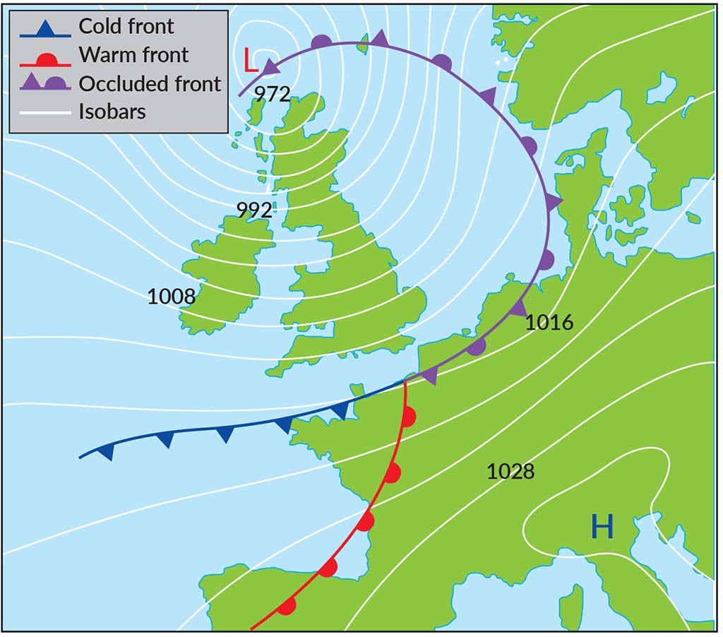
Topic 13.2 Weather Maps and Charts
Isobars
The curved lines on synoptic weather charts are called isobars.
These lines join areas of the same atmospheric pressure.

Slide 21
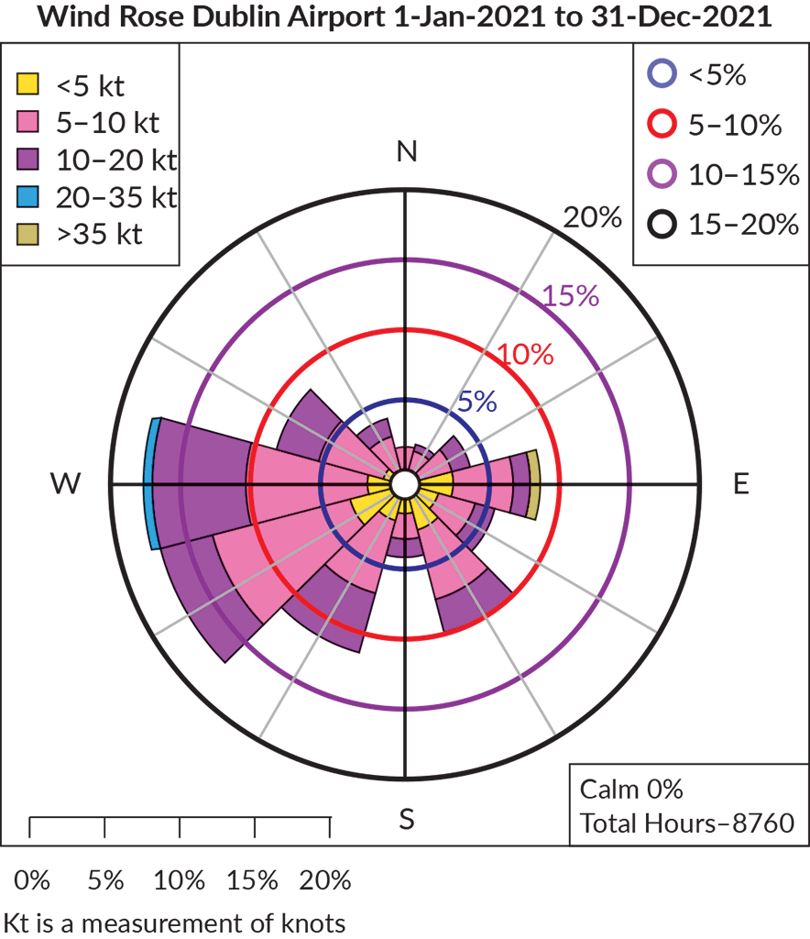
Topic 13.2 Weather Maps and Charts
Weather Charts and Graphs
Meteorologists use a variety of different weather charts and graphs to display different types of weather conditions.
Wind Rose Diagram
Wind rose diagrams demonstrate and summarise the information regarding wind at a specific location over a period of time. They characterise the speed and direction of wind.

Slide 22
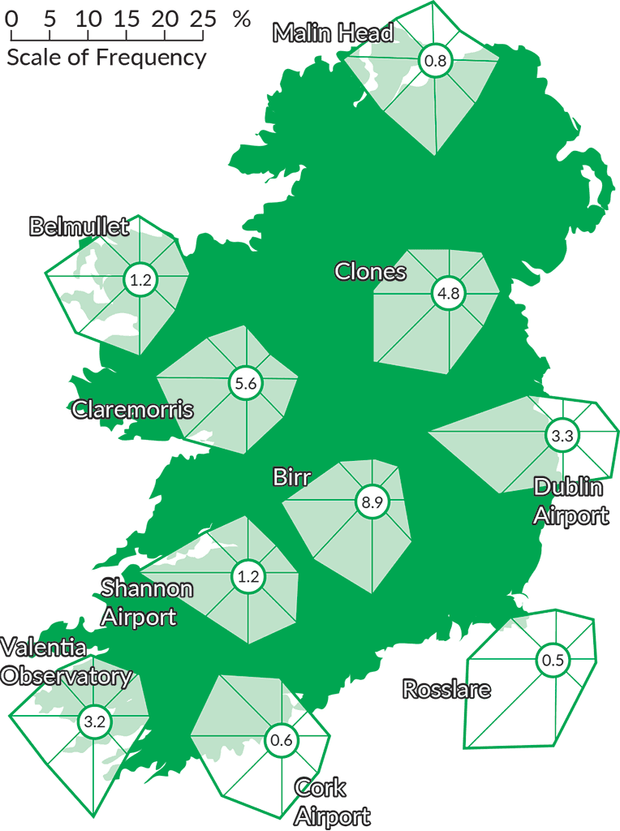
Topic 13.2 Weather Maps and Charts
Weather Charts and Graphs
Wind Radar Charts
Wind radar charts show most frequent wind direction, the percentage of time wind blows from that direction and the percentage of calm weather conditions in that area.

Slide 23
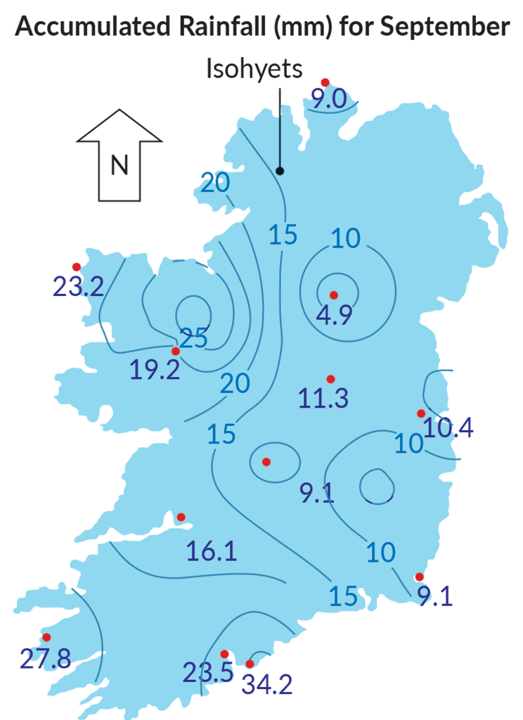
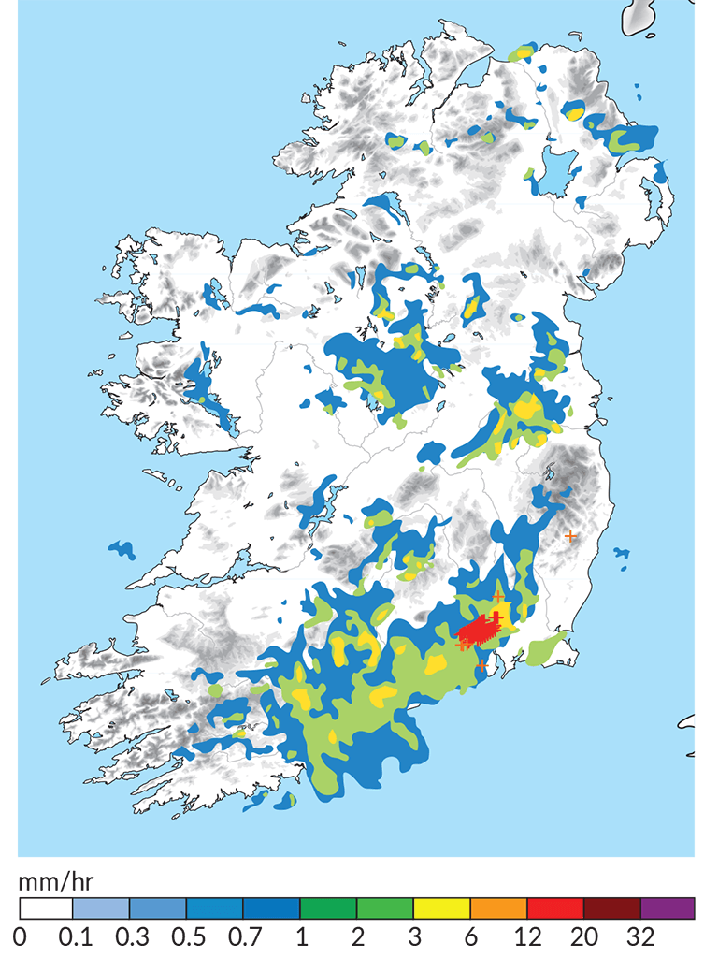
Topic 13.2 Weather Maps and Charts
Weather Charts and Graphs
Precipitation Map
A precipitation map shows predicted or annual precipitation across an area.

Slide 24
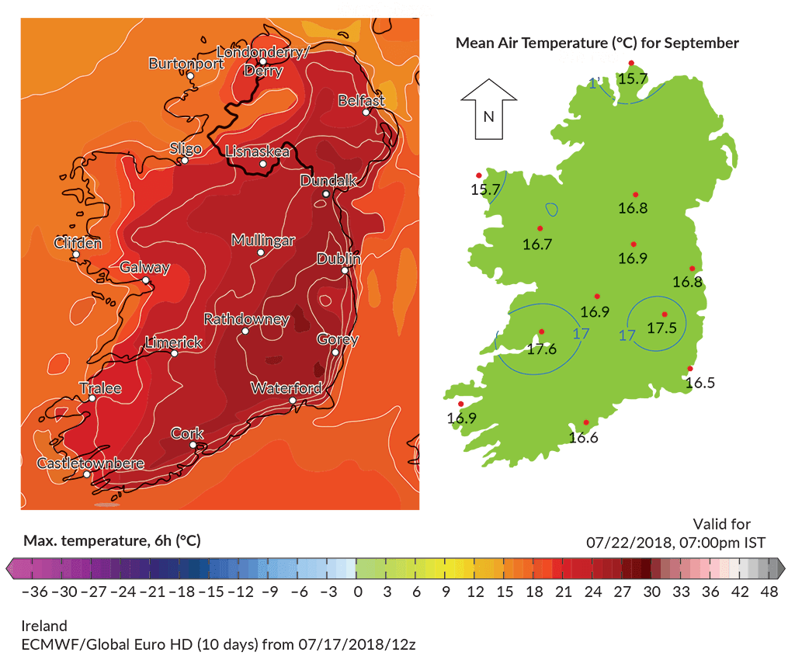
Topic 13.2 Weather Maps and Charts
Weather Charts and Graphs
Temperature Map
A temperature map is used to show predicted or annual temperature across an area.

Slide 25
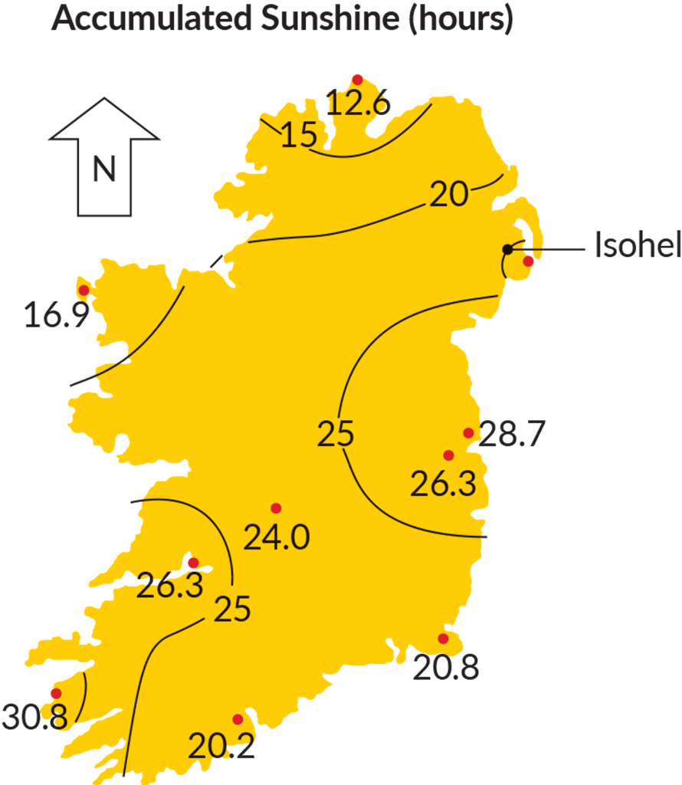
Topic 13.2 Weather Maps and Charts
Weather Charts and Graphs
Sunshine Map
A sunshine map is used to show predicted or average daily sunshine as a fraction of the length of day.

Slide 26
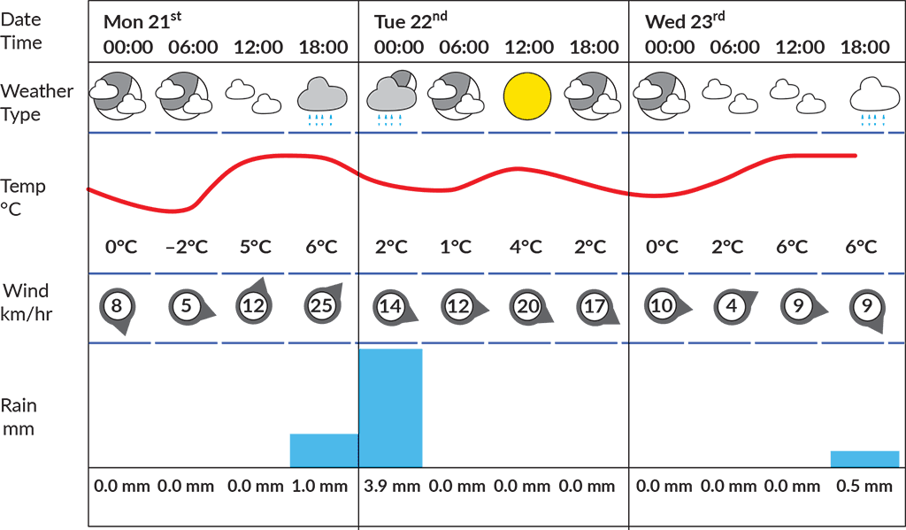
Topic 13.2 Weather Maps and Charts
Weather Charts and Graphs
Weather Graph
Sometimes weather forecasters summarise weather conditions in a graph that includes multiple weather elements.

Slide 27
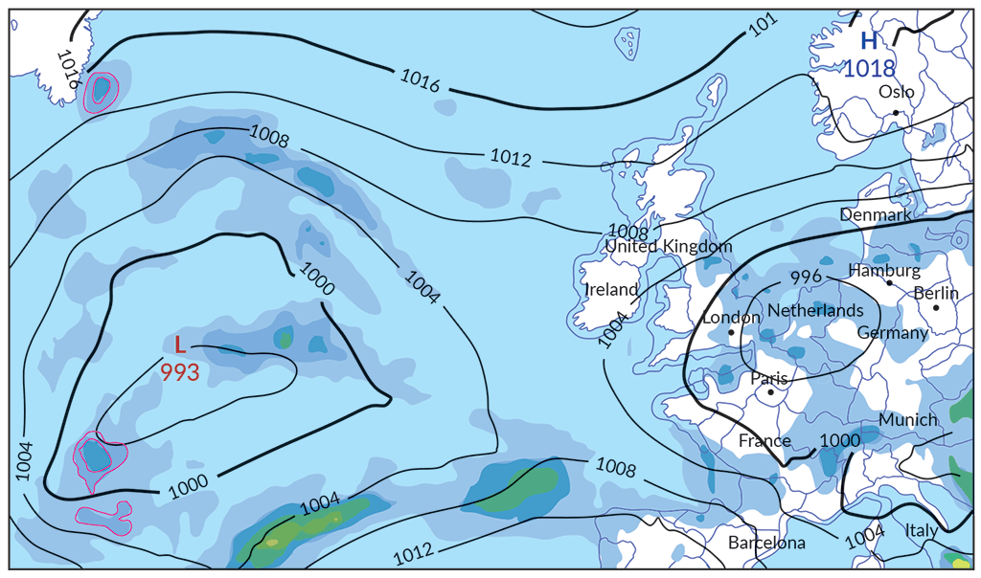
Topic 13.2 Weather Maps and Charts
Weather Charts and Graphs
Weather Graph
Weather chart

Slide 28
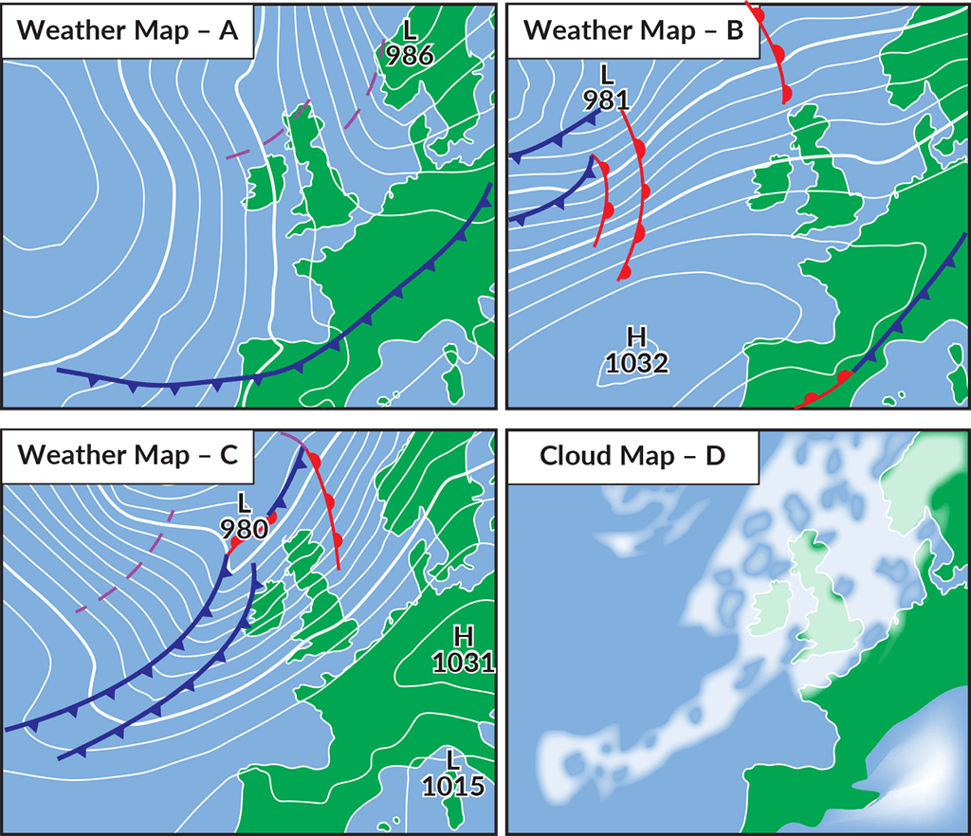
Topic 13.3 Geographic Skills Practice
Average Weather by Month, Dublin
 | Jan | Feb | Mar | Apr | May | Jun | Jul | Aug | Sept | Oct | Nov | Dec
Temperature (°C) | 4.7 | 4.8 | 5.9 | 7.9 | 10.8 | 13.5 | 15.2 | 14.8 | 13.1 | 10.3 | 7 | 5.2
Precipitation (mm) | 75 | 62 | 64 | 72 | 73 | 79 | 82 | 83 | 74 | 85 | 91 | 79

Slide 29
Photo credits
Shutterstock

