Slide 1
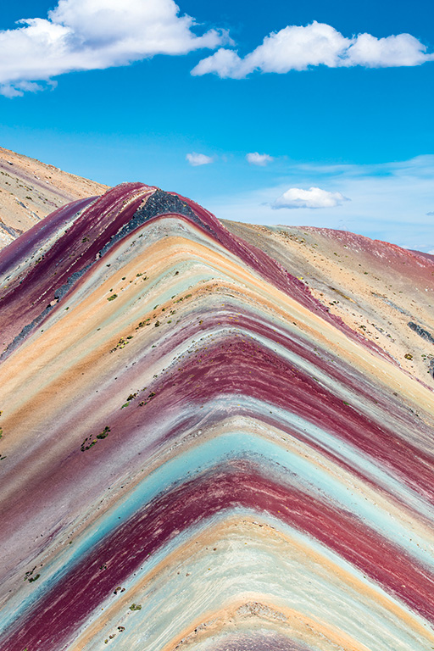
 | Lesson 7.1
 | The rock cycle

Slide 2
Knowledge retrieval
1. Name the three types of fault.
2. Identify what faulting process causes each type of fault to occur.
3. State an example of a landform that forms as a result of normal faulting.
4. Explain why reverse faults occur.
5. Describe why earthquakes are common at strike-slip faults.

Slide 3
Learning intentions
Explain the formation of granite and basalt igneous rocks with reference to landscapes in Ireland.

Slide 4
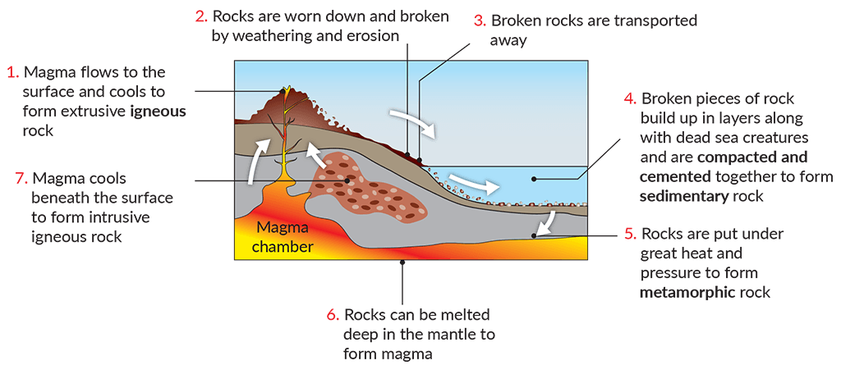
Explanation of topic
The rock cycle

Slide 5
Working activity – group
Read pages 95–96 of The Natural World.
Working activity – individual
Answer the basic, developed and advanced knowledge questions on page 96 of The Natural World.

Slide 6
Progress check
Name the three categories of rock.
State the name of the most common rock in Ireland.
Identify one county where marble can be found.

Slide 7
 | Lesson 7.2
 | Igneous rocks

Slide 8
Knowledge retrieval
1. Name the three categories of rock.
2. State the name of the most common rock in Ireland.
3. Identify one county where marble can be found.
4. Describe how rocks continuously change through the rock cycle.
5. Name one distinctive landscape in Ireland and the rock type it is composed of.

Slide 9
Learning intentions
Explain the formation of granite and basalt igneous rocks with reference to landscapes in Ireland.

Slide 10
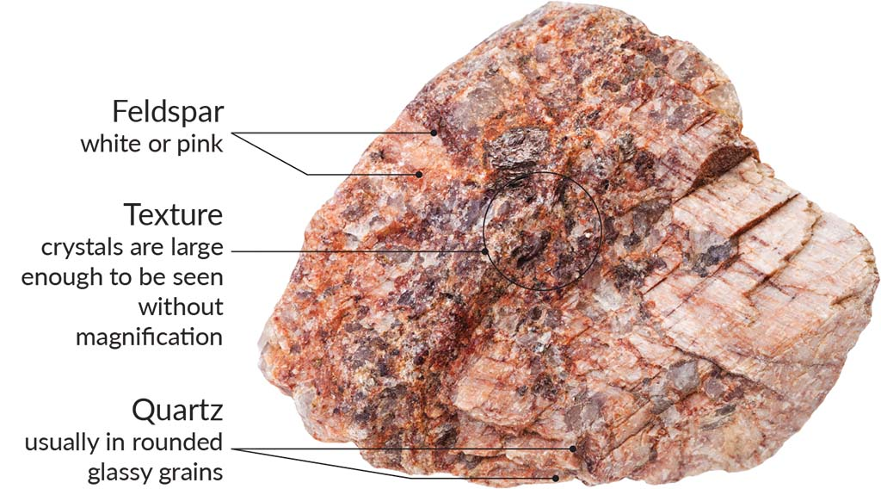
Explanation of topic
Granite

Slide 11
Working activity – group
Read pages 97–99 of The Natural World.

Slide 12
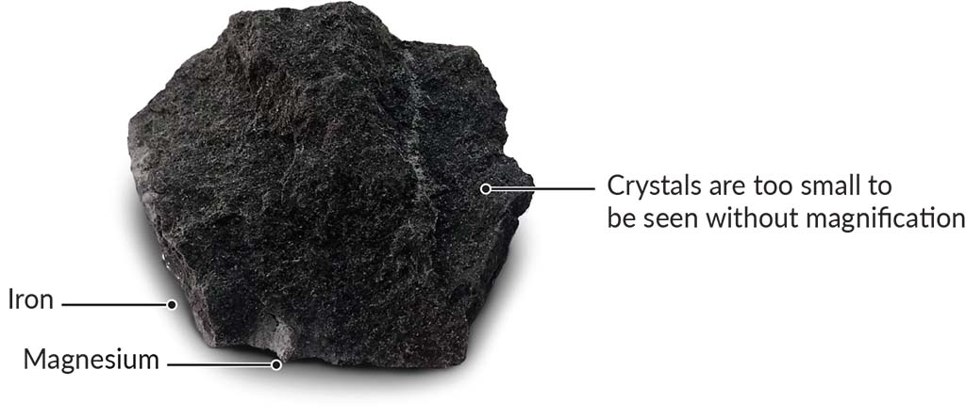
Explanation of topic
Basalt

Slide 13
Working activity – group
Read pages 98–100 of The Natural World.
Working activity – individual
Answer the basic, developed and advanced knowledge questions on page 100 of The Natural World.

Slide 14
Progress check
Name two types of igneous rock.
Explain the term ‘extrusive igneous rock’.
Give an example of a landscape composed of granite in Ireland.

Slide 15
 | Lesson 7.3
 | Sedimentary rocks

Slide 16
Knowledge retrieval
1. Name two types of igneous rock.
2. Explain the term ‘extrusive igneous rock’.
3. Give an example of a landscape composed of granite in Ireland.
4. Outline why large crystals develop in intrusive igneous rocks.
5. Describe the texture, colour, and mineral composition of basalt.

Slide 17
Learning intentions
Outline the formation of limestone and sandstone sedimentary rocks with reference to landscapes in Ireland.

Slide 18
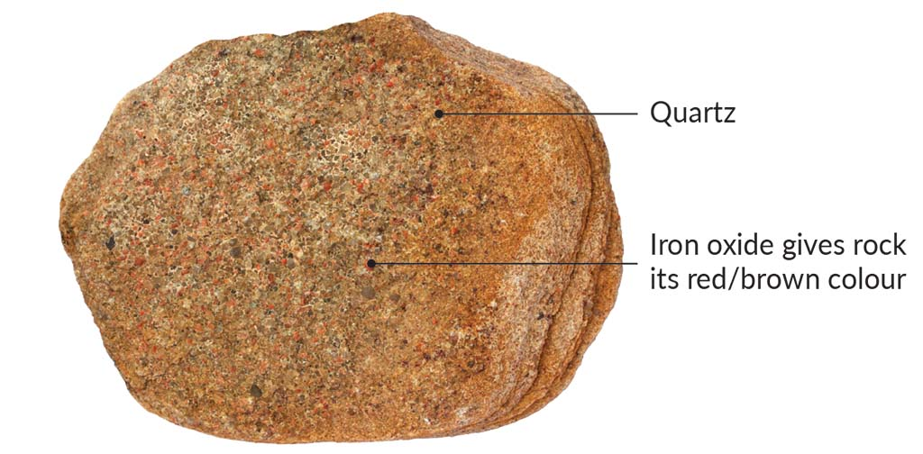
Explanation of topic
Sandstones

Slide 19
Working activity – group
Read pages 101–102 of The Natural World.

Slide 20
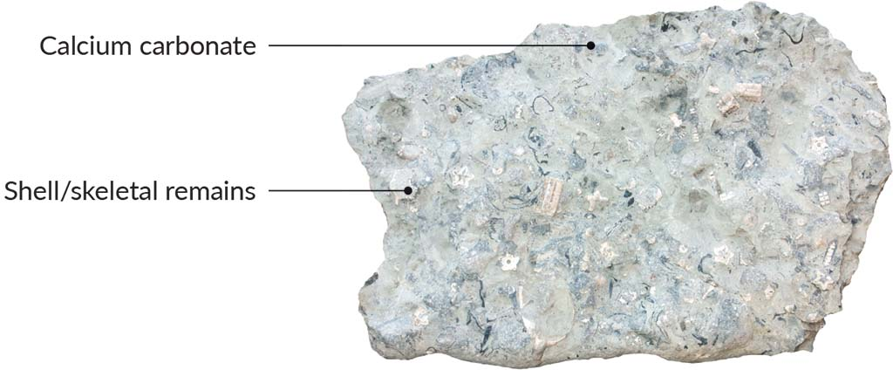
Explanation of topic
Limestone

Slide 21
Working activity – group
Read pages 103–104 of The Natural World.
Working activity – individual
Answer the basic, developed and advanced knowledge questions on page 104 of The Natural World.

Slide 22
Working activity – individual
Outline the role of sedimentary rocks in the formation of distinctive landscapes in Ireland.
Success criteria:
Your answer must:
Identify two types of sedimentary rock that can be found in Ireland.
Name two distinctive landscapes in Ireland that are composed of sedimentary rocks.
Your answer should:
Explain how the weathering of the Caledonian mountain range contributed to the formation of a distinctive landscape in Ireland.
Outline how Ireland’s geographical location 320 million years ago contributed to the formation of limestone.
Clarify the role of the Armorican folding period in the uplifting of sandstone and limestone in Ireland.
Your answer could:
Examine how glacial advances and chemical weathering further developed the distinctive landscape visible in the Burren.

Slide 23
Progress check
Define the three types of sedimentary rock.
Identify two types of sedimentary rock that can be found in Ireland.
Name two distinctive landscapes in Ireland that are composed of sedimentary rocks.

Slide 24
 | Lesson 7.4
 | Metamorphic rocks

Slide 25
Knowledge retrieval
1. Define the three types of sedimentary rock.
2. Identify two types of sedimentary rock that can be found in Ireland.
3. Name two distinctive landscapes in Ireland that are composed of sedimentary rocks.
4. Explain the role of lithification in the formation of sedimentary rocks.
5. Outline how wind and flood deposits contribute to the accumulation of sediment at the bottom of the sea.

Slide 26
Learning intentions
Describe the formation of quartzite and marble metamorphic rocks with reference to landscapes in Ireland.

Slide 27
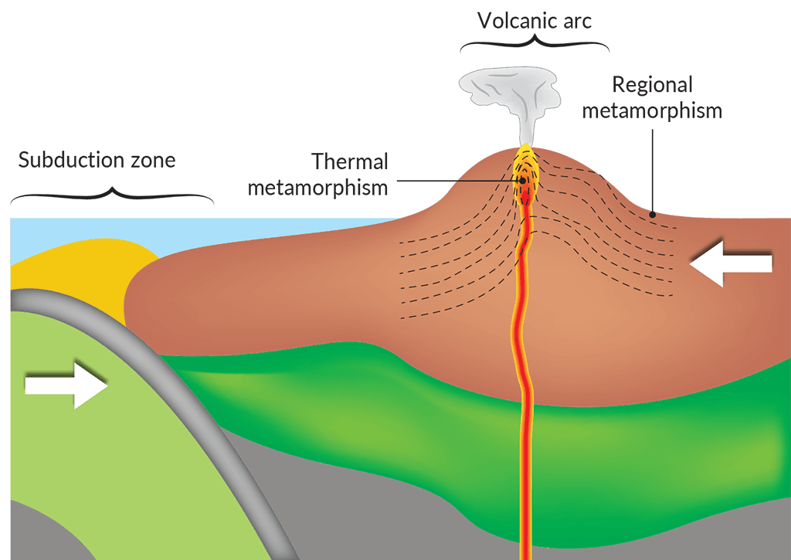
Explanation of topic
Thermal and regional metamorphism

Slide 28
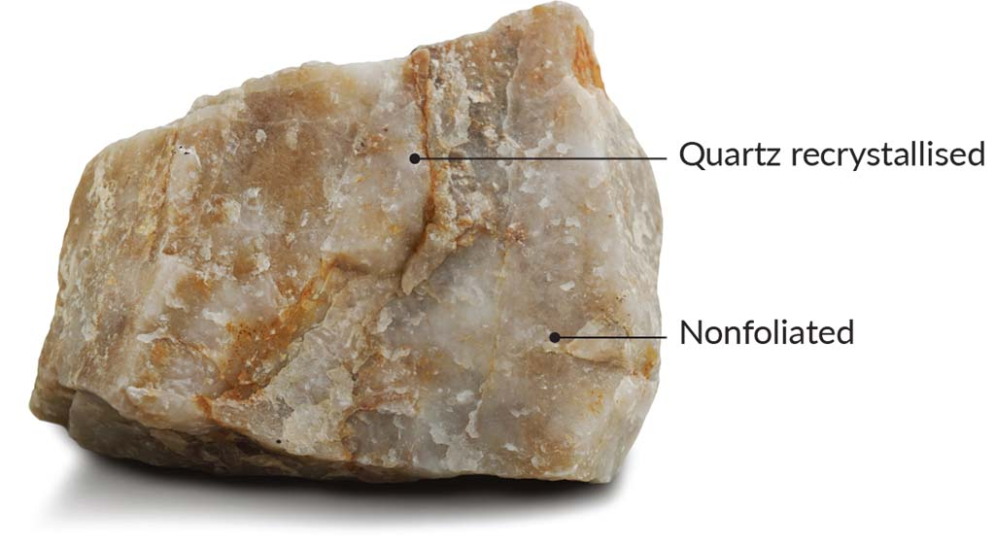
Explanation of topic
Quartzite

Slide 29
Working activity – group
Read page 106 of The Natural World.

Slide 30
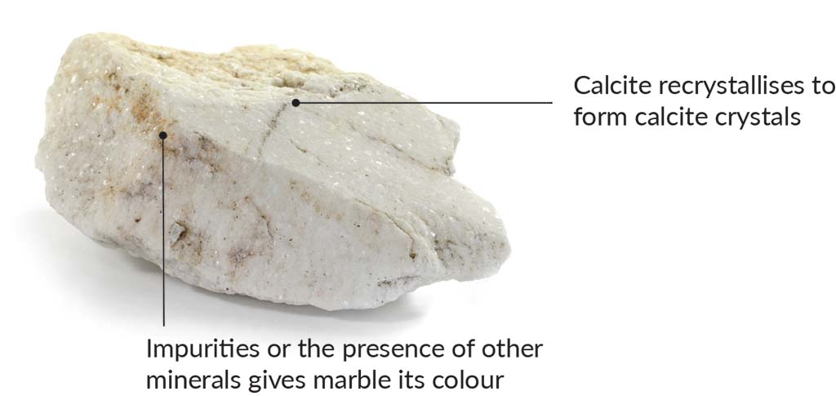
Explanation of topic
Marble

Slide 31
Working activity – group
Read page 107 of The Natural World.
Working activity – individual
Answer the basic, developed and advanced knowledge questions on page 108 of The Natural World.

Slide 32
Progress check
Define the two types of metamorphism.
Describe two types of metamorphic rock with named examples.
Name two distinctive landscapes in Ireland that are composed of metamorphic rocks.

Slide 33
 | Lesson 7.5
 | Human interaction with the rock cycle – geothermal energy

Slide 34
Knowledge retrieval
1. Define the two types of metamorphism.
2. Describe two types of metamorphic rock with named examples.
3. Name two distinctive landscapes in Ireland that are composed of metamorphic rocks.
4. Explain the role of metamorphism in the formation of metamorphic rocks.
5. Name the orogeny in which quartzite peaks were created at the top of the Great Sugarloaf in County Wicklow.

Slide 35
Learning intentions
Discuss how humans interact with the rock cycle with reference to the production of geothermal energy.

Slide 36
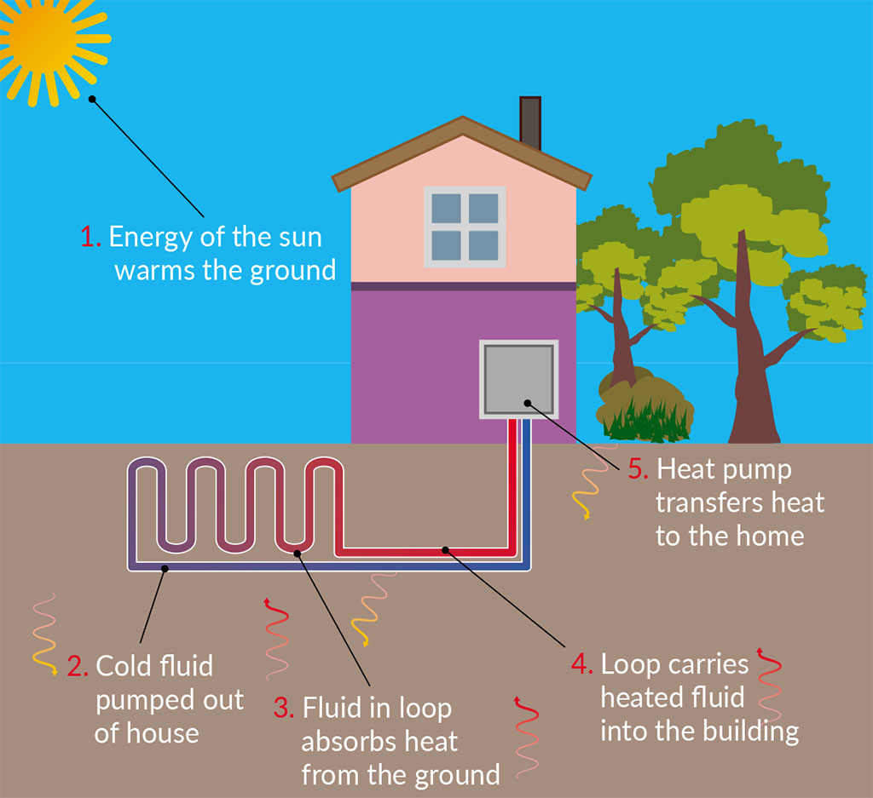
Explanation of topic
Harnessing shallow geothermal energy in a closed-loop system

Slide 37
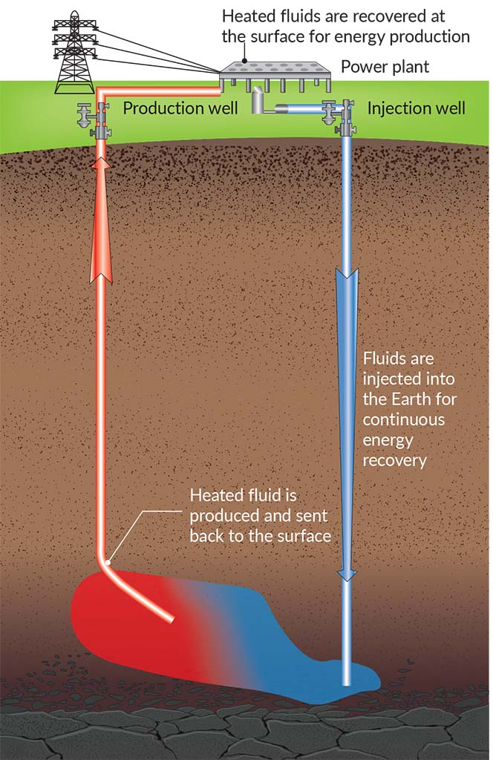
Explanation of topic
Harnessing deep geothermal energy

Slide 38
Working activity – group
Read pages 108–111 of The Natural World.

Slide 39
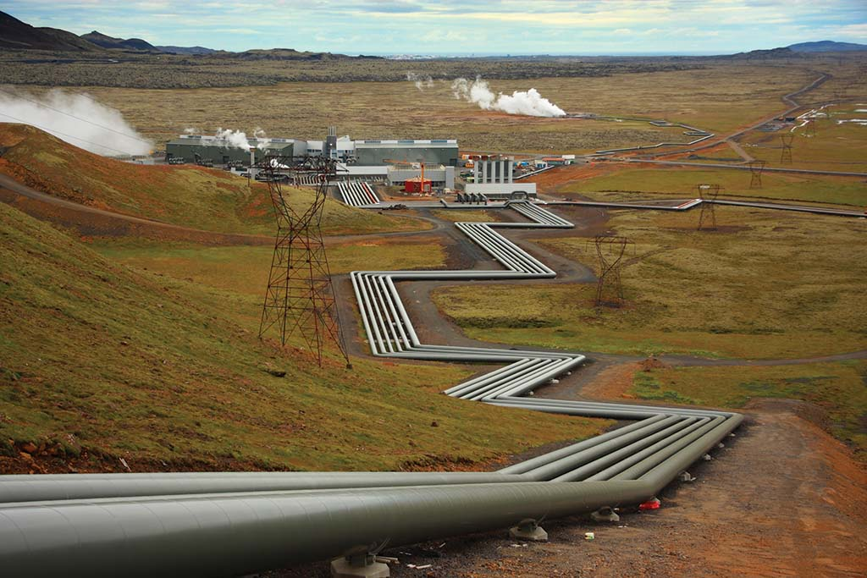
Explanation of topic
An ON Power geothermal energy production plant in Iceland

Slide 40
Working activity – group
Read pages 111–112 of The Natural World.
Working activity – individual
Answer the basic, developed and advanced knowledge questions on page 112 of The Natural World.

Slide 41
Progress check
Define the term ‘geothermal energy’.
State the two types of geothermal energy reserves.
Name a country known as a ‘pioneer’ in geothermal energy production.

Slide 42
Image credits
Shutterstock
Alamy

