Slide 1
Chapter 2: Numbers

Slide 2
Learning Intentions
After this unit of learning, you will be able to:
Define and give examples of different types of number sets.
Follow the correct order of operations for calculations.
Understand and apply the use of powers.
Simplify, add, subtract, multiply and divide fractions.
Convert between fractions, decimals and percentages.

Slide 3
Number Sets and their Number Lines
The natural numbers, $ℕ$, are the whole, positive numbers, or counting numbers.
0 is not a natural number.
1, 2, 3, 4, 5, 6, 7 are elements of the natural number set.
The natural number line uses dots on the numbers we want to include.
The integers, $ℤ$, are the whole, positive and negative numbers.
All natural numbers are integers.
–5, –4, –3, –2, –1, 0, 1, 2, 3, 4, 5 are elements of the integer number set.
The integers number line uses dots on the numbers we want to include.

Slide 4
Number Sets and their Number Lines
The rational numbers, $ℚ$, are the numbers that can be written as fractions using two integers.
All whole numbers are rational as they can be written as a fraction by putting the whole number over 1. Therefore, all natural numbers and all integers are rational.
5, 2, 1, −3, $\frac{1}{2}$, $−\frac{27}{29}$, 0.25, −0.1 are elements of the rational number set.
The real numbers, $ℝ$, are all the numbers that fill the number line: naturals, integers, fractions, decimals and numbers that cannot be written as fractions such as$\sqrt{2}$ and $π$.
The real number line uses a big thick line instead of dots. The above number line represents all the real numbers from −2 to 3, including −2 and 3.

Slide 5
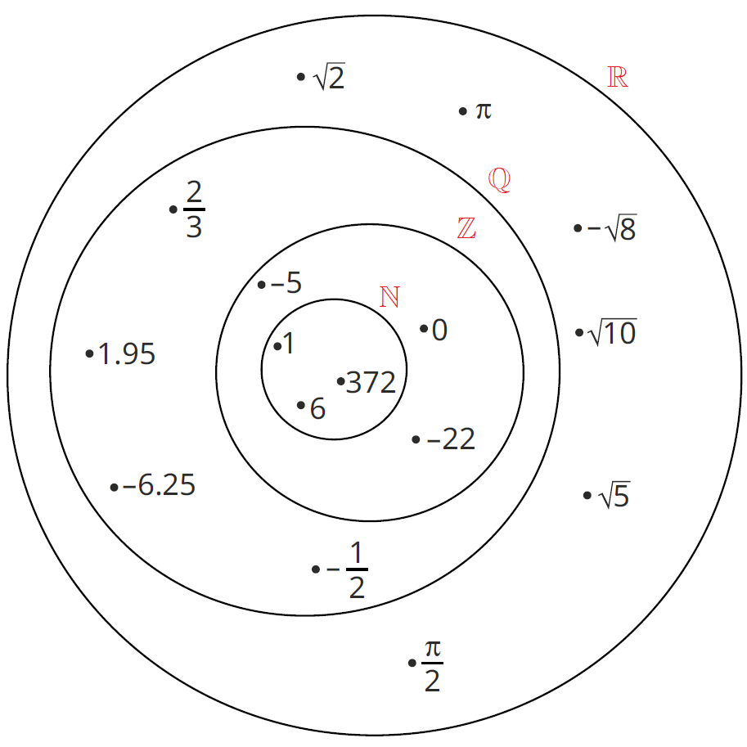
Number Sets and their Number Lines
Natural numbers are a subset of integers. (ℕ ⸦ ℤ)
Integers are a subset of rational numbers. (ℤ ⸦ ℚ)
Rational numbers are a subset of real numbers. (ℤ ⸦ ℝ)
Number sets can be viewed like fishing nets. Each net is bigger than the previous net but still catches all the earlier fish, as well as some new ones.

Slide 6
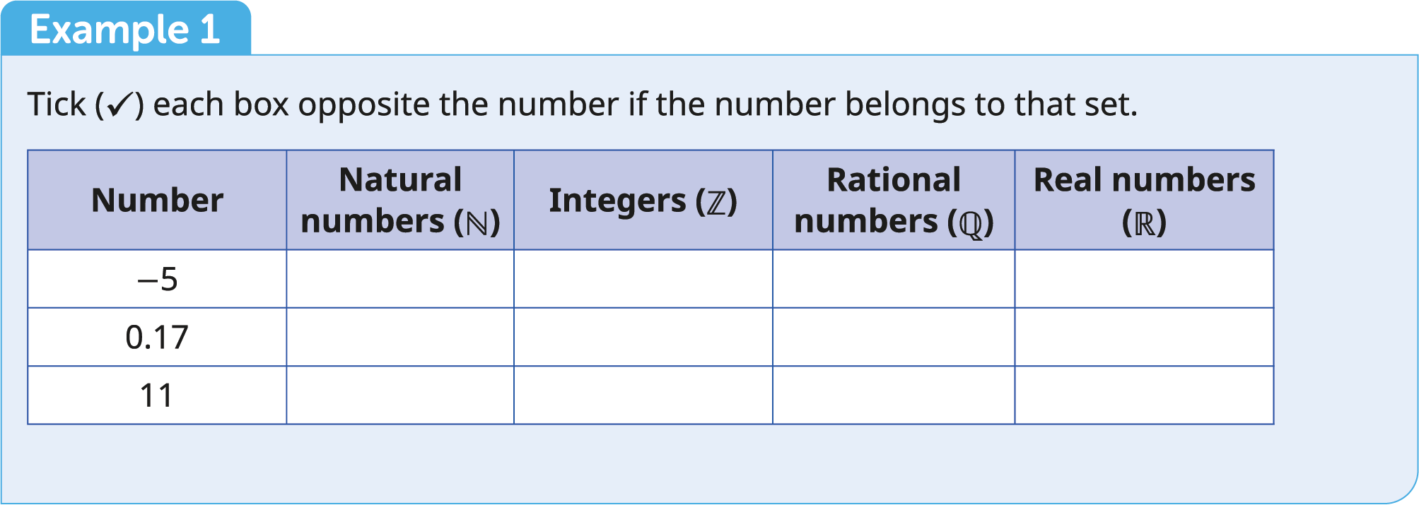

Slide 7
Number Sets and their Number Lines
Example 1
Tick each box opposite the number if the number belongs to that set.
Solution
Number | Natural numbers ($ℕ$) | Integers ($ℤ$) | Rational numbers ($ℚ$) | Real numbers ($ℝ$)
−5 |  | ✓ | ✓ | ✓
0.17 |  |  | ✓ | ✓
11 | ✓ | ✓ | ✓ | ✓

Slide 8
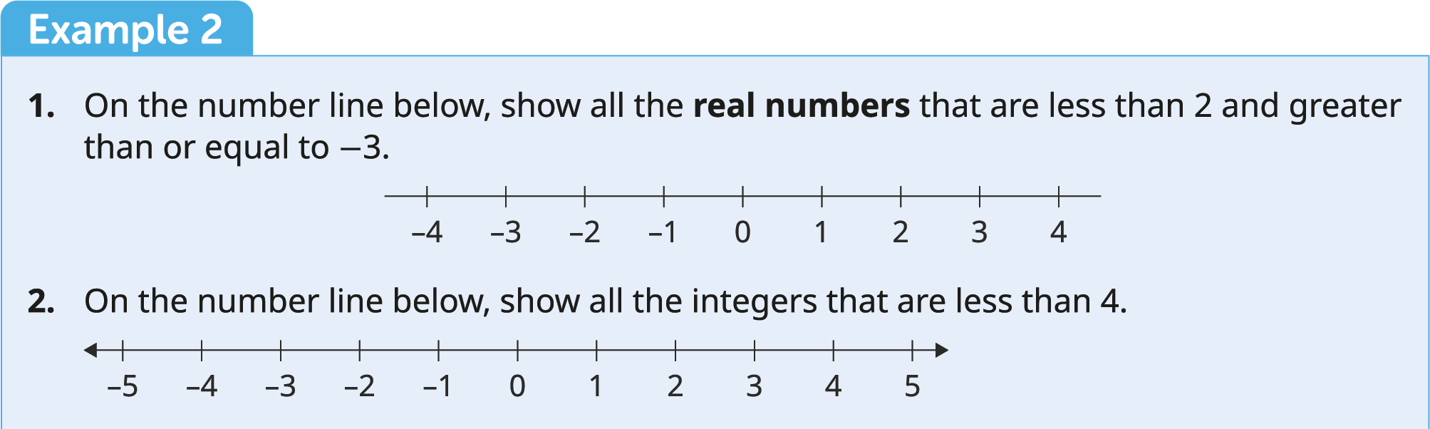

Slide 9
Number Sets and their Number Lines
Example 2
1. On the number line below, show all the real numbers that are less than 2 and greater than or equal to −3.
Solution
The filled-in circle on –3 means “all the real numbers close to –3 and equal to –3”.
The empty circle on 2 means “all the real numbers close to 2 but not equal to 2”.

Slide 10
Number Sets and their Number Lines
Example 2
2. On the number line below, show all the integers that are less than 4.
Solution
The arrow at the end of the line means that it continues forever.

Slide 11
Some Special Types of Numbers
Multiples
Multiples of 3 = {3, 6, 9, 12, 15, 18, …}
Multiples of 5 = {5, 10, 15, 20, 25, 30, …}
Multiples of 100 = {100, 200, 300, 400, 500, 600, …}
Lowest Common Multiple
The lowest common multiple (LCM) of two or more numbers is the smallest number that these numbers will all divide into.

Slide 13
Some Special Types of Numbers
Lowest Common Multiple
Example
Find the lowest common multiple of 3 and 4.
Solution
Multiples of 3 = 3, 6, 9, 12, 15, 18, 21, 24, 27, …
Multiples of 4 = 4, 8, 12, 16, 20, 24, 28, …
Lowest common multiple = 12

Slide 14
Some Special Types of Numbers
Divisors
Numbers that divide in with no remainder.
Divisors of 10 = {1, 2, 5, 10}
Divisors of 30 = {1, 2, 3, 4, 5, 6, 10, 15, 30}
Divisors of 27 = {1, 3, 9, 27}
Factors
A group of numbers that multiply together to give you a desired number.
Factors of 3 = 3 × 1
Factors of 10 = 1 × 10 or 2 × 5
Factors of 12 = 1 × 12 or 2 × 6 or 3 × 4 or 2 × 2 × 3

Slide 15
Some Special Types of Numbers
Highest Common Factor
The Highest Common Factor (HCF) of two or more numbers is the largest number that divides into all of the numbers.

Slide 17
Some Special Types of Numbers
Highest Common Factor
Example
Find the highest common factor of 36 and 54.
Solution
Factors of 36 = {1, 2, 3, 4, 6, 9, 12, 18, 36}
Factors of 54 = {1, 2, 3, 6, 9, 18, 27, 54}
Highest common factor = 18

Slide 18
Some Special Types of Numbers
Prime numbers
A prime number is a natural number greater than 1 that only has two divisors: itself and 1.
Prime number set = {2, 3, 5, 7, 11, 13, 17, 19, 23, 29, 31, 37, 41, 43, 47, 53, …}
Prime factors
To write a number as a product of its prime factors:
Find the smallest prime number that divides in evenly and divide.
Find the smallest prime number that divides into your answer and divide.
Repeat the process until your answer is 1.
Write your number as a product of all your prime divisors.

Slide 20
Some Special Types of Numbers
Example
Write the following numbers as a product of prime factors.
(a) 60
(b) 4641
Solution
(a)
2 | 60
2 | 30
3 | 15
5 | 5
 | 1
(b)
3 | 4641
7 | 1547
13 | 221
17 | 17
 | 1
60 = 2 × 2 × 3 × 5
4641 = 3 × 7 × 13 × 17

Slide 21
Some Special Types of Numbers
Square numbers
To square means to multiply a number by itself.
A short way of writing 5 × 5 is 5² (five squared). The small 2 is called an index, power or exponent.
1², 2², 3², 4², 5², 6², 7², 8², 9², 10², 11², 12², 13², …
is the same as
1, 4, 9, 16, 25, 36, 49, 64, 81, 100, 121, 144, 169, …
is the same as
The numbers 1, 4, 9, 16, 25, 36, 49, 64, 81, … are called “perfect squares”.

Slide 22
Some Special Types of Numbers
Square roots
Every mathematical operation has an inverse (opposite) operation to reverse (or undo) it.
If we view a perfect square as the area of a polygon square, then the square root would give us the side length (what we had to square to get the area) of that square.
$\sqrt{1}$ = 1 since 1² = 1
Note: When a calculation involves working with a power or a square root, we always apply the power or root first.
$\sqrt{4}$ = 2 since 2² = 4
$\sqrt{9}$ = 3 since 3² = 9
$\sqrt{16}$ = 4 since 4² = 16
$\sqrt{25}$ = 5 since 5² = 25

Slide 24
Some Special Types of Numbers
Example
Find the value of each of the following:
(a) 3²
(b) 4²
(c) $\sqrt{36}$
(d) $\sqrt{49}$
Solution
(a) 3² = 9
(b) 4² = 16
(c) $\sqrt{36}$ = 6
(d) $\sqrt{49}$ = 7

Slide 25
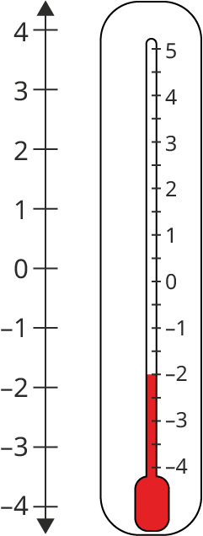
Operations with Integers
Adding and subtracting
When adding and subtracting integers, it can be very helpful to use a number line.
The arrows show that the number line continues forever in both directions.
The values get bigger as you move to the right.
The values get smaller as you move to the left.
To add, jump to the right. To subtract, jump to the left.
On a vertical number line, the values get bigger as you move up and smaller as you move down.
To add, jump up. To subtract, jump down.

Slide 27
Example
Evaluate each of the following.
(a) 2 + 4
(b) 9 − 5
(c) 4 − 9
(d) −3 + 6
(e) −3 − 4
(f) −7 + 4
Solution
(a) 2 + 4 = 6
Start at 2, jump four places to the right.
(b) 9 − 5 = 4
Start at 9, jump five places to the left.
(c) 4 − 9 = −5
Start at 4, jump nine places to the left.

Slide 28
Example
Evaluate each of the following.
(a) 2 + 4
(b) 9 − 5
(c) 4 − 9
(d) −3 + 6
(e) −3 − 4
(f) −7 + 4
Solution – Continued
(d) −3 + 6 = 3
Start at −3, jump six places to the right.
(e) −3 − 4 = −7
Start at −3, jump four places to the left.
(f) −7 + 4 = −3
Start at −7, jump four places to the right.

Slide 29
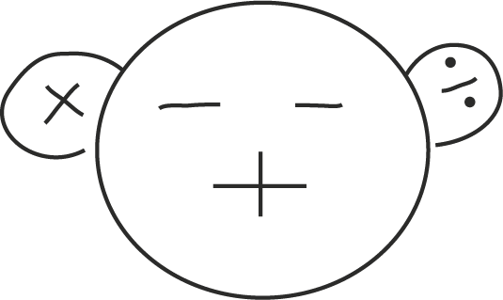
Operations with Integers
Multiplying and dividing
Be mindful of signs (positive or negative) when multiplying and dividing.
$$\left(−\right)\left(−\right)=+$$
}
{
$$\left(−\right)÷\left(−\right)=+$$
Multiplying/dividing two same signs → +
$$\left(+\right)\left(+\right)=+$$
$$\left(+\right)÷\left(+\right)=+$$
$$\left(+\right)\left(−\right)=−$$
}
Multiplying/dividing two different signs → −
{
$$\left(+\right)÷\left(−\right)=−$$
$$\left(−\right)\left(+\right)=−$$
$$\left(−\right)÷\left(+\right)=−$$
Examples
Examples
$$3\left(2\right)=6$$
$$\left(8\right)÷\left(2\right)=4$$
$$−3\left(−2\right)=6$$
$$\left(−8\right)÷\left(−2\right)=4$$
$$3\left(−2\right)=−6$$
$$\left(8\right)÷\left(−2\right)=−4$$
$$−3\left(2\right)=−6$$
$$\left(−8\right)÷\left(2\right)=−4$$

Slide 30
Order of Operations (BIRDMAS)
When a calculation involves more than one operation, apply them in the order shown below.
1st | B | Brackets
2nd | I | Index (plural: indices) | Interchangeable. Can be applied one after the other in either order. E.g. $\sqrt{\left(2^{2}\right)}=2$ and ${\left(\sqrt{2}\right)}^{2}=2$.
 | R | Roots
3rd | D | Division | Multiplication and division are performed whichever comes first from left to right. E.g. $10÷2×3=15$ and $6×2÷4=3$.
 | M | Multiplication
4th | A | Addition | Addition and subtraction are performed whichever comes first from left to right. E.g. $7−2+3=8$ and $4+1−3=2$.
 | S | Subtraction

Slide 32
Order of Operations (BIRDMAS)
Example 1
Work out the answer to each of the following.
(a) $7+6×2$
(b) $19−15÷3$
(c) $\left(1+4^{2}\right)×2−4$
(d) ${\left(9−3×2\right)}^{2}÷(18÷6)$
Solution
(a) $7+6×2$ $$=7+\left(6×2\right) \\ =7+12 \\ =19$$
(b) $19−15÷3$ $$=19−\left(15÷3\right) \\ =19−5 \\ =14$$
(c) $\left(1+4^{2}\right)×2−4$ $$=\left(1+16\right)×2−4 \\ =17×2−4 \\ =\left(17×2\right)−4 \\ =34−4 \\ =30$$
(d) ${\left(9−3×2\right)}^{2}÷(18÷6)$ $$={\left(9−\left(3×2\right)\right)}^{2}÷(3) \\ ={\left(9−6\right)}^{2}÷3 \\ ={\left(3\right)}^{2}÷3 \\ =9÷3 \\ =3$$

Slide 34
Order of Operations (BIRDMAS)
Example 2
Insert brackets into each of the following statements to make them true. You may need more than one pair of brackets in some of the statements.
(a) $5×2+3=25$
(b) $7−4×11=33$
(c) $9−3^{2}=36$
Solution
(a) $5×(2+3)=25$
(b) ($7−4)×11=33$
(c) ($9−{3)}^{2}=36$

Slide 35
Properties of Integers
Commutative
The order in which we add or multiply does not change the value of the answer.
Addition and multiplication are commutative.
$$2+4=6$$
$$4+2=6$$
$$2×4=8$$
$$4×2=8$$
The order in which we subtract or divide does change the value of the answer.
Subtraction and division are not commutative.
$$2−4=−2 \\ 4−2=2$$
$$2÷4=\frac{1}{2}$$
$$4÷2=2$$

Slide 36
Properties of Integers
Distributive
Look at these two methods to evaluate $3(2+4)$.
Method A:
Add the numbers inside the brackets first. Multiply your answer by the number outside the brackets.
Method B:
Multiply the number in front of the bracket by each number inside the brackets. Add your answers together.
$3\left(2+4\right)$
$=3\left(2\right)+3\left(4\right)$ $=6+12$ $=18$
$3\left(2+4\right)$
$=3\left(6\right)$ $=18$
In the above calculation, we need to multiply 3 by everything in the brackets. Both methods give the same answer. This is the distributive property. That is, multiplication is distributive over addition.

Slide 37
Properties of Integers
Associative
Look at these methods to evaluate $2+3+4$ and $2×3×4$.
$\left(2+3\right)+4$
$$=5+4 \\ =9$$
$2+(3+4)$
$$=2+7 \\ =9$$
$\left(2×3\right)×4$
$$=6×4 \\ =24$$
$2×(3×4)$
$$=2×12 \\ =24$$
The way in which the numbers are grouped does not change the answer.
Addition and multiplication are associative.
Subtraction and division are not associative.

Slide 38
Exponents (Powers)
Power, index and exponent all mean the same thing.
Powers can be thought of as repeated multiplication.
The power tells us how many times a number (the base) is multiplied by itself.
power
$$2^{3}$$
base
Words | Index notation | Expansion | Value
2 to the power of 3 | $$2^{3}$$ | $$2×2×2$$ | 8
2 to the power of 5 | $$2^{5}$$ | $$2×2×2×2×2$$ | 32
3 to the power of 4 | $$3^{4}$$ | $$3×3×3×3$$ | 81
5 to the power of 5 | $$5^{5}$$ | $$5×5×5×5×5$$ | 3,125
10 to the power of 6 | $${10}^{6}$$ | $$10×10×10×10×10×10$$ | 1,000,000

Slide 39
Exponents (Powers)
Any base to the power of one is itself.
$$2^{1}=2$$
$$3^{1}=3$$
Any base to the power of zero is 1.
$$2^{0}=1$$
$$3^{0}=1$$
When multiplying like (same) bases, we add the powers.
$$\left(2^{3}\right)\left(2^{2}\right)=2^{5}$$
$$\frac{2^{5}}{2^{3}}=2^{2}$$
When dividing like bases, we subtract the powers.
 | Same as | Same as
$$\left(5\right)\left(5\right)=5^{2}$$
$$\left(2\right)\left(2\right)\left(2\right)=2^{3}$$ | $$2\left(2^{2}\right)=2^{3}$$ | $$2^{2}\left(2\right)=2^{3}$$
$$\left(2\right)\left(2\right)\left(2\right)\left(2\right)=2^{4}$$ | $$\left(2^{2}\right)\left(2^{2}\right)=2^{3}$$ | $$2\left(2^{3}\right)=2^{4}$$
$$\left(3\right)\left(3\right)\left(3\right)\left(3\right)\left(3\right)=3^{5}$$ | $$3\left(3^{4}\right)=3^{5}$$ | $$3^{2}\left(3^{3}\right)=3^{5}$$
$$\left(3\right)\left(3\right)\left(3\right)\left(3\right)\left(3\right)(3)=3^{6}$$ | $$3\left(3^{5}\right)=3^{6}$$ | $$3^{3}\left(3^{3}\right)=3^{6}$$

Slide 41
Exponents (Powers)
Example
Express each of the following in the form $a^{b}$ where $a$ is a prime number and $b$ is an integer.
(a) $8$
(b) $27$
(c) $625$
(d) $128$
(e) $3(3)(3)(3)$
(f) $2^{3}\left(2^{5}\right)$
(g) $\frac{2^{6}}{2^{3}}$
(h) $\frac{5×5^{2}×5^{5}}{5^{2}×5^{2}}$
Solution
(a) $8$
$$=2^{3}$$
(b) $27$
$$=3^{3}$$
(c) $625$
$$=5^{4}$$
(d) $128$
$$=2^{7}$$
(e) $3\left(3\right)\left(3\right)\left(3\right)$
$$=3^{4}$$
(f) $2^{3}\left(2^{5}\right)$ $$=2^{3+5} \\ =2^{8}$$
(g) $\frac{2^{6}}{2^{3}}$ $$=2^{6−3} \\ =2^{3}$$
(h) $\frac{5×5^{2}×5^{5}}{5^{4}×5^{3}}$
$=\frac{5^{8}}{5^{7}}$ $$=5^{1}$$

Slide 42
Fractions
When a whole is broken into parts, we have fractions of the whole.
Numerically, fractions are written as two whole numbers, one on top of the other, separated by a line.
$$\text{Fraction}\text{ =} \frac{\text{Numerator}}{\text{Denominator}}$$

Slide 43
Fractions
Equivalent fractions
$\frac{1}{2}=\frac{5}{10}=\frac{50}{100}=\frac{100}{200}$
$\frac{120}{240}=\frac{12}{24}=\frac{6}{12}=\frac{1}{2}$
If we multiply the top and bottom of a fraction by the same number, the value of the fraction stays the same. The fraction $\frac{8}{12}$ can be simplified to $\frac{2}{3}$.
We do this by dividing the top and the bottom by 4: $\frac{ ^{2}8}{ _{3}12}=\frac{2}{3}$

Slide 44
Fractions
Finding a fraction of a value
Divide by the denominator to find one portion.
Multiply by the numerator to find the total portions we want.
To find a fraction of a value on a calculator, multiply the value by the fraction.
Example
$\frac{1}{4}$ of 20 means we want to break 20 into 4 portions and keep 1 of them.
Solution
$20÷4=5$
$5×1=5$ So, $\frac{1}{4}$ of 20 is 5.

Slide 45
Fractions
Finding a fraction of a value
Divide by the denominator to find one portion.
Multiply by the numerator to find the total portions we want.
To find a fraction of a value on a calculator, multiply the value by the fraction.
Example
$\frac{2}{3}$ of 66 means we want to break 66 into 3 portions and keep 2 of them.
Solution
$66÷3=22$
$22×2=44$ So, $\frac{2}{3}$ of 66 is 44.
Note: $\frac{2}{3}$ of 66 is the same as $\frac{2}{3}×66$.

Slide 47
Fractions
Example 1
Shade in $\frac{2}{3}$ of the following strip.
Solution
The strip has 6 sections. $\frac{2}{3}=\frac{4}{6}$, so shade 4 sections.

Slide 49
Fractions
Example 2
Show the approximate height of water in a cylinder-shaped glass, if the glass is $\frac{3}{8}$ full.
Solution
Use a ruler to make 8 evenly spaced marks along one side of the cylinder. The third mark from the bottom is $\frac{3}{8}$.

Slide 50
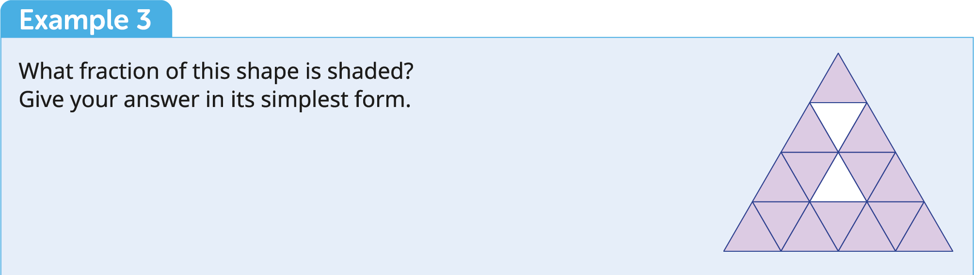

Slide 51
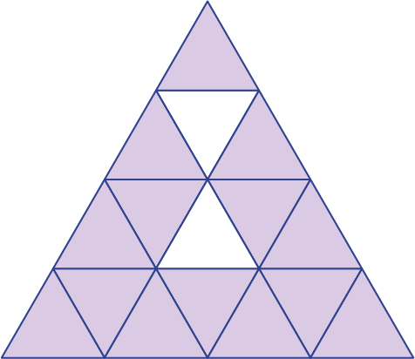
Fractions
Example
What fraction of the shape is shaded? Give your answer in its simplest form.
Solution
The shape is split into 16 triangles. 14 of them are shaded.
$$\frac{14}{16}=\frac{7}{8}$$

Slide 52
Fractions
Adding and subtracting fractions
When the denominators are the same, add or subtract the numerators.

Slide 54
Fractions
Example
Write the following as single fractions.
(a) $\frac{1}{12}+\frac{4}{12}$
(b) $\frac{4}{7}−\frac{3}{7}$
(c) $\frac{1}{6}−\frac{3}{6}+\frac{5}{6}$
Solution
(a) $\frac{1}{12}+\frac{4}{12}$
$=\frac{5}{12}$
(b) $\frac{4}{7}−\frac{3}{7}$
$=\frac{1}{7}$
(c) $\frac{1}{6}−\frac{3}{6}+\frac{5}{6}$
$=\frac{3}{6}$
$=\frac{1}{2}$

Slide 55
Fractions
Adding and subtracting fractions
When the denominators are not the same, follow these steps:
Find the LCM of the denominators. Write all of your fractions over this common denominator.
Adjust the values of the numerators. For each fraction, work out what you multiplied the denominator by to get the common denominator. Multiply the numerator by the same number.
Multiply out the brackets in the numerator.
Add all the values in the numerator together.
If your answer is not already in lowest terms, simplify it by dividing the numerator and denominator by the HCF.

Slide 57
Fractions
Example
Write the following as single fractions.
(a) $\frac{3}{4}+\frac{1}{3}$
(b) $\frac{2}{5}−\frac{3}{2}$
(c) $\frac{9}{10}+\frac{2}{3}−\frac{1}{6}$
Solution
(a) $\frac{3}{4}+\frac{1}{3}$
$=\frac{3\left(3\right)+1\left(4\right)}{12}$ $=\frac{9+4}{12}$ $=\frac{13}{12}$
(b) $\frac{2}{5}−\frac{3}{2}$
$=$ $\frac{2\left(2\right)−3\left(5\right)}{10}$
$=\frac{4−15}{10}$
$=−\frac{11}{10}$
(c) $\frac{9}{10}+\frac{2}{3}−\frac{1}{6}$
$=$ $\frac{9\left(3\right)+2\left(10\right)−1\left(5\right)}{30}$
$=\frac{27+20−5}{30}$
$=\frac{42}{30}$
$=\frac{7}{5}$

Slide 58
Fractions
Multiplying fractions
Multiply top by top and bottom by bottom.

Slide 60
Fractions
Example
Simplify each of the following:
(a) $\left(\frac{2}{3}\right)\left(\frac{4}{5}\right)$
(b) $\left(\frac{5}{6}\right)\left(\frac{1}{4}\right)$
(c) $\left(−\frac{10}{3}\right)\left(\frac{3}{6}\right)$
Solution
(a) $\left(\frac{2}{3}\right)\left(\frac{4}{5}\right)$
$=\frac{2×4}{3×5}$ $=\frac{8}{15}$
(b) $\left(\frac{5}{6}\right)\left(\frac{1}{4}\right)$
$=\frac{5×1}{6×4}$
$=\frac{5}{24}$
(c) $\left(−\frac{10}{3}\right)\left(\frac{3}{6}\right)$
$=\frac{−30}{18}$
$=\frac{−5}{3}$
Note: $\frac{−5}{3}=\frac{5}{−3}$ $=−\frac{5}{3}$

Slide 61
Fractions
Dividing fractions
KFC (Keep, Flip, Change)
Keep the fraction on the left
Flip the fraction on the right
Change the symbol from $÷$ to $×$

Slide 63
Fractions
Example
Simplify each of the following:
(a) $\frac{3}{4}÷\frac{1}{2}$
(b) $4÷\frac{1}{3}$
(c) $\frac{7}{8}÷\frac{3}{4}$
Solution
(a) $\frac{3}{4}÷\frac{1}{2}$
$=\frac{3}{4}×\frac{2}{1}$ $=\frac{6}{4}$ $=\frac{3}{2}$
(b) $4÷\frac{1}{3}$
$=\frac{4}{1}×\frac{3}{1}$
$=\frac{12}{1}$
$=12$
(c) $\frac{7}{8}÷\frac{3}{4}$
$=\frac{7}{8}×\frac{4}{3}$
$=\frac{28}{24}$
$=\frac{7}{6}$
Note: Write a whole number as a fraction by putting it over 1.

Slide 64
Fractions
Types of fractions
In proper (top heavy) fractions the top is smaller than the bottom.
Examples: $\frac{1}{2}$, $\frac{7}{8}$, $\frac{2}{3}$, $\frac{3}{4}$, $\frac{9}{10}$
In improper (bottom heavy) fractions the top is bigger than the bottom.
Examples: $\frac{3}{2}$, $\frac{11}{8}$, $\frac{5}{3}$, $\frac{27}{6}$, $\frac{19}{10}$
A mixed fraction is a mix of a whole number and a proper fraction.
Examples: $1\frac{1}{2}$, $8\frac{3}{8}$, $1\frac{2}{3}$, $8\frac{3}{4}$, $1\frac{9}{10}$

Slide 65
Fractions
Converting top-heavy fractions to mixed fractions
Divide the denominator (bottom) into the numerator (top) to find out how many whole units there are.
The remainder is the new numerator for the proper fraction.

Slide 67
Fractions
Example
Write each of the following top-heavy fractions as a mixed fraction.
(a) $\frac{7}{4}$
(b) $\frac{19}{6}$
(c) $\frac{24}{10}$
Solution
(a) $7÷4$ is 1 remainder 3 So, $\frac{7}{4}=1\frac{3}{4}$
(b) $19÷6$ is 3 remainder 1 So, $\frac{19}{6}=3\frac{1}{6}$
(c) $\frac{24}{10}=\frac{12}{5}$
Then $12÷5$ is 2 remainder 2 So, $\frac{12}{5}=2\frac{2}{5}$
First, write the fraction in its
simplest form by dividing top
and bottom by common factor, 2.

Slide 68
Fractions
Converting mixed fractions to top-heavy fractions
Multiply the whole number by the denominator.
Add on the numerator.

Slide 69
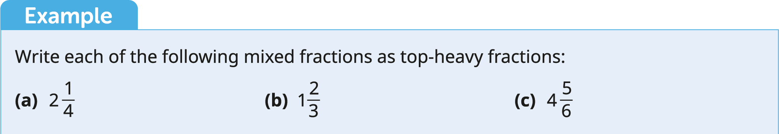

Slide 70
Fractions
Example
Write each of the following mixed fractions as a top-heavy fraction.
(a) $2\frac{1}{4}$
(b) $1\frac{2}{3}$
(c) $4\frac{5}{6}$
Solution
(a) $\left(2×4\right)+1=9$
So, $2\frac{1}{4}=\frac{9}{4}$
(b) $\left(1×3\right)+2=5$
So, $1\frac{2}{3}=\frac{5}{3}$
(c) $\left(4×5\right)+5=29$
So, $4\frac{5}{6}=\frac{29}{6}$

Slide 71
Decimals and Percentages
Converting between fractions, decimals and percentages
To convert from a fraction or decimal to a percentage, multiply by 100.
To convert from a percentage to a fraction or decimal, divide by 100.
Fraction | Decimal | Percentage
1 | 1 | 100%
$\frac{1}{4}$ | 0.25 | 25%
$\frac{3}{4}$ | 0.75 | 75%
$\frac{1}{2}$ | 0.5 | 50%
$\frac{4}{100}$ | 0.04 | 4%
$\frac{63}{100}$ | 0.63 | 63%
$\frac{1369}{1000}$ | 1.369 | 136.9%

Slide 72
Decimals and Percentages
Finding a percentage of a value
To find 32% of 196:
Method 1: Divide by 100 and multiply by the number of percent you want to find.
$196÷100=1.96$
$1.96×32=62.72$
So, 32% of 196 is 62.72
Method 2: Convert the percentage to a decimal by dividing by 100. Multiply.
$32\%÷100=0.32$
$0.32×196=62.72$
So, 32% of 196 is 62.72

Slide 73
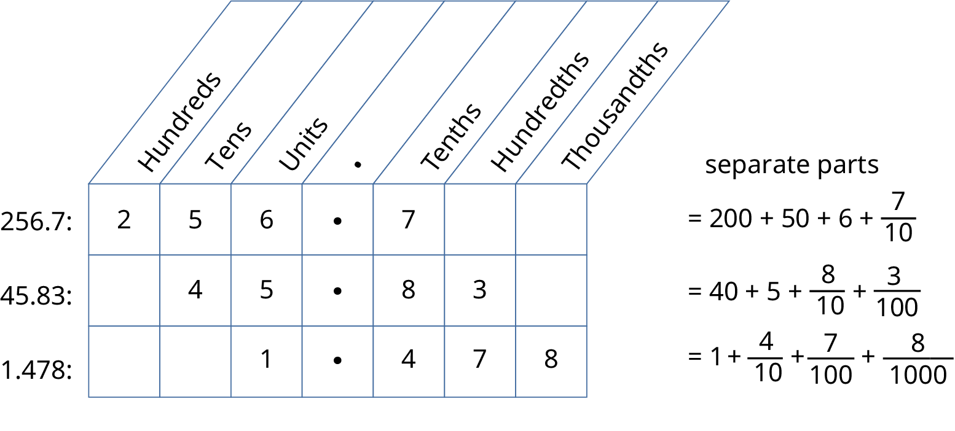
Place Value

Slide 75
Place Value
Example
Write each of the following in words.
(a) $4321$
(b) $150 332$
(c) $1 500 500$
Solution
Four thousand, three hundred and twenty-one
One hundred and fifty thousand, three hundred and thirty-two
One million, five hundred thousand

Slide 77
Place Value
Example
Write each of the following as numbers.
(a) Three hundred and forty-two
(b) Six hundred and fifty-two thousand, nine hundred and twenty-one
(c) Three million and five
Solution
(a) $342$
(b) $652 921$
(c) $3 000 005$

Slide 78
Rounding
Look at the number to the right of where you want to end.
If it’s 5 or more, round up.
If it’s less than 5, round down.
Rounding to the nearest 10, 100, 1000, etc.
Number | Nearest 10 | Nearest 100 | Nearest 1000
3426 | 3430 | 3400 | 3000
1279 | 1280 | 1300 | 1000
17 348 | 17 350 | 17 300 | 17 000
56 751 | 56 750 | 56 800 | 57 000
95 612 | 95 610 | 95 600 | 96 000

Slide 80
Rounding
Rounding to the nearest whole number
Example
Round each of the following correct to the nearest whole number:
(a) 3.6
(b) 24.2
(c) 123.17
(d) 203.99
Solution
(a) 4
(b) 24
(c) 123
(d) 204

Slide 81
Rounding
Rounding correct to decimal places
To find your position, start counting from the first decimal place.
Number | Correct to 1 decimal place | Correct to 2 decimal places | Correct to 3 decimal places
3.141592 | 3.1 | 3.14 | 3.142
11.23568 | 11.2 | 11.24 | 11.236
0.798326 | 0.8 | 0.80 | 0.798
0.9191 | 0.9 | 0.92 | 0.919

Slide 82
Rounding
Rounding correct to significant figures
To find your position, start counting from the first non-zero digit.
Do not count leading zeros.
Do count zeros in between other digits.
Number | Correct to 1 significant figure | Correct to 2 significant figures | Correct to 3 significant figures
3.141592 | 3 | 3.1 | 3.14
1361.489 | 1000 | 1400 | 1360
0.0035081 | 0.004 | 0.0035 | 0.00351
76 636.54 | 80 000 | 76 000 | 75 600

