Slide 2
Pulse, Metre & Rhythm

Slide 3
This chapter helps us to…
Identify pulse and metre in pieces of music.
Conduct pieces of music in different metres.
Perform and compose body-percussion patterns.
Compose rhythmic patterns in different time signatures.
Identify, compose and perform rhythm patterns for various types of performances.

Slide 4
This chapter helps us to…
Explore rhythmic features in music.
Compose a rhythmic ostinato for performance.
Discuss the use of silence in music.
Perform rhythmic sight-reading.
Identify and write down rhythm patterns using rhythmic notation.

Slide 5
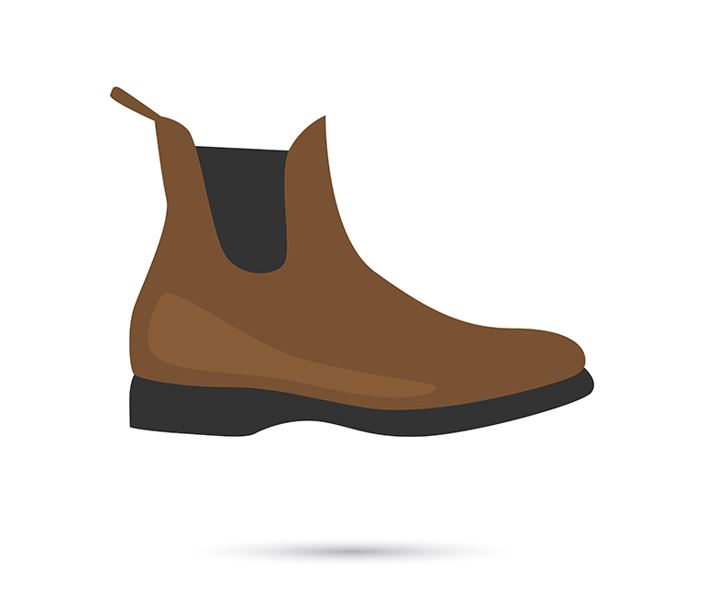
Pulse
A beat is the basic unit of time in music.
Pulse is the continuous, regular beat that you can detect in most music.
Pulse is made up of even and repeating beats.
We can clap along or tap our feet to the pulse of music.
Pulse is measured in BPM (beats per minute).

Slide 6
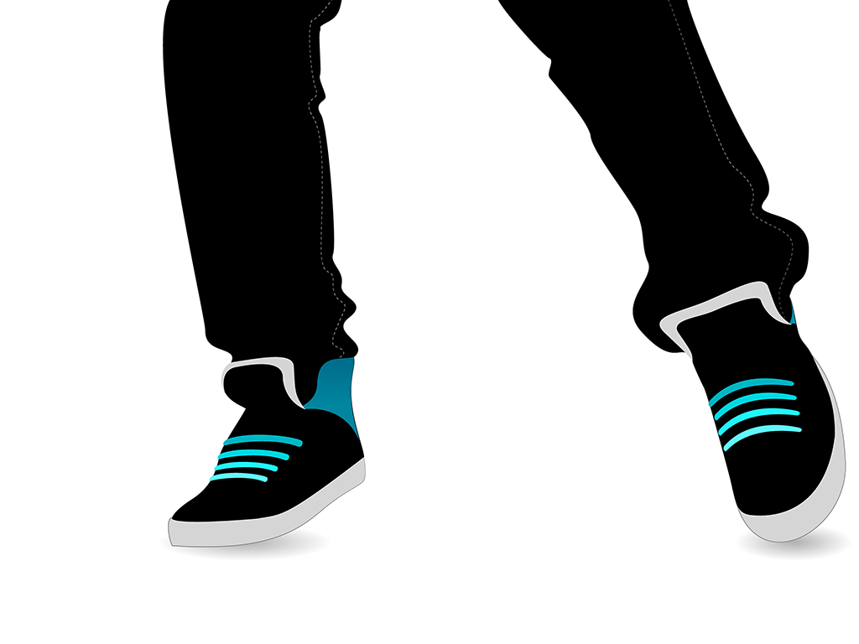
Body beats
Body percussion is a style of performance that uses body movement and actions.
Body percussion uses sounds made by parts of the body, such as the hands, feet, fingers and mouth.
They body is used as an instrument to produce rhythmic sounds.

Slide 7
Recap
Pulse is the steady, repeating beat that you can detect in most music.
A beat is the basic unit of time in a piece of music.
Pulse is measured in BPM (beats per minute).
Body percussion is a style of performance that uses the body and movement to create sounds.

Slide 8
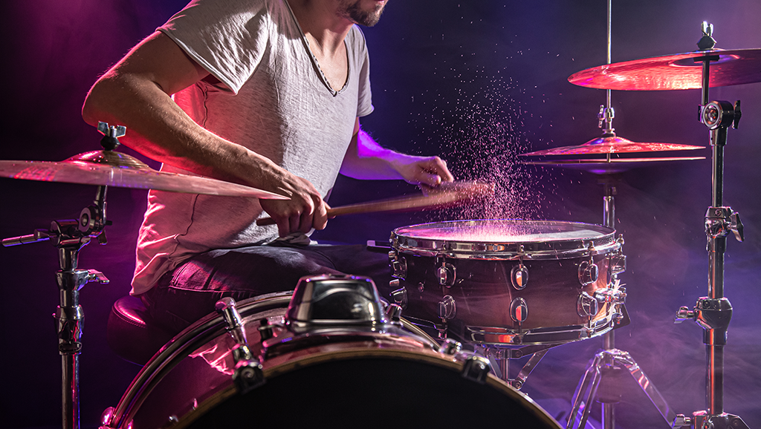
Metre
Metre is the way beats or pulses are grouped together to make a pattern of strong and weak beats.
The metre organises the pulses heard in a piece of music into a pattern based on where the strong beats will fall.

Slide 9
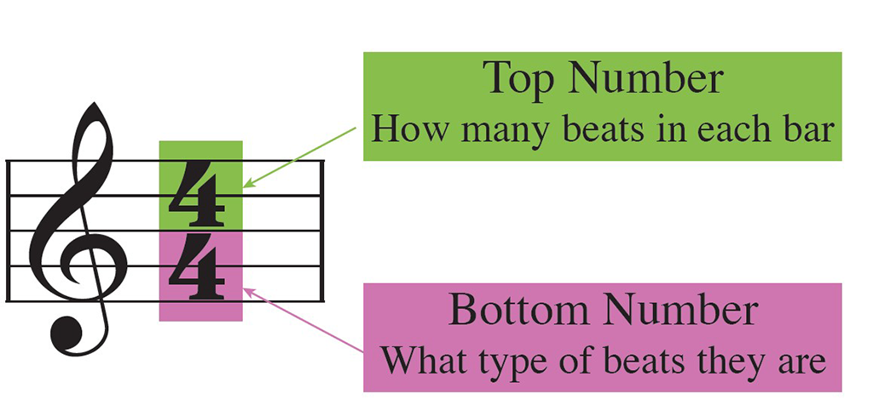
Time Signatures
A time signature indicates the metre of a piece of music and tell us how many pulses there are in each pattern.
Time signatures are printed at the start of a piece of music.
They consist of two numbers, one above the other.
The top number tells us how many pulses there are in each bar.
The bottom number tells us what type of beats they are.

Slide 10
Time Signatures
 | In there are 2 beats in each pattern. A strong beat is heard every 2 beats.
 | In there are 3 beats in each pattern. A strong beat is heard every 3 beats.
 | In there are 4 beats in each pattern. A strong beat is heard every 4 beats.

Slide 11
Recap
Metre is the organisation of beats, based on where the strong beats are.
A bar is a small segment of music that holds a certain number of beats.
The first beat of each bar is usually a strong beat. It is followed by one or more weak beats.
The time signature gives us information about the metre.
The top number of the time signature tells us how many beats there are in each bar.

Slide 12
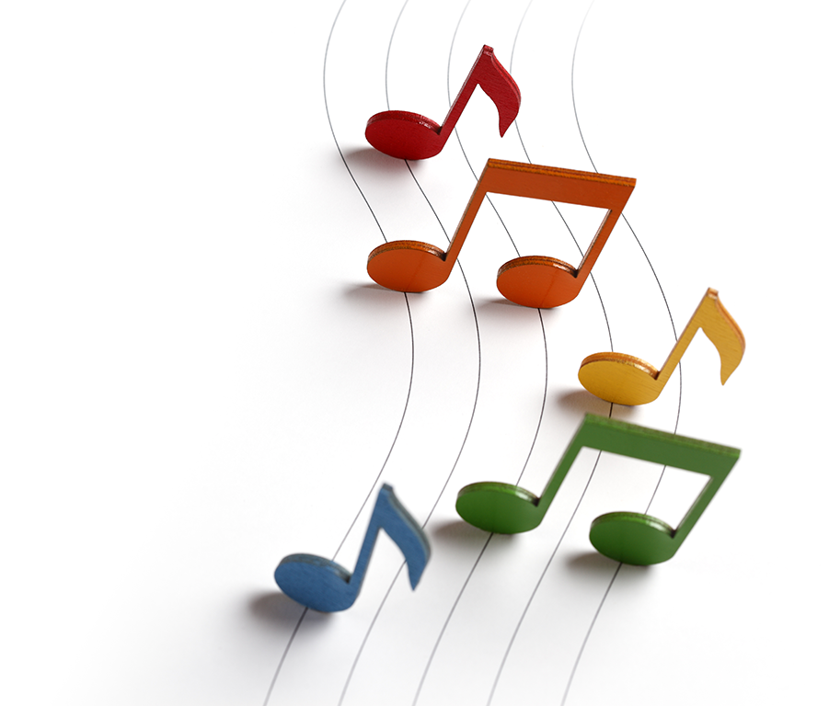
Note values
In music, special symbols are used to indicate the number of beats that each sound will last for.
These are known as note values.
Note values are used to create rhythmic patterns.

Slide 13
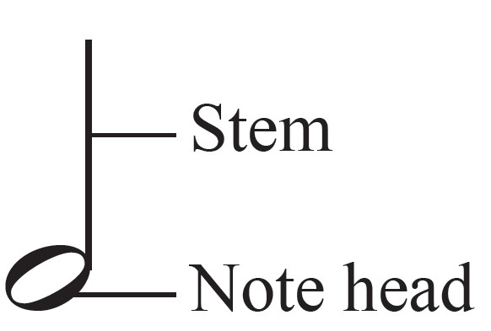
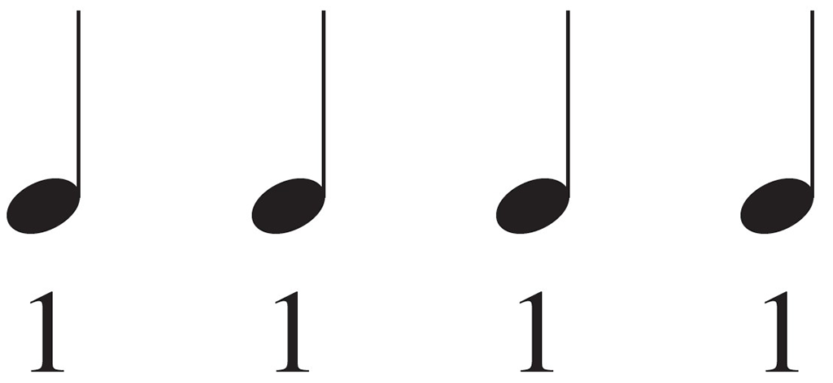
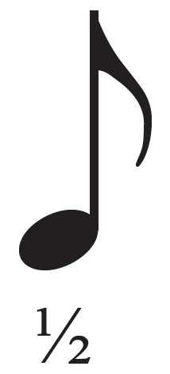
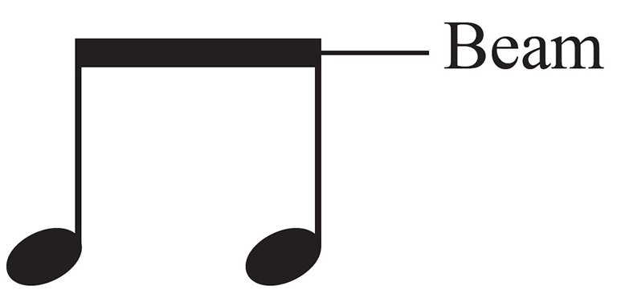
Note values
Semibreve | A semibreve symbol represents 4 beats of sound.
Minim | A minim symbol represents 2 beats of sound.
Crotchet | A crotchet symbol represents 1 beat of sound.
Quaver | A quaver is worth ½ a beat of sound.
Quaver | A pair of quavers is equal to 1 beat (1/2 + ½ = 1). Their tails are joined together using a straight line called a beam.

Slide 14
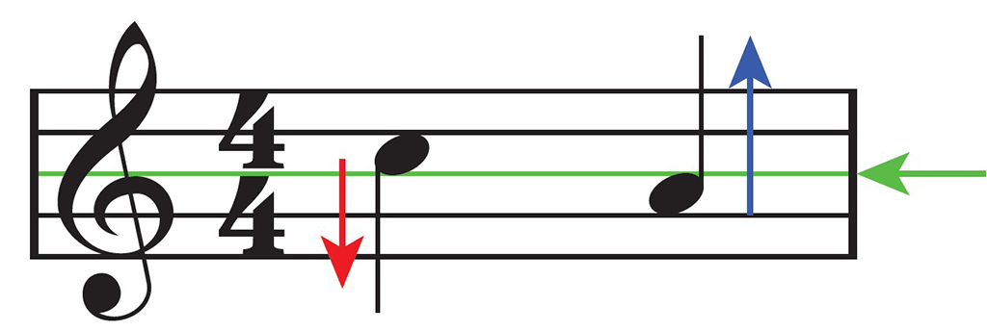
Note Stems
Notes above the middle line of the stave have a downward stem joined to the left side of the note head.
Notes below the middle line have an upward stem on the right side of the note.
The stems of notes on the middle line can go up or down.

Slide 15
What Time Signatures Tell Us
Time signature | What it tells us
 | There are 2 crotchet beats in each bar.
 | There are 3 crotchet beats in each bar.
 | There are 4 crotchet beats in each bar.

Slide 16
Bars and Bar Lines
A bar is a small segment of music that holds a certain number of beats.
Bar lines are vertical lines that mark the end of each bar of music.
The bar lines separate each group of beats to make them easier to read.

Slide 17
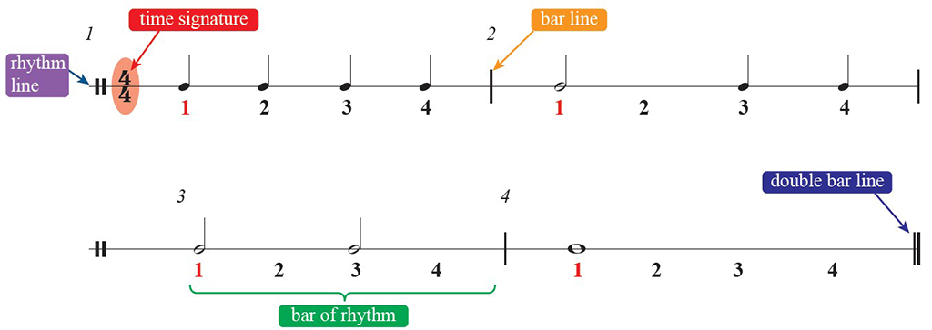
Bars and Bar Lines
The number of beats grouped together in each bar must equal the top number in the time signature.
A double bar line is used to indicate the end of a piece of music.

Slide 18
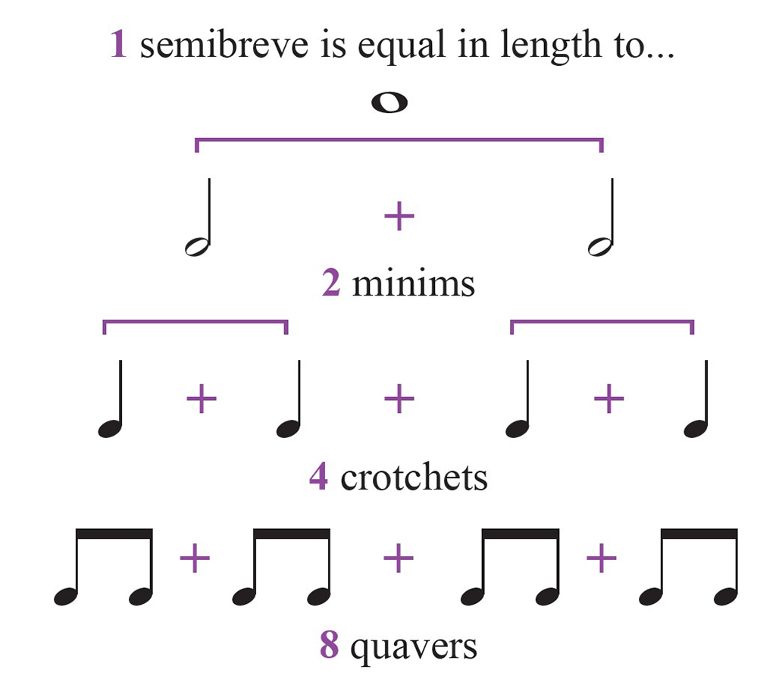
Recap
Note values are symbols which indicate how long a note lasts for.
Note values include
A time signature indicates how many beats there are in each bar of music and what type of beats these are.
A pattern of note values is called a rhythm pattern.
A rhythm pattern is written on a rhythm stave with bar lines to separate the rhythms based on the time signature.

Slide 19
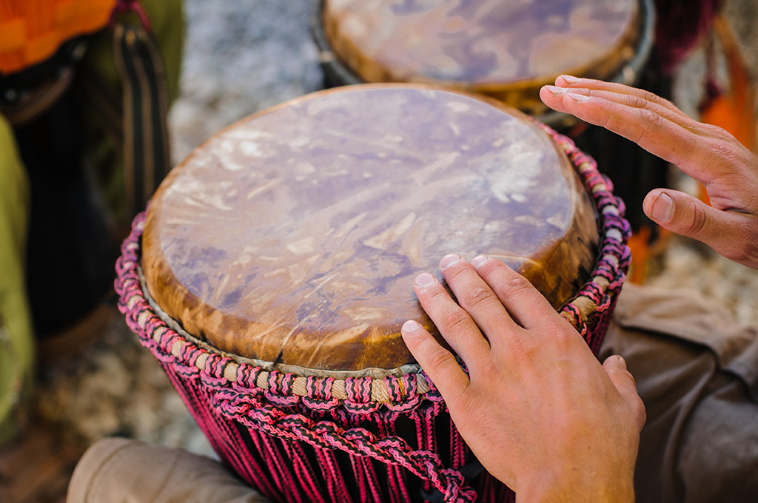
Rhythmic Features
Rhythmic features describe specific elements of a rhythm pattern that can be identified by listeners.
Rhythmic features include:
Repeated rhythmic patterns
Rhythmic ostinatos
Dotted rhythms
Rests

Slide 20
Rhythmic Ostinatos
A rhythmic ostinato is a short rhythm pattern that is repeated throughout a whole piece of music or for a long section of it.
Ostinatos can have a simple or complex rhythm.
They are easy to recognise in music as they repeat throughout.

Slide 21
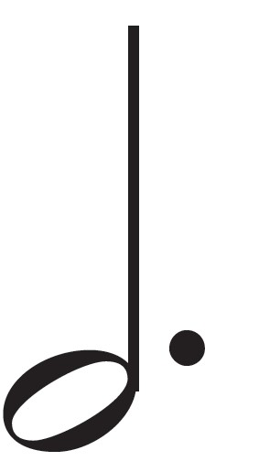
Dotted Rhythms
A dot placed after a note adds on half the value of the original note, making the note last half as long again.
Note | Beats | Dotted note | Beats
Semibreve | 4 beats |  | 6 beats
Minim | 2 beats |  | 3 beats
Crotchet | 1 beat |  | 1 ½ beats

Slide 22
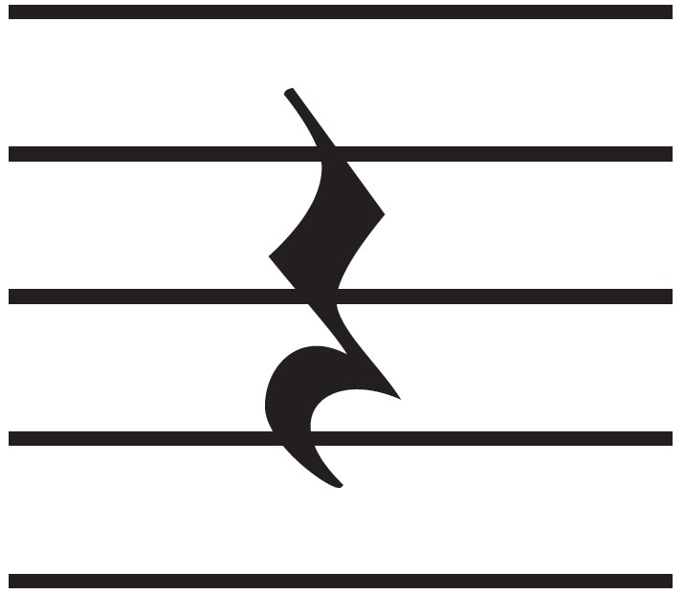
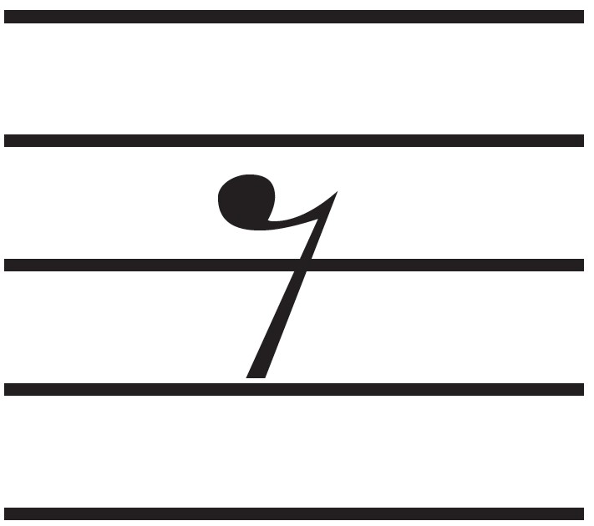
Rests
Symbols used to indicate durations of silence are called rests.
There is a rest for every note value.
Note value |  | Note | Rest
Semibreve | 4 beats
Minim | 2 beats
Crotchet | 1 beat
Quaver | ½ beat

Slide 23
Recap
Rhythmic features describe specific elements of the rhythm pattern.
A repeated rhythm pattern is a group of note values that appears several times in a piece of music.
A rhythmic ostinato is a short rhythm pattern that is constantly repeated in (a section of) a piece of music.
Dotted rhythms include notes that have a dot added after them. The dot adds on half of the value of the original note.
A rest is a symbol used to indicate silence in music. There is a rest symbol to match every note value.
Rests can add drama or tension to piece of music.

Slide 24
Sight-reading and Rhythmic dictation
Sight-reading is the skill of performing a new piece of music from sight, without preparing or practicing the music beforehand.
Rhythmic sight-reading involves clapping or tapping out a rhythm pattern that you have not seen before.
Rhythmic dictation involves listening to an excerpt and identifying or writing out the rhythm pattern that you hear.

Slide 25
Unit A2 Review Keywords
Pulse
Beat
Body percussion
Metre
Time signature
Bar
Conductor
Semibreve
Minim
Crotchet
Quaver
Stave
Rhythm pattern
Bar line
Double bar line
Rhythmic ostinato
Dotted rhythm
Rest
Rhythmic sight-reading
Rhythmic dictation

Slide 26
Credits
Shutterstock

