Slide 2
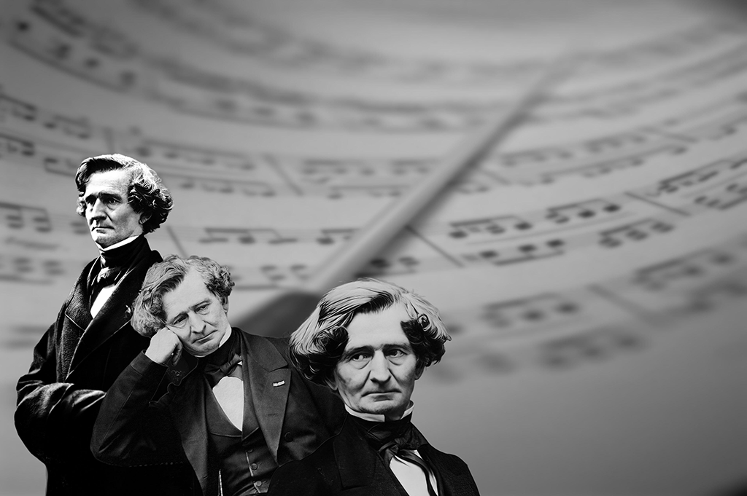
Symphonie Fantastique Op. 14 by Hector Berlioz

Slide 3
The Romantic Era
When? | 1820 – 1910
Composers | Berlioz, Chopin, Field, Tchaikovsky, Mahler
Form | Composers modified classical forms to suit their needs, while still continuing to use some features e.g. sonata.
Orchestra | Expanded greatly and now included piccolo, contrabassoon, trombone and tuba. The piano and harp also sometimes featured.
Melody | Wide-ranging, dramatic, chromatic, sometimes containing a Leitmotif.
Harmony | Richer and fuller with an increased use of chromatic harmony.
Contrasts | Use of unusual modulations, changing moods, textures, dynamics and tempos.

Slide 4
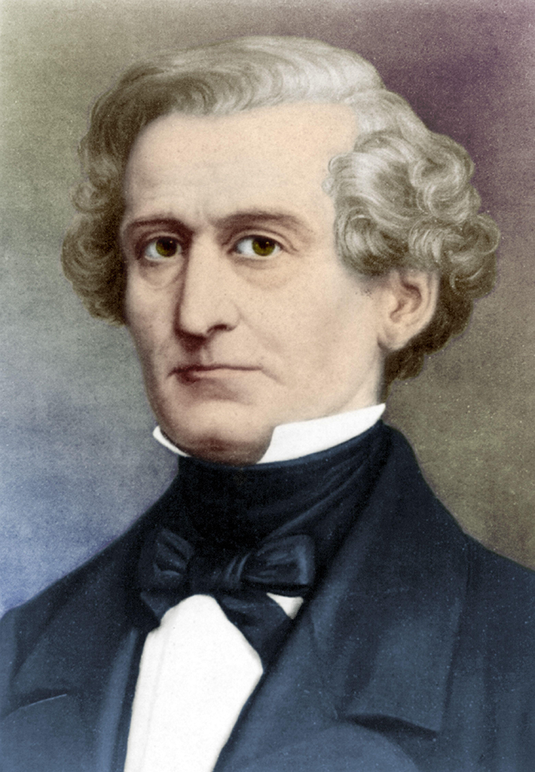
Hector Berlioz
When? | Born in France in 1803
Composed | Music for orchestra, operas and choral works
Style | Long irregular, tuneful melodies Use of large orchestra Unusual instrument combinations Combination of themes to create polyphony Inventive rhythm patterns.

Slide 5
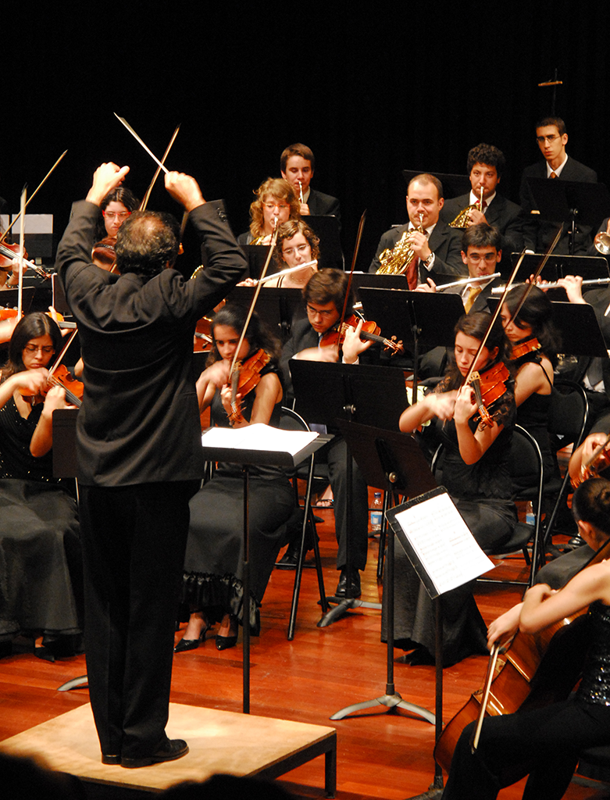
Symphonie Fantastique
A symphony is a piece of music for orchestra, usually in four movements.
This symphony is in five movements.
Berlioz extended it to five movements to accommodate his story.
Symphonie Fantastique is a piece of programme music.
Programme music is instrumental music intended to tell a story, depict a character or paint a scene or mood for the listener.

Slide 6
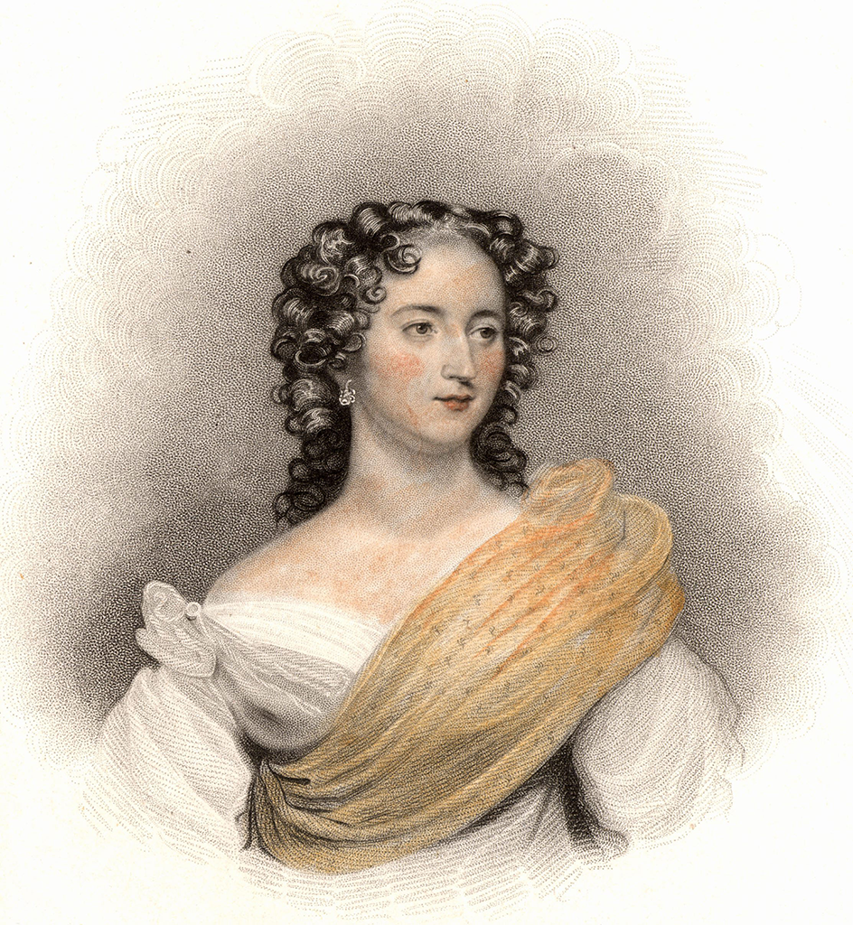
Symphonie Fantastique
For the purpose of your study, you must explore Movements II and IV.
Movement I | Passions (Daydreams – Passions)
Movement II | Un Bal ( a ball)
Movement III | Scène aux champs (Scene in the country)
Movement IV | Marche au Supplice (March to the scaffold)
Movement V | Songe d’une nuit du sabbat (Dream of a witches’ Sabbath)

Slide 7
Idée Fixe
The five movements in this work are linked by a recurring theme that represents the artist’s beloved.
This theme is known as the Idée Fixe.
Each movement has its own version of the Idée Fixe.

Slide 8
Orchestration
The instruments listed here reflect the instrumentation of Movements II and IV only.
There is no percussion in Movement II.
Strings | Woodwind | Brass | Percussion
15 Violins 1 15 Violins 2 10 Violas 11 Cellos 9 Double basses 2 Harps (II) | 2 Flutes (+ piccolo) 2 Oboes (1 only in II) 2 Clarinets 4 Bassoons (IV) | 4 French horns 2 Cornets 2 Trumpets (IV) 3 Trombones (1 alto and 2 tenor) (IV) 2 Ophicleides (tuba) (IV) | 4 Timpani (IV) Snare drum (IV) Cymbals (IV) Bass drum (IV)

Slide 9
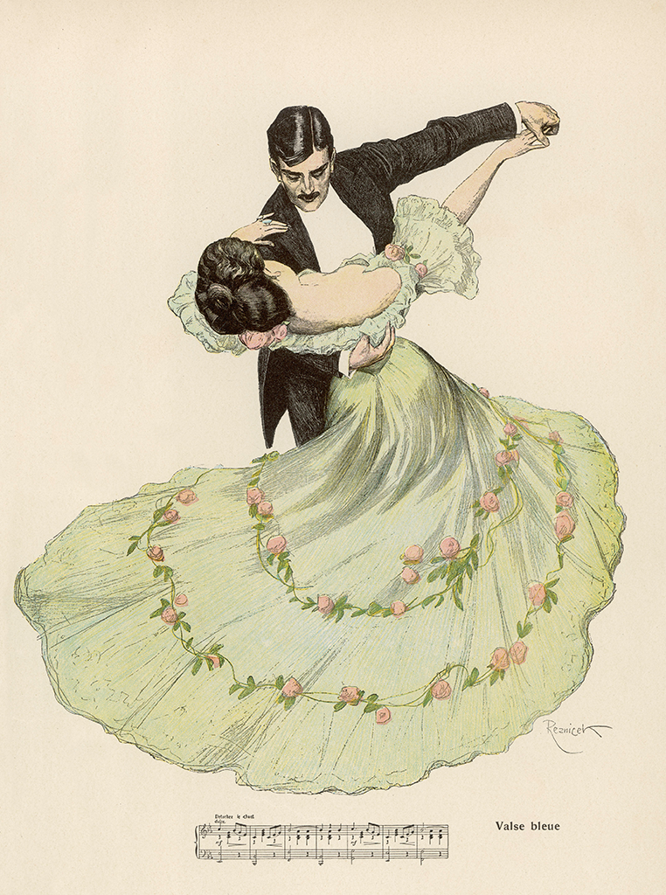
Movement II: Overview of Themes
Waltz Theme (Theme 1)
Idée Fixe

Slide 10
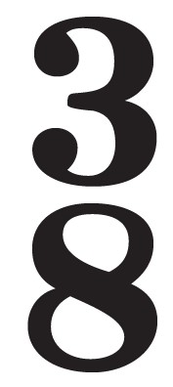
Movement II: The Waltz Theme
This theme is always in A major
time signature giving a waltz feel
Moves mainly in step and features chromaticism, sequence and a rall…a tempo.

Slide 11
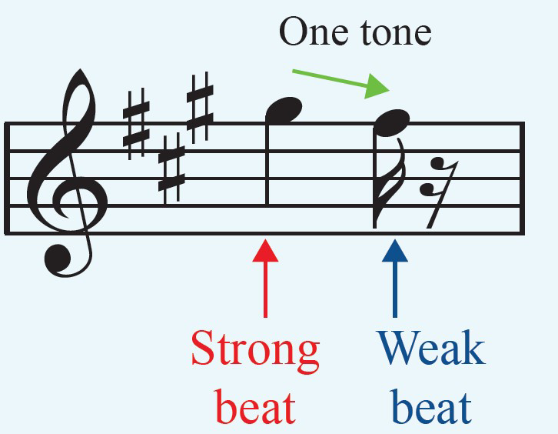
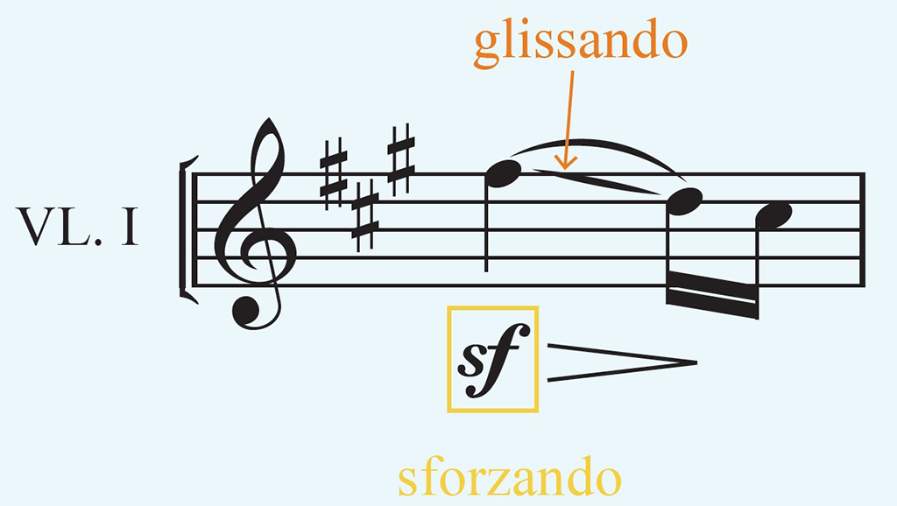
The Walz Theme Sigh Motif and Glissando
Sigh Motif: The sigh motif is made up of a pair of notes where the first note falls by a tone (or semitone) to the second note, and the first note is on a stronger beat than the second note. This creates an ‘ah-’ effect.
Glissando: Sliding between two notes.

Slide 12
Idée Fixe (the artist’s beloved)
The Idée Fixe interrupts the flow of the music in both the 2nd and the 4th movements.
It is always played by woodwind instruments.

Slide 13
Idée Fixe Movement II vs. Movement IV
Movement II: Un Bal (bars 120-128, 302-309) | Movement IV: Marche au Supplice (bars 164-168)
8 bars long F major (notice the ♮ signs and the B♭ accidental) Played by flute and oboe and then by flute and clarinet | - 5 bars long (the first 7 notes) - G major (notice the B♮s) - Played by clarinet -

Slide 14
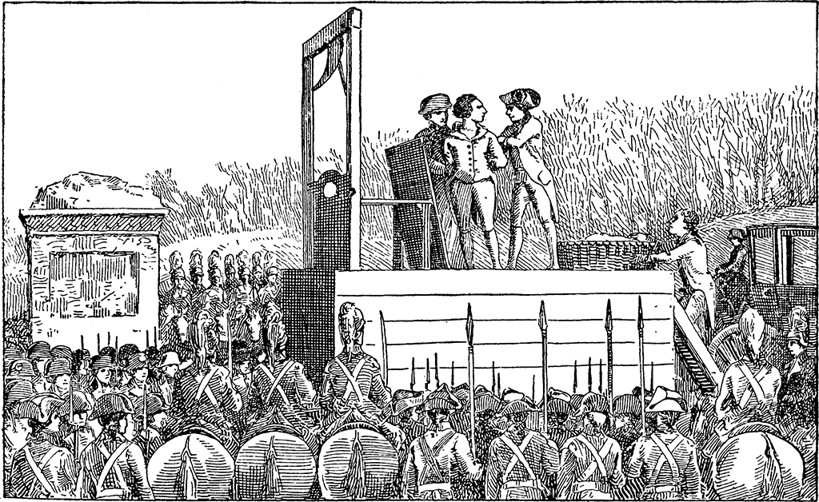
Movement IV: Overview of Themes
Descending Theme
March Theme

Slide 15
Movement IV: Descending Theme
G minor tonality creates a somber mood.
After an octave leap announces the theme
Then descends two octaves with a 2-bar repeating pattern
Two-bar rhythm repeated three times.
Heard five times when first introduced

Slide 16
Movement IV: March Theme
This march-like theme illustrates a march to the artist’s death
B♭ major;
Three phrases
Includes syncopation and dotted rhythms
Repeated notes in melody
Descending scale in third phrase.

Slide 17
Movement II Analysis Un Bal - Summary
Introduction | A |  |  |  | B | A |  |  |  | Coda
Bars 1-36 | 36-120 |  |  |  | 120-173 | 173-256 |  |  |  | 257-368
A minor | A major |  |  |  | F major | A major |  |  |  | A major
See analysis for transitions between sections | Theme 1 | Theme 2 | Theme 3 | Theme 1 | Idée Fixe | Theme 1 | Theme 2 | Theme 3 | Theme 1 | Coda | Idée Fixe |  | Finale
Most themes have their own two-bar introduction | 38-54 | 56-66 | 68-93 | 94-120 | 120-173 | 173-190 | 191-203 | 203-232 | 233-256 | 257- 302 |  | 302-320 |  | 320-368

Slide 18
Un Bal Themes
Theme 1
Theme 2
Theme 3

Slide 19
Un Bal Introduction (Bars 1-36)
Begins with an A minor chord but moves to A major
Tremolo
Arpeggio
Triplets
Dialogue
Sustained chords
Dynamics range from pp to ff
Ends with a perfect cadence.

Slide 20
Un Bal Section A
Theme 1 (Bars 36 - 54) | Theme 2 (Bars 54 – 62) | Theme 3 (Bars 66 – 76)
- 2-bar introduction Chromaticism Moves mostly by step Sigh motif Sforzando Glissando Ends with a perfect cadence. | 2-bar introduction Broken chords on harp Rising pizz. arpeggio Triplet link between phrases Mostly moving in step A major chord marks ending. | 2-bar introduction on flutes and clarinets Theme played by strings One-bar falling sequence of repeated semiquavers Sigh motif 3-note waltz rhythm on harp.

Slide 21
Un Bal Section A
Theme 3 phrase B (Bars 78 - 85) | Transition (Bars 85 –93) | Theme 1 (Bars 94 – 120)
Canon at 2 quavers’ distance Polyphonic/ contrapuntal texture Pizz. quaver accompaniment Flute and clarinet in dialogue with horns. | Nine bars of link material Rising triplets on harp Trills on violins and cellos Contrary motion scales Chromatic movement Perfect cadence. | Waltz theme returns Extended version Waltz rhythm shared between different parts of orchestra Surprising sforzando (sf) Descending chromatic scale Extremely quiet tremolo.

Slide 22
Un Bal Section B (120 - 173)
Idée Fixe (Bars 120-162) | Transition (Bars 163-174)
- Solo flute and oboe introduce the Idée Fixe Tremolo in upper strings pp staccato broken chords on cello and bass Repeated a 4th lower Played by flute and clarinet with a stronger string accompaniment Fragments of canon create a contrapuntal texture Rising sequence Dominant pedal Wide leaps. | 11-bar transition section Preparing for the return of section A Off-beat semiquaver figure that descends by a semitone Dialogue between strings and woodwind Horn pedal on E Moves back to A major.

Slide 23
Un Bal Return of Section A
Theme 1 (Bars 173-183) | Theme 2 (Bars 191-202) | Theme 3 Phrase A (Bars 203-215)
2-bar introduction Theme played by violin 2, viola and cello Ornamental demi-semiquaver on violin 1 Pizz. tonic pedal on cello and bass Triplet broken chords on harp. | 2-bar introduction Semiquaver broken chords on harp Quaver broken chords on cellos and basses Semiquaver block chords on woodwinds Violins and violas play theme. | 2-bar introduction Ascending staccato scale in parallel 3^{rds} Descending staccato scale on cello Accompaniment has pizz. strings and broken chords Triplet and figure on harps.

Slide 24
Un Bal
Theme 3 Phrase B (Bars 215-222) | Transition (Bars 222-232) | Theme 1 (Bars 233-253)
8-note motif Canon between violins and flute and clarinet and cellos Cello plays 2 octaves below Dialogue between 2nd violins and violas Wide ranging dynamics. | 11 bars of link material Wind play repeated block chords 1st violins play a trill into an ascending scale 1st violins then hold a single note into a descending scale Chromatic movement in the violins Piccolos enter A bar’s rest before the Waltz theme returns. | Piccolo, flute, oboe and clarinets play theme Strings and horn accompany Accented syncopation on horns Repeated semiquaver pattern on violins Strings play waltz rhythm pizz. Harps join playing the theme The final phrase is extended Ends with a perfect cadence.

Slide 25
Un Bal Coda
Coda (Bars 257-302) | Idée Fixe (Bars 302-319) | Finale (Bars 320-368)
Polyphonic texture Wind and horns play 8-bar phrase Tremolo strings Tonic pedal and triplet figure Offbeat crotchet chords Scalic movement Ends with a perfect cadence. | Tempo slows Clarinet plays slightly altered Idée Fixe pp sustained notes in accompaniment Descending arpeggio on harp Idée Fixe repeated a 4th lower New ending to Idée Fixe . | Back to original tempo Tutti Block chords Fortissimo (ff) dynamics Tremolo and sforzando on strings Descending scales and octave leaps The music gets faster Ends on a perfect cadence.

Slide 26
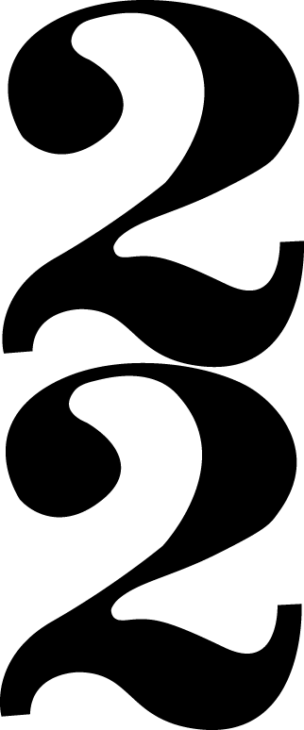
Movement IV Marche au Supplice - Summary
G minor
Allegretto non troppo
Cut common time
Similar to sonata form without recapitulation
Theme 1 = The Descending Theme
Theme 2 = The March Theme
The Idée Fixe appears in the coda.

Slide 27
Movement IV Marche au Supplice - Summary
Introduction | Exposition |  | Development | Coda
Bars 1-17 | 17-78 |  | 78-139 | 140-178
A minor - A major | A major |  | F major | A major
 | Theme 1 | Theme 2 | Intro, Themes 1 and 2, Intro, Theme 1 | Coda-like material |  | Idée Fixe |  | Finale
 | 17-61 | 62-77 | 78-81, 82-88, 89-104, 105-108, 109-114, 114-122 | 140-167 | 164-168 |  | 168-end

Slide 28
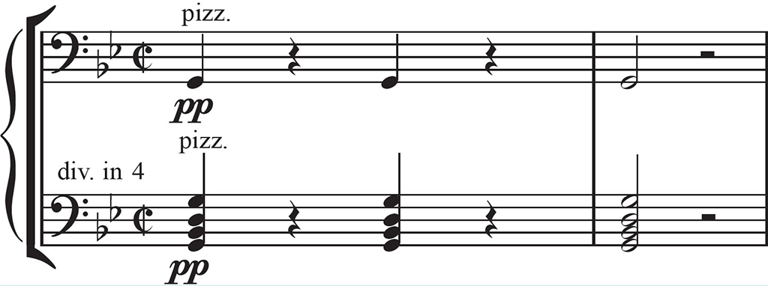
Marche au Supplice Introduction (Bars 1-17)
Repeated motifs create tension
Dynamics ranging from pp to ff
Timpani - Sextuplet rhythm ostinato
Horns play 4-note motif
Syncopation
Pizzicato lower strings
G minor block chords.

Slide 29
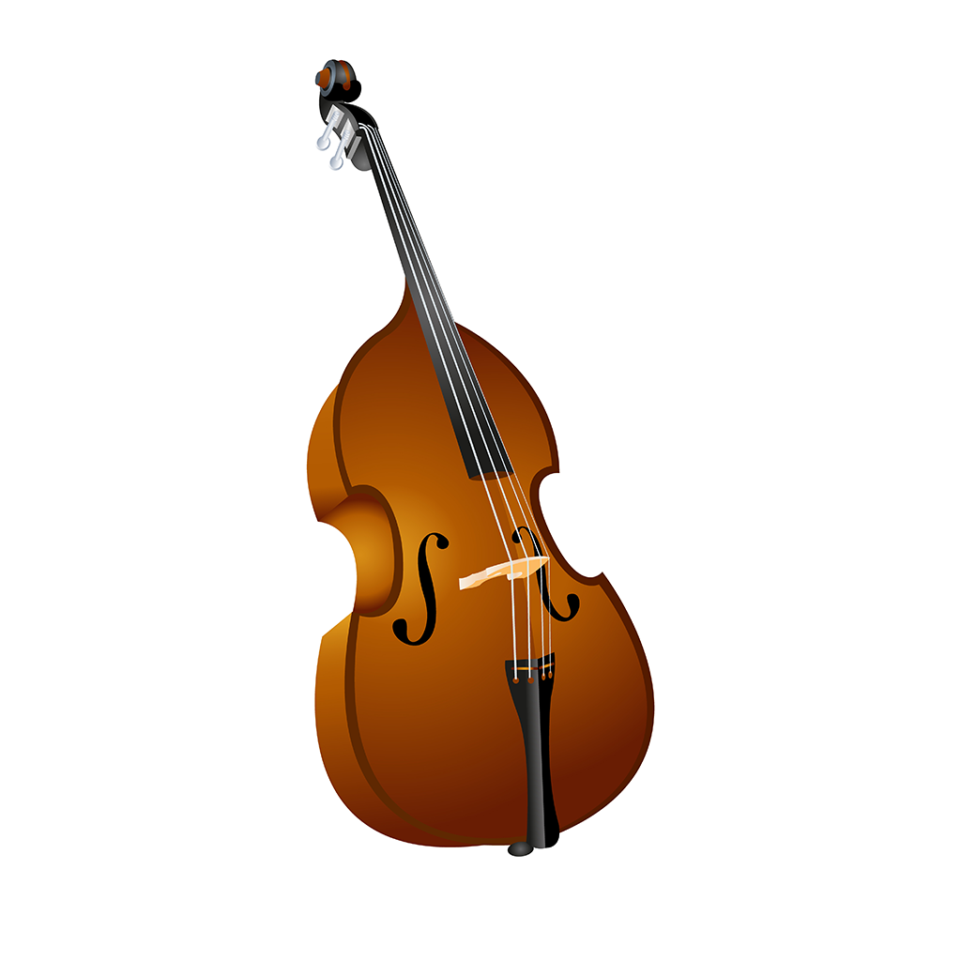
Marche au Supplice Theme 1 - Descending Theme (Bars 17-61)
1st time | 2nd time | 3rd time | 4th time | 5th time
Monophonic G minor Cello + Bass Dynamic change. | Cello + Bass Violas 3rd above Bassoon Countermelody Rising Sequence Dotted rhythm Tonality change Modulates to E♭ major. | Eb major Violins on theme in octaves Countermelody on violas and cellos Polyphonic Sextuplet rhythm timpani. | Repeat of 3rd time Woodwind and horns join Syncopated chords Back to G minor. | Lower strings on theme Upper strings play inversion Contrary motion Pizzicato Melodic minor scale Bassoon Countermelody Polyphonic. Bb major scale

Slide 30
Marche au Supplice Theme 2 - March Theme 1st and 2nd times (Bars 62-77)
Woodwind and brass play theme in B♭ major.
Syncopation and dotted rhythms create a military feel
Homophonic texture
Bassoon and tuba play octave leaps creating a tonic pedal
Strings play fanfare-like chord.

Slide 31
Marche au Supplice Analysis Development Section (Bars 78-139)
Descending Theme (Bars 78-88) | March Theme 3rd + 4th time (Bars 89-104) | Descending Theme (Bars 105-113)
G minor Antiphonal dialogue Staccato sextuplet rhythm on strings Theme split across orchestra Alternating pizzicato and arco techniques on strings. | B♭ major Elaborate string accompaniment Antiphonal dialogue Viola and cello play a triplet arpeggio motif Double basses play a double pedal note Strings play chords. March theme heard a 4th time | Linking bars in G minor Sextuplet rhythm on timpani Dialogue with strings Brass and percussion drop out Pizzicato strings Triplet descending chromatic scale.

Slide 32
Marche au Supplice Analysis Development Section (Bars 78-139)
Descending theme 114 - 122 | Descending theme 123- 139
Trombones and ophicleide Rising sequence Stepwise movement in strings Grace notes Sextuplets on flute, oboe and clarinet Crescendo from bar 115 – 120 Diminution of theme in bar 121 Rising sextuplet chromatic scale. | Full orchestra except for upper strings play theme Chromatic movement in tremolo strings Timpani rolls Cymbal crashes Sudden drop in dynamics Dramatic ff tritone played by whole orchestra Woodwind play inversion of the Descending Theme in D♭ major Staccato octaves on strings Staccato octaves on strings.

Slide 33
Marche au Supplice Coda (Bars 140 – 178)
Begins with strings playing ff dotted rhythm (reminding us of the March theme)
Descending staccato scale on strings
Antiphonal dialogue between wind, and timpani and strings
Use of the tritone
Timpani roll and tremolo on strings
Descending triplet scale in woodwind and strings
Imperfect cadence before the Idée Fixe enters
Idée Fixe on solo clarinet in G major.

Slide 34
Marche au Supplice Coda (Bars 169 – 178)
Dramatic tutti G minor chord played ff – the fall of the guillotine! cuts the idee fixe short after only seven notes
Pizz. notes passed down through the strings
Timpani and snare play roll
Fanfare-like G major chord from woodwind and brass
ff tremolo semibreves from cellos and violas
Ends with an ff G major chord.

Slide 35
Credits
Shutterstock
Alamy

