Slide 2
What is morality?
Throughout life, we all encounter moments where we must decide between two options. This means we could make the right choice or the wrong choice.

Slide 3
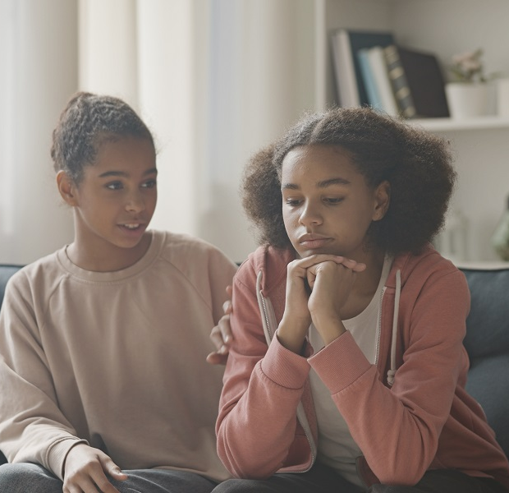
What is morality?
To make this decision, we might reflect on advice given by our parents, friends or teachers.
Being able to identify between good and bad behaviour and making a decision based on this knowledge can be described as morality.

Slide 4
What is morality?
Simply put, morality is making the right choices. There are many ways a person decides on what is moral.
Our conscience is a feeling we have that helps us decide what is right and wrong – it is like a little voice in our heads.
People may have different views on what is moral depending on lessons they have learned in their lives. Their morality can also be influenced by the people around them.

Slide 5
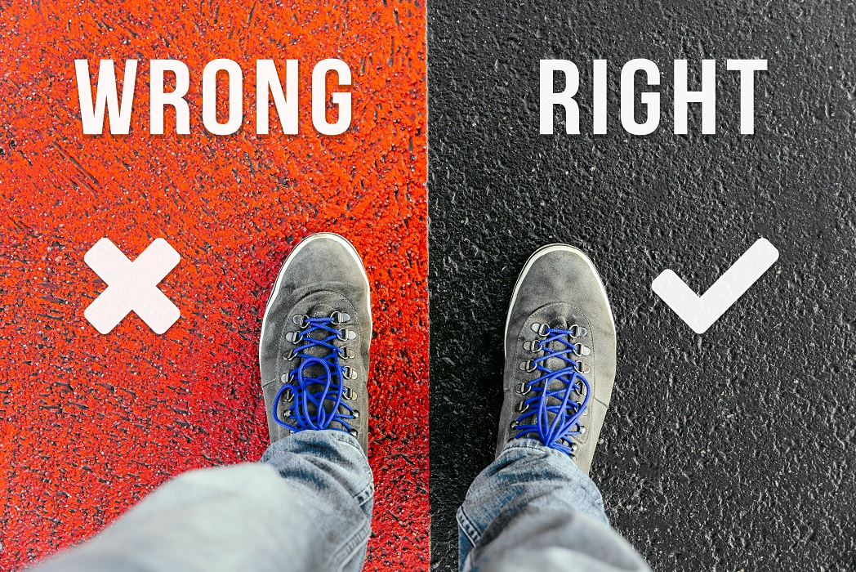
What is morality?
Being moral means making good choices to do the right thing. Ask yourself what is important to you. These values will make up your principles. They will help you to make the right choice.

Slide 6
Sources of morality
Our morality comes from many different sources. These help to shape us into the people we are now and the people we will become.
What are these sources?
Home and family
Peer group/friendship group
School
The State
Religion
Non-religious opinion.

Slide 7
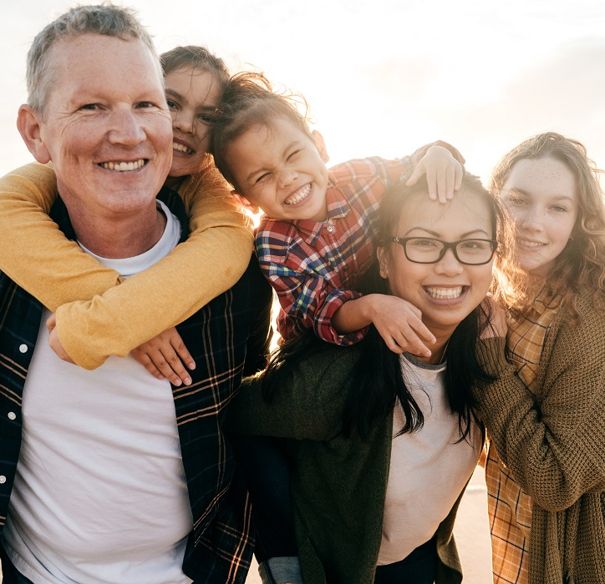
Home and family
Our home and family are two of our most important sources of morality. Our family provides moral standards, education, religious background, love, security, customs and cultures.
If we are taught good values in the home, we will learn to be respectful to others throughout life.
Parents are the main educators of their children. They can instil good values.

Slide 8
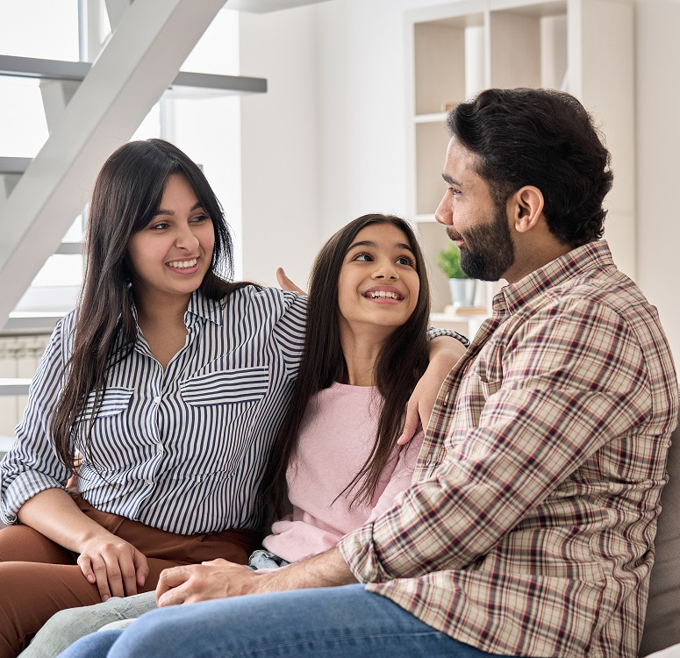
Home and family
Often people will have the same opinion about issues as the rest of their family. This is because they have discussed these topics with those closest to them.
They trust their judgement and learn a lot from each other. It is at home that talents are nurtured and nourished.

Slide 9
Home and family
It is through our family that we learn about ourselves and come to appreciate what is good. Stories are passed from one generation to the next, which helps to form our character.

Slide 10
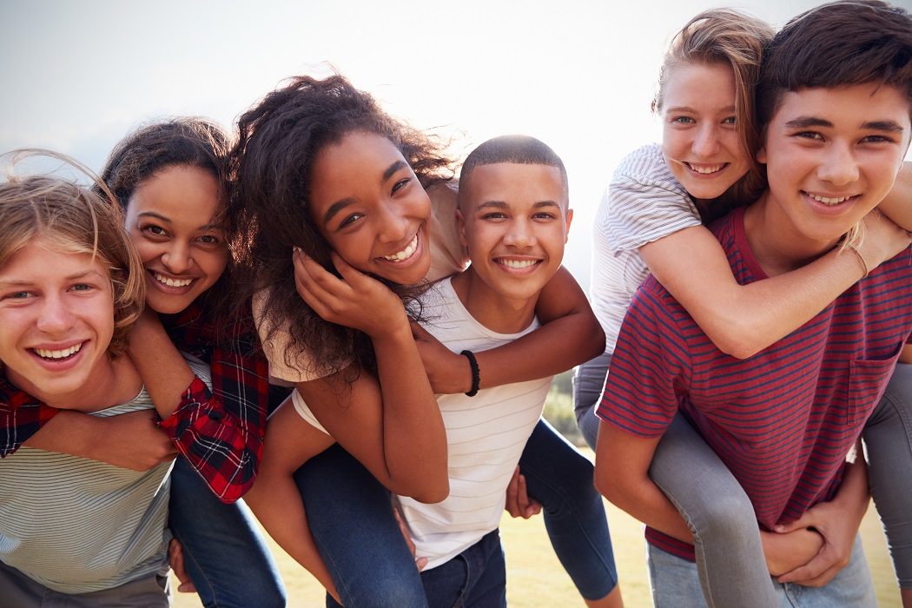
Peer group/friendship group
Our peers are people of the same age.
Friends are important, as they can help us to become better people. Young people grow and develop during adolescence.
Sometimes young people become pressurised into doing things that the friendship group decides.

Slide 11
Peer group/friendship group
Adolescence is a time when you must make decisions for yourself.
Young people spend a lot of time with their friends and talk to them about all sorts of things. They can learn from each other and see things from a different point of view.
Their friends may have had different experiences, so they can teach each other about new issues or change how the group feels about others.

Slide 12
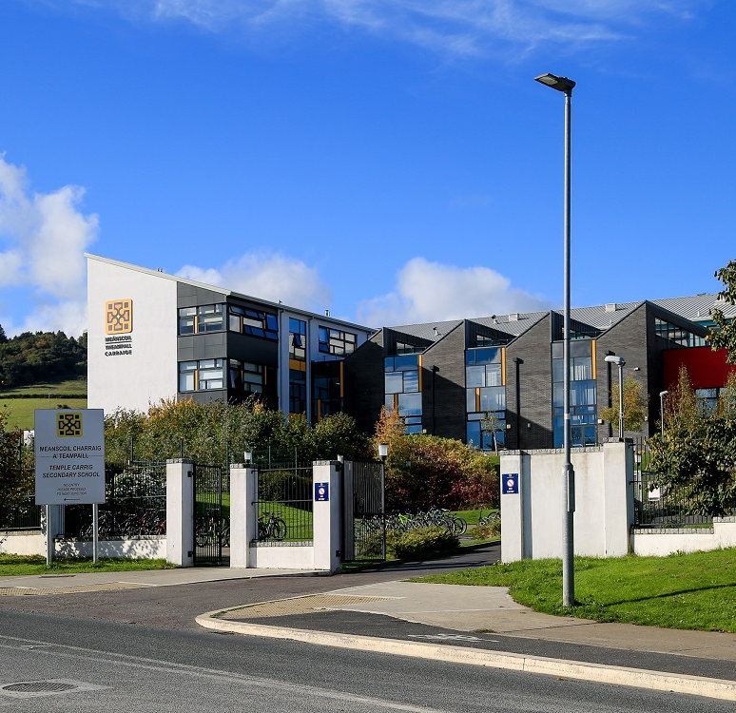
School
A school is a community whose members work together to help and support each other.
This means showing respect for your fellow classmates, your teachers and all who work in the school community.
At school, we can be influenced by other people, or we can be a source of influence for others. This means that school can help to shape the people we become later in life.

Slide 13
School
We learn a lot about important issues in life through subjects such as Religious Education, CSPE and SPHE.
These subjects often deal with issues of morality, such as caring for the environment, overuse of social media, racism and the use of drugs and alcohol.

Slide 14
The State
The State is another source of morality.
Ireland is a democratic state. This means that every few years we elect people to represent us in Dáil Éireann (our parliament).
The elected government makes laws, which everyone must obey. These laws protect us.

Slide 15
Religion
For many people, religion is another important source of morality.
Most world religions have a moral vision, which is the ability to see the difference between right and wrong.
For Christians, the most important ideal is to follow the teachings of Jesus Christ.
Muslims look to the Qur’an for spiritual and moral guidance.

Slide 16
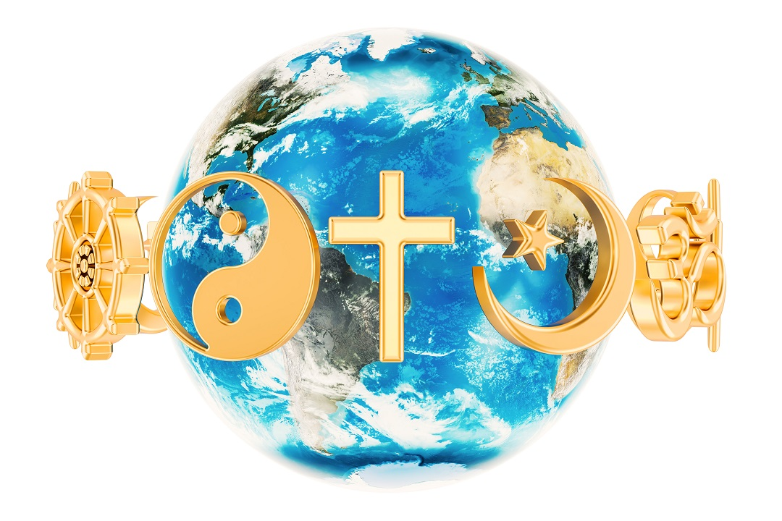
Religion
Jewish people look to the Torah for their spiritual wellbeing.
For Hindus, dharma is the religious and moral law.
In Buddhism, the Four Noble Truths teach the importance of generosity and mutual understanding.

Slide 17
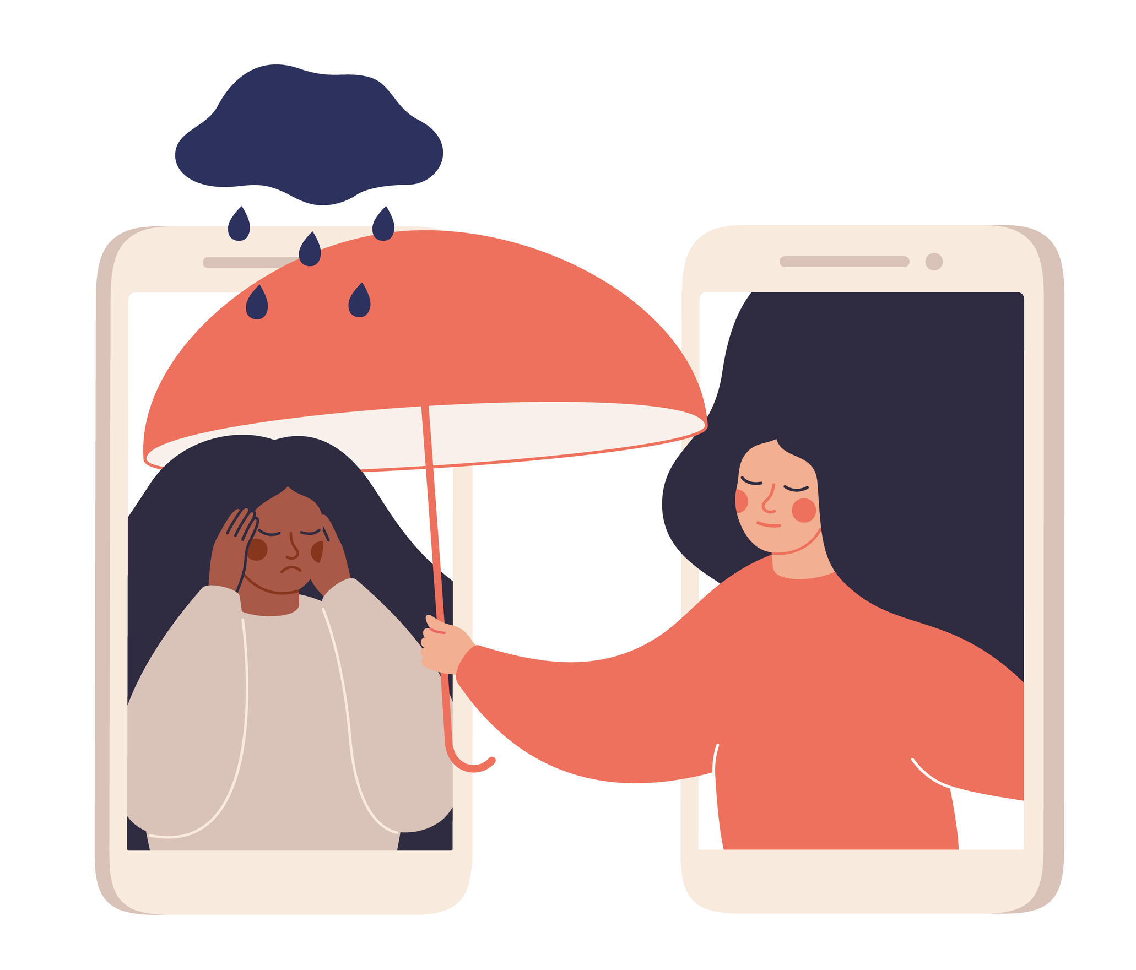
Non-religious opinion
Non-religious understanding of being moral is based on reason, kindness, empathy and understanding.
Empathy is about understanding what another person is going through. It is like holding their hand and walking in their shoes.

Slide 18
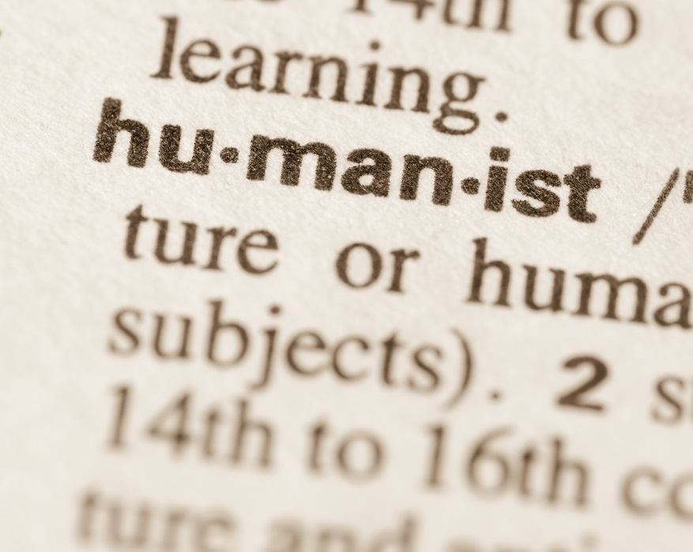
Non-religious opinion
Humanists believe that people do not need any guidance from religious teachings because morality is something people learn from experience.
When we make a mistake, we learn from the experience of this.
It is important to be kind to each other, as each person is as important as the other.

Slide 19
How do we understand and learn about morality?
A person’s sense of right and wrong depends on many things. What one person sees as right or moral, another may see as wrong or immoral.
Every person has a sense of morality, regardless of their age, ethnicity or religious background.
The communities we live in also affect our sense of morality. And our morality affects those in our communities.

Slide 20
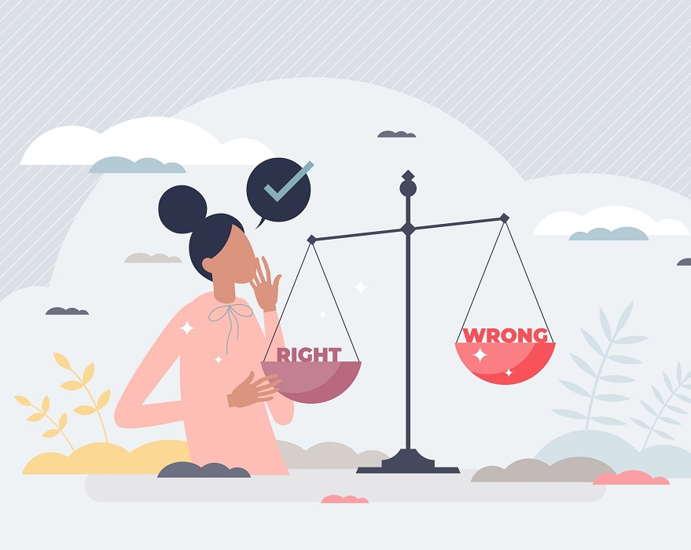
How do we understand and learn about morality?
In this way, we can say that morality is both personal and communal.
When making moral decisions, people must remember that they have different kinds of relationships with others and their decisions can affect them in different ways.
Interpersonal relationships are relationships we have with individuals, such as a parent.

Slide 21
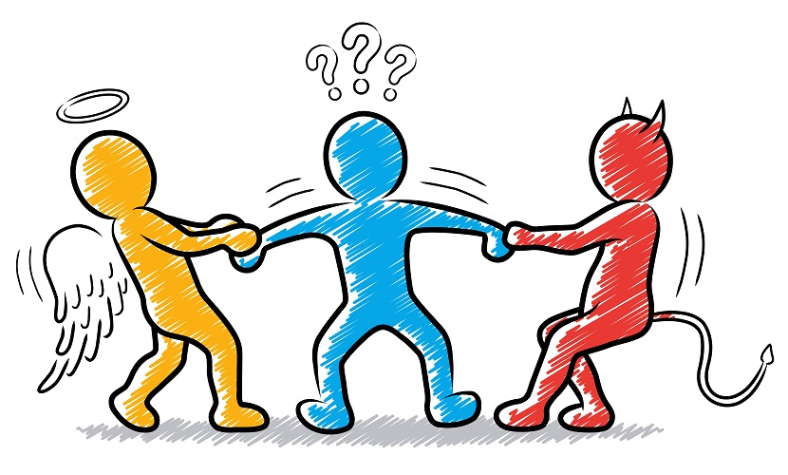
How do we understand and learn about morality?
Communal relationships are relationships we have with a group of people, such as members of a club we belong to.
Even though we may not realise it, we have global relationships with people of different nationalities and religions all over the world.

Slide 22
How do we understand and learn about morality?
We are connected to them simply because we all live on the same planet.
Decisions made by individuals or groups of people can have a global effect, such as countries holding nuclear weapons or policies about caring for the Earth.

Slide 23
Morality and social media
We can learn a lot about moral issues through social media. We can use TikTok, Snapchat, Facebook or Instagram to find out what is happening around us.
The downside to social media is that it can make it easier for people to treat each other badly.
We should try to live by the Golden Rule, shared by all religions: Treat others as you would like to be treated.

Slide 24
Image credits
Shutterstock
Alamy

