Slide 1
Let's Do Business EDCO Webinar
Jayne Lenehan & Julie O'Keeffe
Monday 3rd March

Slide 2
About the authors
Julie O'Keeffe
Jayne Lenehan
Business, Economics, LCVP and Maths teacher in Newbridge College
Over 22 years’ experience teaching Leaving Certificate Business.
An active member of the BSTAI, serving as secretary and chairperson of the Kildare branch for many years.
Currently serving as Conference Treasurer on the BSTAI National Executive
Business, LCVP and French teacher in Newbridge College
Over 16 years’ experience teaching Leaving Certificate Business.
Has worked with the State Examinations Commission
Active member of the BSTAI, having presented with Julie on several occasions

Slide 3
Webinar Plan!
Key Competencies
Cross Cutting themes
What's in! What's out!
Breakdown of strands
Unifying Strand
Investigative Study
Sample lesson
Student Activity Book
Teachers Resource Book
Notes:
JLE

Slide 4
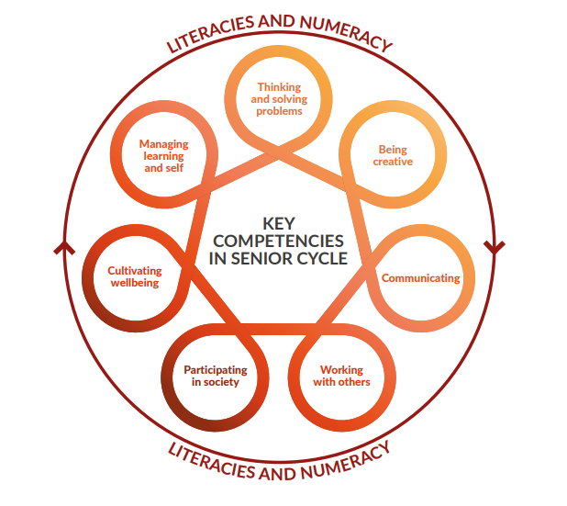
Key Competencies
Refers to the KNOWLEDGE, SKILLS, VALUES + DISPOSITIONS that students learn as they go through the course
Clear emphasis on these throughout the TB and the SAB in the form of activities and research methodologies.
Students learning in senior cycle is expected to take two forms; their learning within all of their subjects and modules and learning that takes place across all of their subjects.
The learning that takes place across all subjects is characterised as key competencies.
Notes:
JOK

Slide 5
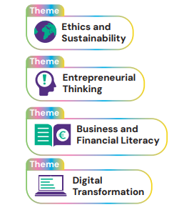
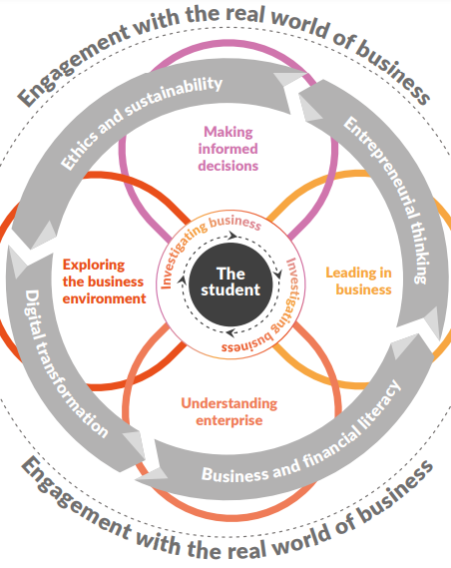
Cross Cutting themes
Clearly identifiable throughout the book using these icons.
All about exploring the dynamic world of business.
Ethics & Sustainability: Businesses must act ethically and sustainably, ensuring transparency and responsible engagement with customers, employees, communities, and the environment.
Entrepreneurial Thinking: Developing an entrepreneurial mindset helps students spot opportunities, manage risks, adapt to change, and drive innovation for personal and business growth.
Business & Financial Literacy: Understanding business and finance empowers individuals to make informed decisions, supporting lifelong learning and responsible financial choices.
Digital Transformation: Advances in technology, such as AI and big data, are reshaping business operations, customer interactions, and decision-making, requiring businesses to embrace innovation while managing challenges.
Notes:
JLE – JOK

Slide 6
4 Strands - new material in each of the strands
Exploring the Business Environment
Understanding Enterprise
Leading in Business
Being Informed & Making Informed decisions
Content similar to elements of Unit 1,6+7
Content similar to elements of Unit 2,5+6
Content similar to elements of Unit 3,4+5
Content similar to elements of Unit 1
Notes:
JLE

Slide 7
Unifying Strand
What is it?
This learning covers all four strands and shows how to work with information and data to make informed conclusions, decisions, and recommendations.
This Unifying Strand is designed to inspire an entrepreneurial mindset, encouraging students, to think like an entrepreneur, to be innovative and creative, to maximise opportunities, to analyse risk, to develop resilience and to adapt to change.
Completed in the form of reports , letters, charts, diagrams, articles from newspapers, graphs etc.
Notes:
JOK

Slide 8
Developing questions to research
Managing Information
Project Planning
Analysing and Evaluating Information
Presenting Findings & Perspectives
Acknowledging Sources
Notes:
JOK

Slide 9
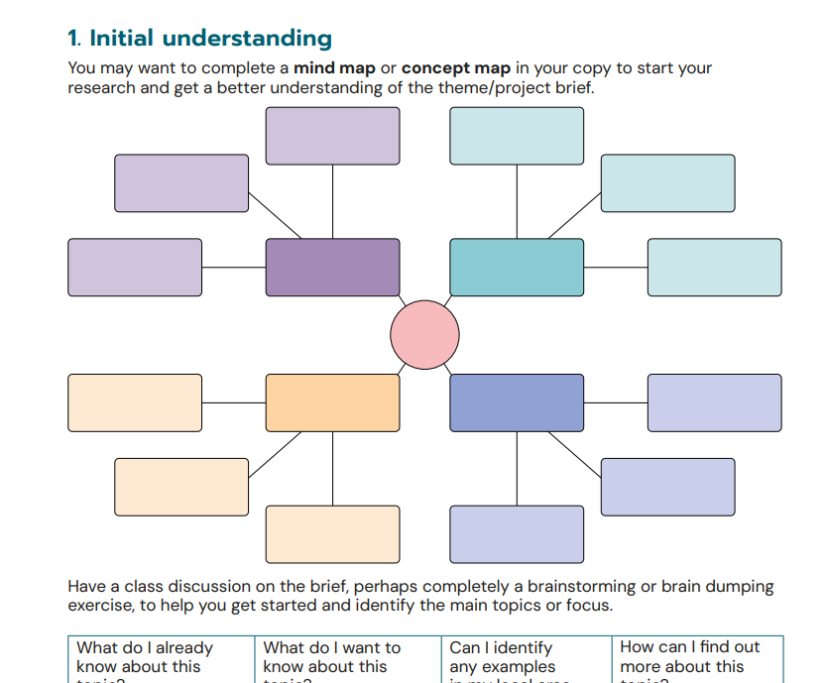
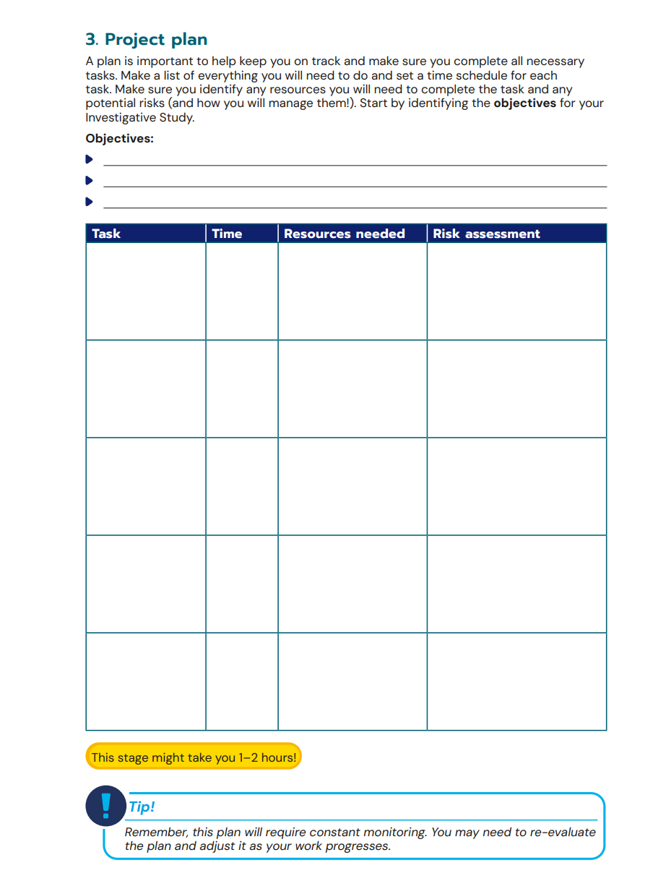
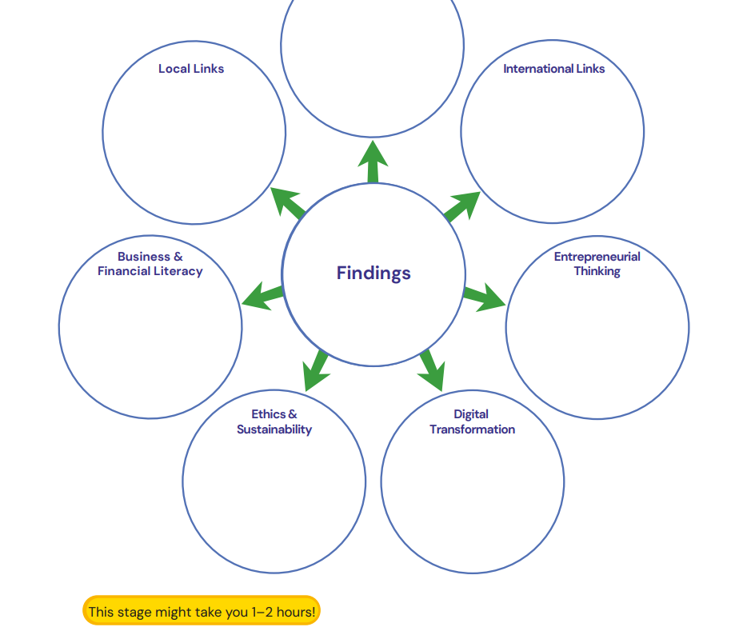
Investigative Study
Mindmap / concept map to start the brainstorming process
The Business Alive Investigative Study is an additional assessment worth 40% of a student's final grade in Senior Cycle Business. It allows students to RESEARCH, ANALYSE, and EVALUATE a business topic using different sources of information.
Students will:
Plan and manage their study, tracking progress.
Investigate a business topic and apply skills learned.
Incorporate key business themes from the curriculum.
Draw conclusions and make recommendations based on research.
Present their findings effectively.
Plannning template provided
Suggested timelines given for each stage
Notes:
JOK

Slide 10
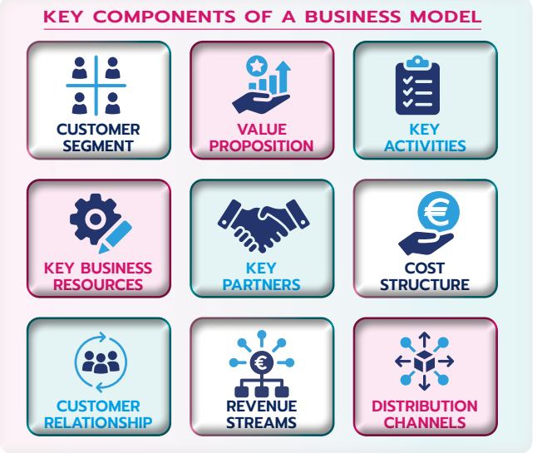
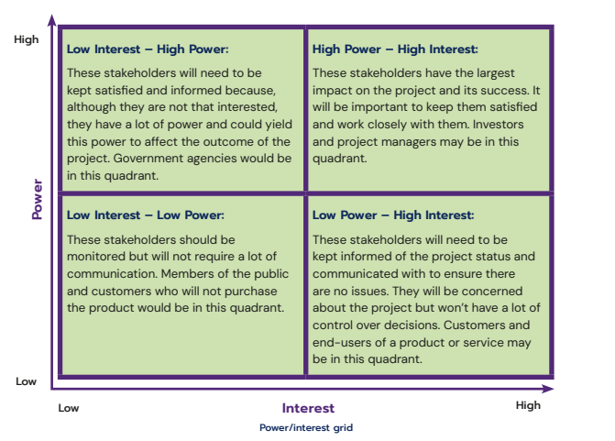
What's in v What's out!
What's in! | What's out!
Government Policies | Calculations
Business Governance and ESG Reporting | Mgmt Activities – Organising + Controlling
Stakeholder Mapping | Breakeven
Design Thinking | Categories of Industry
Business Models | European Policies
Business Model Canvas | Global Marketing
Emphasis on Digital Technology
Notes:
JLE

Slide 11
Strand 1
What’s familiar… | What’s new…
Stakeholders | Stakeholder mapping
Forms of Business | Business regulation & governance ESG reports
Economic indicators | Value of the business economy in Ireland
European Union (main bodies/directives, directives & opinions) | National policy
International Trade (BOP & BOT incl) | Globalisation & FDI (incl. role of technology)
 | APPLYING MY LEARNING
Notes:
JLE

Slide 12
Strand 2
What’s familiar… | What’s new…
Enterprise | Role of government
Idea development | Design thinking
Business planning | Business models. Ethics & sustainability in planning Business model canvas. Technology driven business models
Target market & Marketing | 7P’s. USP analysis. Evaluating & improving marketing mix
 | Power Interest Grid. STEEPLE analysis
Cashflow | Operational model (Key costs & revenues)
Growth, development & expansion | Porters Five Forces. Cost-Benefit Analysis
Insurance as a risk management strategy | Risk Management APPLYING MY LEARNING
Notes:
JLE

Slide 13
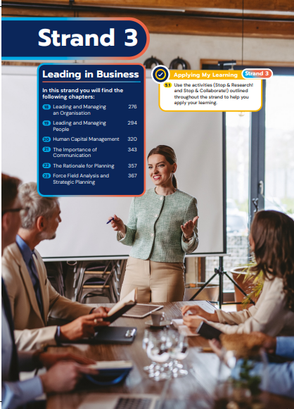
Strand 3
What’s familiar… | What’s new…
Leadership | Organisational culture
Management | Workplace conflict & resolution
Workforce planning. Recruitment | Ethics & sustainability. Digital transformation.
Motivation | Employee appraisal
Human Capital Management | Teamwork & collaboration. Remote working. Corporate wellness
Communication
Rational for planning. Strategic & contingency planning. | Resistance to change & overcoming it. Force Field Analysis.
 | APPLYING MY LEARNING
Notes:
JOK

Slide 14
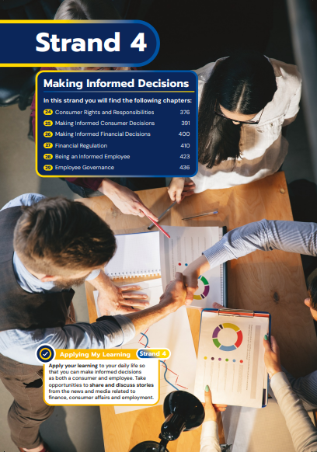
Strand 4
What’s familiar…. | What’s new…
Consumer Legislation | Ethics & sustainability. Shadow economy. Circular economy. Impact of technology
European data regulation | Understand & discuss consumer related stories.
 | Saving, borrowing, investing.
 | Risk Tolerance, Fintech. Central Bank Digital Currency. Financial fraud.
 | Understand & discuss finance related stories
Employment Legislation | Gig-based economy.
 | Impact of annual budget
 | Understand & discuss workplace related stories
Notes:
JOK

Slide 15
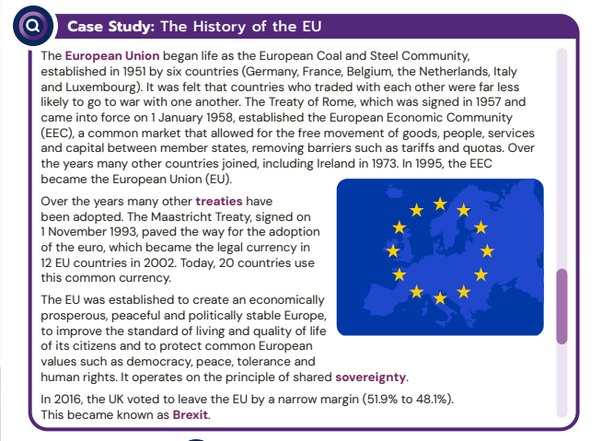
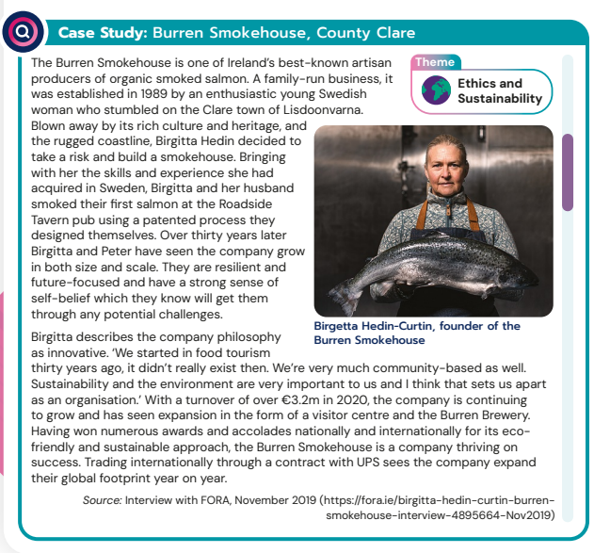
Case Studies
Over 40 case studies throughout the book - local, national and international examples.
Companies vary from Donegal to Cork, Tipperary to Kildare.
Topical for LC students - links drawn to Cros Cutting themes.
Embedded throughout the book and not just at the start.
Stimulate learning, allows for development of key competencies.
Notes:
JLE

Slide 16
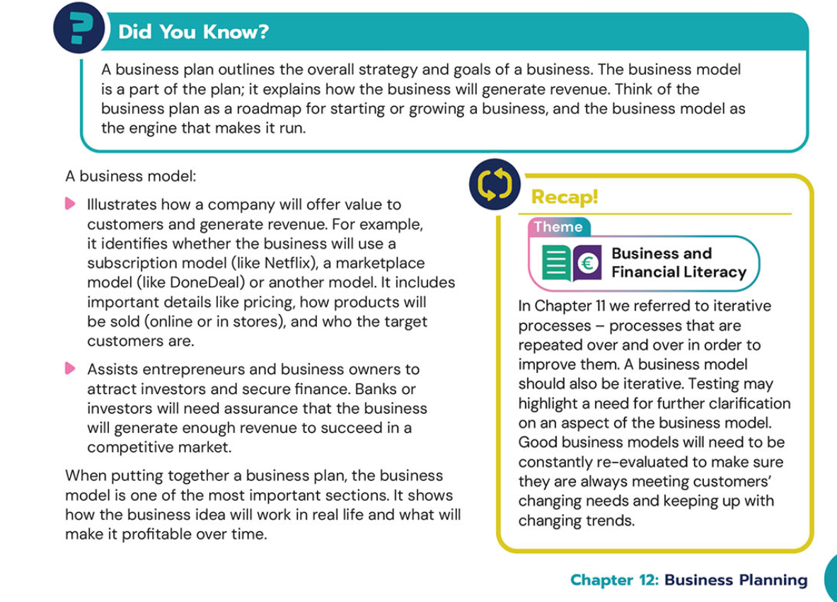
Sample Lesson – Business Model Canvas!
Note the references to the Cross Cutting themes – visual logos
Use the examples generated in this STOP & RESEARCH! activity to generate further class discussion. Make sure to have LOCAL examples too
Notes:
JOK

Slide 17
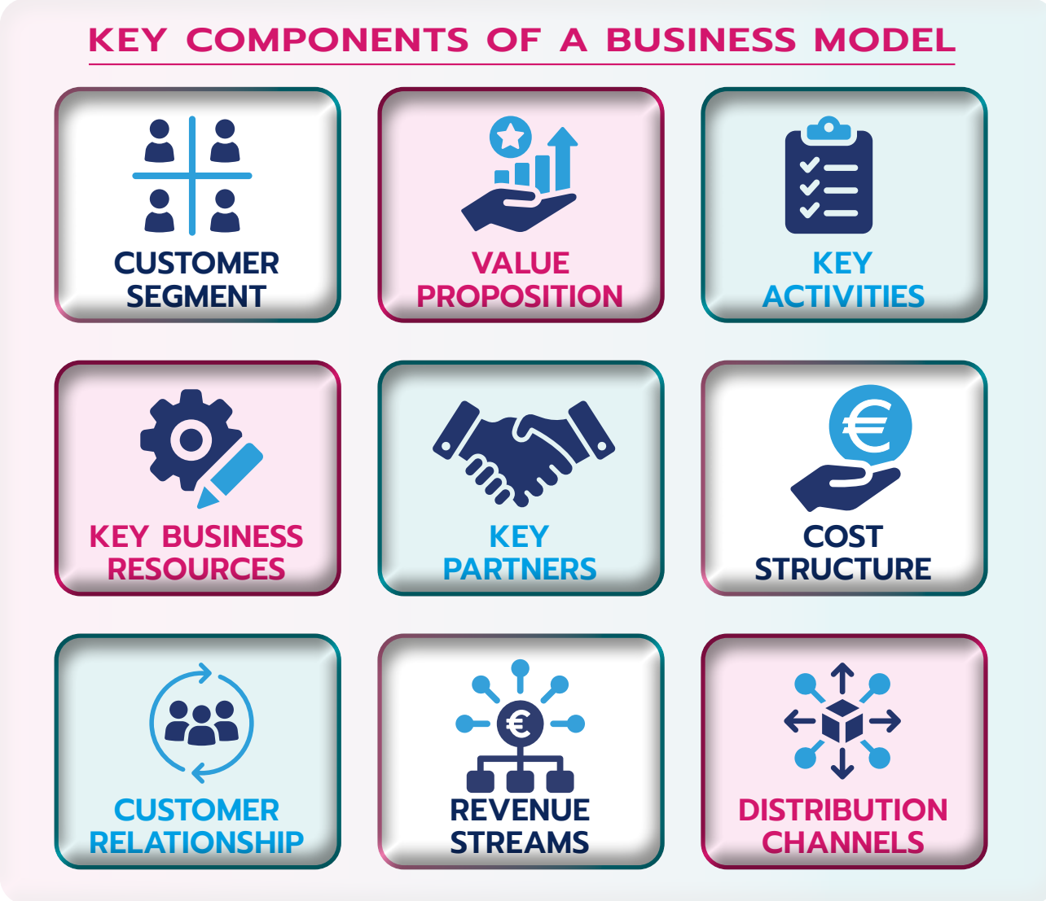
Clear graphic will help students to work through the theory that follows.
Simpflying theory as go through each part of the chapter
Clear , well presented content. Allows for easy navigation through the material. Ideal opportunity for a TPS – Think Pair Share activity
Notes:
JOK

Slide 18
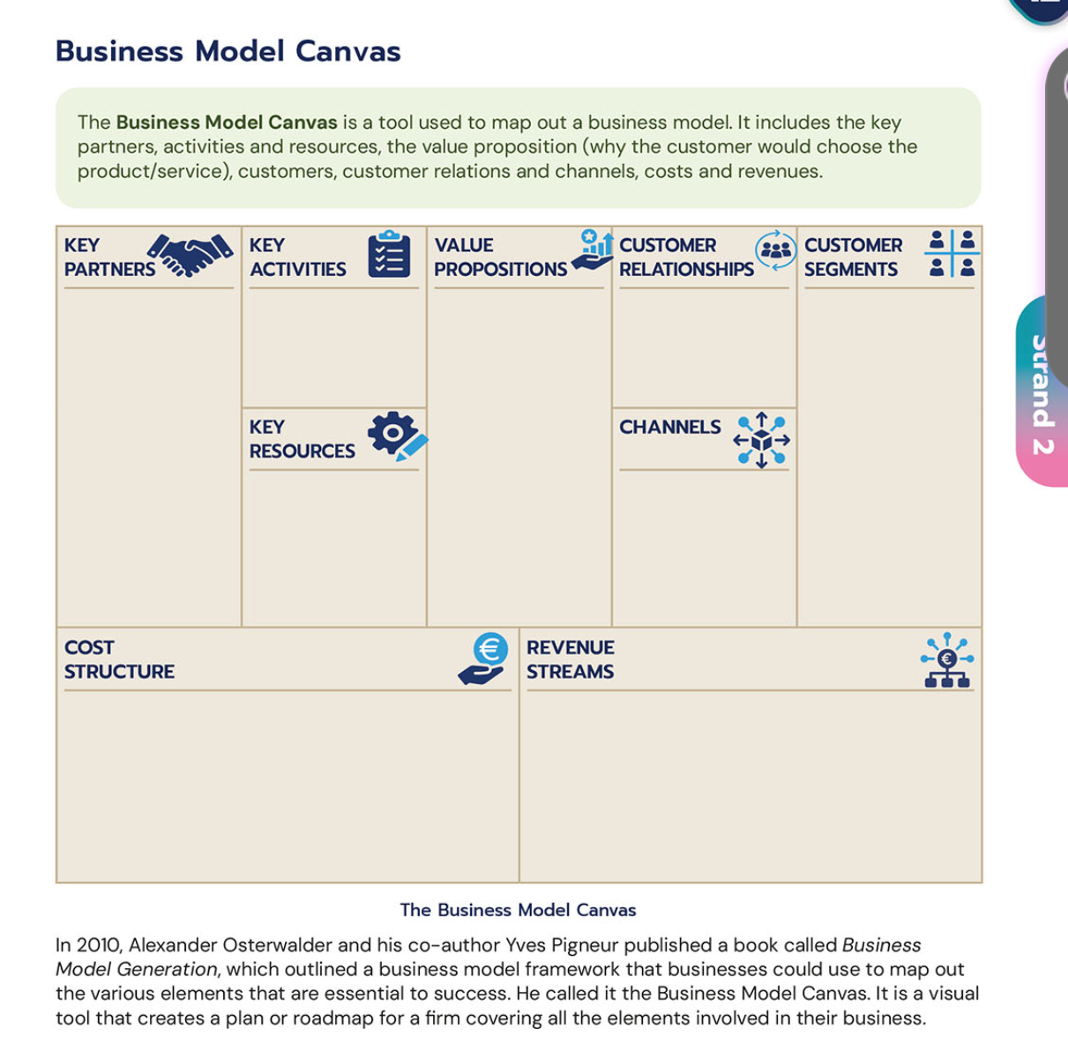
Clear identifiable definition to begin with.
Student friendly language (any difficult terms simplified for students)
Blank business model canvas with headings,
Won't overwhelm students, start small and build knowledge with them.
Further explanation of the topic/ scaffolded for stronger students.
Notes:
JLE

Slide 19
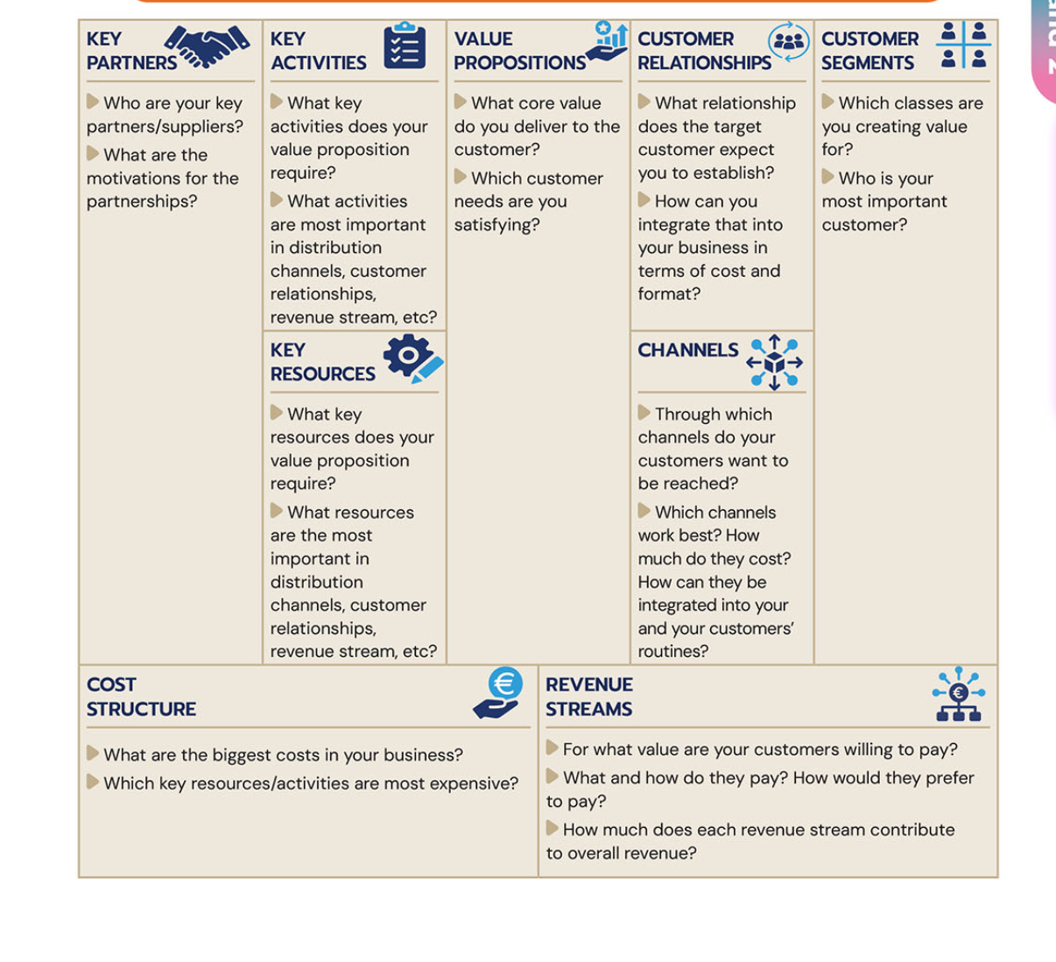
Video to cement explanation of term – differentiated & appeals to all learning styles
Building on knowledge – Each key heading explained with sample questions which will aid completing a business model canvas
Notes:
JLE

Slide 20
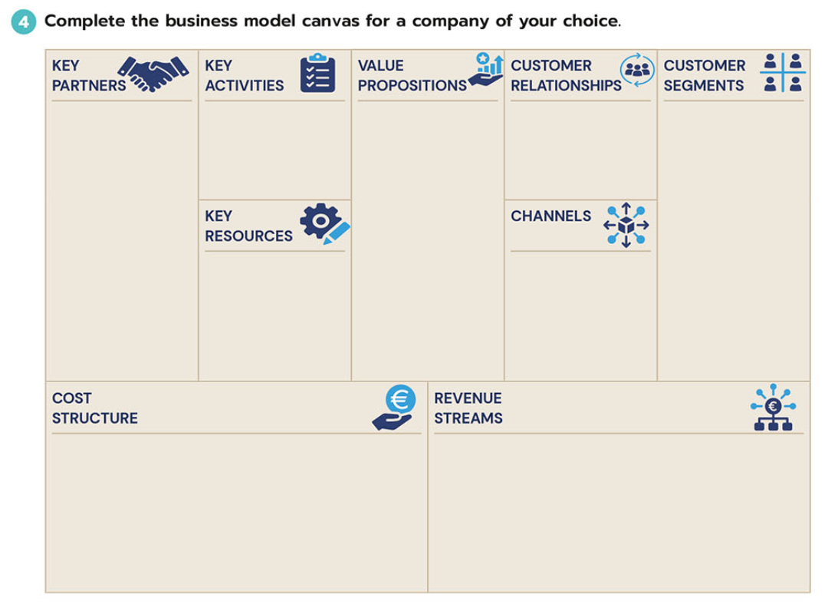
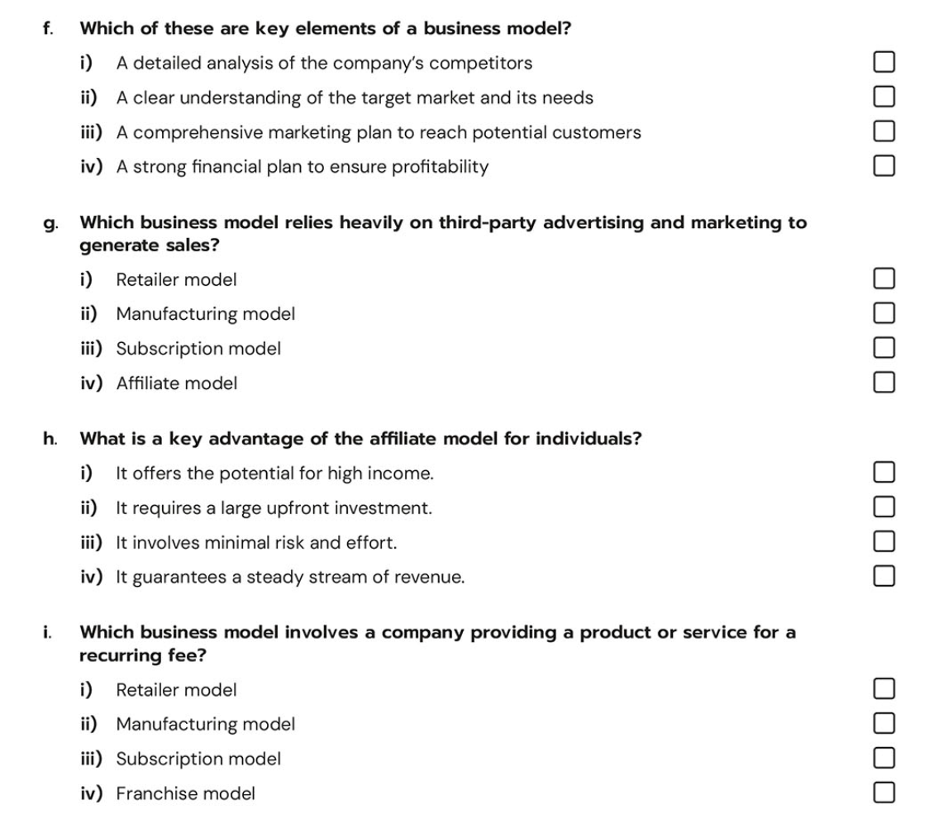
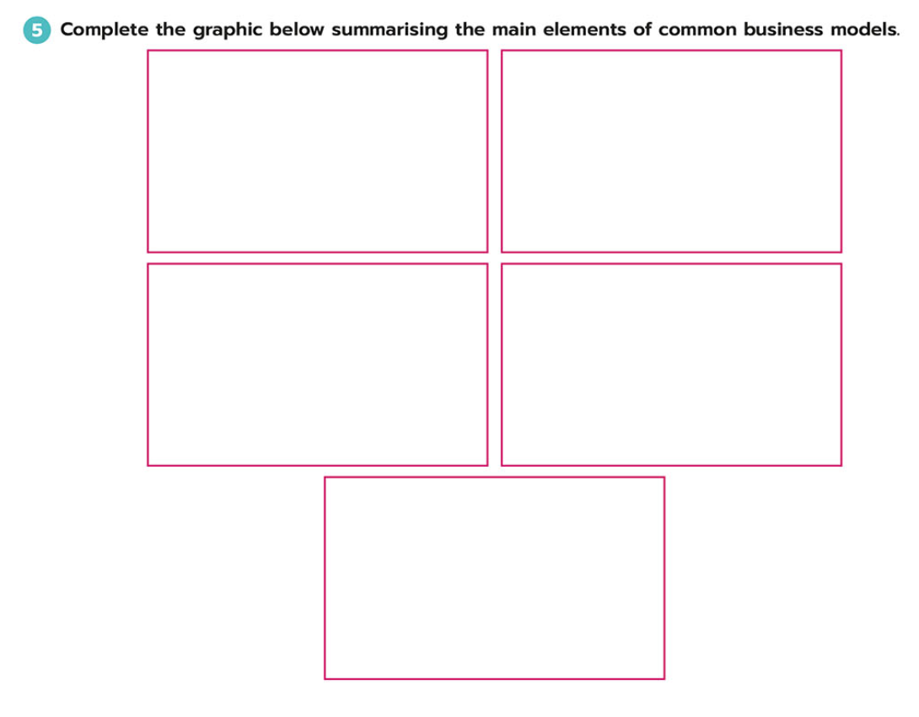
One Stop Shop!
Student Activity Book: Corresponding Activities
Activities to reinforce learning
Range of activities for different learning styles
Sample of blank business model canvas to complete, multiple choice questions at the start to aid recall of information, graphic organiser to summarise learning.
Notes:
JOK

Slide 21
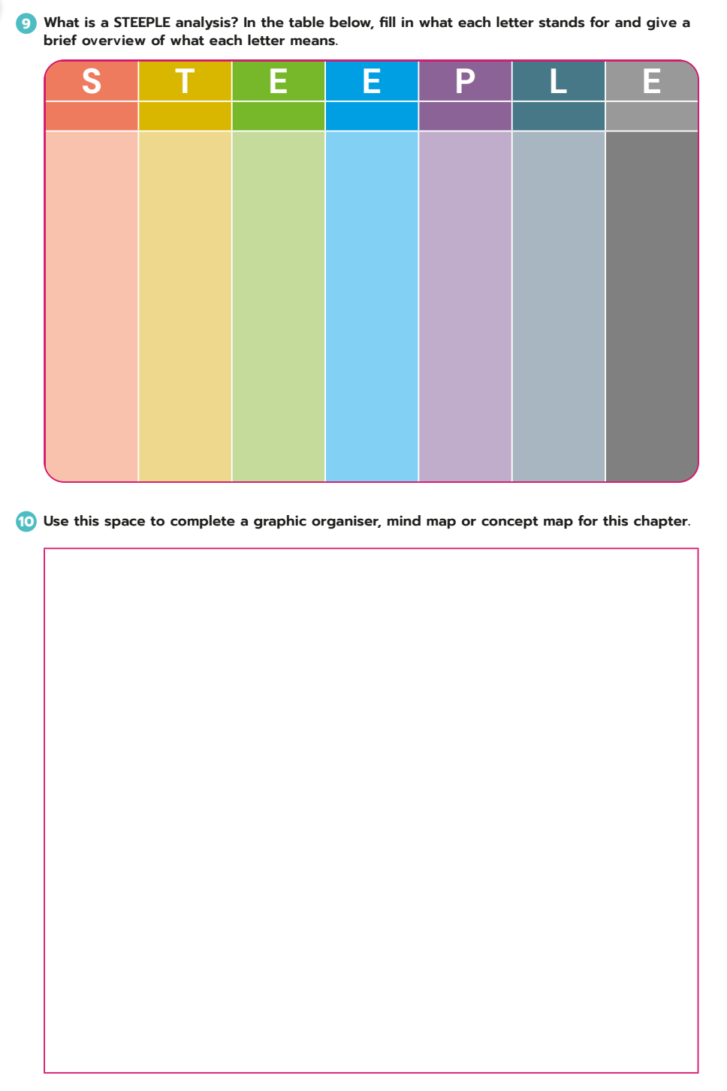
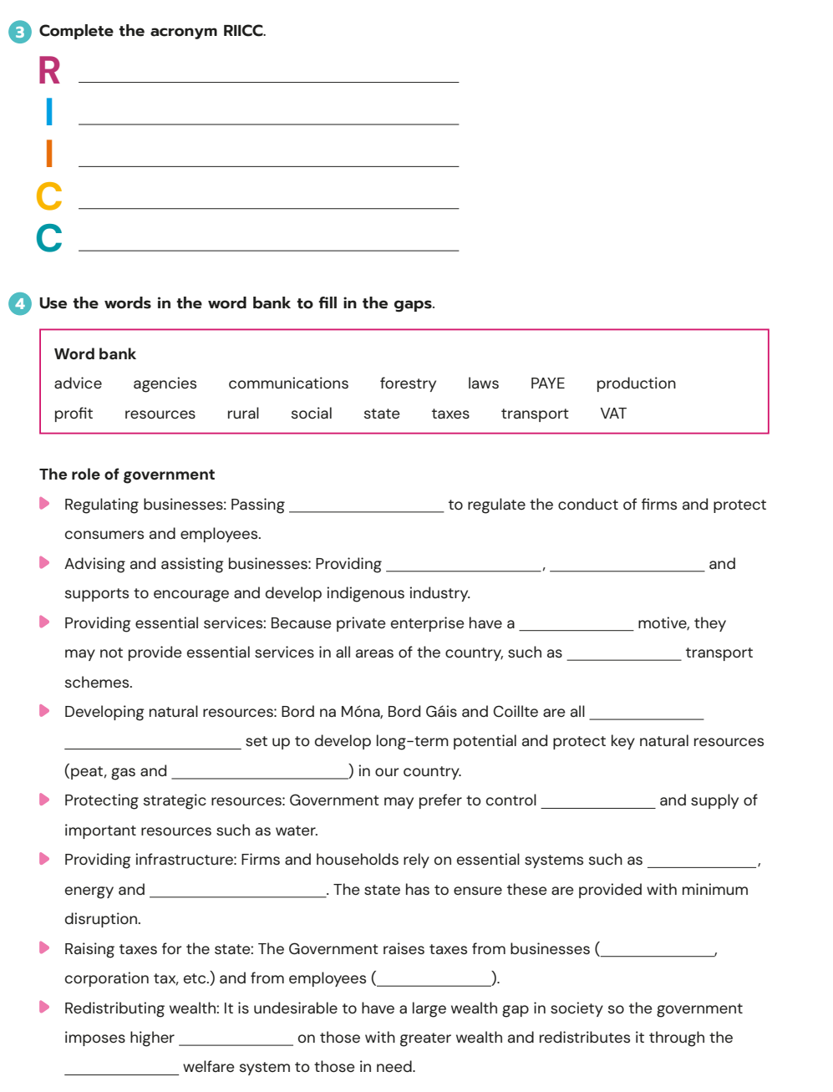
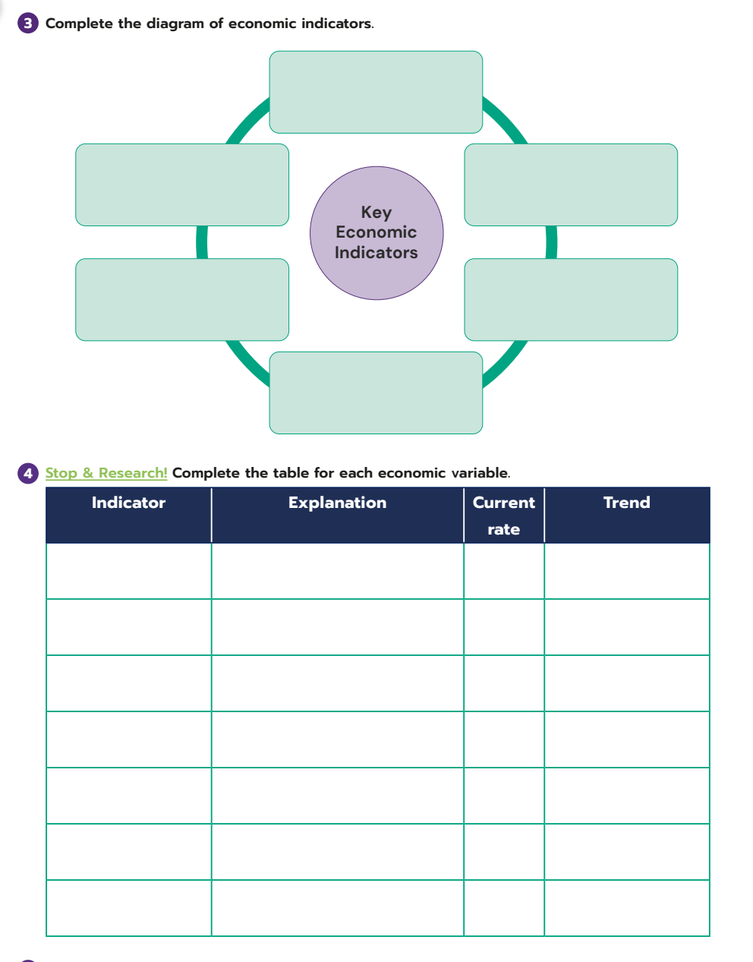
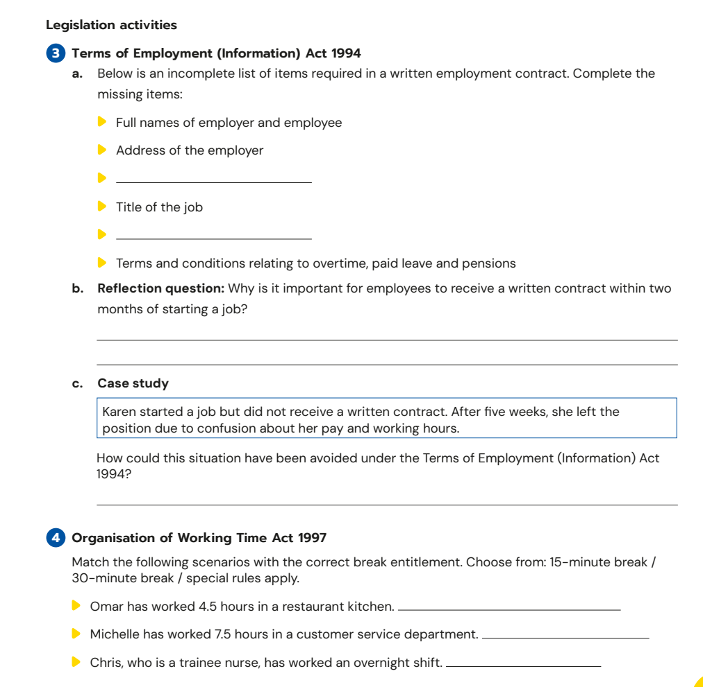
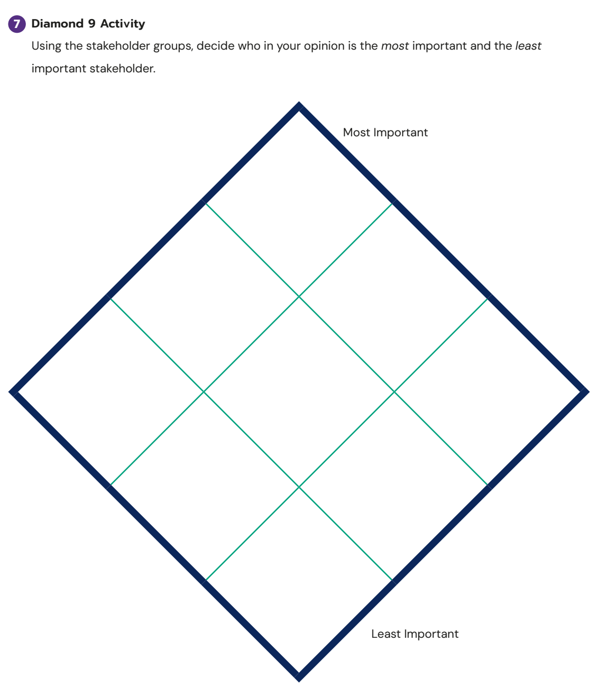
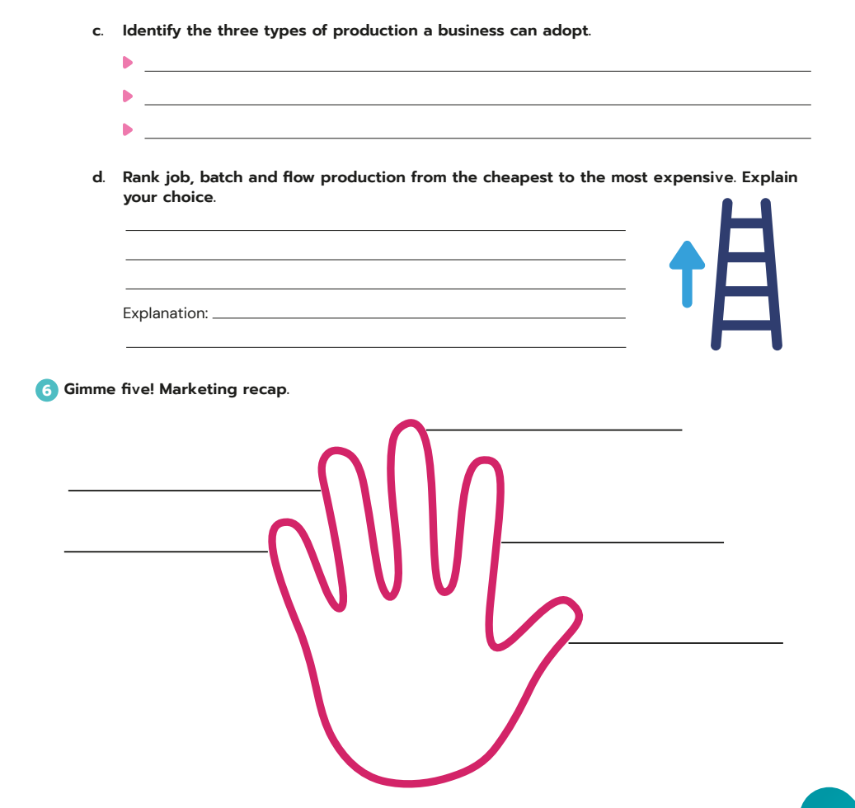
Student Activity Book
Broad range of activities, including
Multiple Choice Questions at the start of every chapter
Short questions
Matchup
Cloze texts [wordbanks provided]
Wordsearches
Diamond 9
Mindmapping
Ladder diagrams
Acronym completion
Learning traingle
Video Worksheets
And more!!!
Notes:
JLE

Slide 22
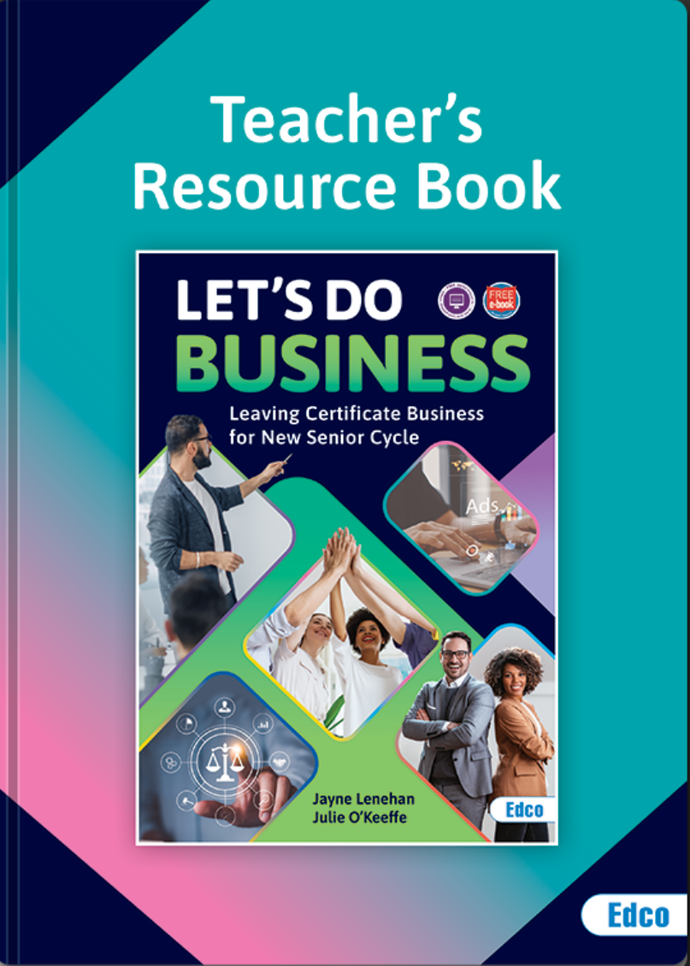
Teachers Resource Book
We have created this Teacher’s Resource Book to help you navigate through the new Leaving Certificate Business course.
Accompanies the Let’s Do Business textbook, Student’s Activity Book and Investigative Study Guide
Digital Resources
Solutions
Additional Activities
Planning materials
Comprehensive guide and sample answers on how to approach LC questions.
Notes:
JLE

Slide 23
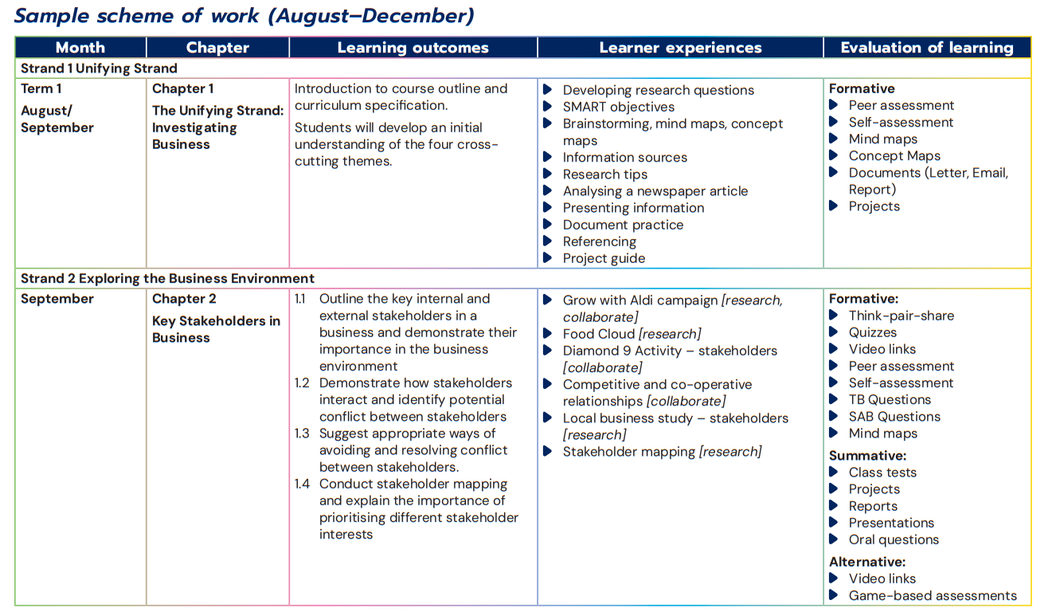
Sample Planning Doc
Evaluation broken down in formative / summative / alternative.
L.O's clearly outlined for teachers.
Learner Experiences: Quick and easy to see how the students will engage with the learning

Slide 24
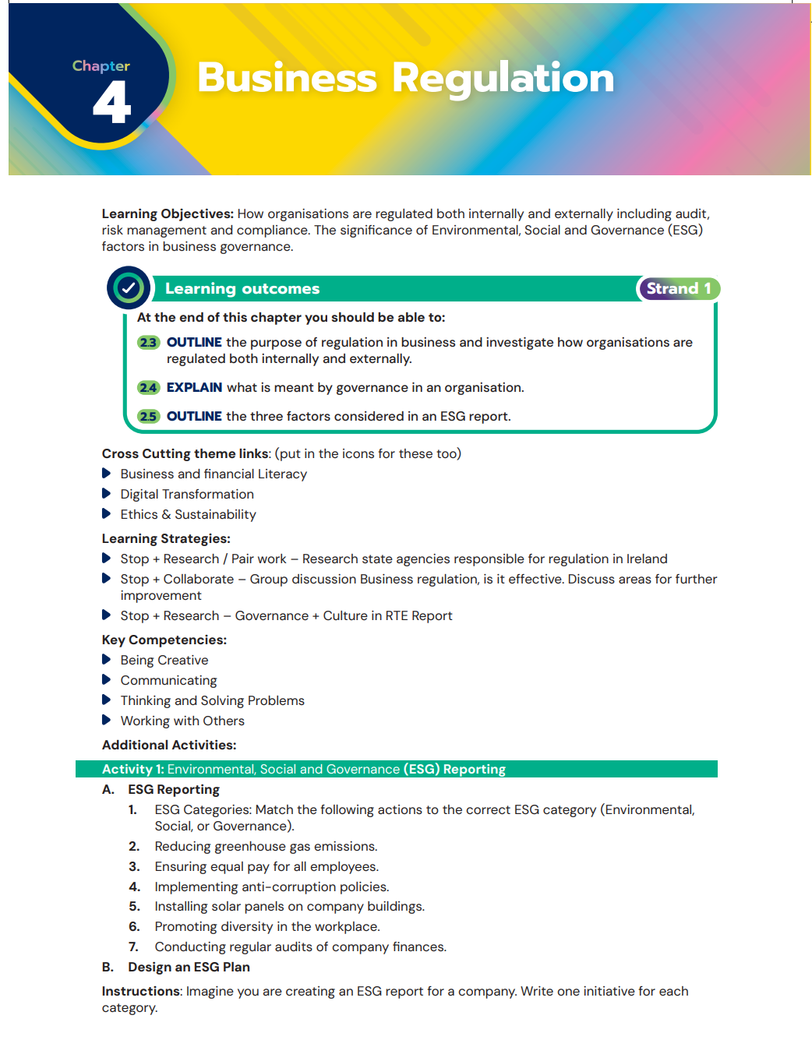
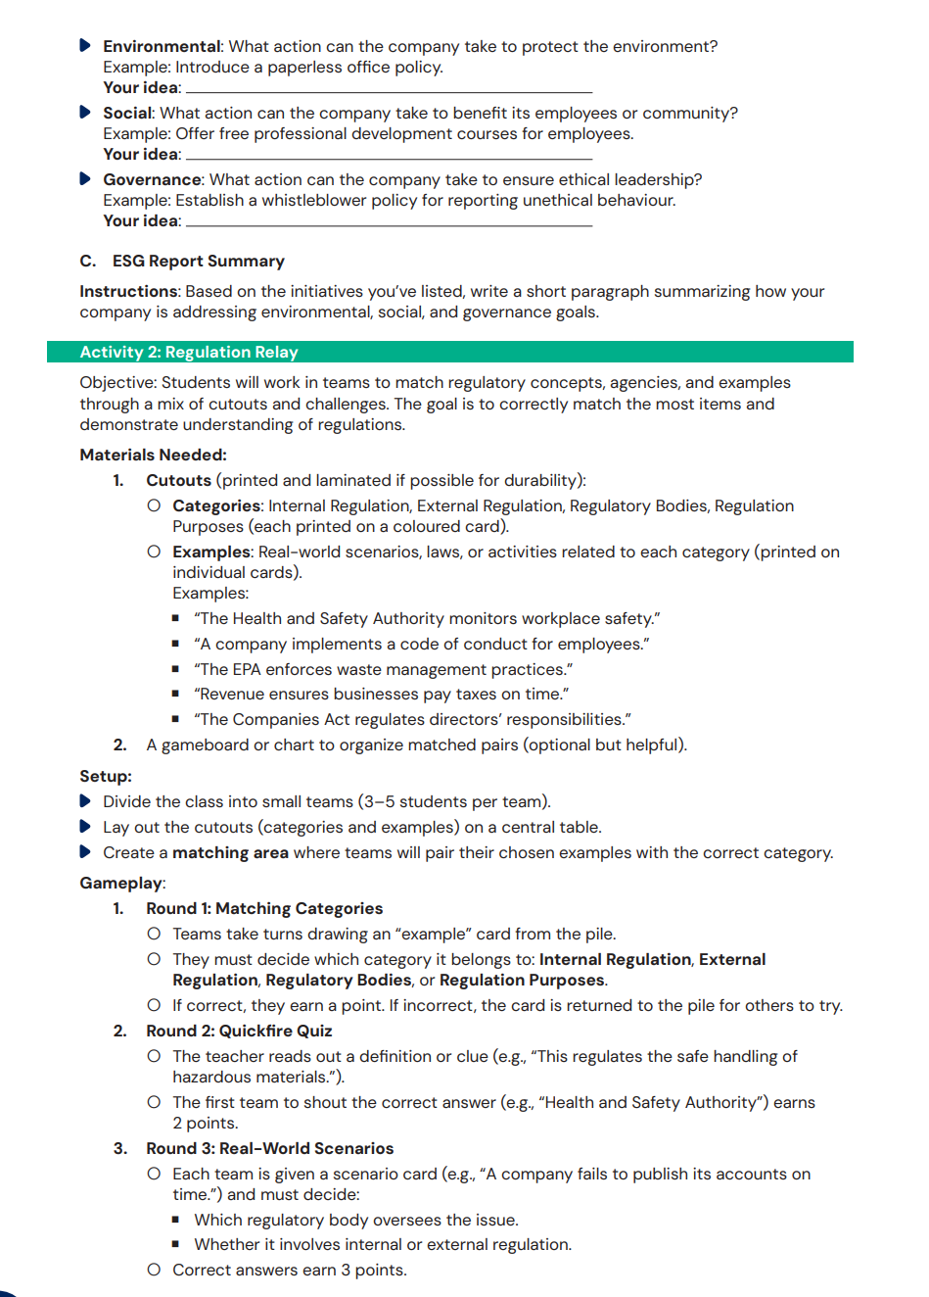
Layout of each chapter with additional activities.

Slide 26
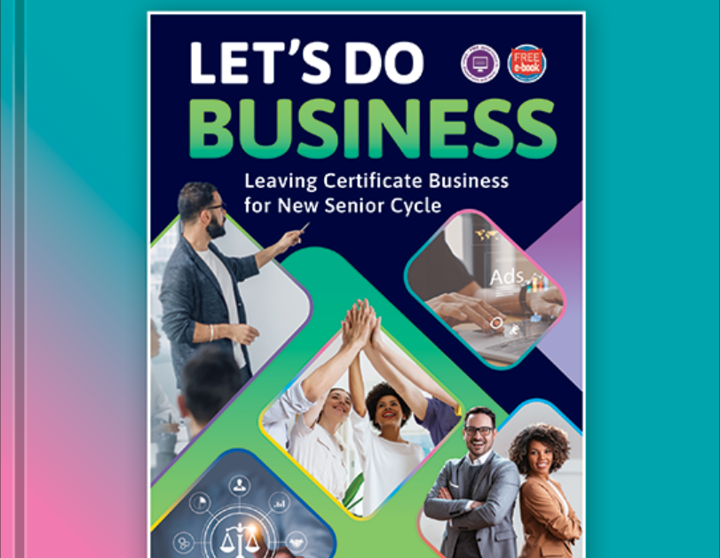
Thank you for listening!
We welcome any questions you may have!

