Slide 1
Exam Tips for Junior Cycle Religious Education

Slide 2
Niamh Mc Dermott and Lori Whelan
Authors of a very successful “Reflections” Textbook
Combined 58 years of teaching in the classroom

Slide 3
We are all in the same boat awaiting the JC RE
exam of 2025.
We have found that our students make the same mistakes when it comes to approaching exam questions. This is what we are here for.

Slide 4
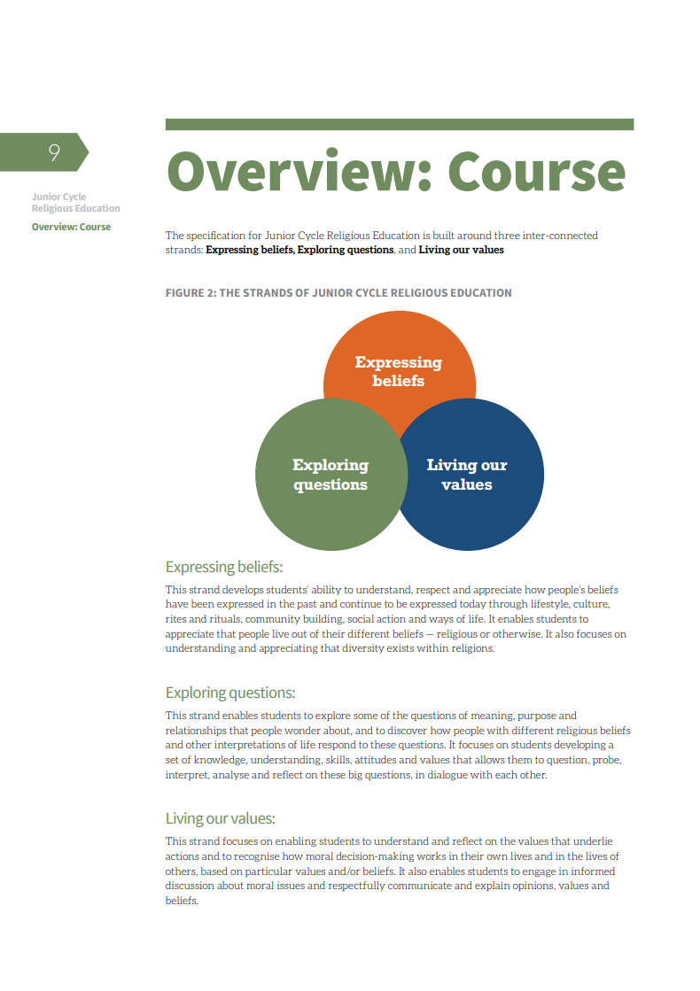
Know your Specification

Slide 5
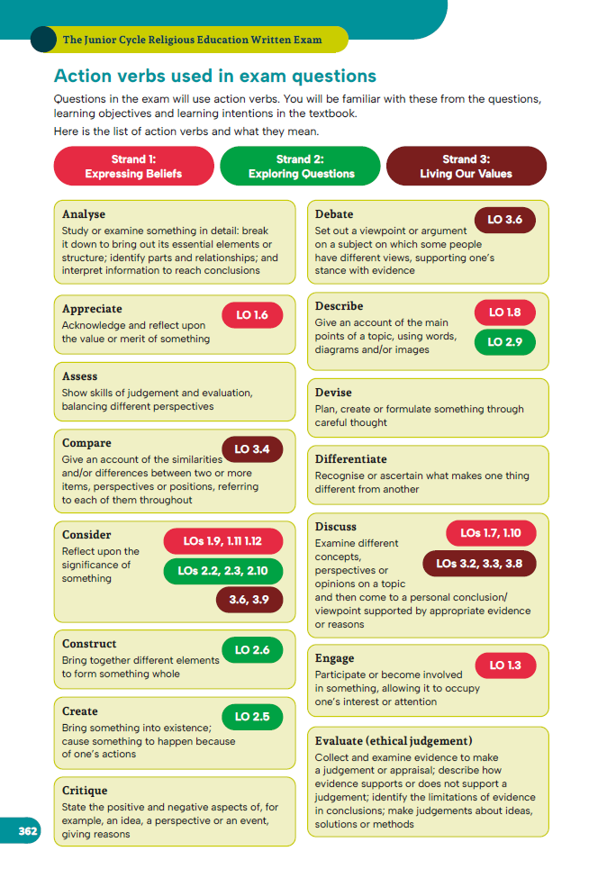
Action Verbs are important to RE
For example, the word DESCRIBE was used 10 times in 2024 exam paper.

Slide 6
Know the structure of the Exam.
How many Questions?
Are some questions longer than other questions?

Slide 7
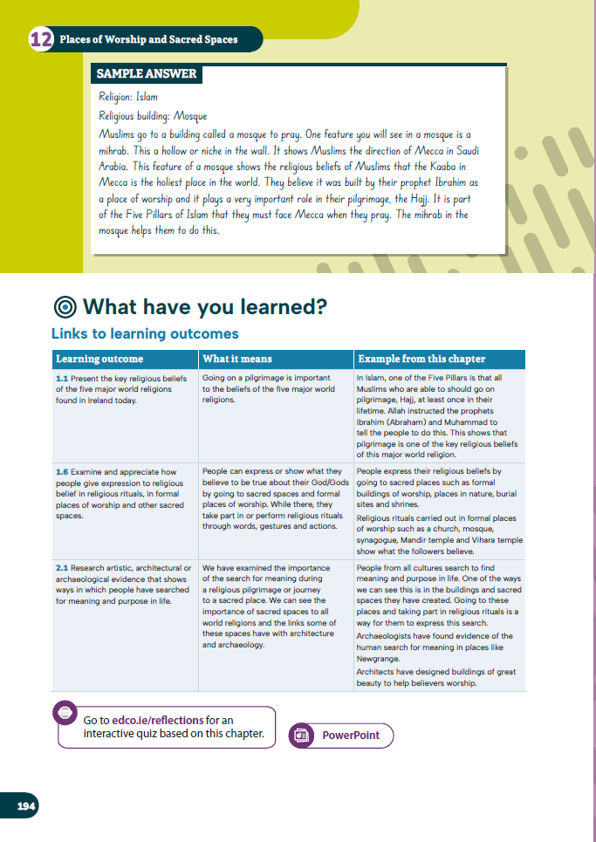
Get them to count the sentences they wrote, not the lines they filled.

Slide 8
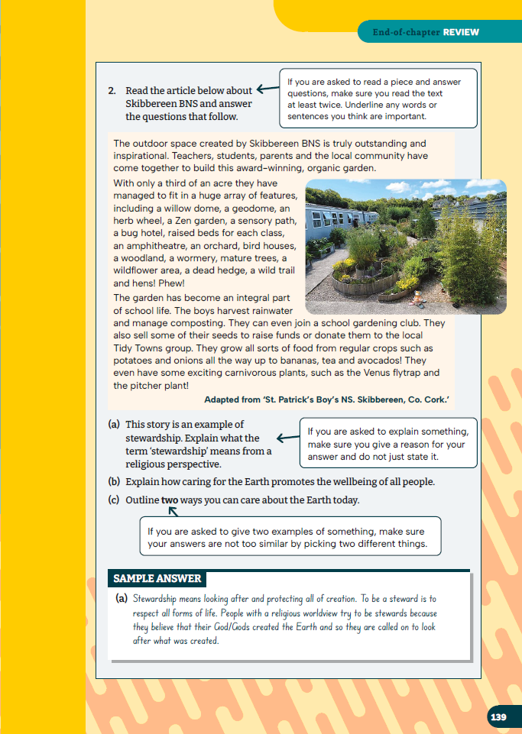
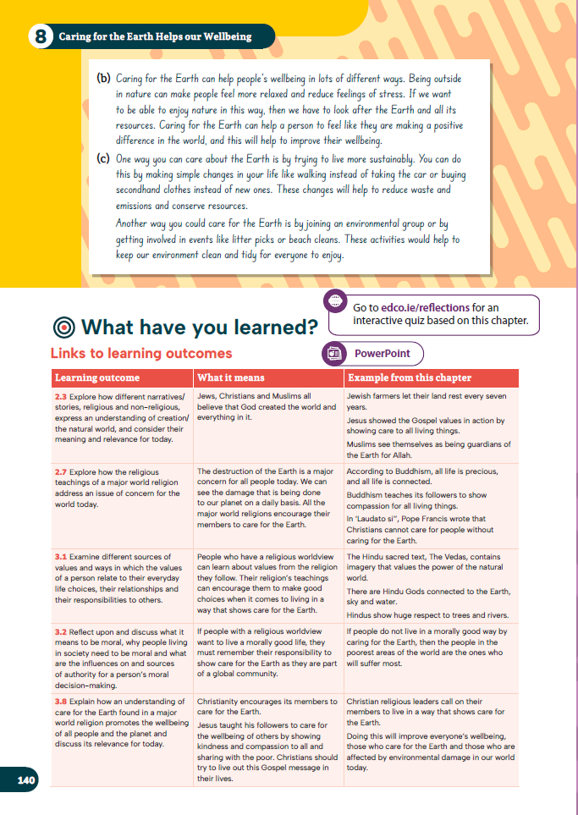
Underline and circle key words

Slide 9
Answers need to be developed. Do example on board for place of worship question, “Outline how a place of worship is important for members of one of the following religions.”
Gives them a place to communicate with their God, contains religious symbols such as statues/candles etc which could help focus their worship, they can meet and connect with other believers of the same faith and be part of a community, they can hear their sacred text being read aloud, they can learn about their faith from a religious leader, they can receive comfort in times of need, they can participate in important rituals, it can offer a quiet space away from a busy world to focus on their faith.

Slide 10
Common mix ups
(a) Leader/Founder: Pope/Priest/Rabbi/Imam/Monk/ v’s Founder: Jesus/Moses/Mohammad/Siddhartha Gautama
Interfaith/ecumenism – Communication &understanding between different world religions v’s Communication & understanding between different Christian churches
(c) Founding story/creation story

Slide 11
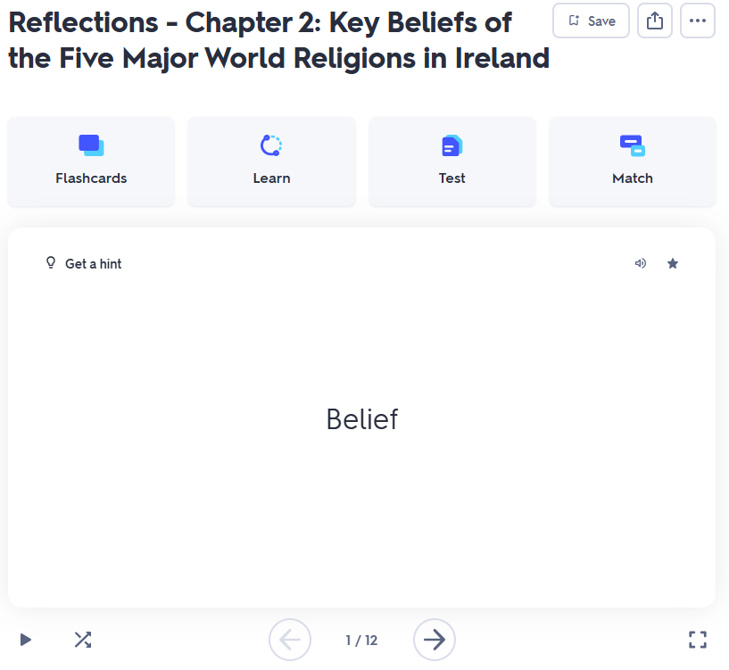
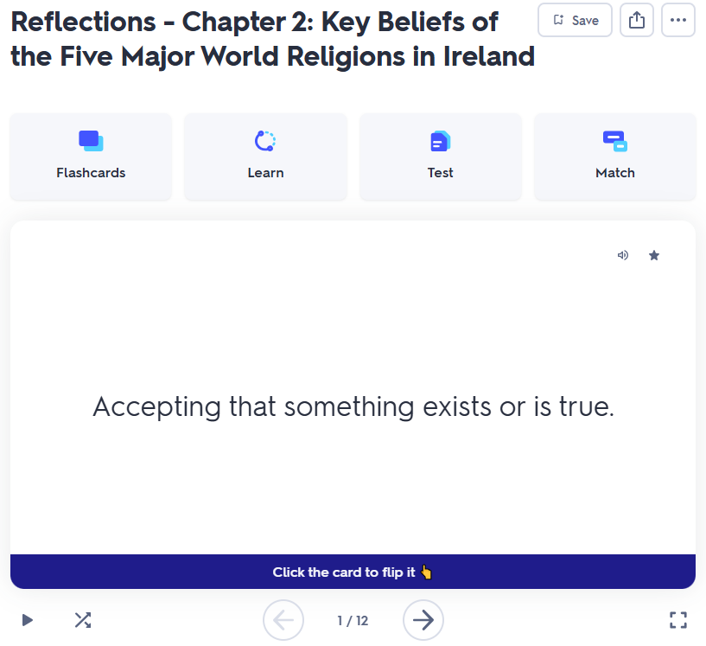
Use Revision Notes and Summaries: Use Flash Cards/Mind Maps/Diagrams if they work for you

Slide 12
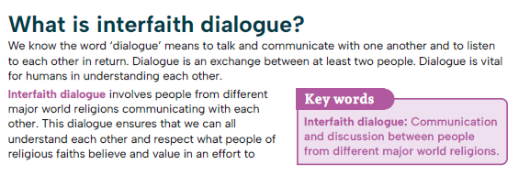
Practice Exam Questions

Slide 13
Link Theory to life examples. Tell your story.

Slide 14
Time Management

Slide 15
Read the Question

Slide 16
Stay Calm as you have done the work

Slide 18
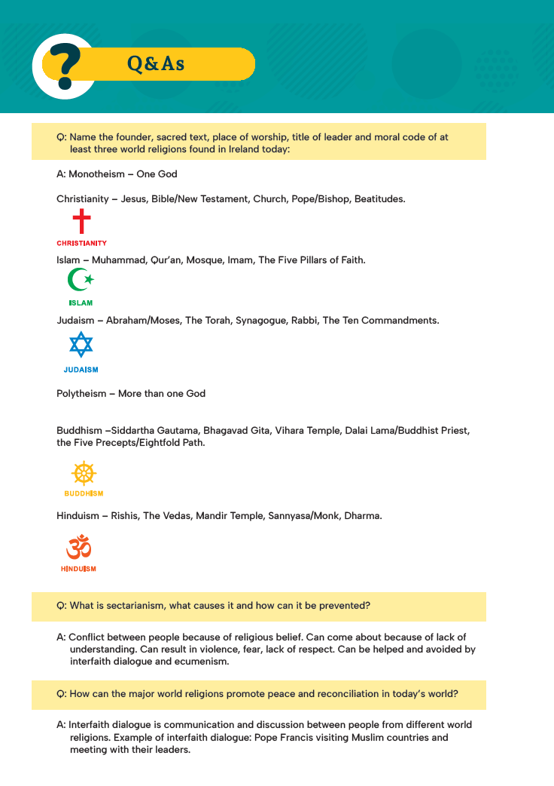
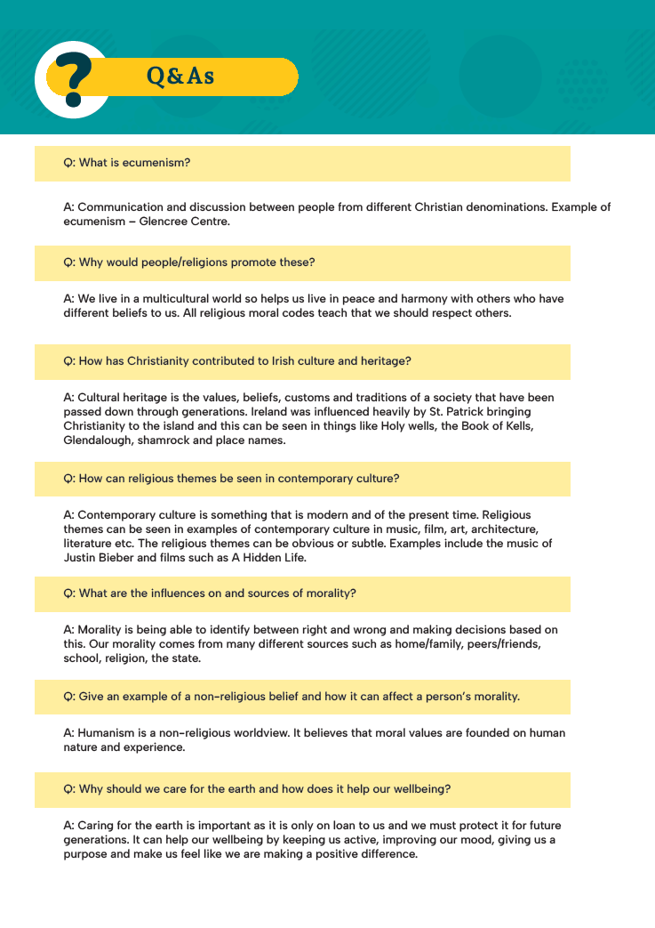

Slide 19
Share your experience and Q & A

