Slide 1


Let's Do Business
EDCO Webinar
Jayne Lenehan & Julie O'Keeffe
Wednesday 27th August

Slide 2
Webinar Plan!
Introduction to the course
Unifying Strand – Discussing each element briefly with students, brainstorming, SMART plans etc
Ch2 – Key Stakeholders in Business
  Stakeholders
  Relationships
  Conflict
  Stakeholder Mapping
Showcasing digital platform
Looking at each of the areas listed above in detail and explaining how to deliver your lessons using all of the resources provided.
Notes:
JLE

Slide 3

Key Competencies
RECAP!
Refers to the KNOWLEDGE, SKILLS, VALUES + DISPOSITIONS that students learn as they go through the course
Clear emphasis on these throughout the TB and the SAB in the form of activities and research methodologies.
Students learning in senior cycle is expected to take two forms; their learning within all of their subjects and modules and learning that takes place across all of their subjects.
The learning that takes place across all subjects is characterised as key competencies.
Notes:
JOK

Slide 4
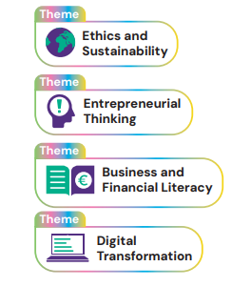
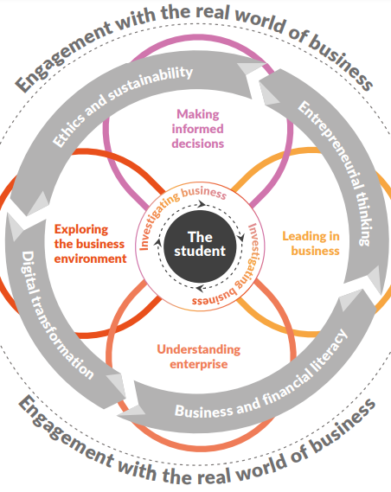
Cross Cutting themes
RECAP!
Clearly identifiable throughout the book using these icons.
All about exploring the dynamic world of business.
Ethics & Sustainability: Businesses must act ethically and sustainably, ensuring transparency and responsible engagement with customers, employees, communities, and the environment.
Entrepreneurial Thinking: Developing an entrepreneurial mindset helps students spot opportunities, manage risks, adapt to change, and drive innovation for personal and business growth.
Business & Financial Literacy: Understanding business and finance empowers individuals to make informed decisions, supporting lifelong learning and responsible financial choices.
Digital Transformation: Advances in technology, such as AI and big data, are reshaping business operations, customer interactions, and decision-making, requiring businesses to embrace innovation while managing challenges.
Notes:
JLE – JOK

Slide 5
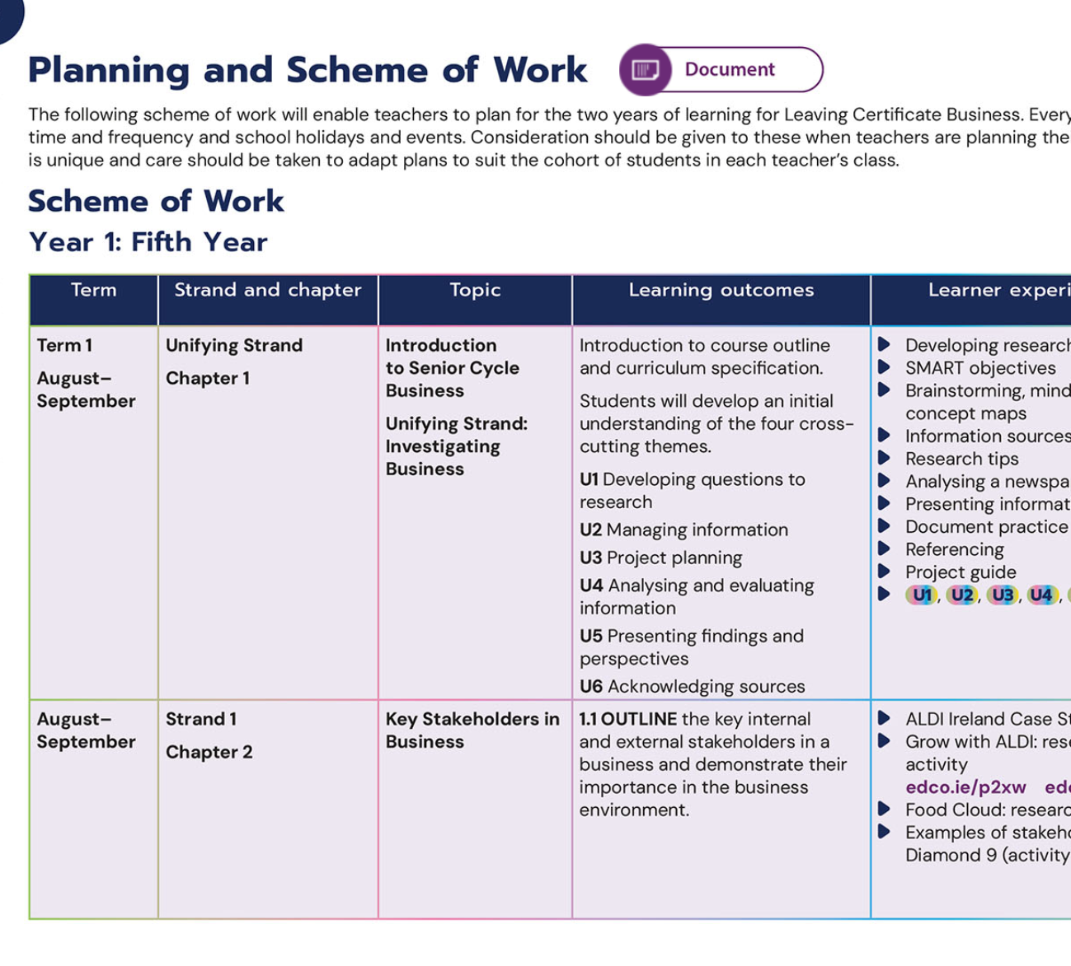
Planning & Scheme of Work
Click for a full editable word version of the 2 year scheme of work.

Slide 6

Unifying Strand
What is it?
This learning covers all four strands and shows how to work with information and data to make informed conclusions, decisions, and recommendations.
This Unifying Strand is designed to inspire an entrepreneurial mindset, encouraging students, to think like an entrepreneur, to be innovative and creative, to maximise opportunities, to analyse risk, to develop resilience and to adapt to change.
Completed in the form of reports , letters, charts, diagrams, articles from newspapers, graphs etc.
The skills necessary to succeed in the AAC will be introduced in 5th year but embedded throughout their learning.
Notes:
JOK

Slide 7

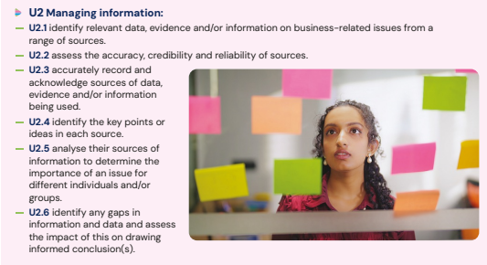
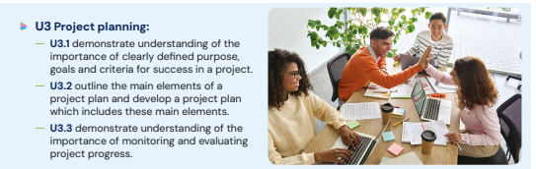
Developing questions to research
Managing Information
Project Planning
Analysing and Evaluating Information
Presenting Findings & Perspectives
Acknowledging Sources
Notes:
JOK

Slide 8
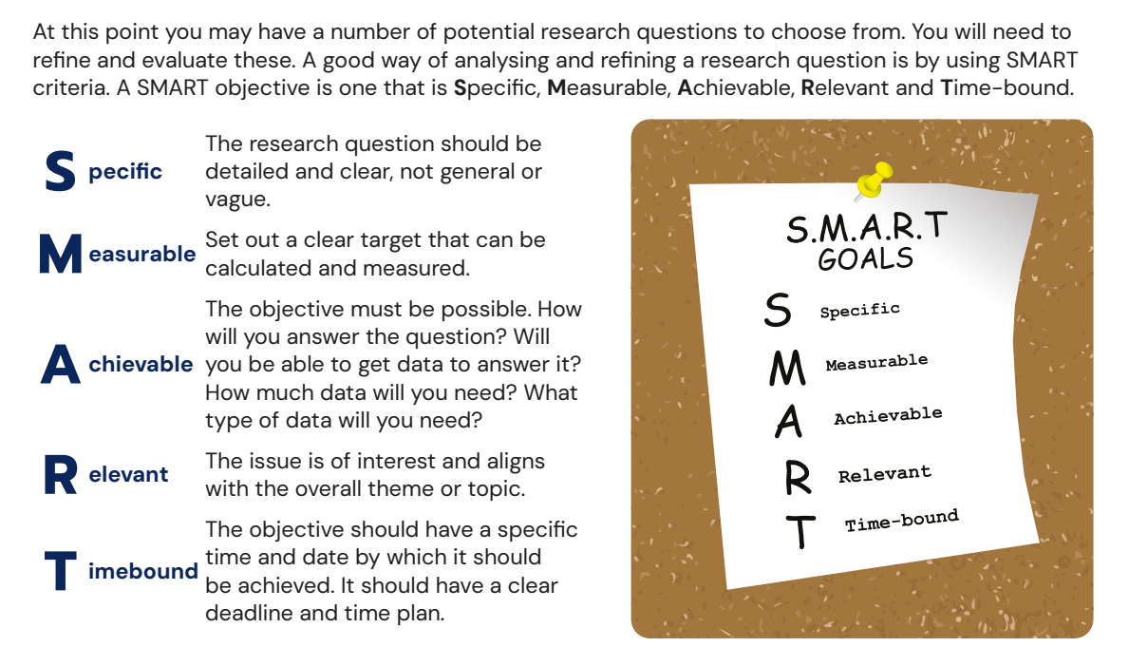
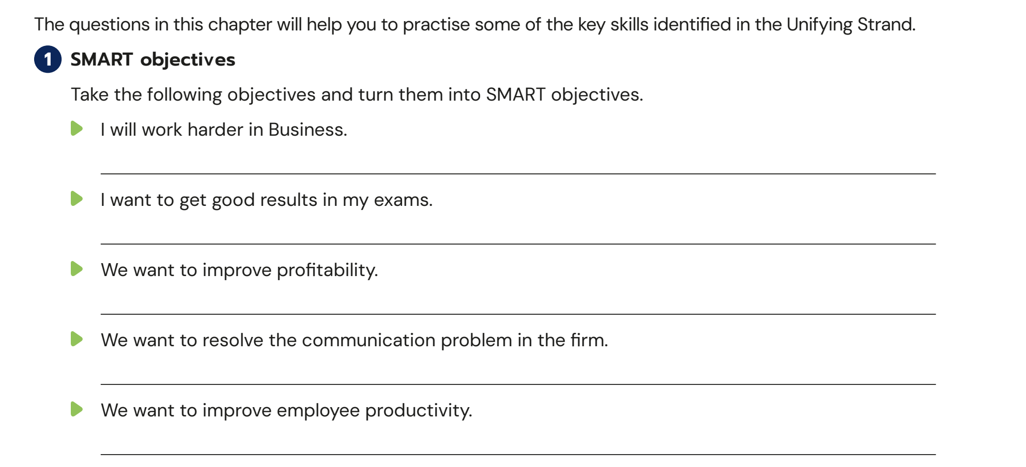
Student Activity Book – Pg 1

Slide 9
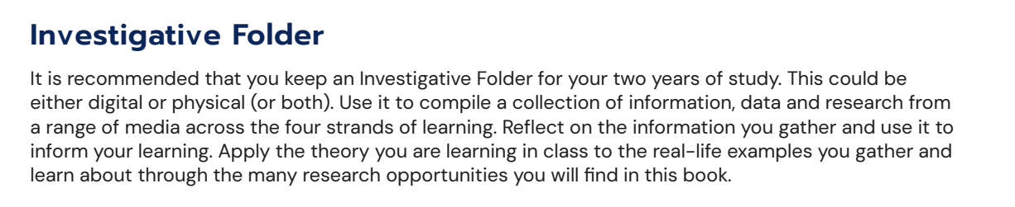

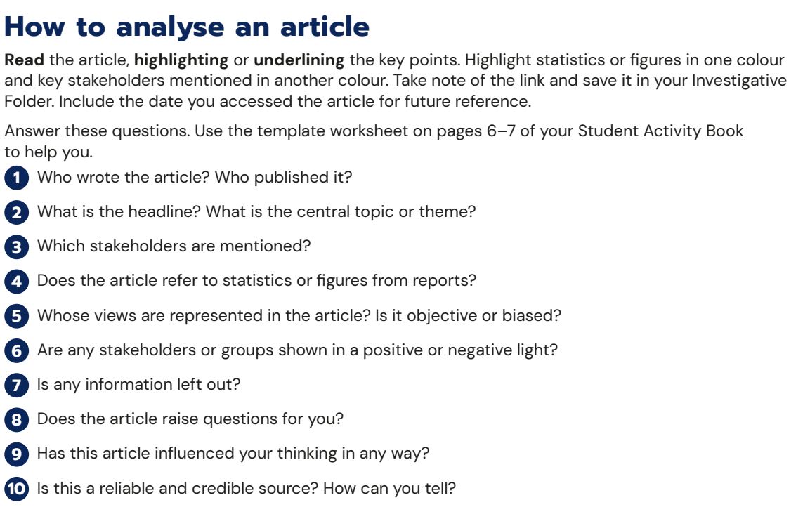
Investigative Folder

Slide 10
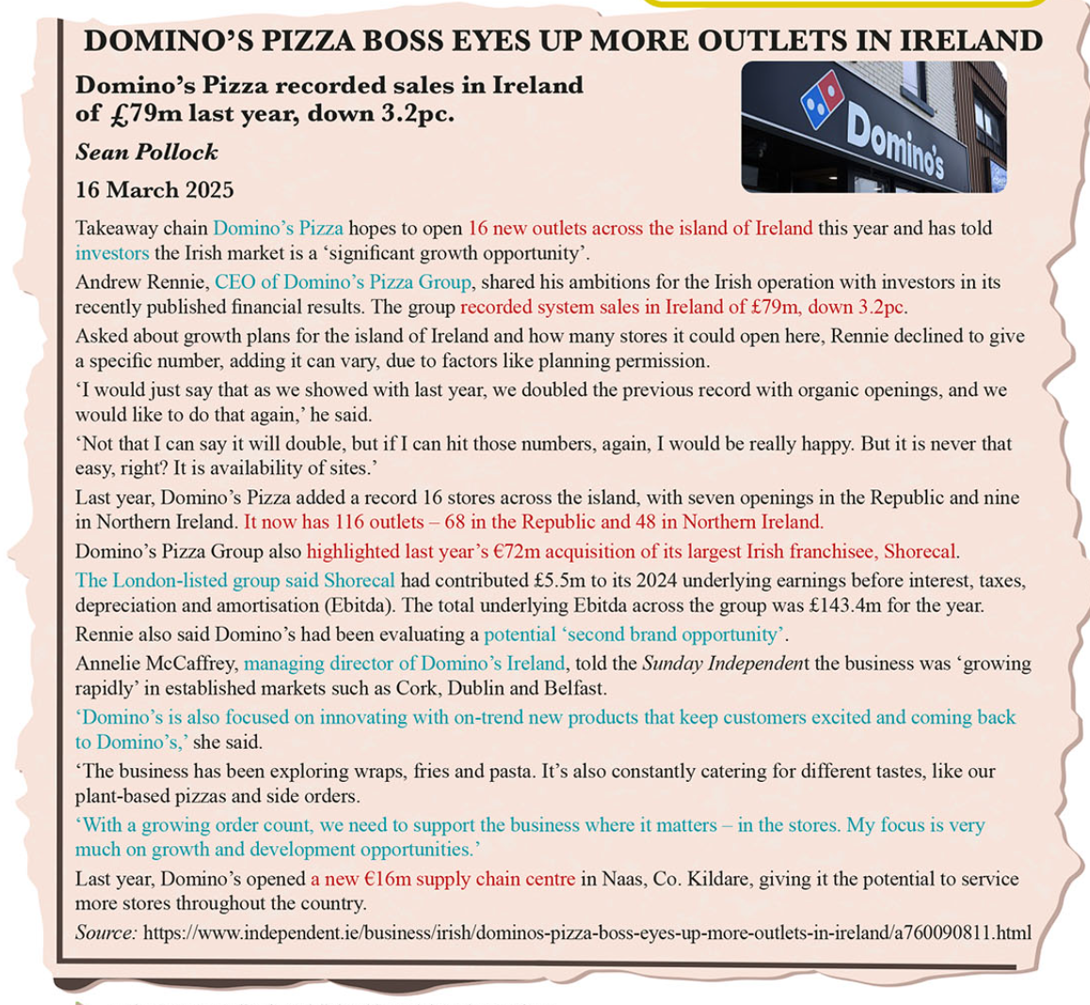
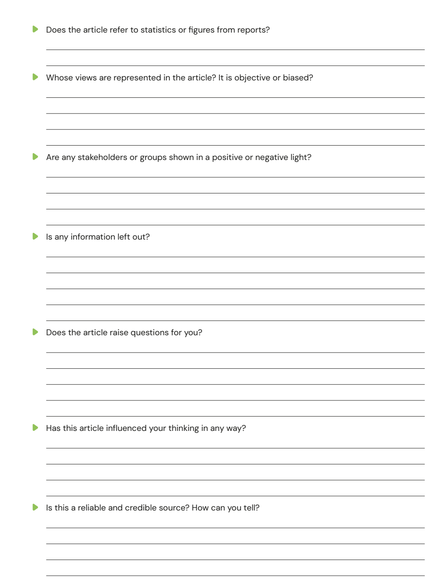

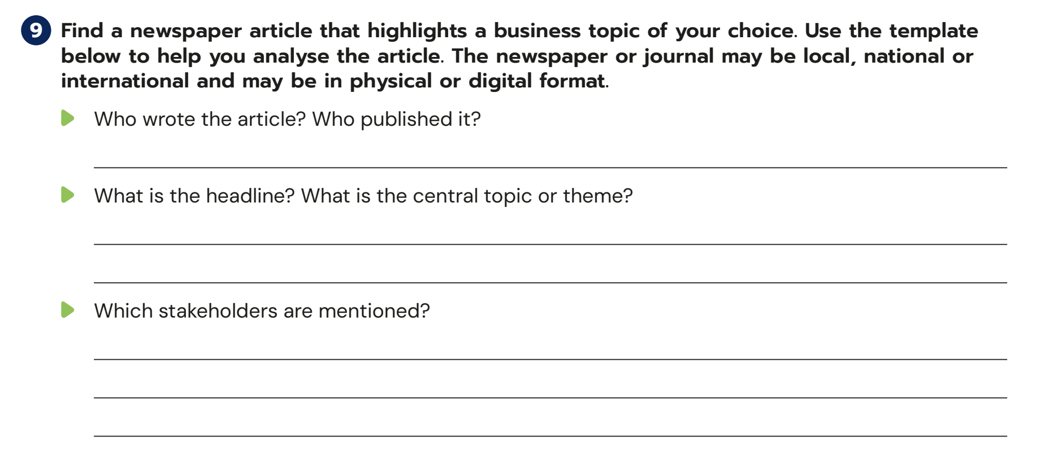
Student Activity Book – Pg 6+7

Slide 11

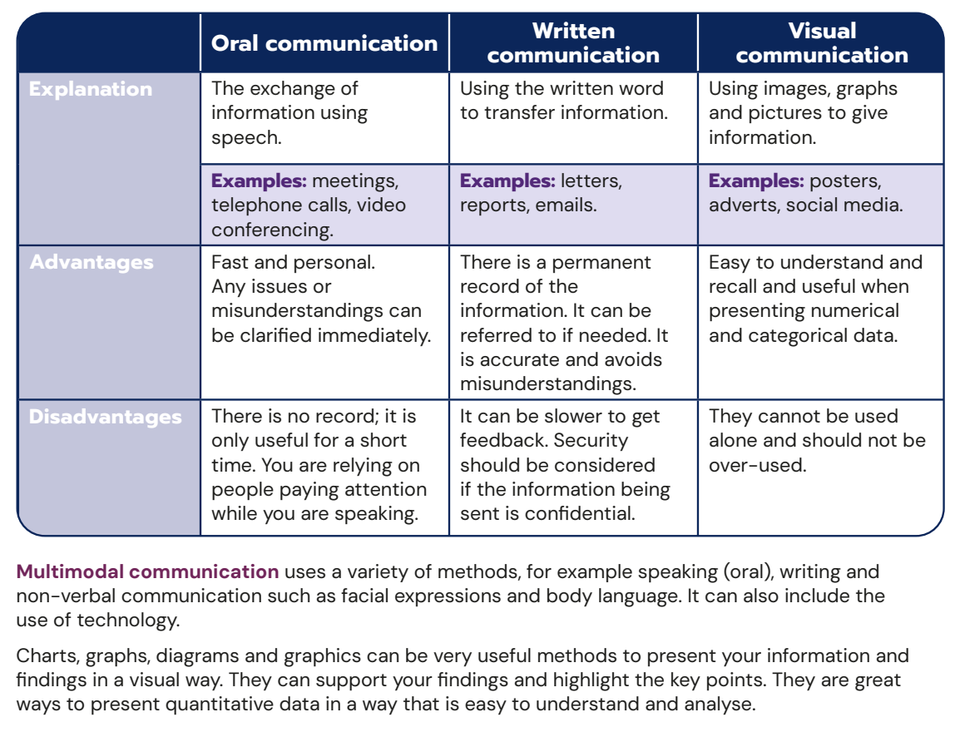
Presenting
Findings

Slide 12
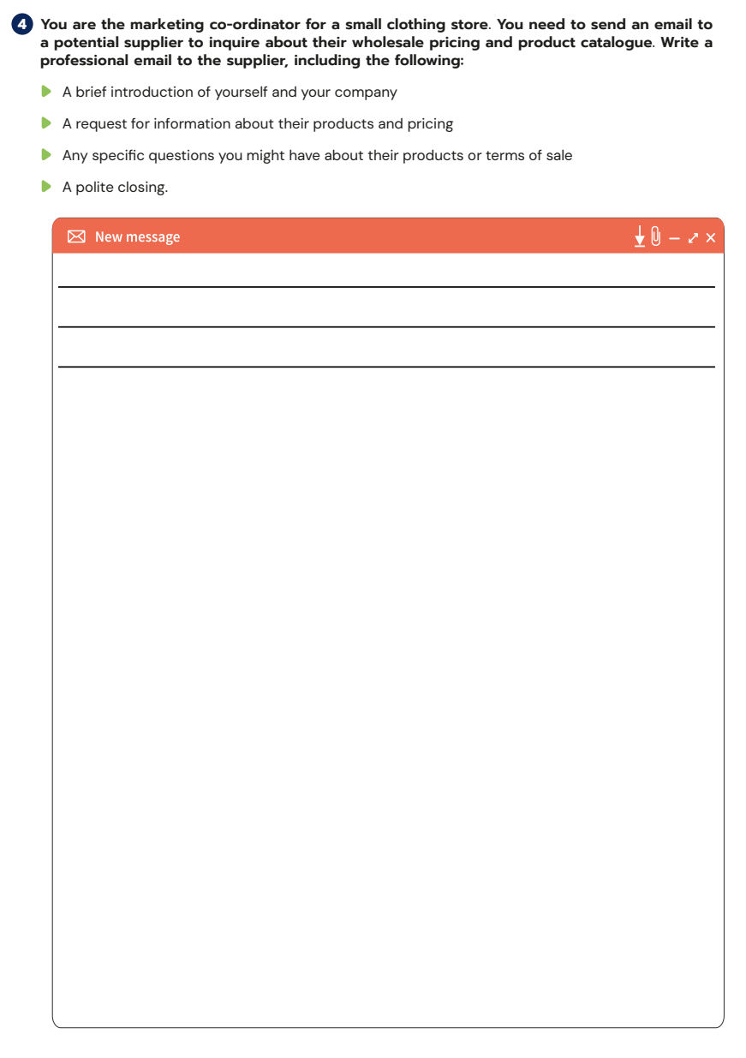

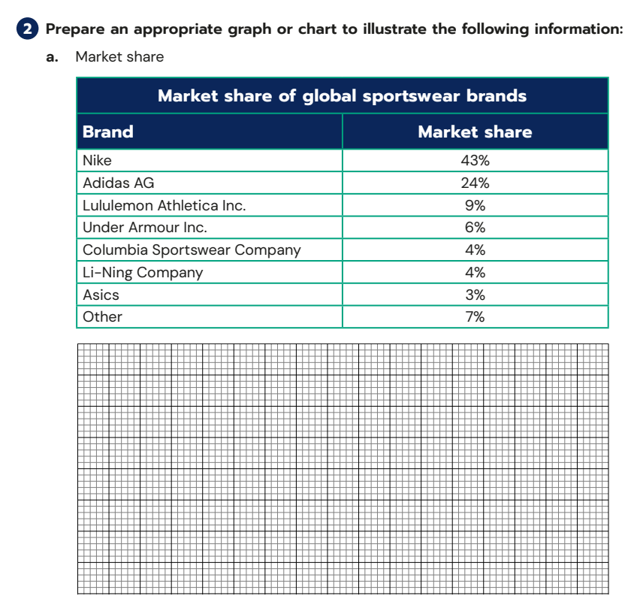
Student Activity Book – Pg 1-6
Graphs / Emails / Reports

Slide 13
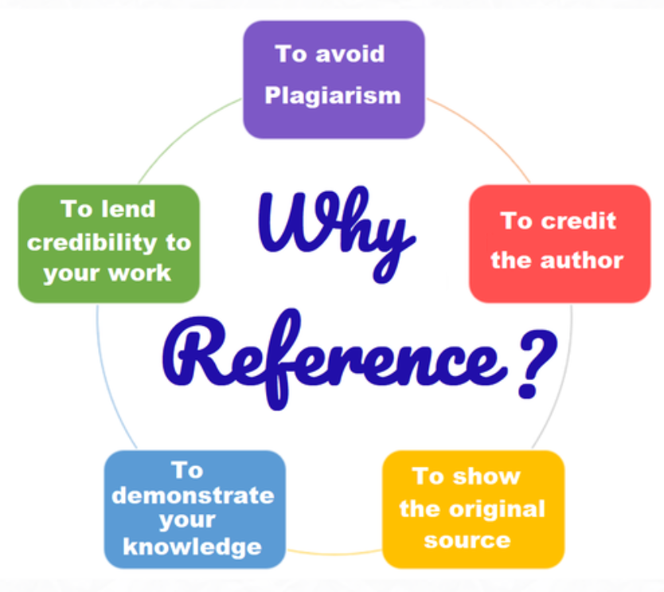
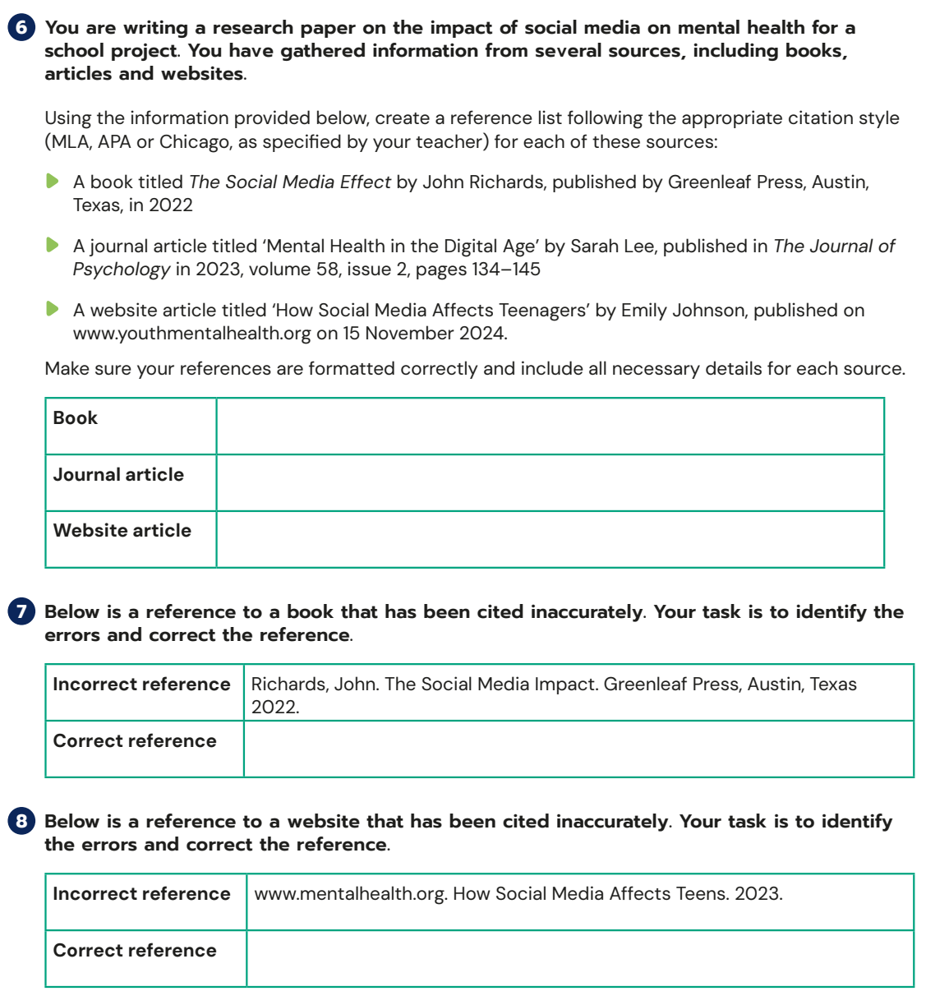
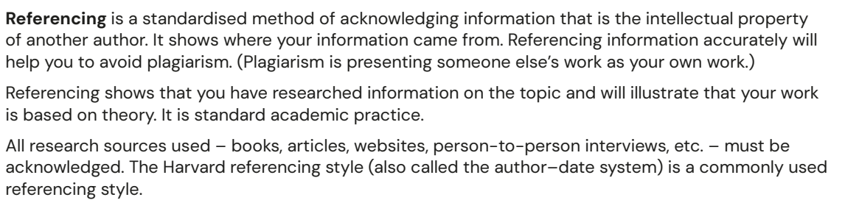
Acknowledging Sources
Student Activity Book – Pg 6

Slide 14
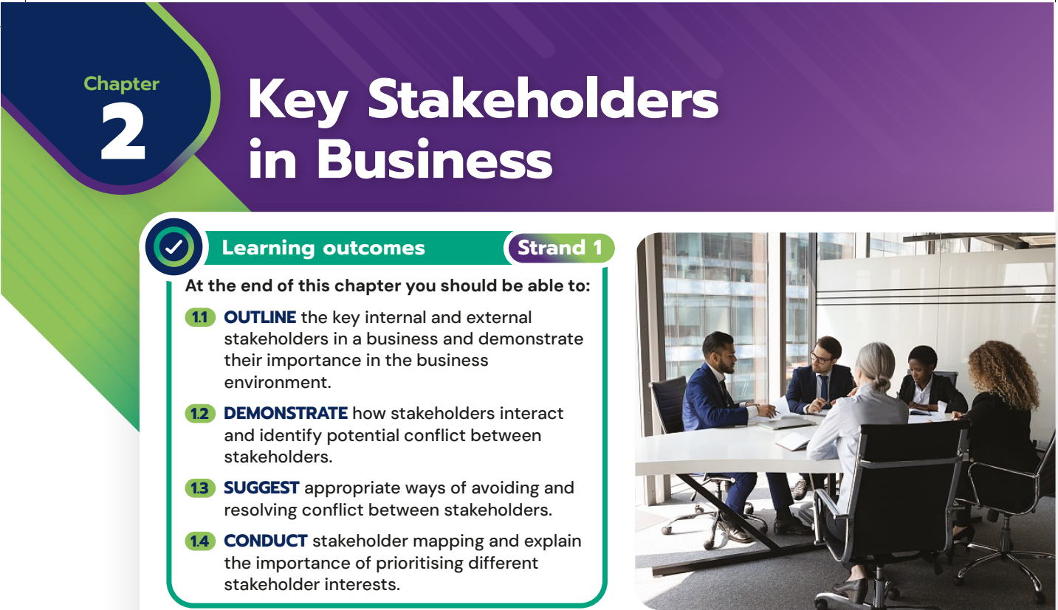
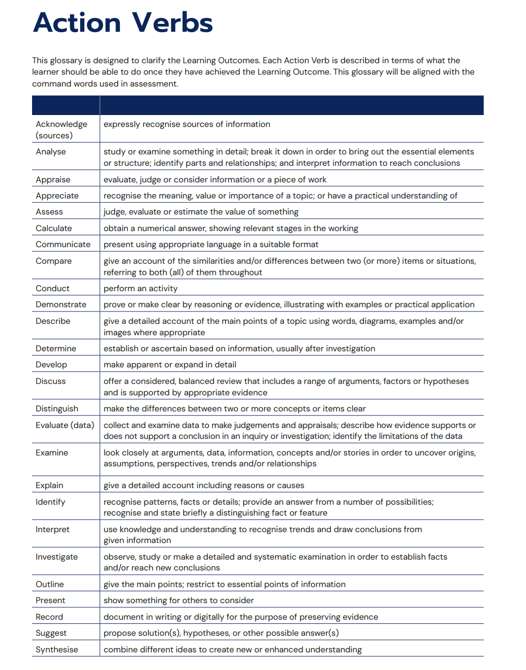

Slide 15
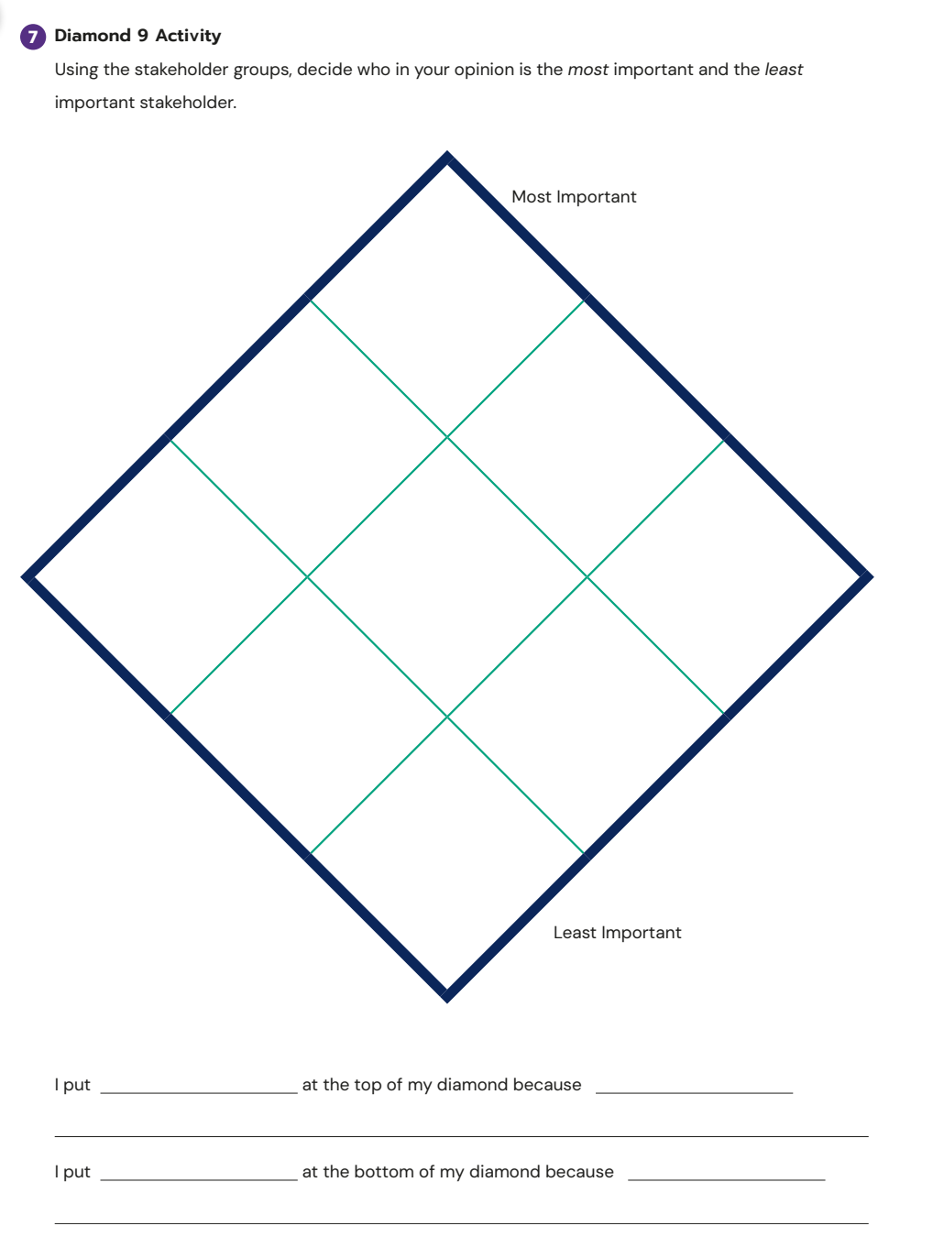
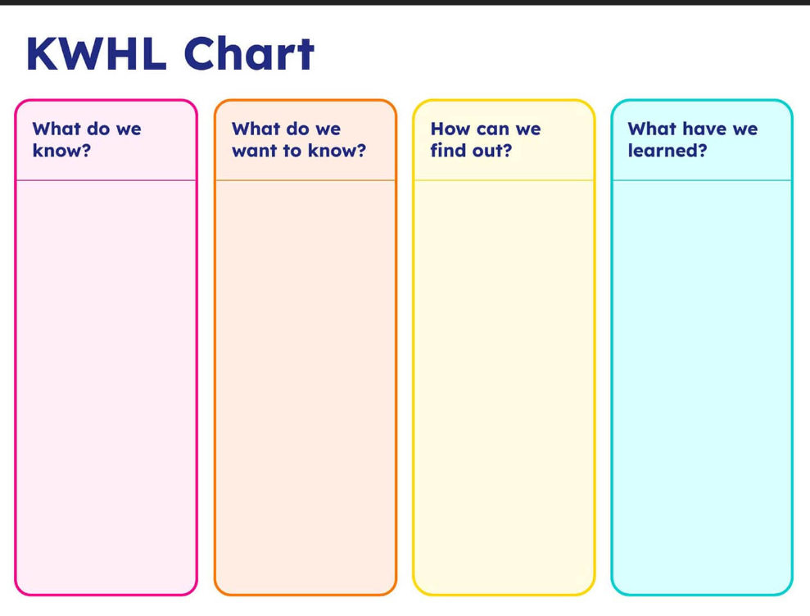


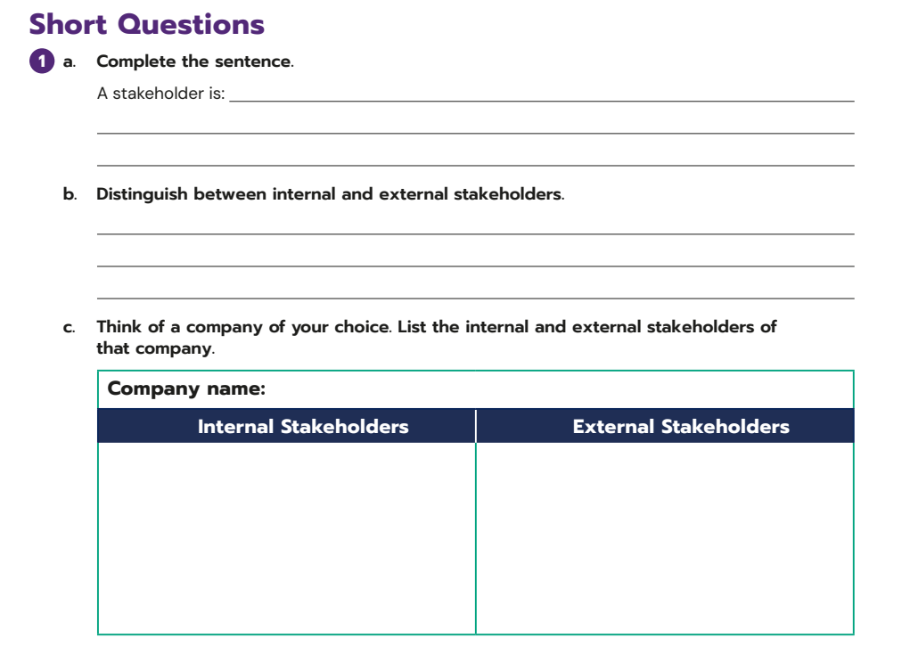
Lesson Plan
1. Read Aldi Case Study
  Complete a KWHL together
  Look at the ‘Tip’ point on Pg 21
  SAB – P8 Q1 A-C
  Explain stakeholders including references to Aldi Pg’s 21 - 23
  Complete Stop + Research Activities x 2 on Pg 25 [allow approx. 10 mins for this]
  Complete SAB Q6 Pg 11 in pairs / groups using a local example relevant to them. [allow 10/15 mins]
  Diamond 9 SAB Q7 Pg12

Slide 16

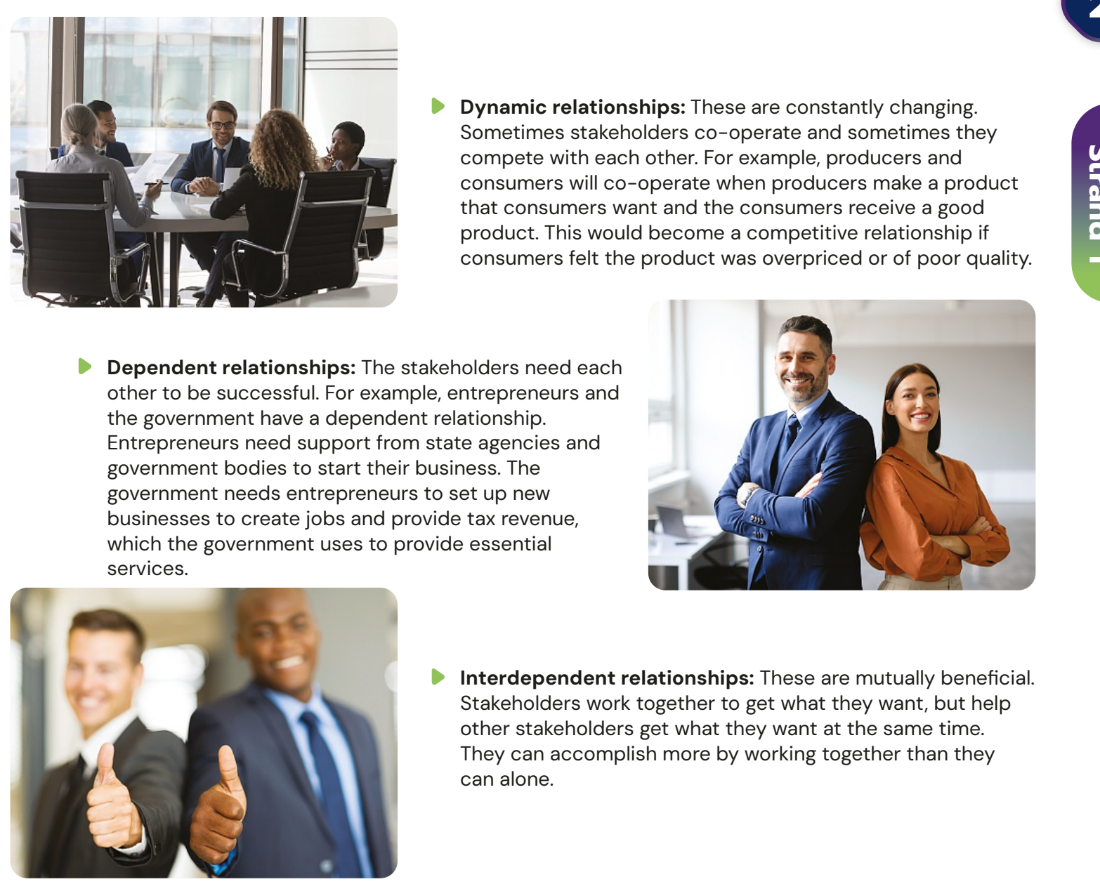
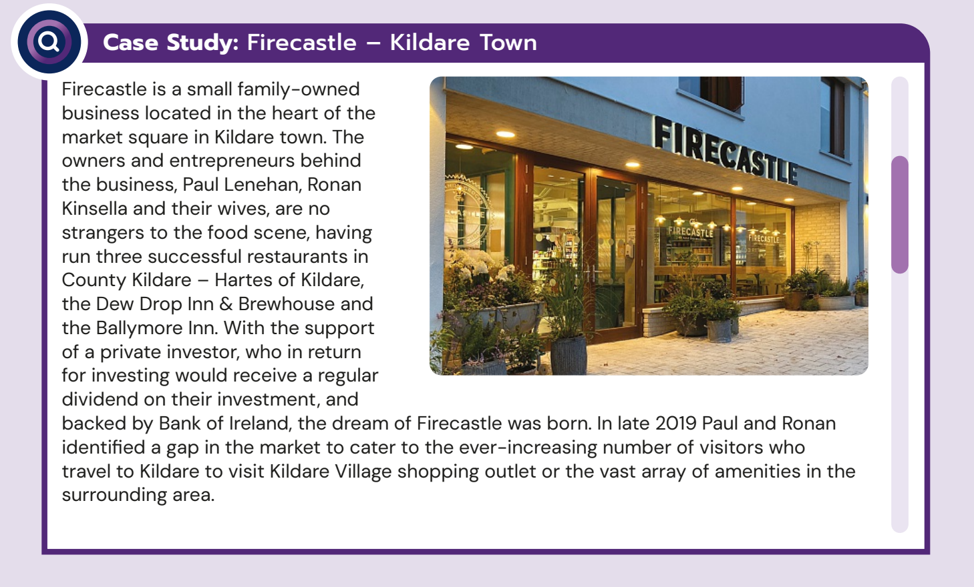
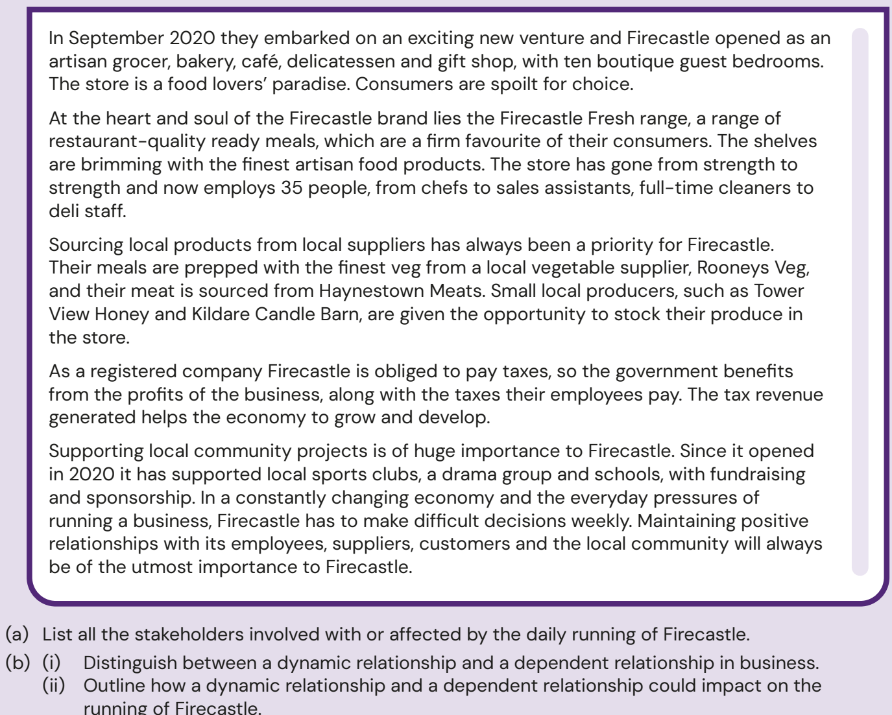
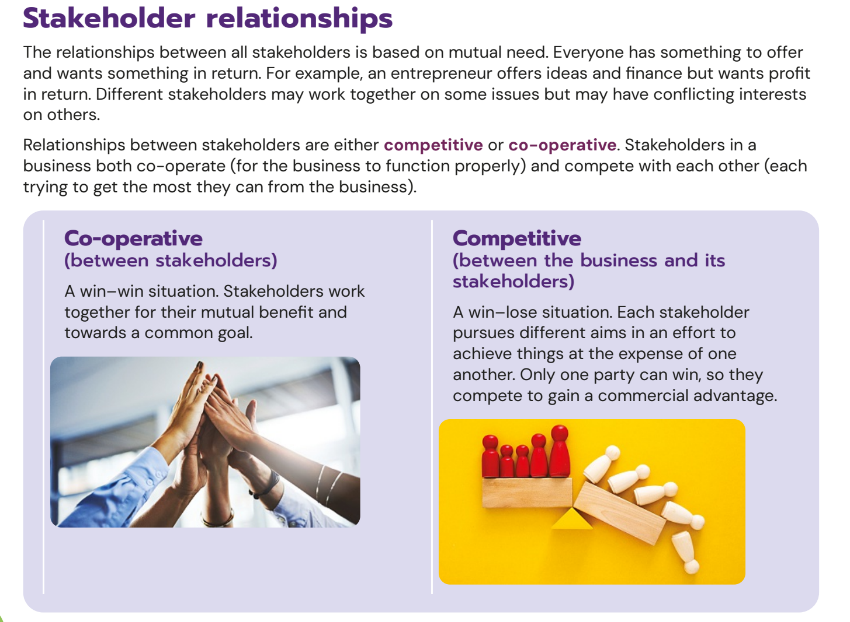
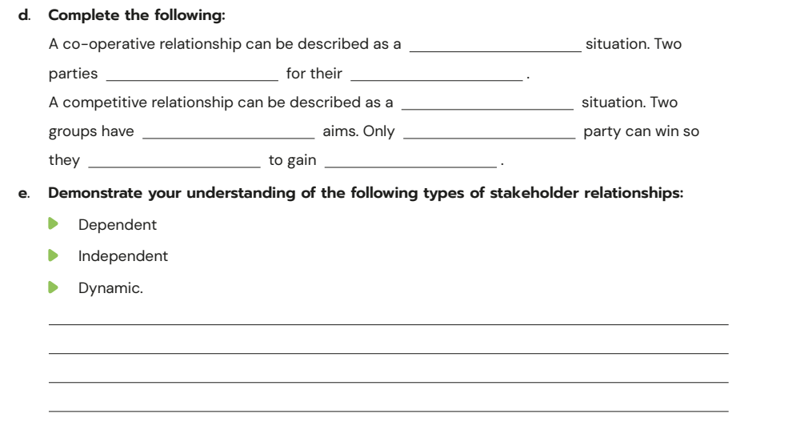
Lesson Plan
2. Relationships
  Explain terms Pg 24-26
  SAB Pg 8 Q1 D+E
  SAB Pg 13 Q8 [Linked to Stop + Collaborate on Pg 26] [allow 15 mins]
  Firecastle Case Study TB Pg33+34 Q’s A+B
  Stakeholder Relationships Games - onscreen

Slide 17
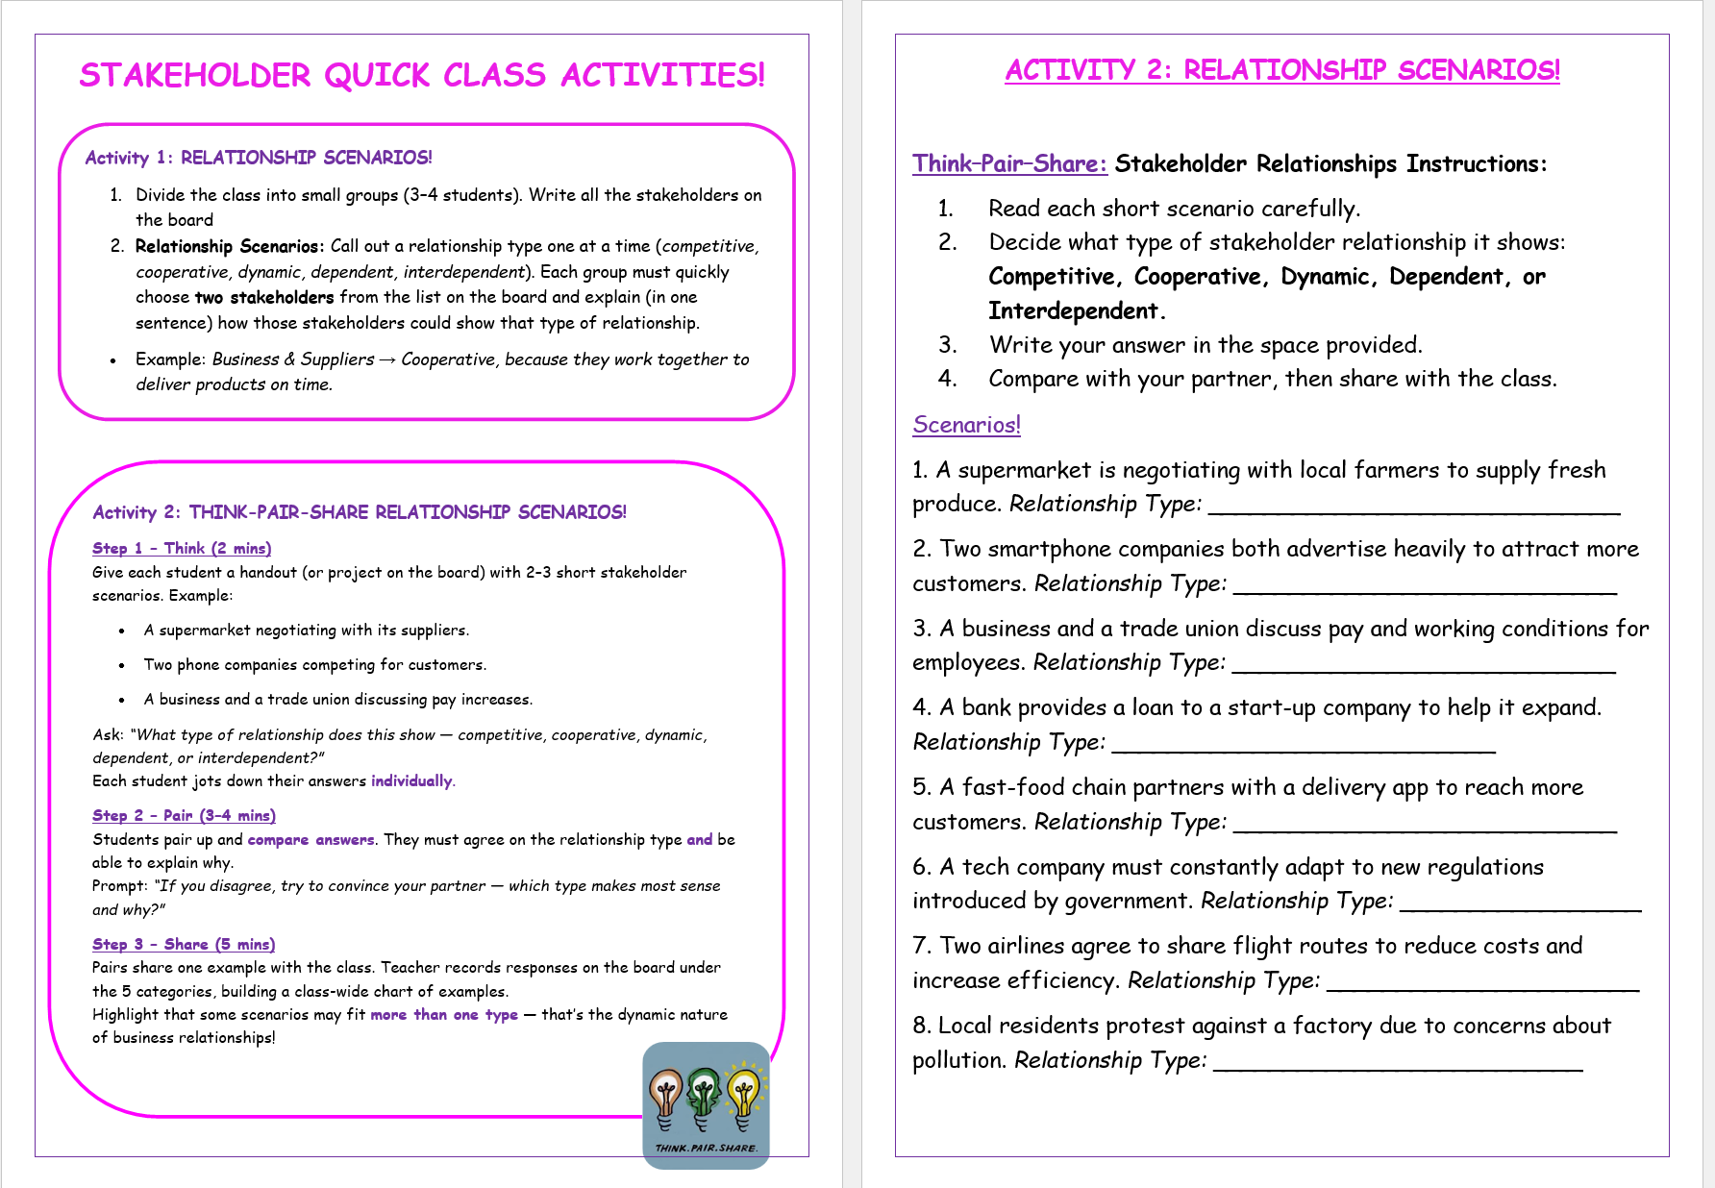


Slide 18
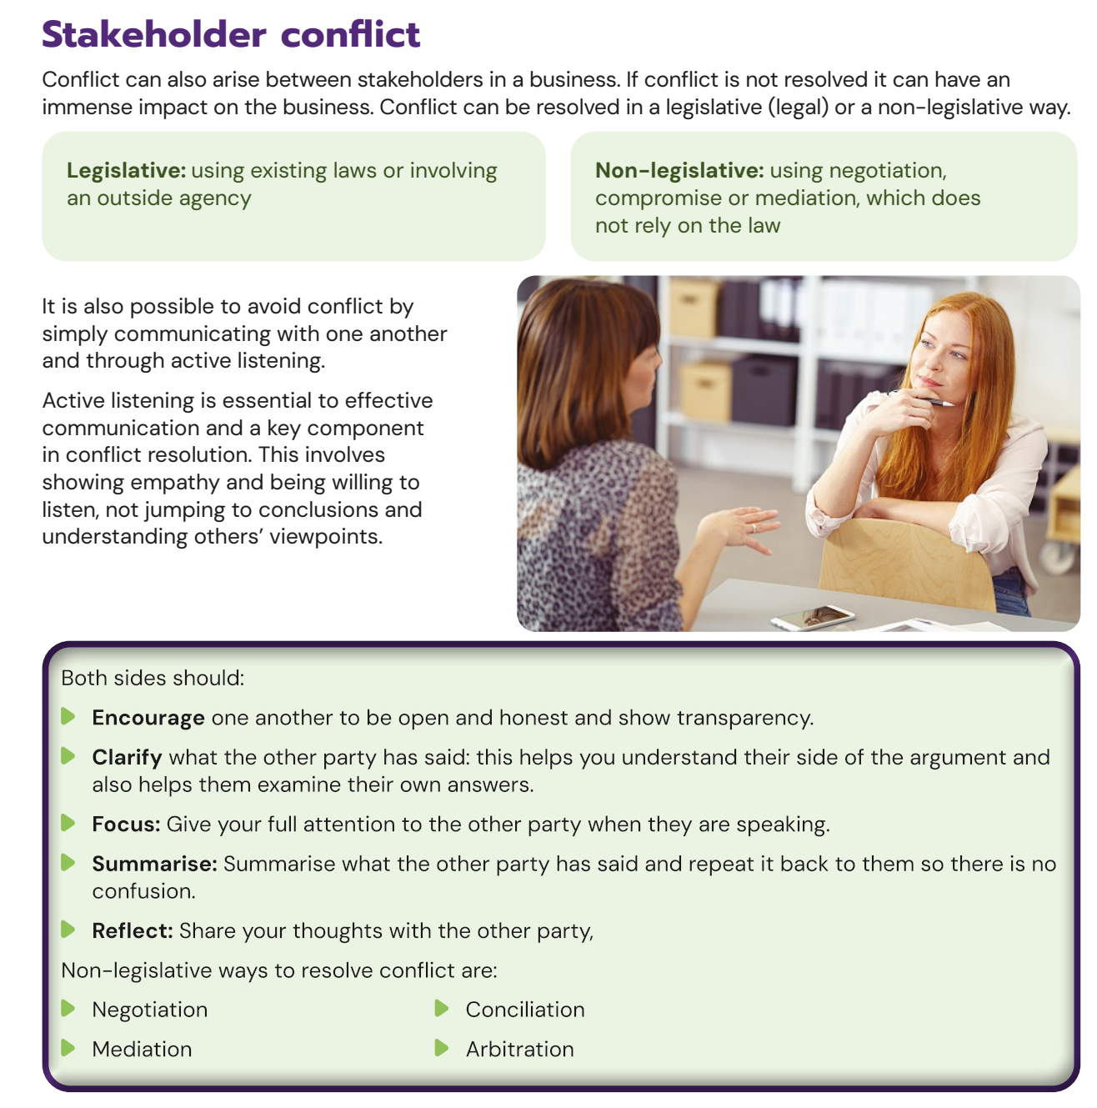
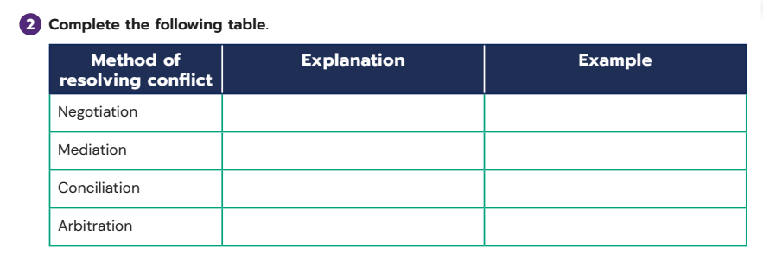
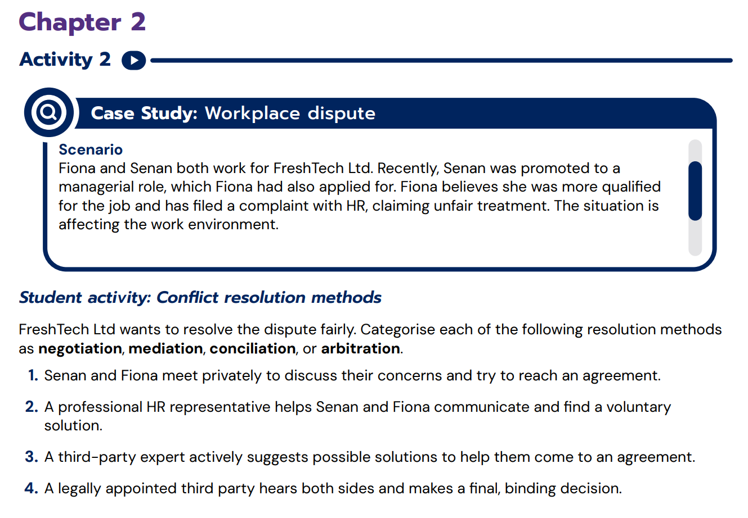
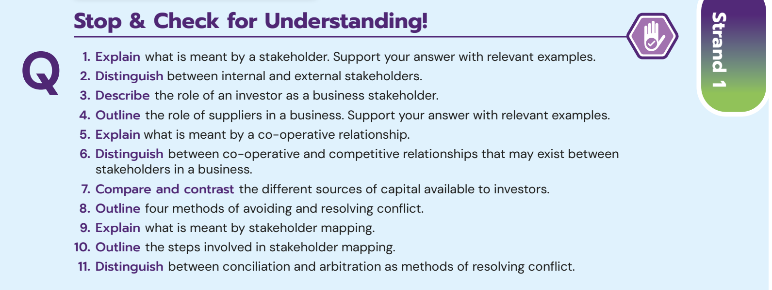
Lesson Plan
3. Conflict
  Explain key terms TB Pg 27 + 28
  SAB Pg 9 Q2
  TB Pg 33 Q8 [Stop & Check for understanding]
  TRB Additional Activity 2
  Conflict Resolution Speed Round [onscreen]

Slide 19
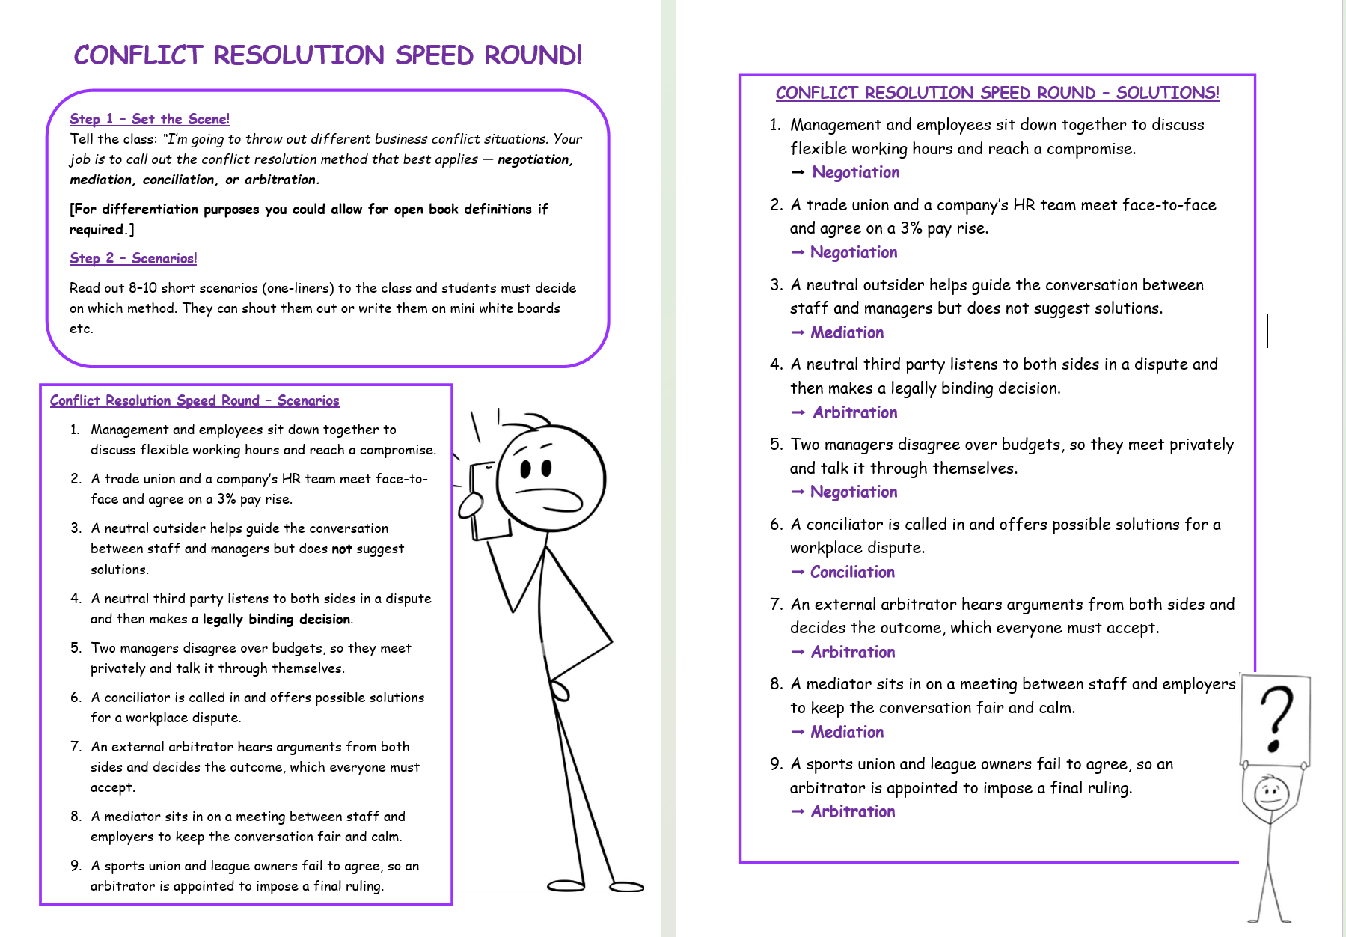

Slide 20

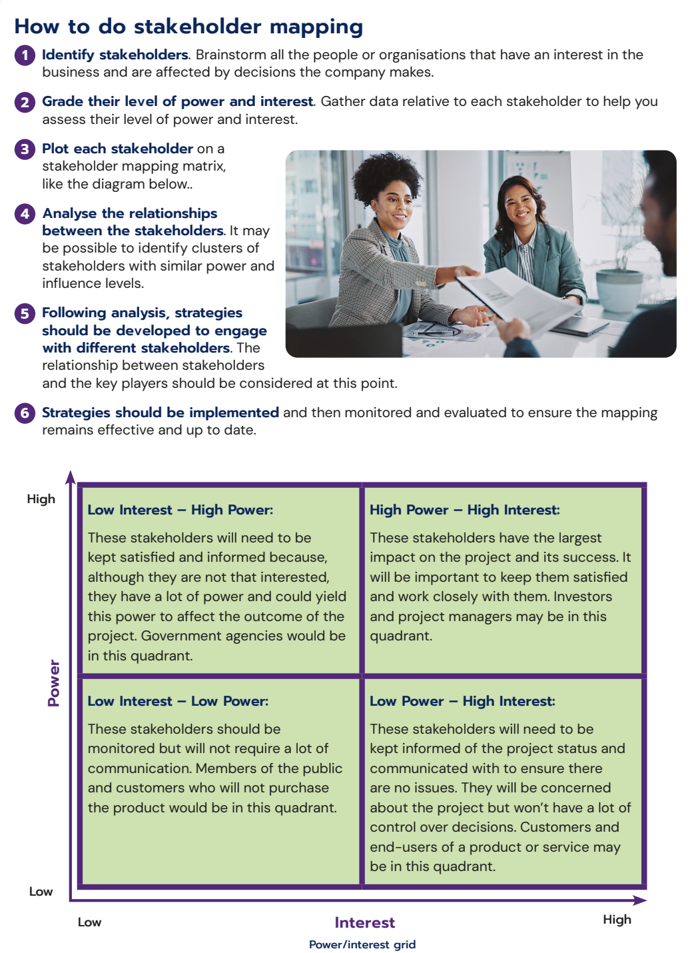
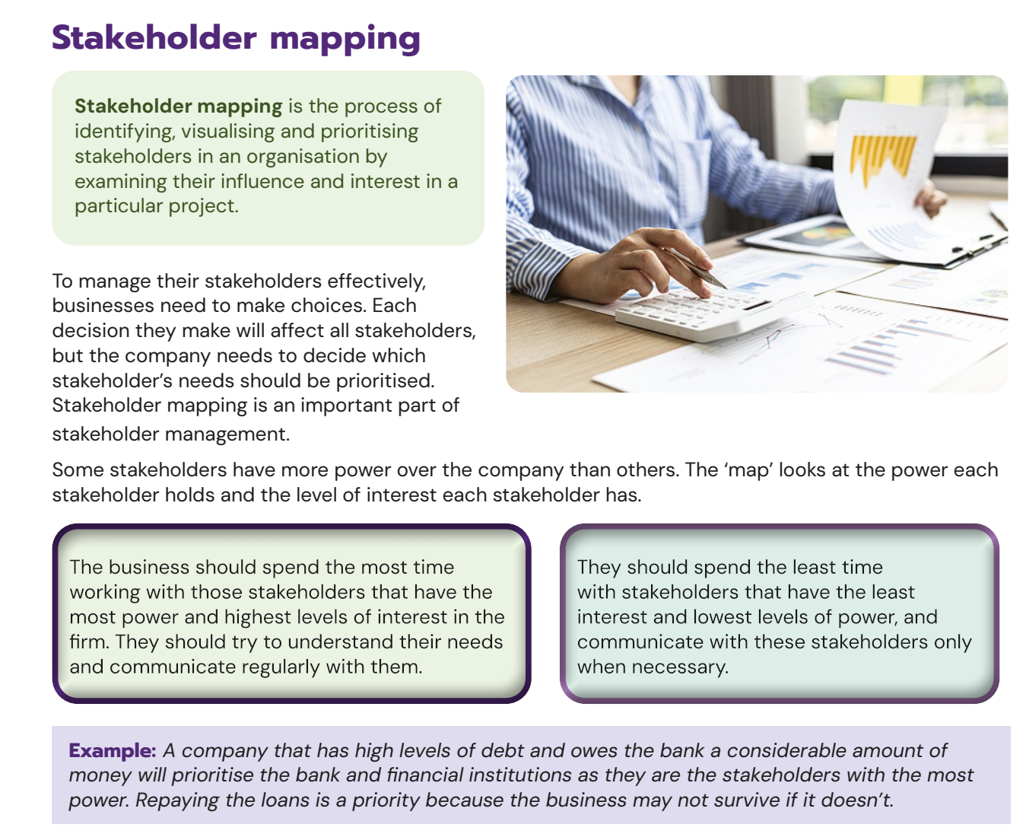
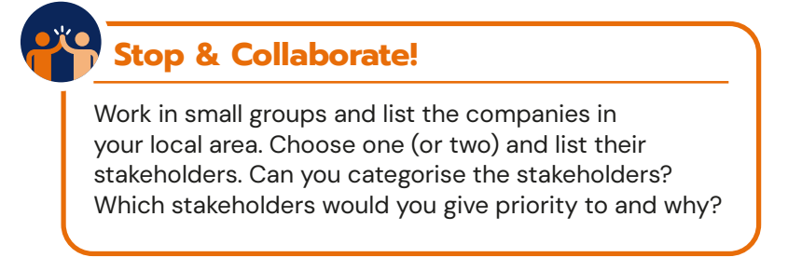
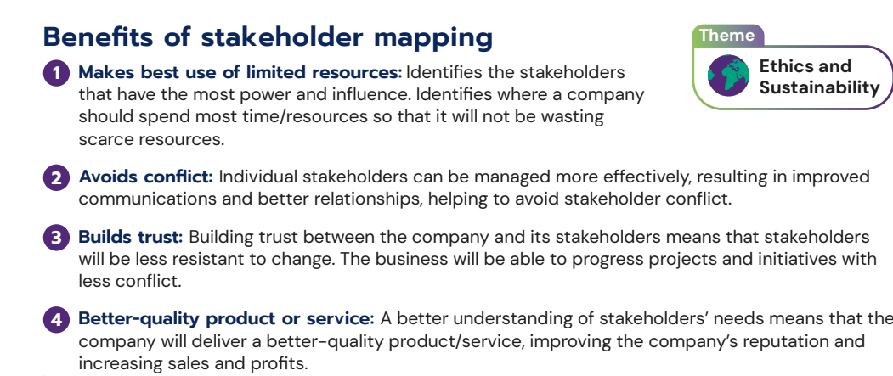
Lesson Plan
4. Stakeholder Mapping
  Explain key terms TB Pg 29
  Stop + Collaborate [allow 5/10 mins]
  SAB Pg 9 Q4
  How to do Stakeholder Mapping TB Pg 30+31
  SAB Pg Q5 linked to Stop + Research TB Pg32
  Firecastle Case Study Part C TB Pg 34
  TPS – Ask students to come up with benefits of stakeholder mapping and then refer to TB Pg 32
  Written Work Pg 34 Q7 Developing Your Knowledge
Using the companies we looked at during our learning of stakeholders try categorise those and decide who you need to give priority to?

Slide 21
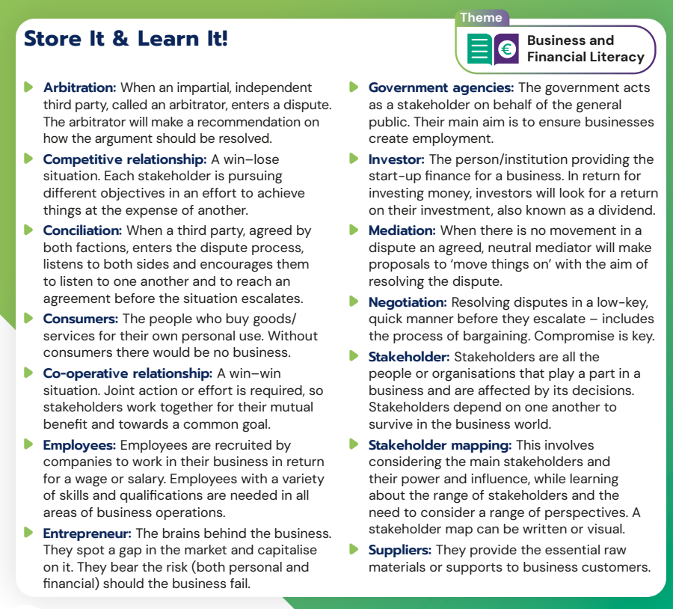
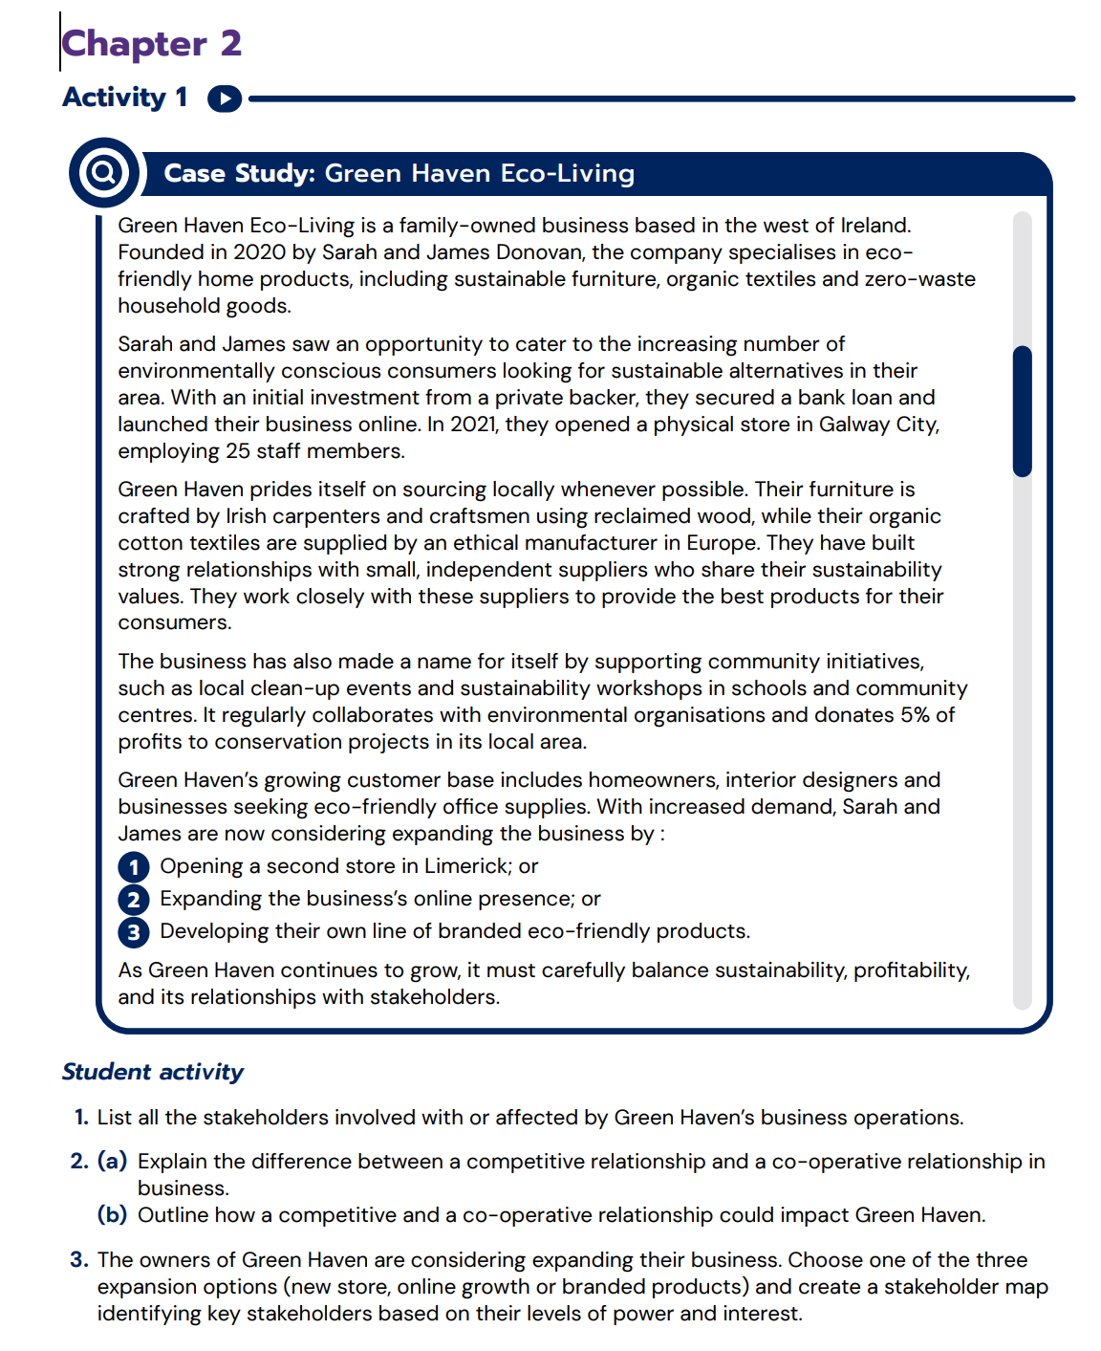
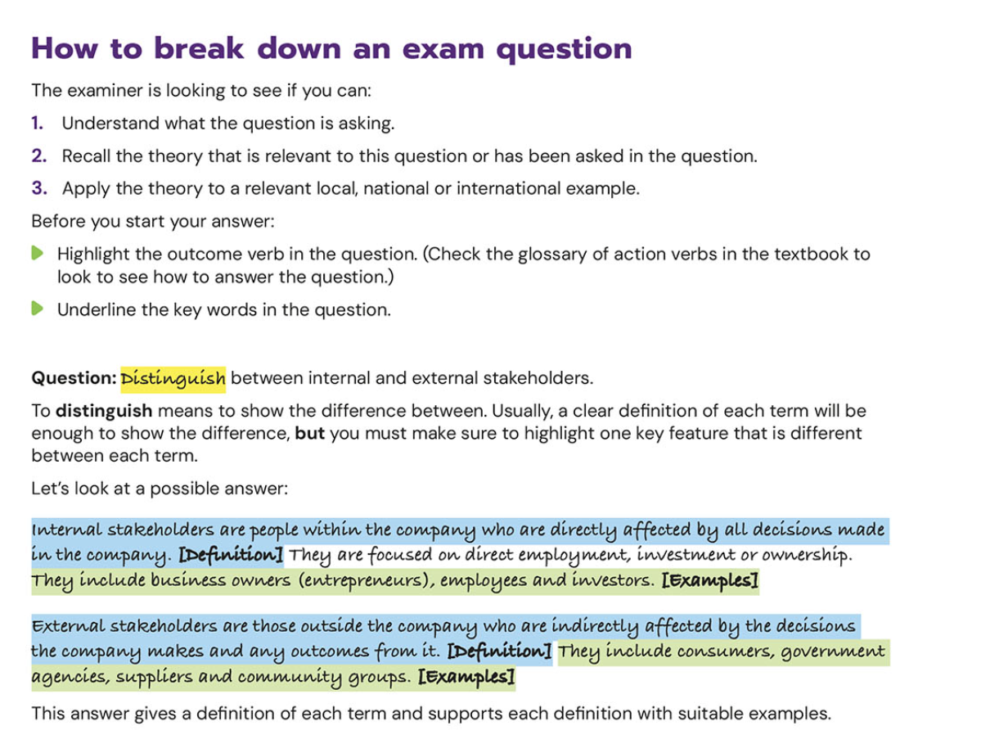
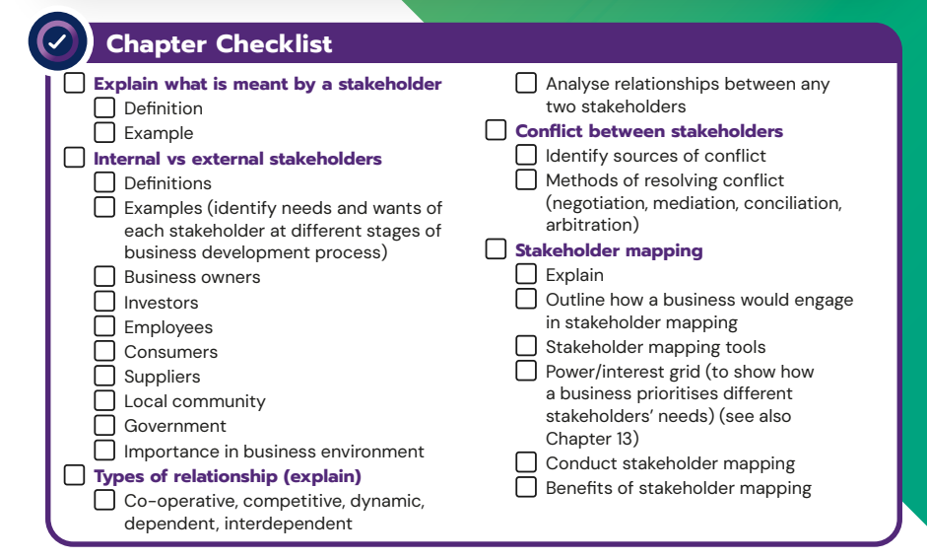
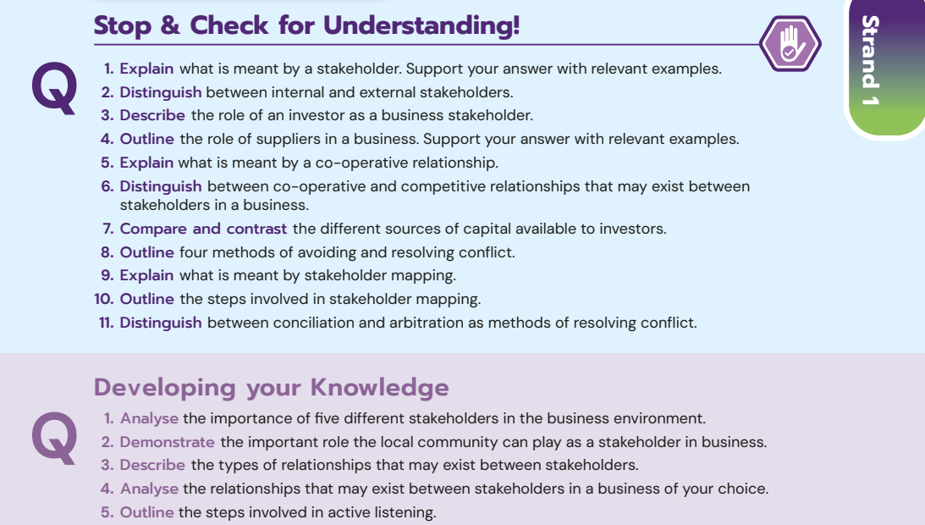
Lesson Plan
5. Assessment
  Store It & Learn It at the end of every chapter
    Definitions Quiz
    What am I?
    Matchup
    Describe it!
  TB Questions
  Chapter Check List
    Create a mind-map SAB Pg 14
  Additional Activity 1 [could also be used as a test]

Slide 22
Chapter 2 Activities
4 Stop & Research Activities
Case Study to introduce the topic – local/national + international example
6 links to cross cutting themes
3 Stop & Collaborate Activities
13 Activity Questions in the SAB
2 additional activities in TRB along with powerpoints, video links and games
16 Differentiated Questions with a case study stimulus included

Slide 23
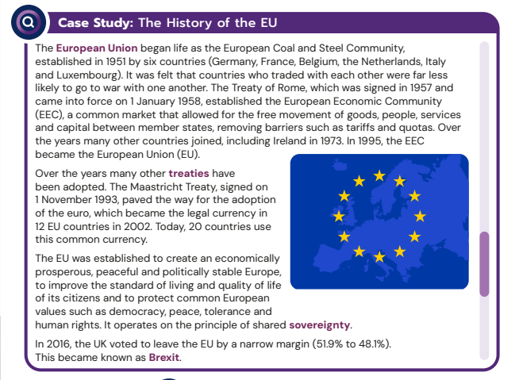
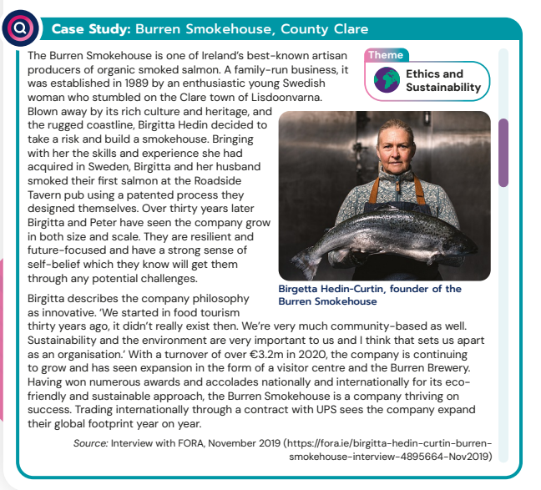
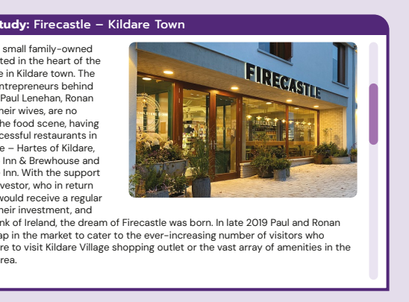
Case Studies
Over 40 case studies throughout the book - local, national and international examples.
Companies vary from Donegal to Cork, Tipperary to Kildare.
Topical for LC students - links drawn to Cross Cutting themes.
Embedded throughout the book and not just at the start.
Stimulate learning, allows for development of key competencies.
Notes:
JLE

Slide 24

Teachers Resource Book
We have created this Teacher’s Resource Book to help you navigate through the new Leaving Certificate Business course.
Accompanies the Let’s Do Business textbook, Student’s Activity Book and Investigative Study Guide
Digital Resources
Solutions
Additional Activities
Planning materials
Comprehensive guide and sample answers on how to approach LC questions.
Notes:
JLE

Slide 25
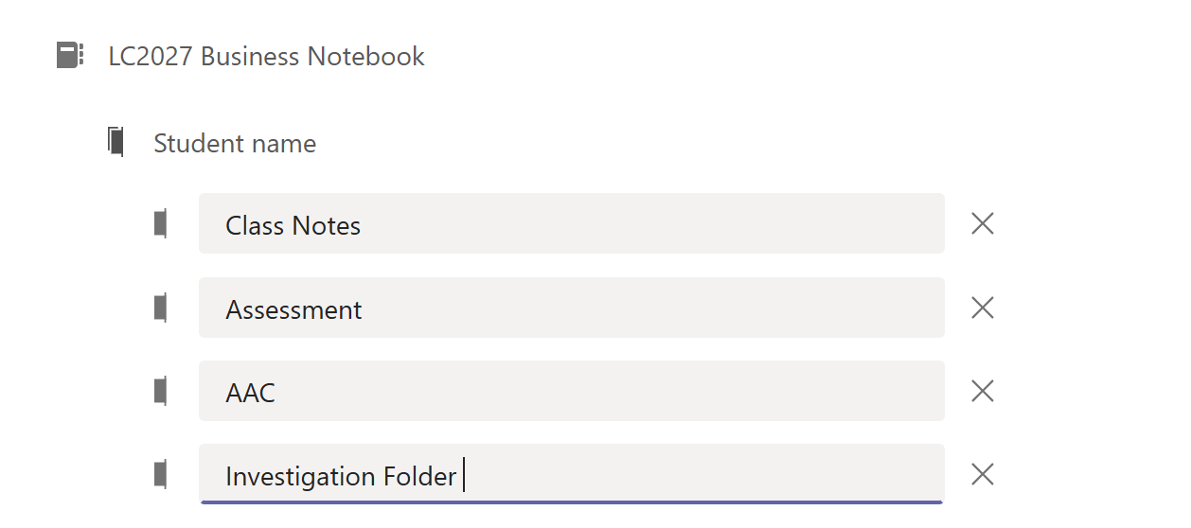
AAC
Student’s Digital Notebook
Links to newspaper articles/video links/podcasts etc will be shared with students & saved in their investigation folder.
This will start in 5th Year
Sample mini projects in 5th year term 1.

Slide 26
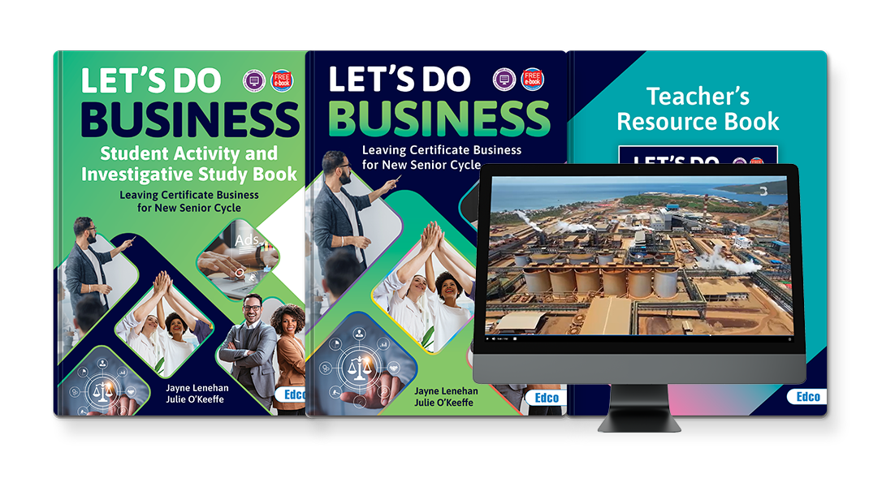

Thank you for listening!
We welcome any questions you may have!

