Slide 1
Key Stakeholders in Business

Slide 2

Key Stakeholders in Business

Slide 3
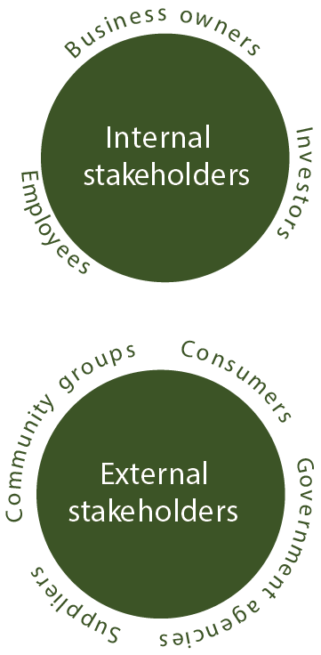
Stakeholders
An individual or organisation who has any interest in the business and the decisions it makes.
Internal stakeholders: People in the company who are directly affected by all decisions made in the company. They include business owners (entrepreneurs), employees and investors.
External stakeholders: People outside the company who are indirectly affected by the decisions the company makes. They include consumers, government agencies, suppliers and community groups.

Slide 4

Business owner/entrepreneur
The person who bears the risk (both personal and financial) should the business fail. They are the person who has spotted a gap in the market and decided to capitalise on it by establishing a new business. Profit is their reward.
Example: ALDI Ireland is part of the ALDI South Group, which was founded by the Albrecht family.

Slide 5
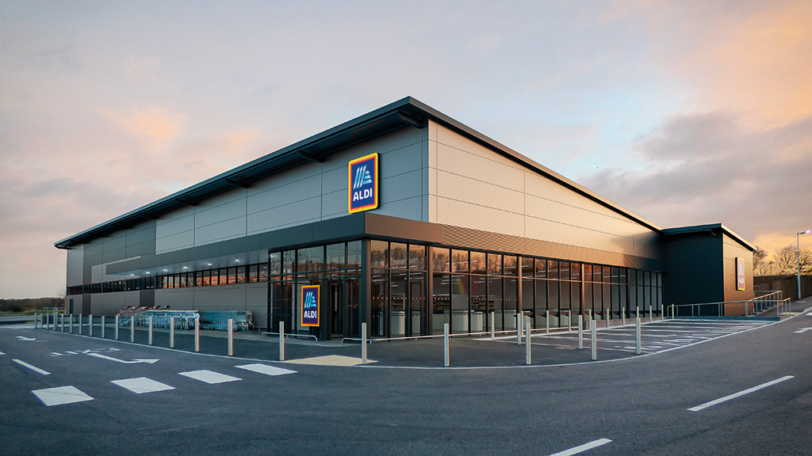
Investors
Investors provide the entrepreneur with the capital (money) to establish a business. They want a return on their investment, also known as a dividend. Capital can be:
Loan capital: A loan from a lender such as a bank. They money borrowed must be repaid with interest over an agreed period of time.
Owner capital (equity capital): Money provided by individuals or organisations who then become part owners of the company (shareholders) and are entitled to a share of the profits (dividends).
Grant: Money provided by state agencies, e.g. Enterprise Ireland, IDA Ireland, a Local Enterprise Office (LEO). The grant does not have to be repaid as long as conditions are met, e.g. employing local people.

Slide 6
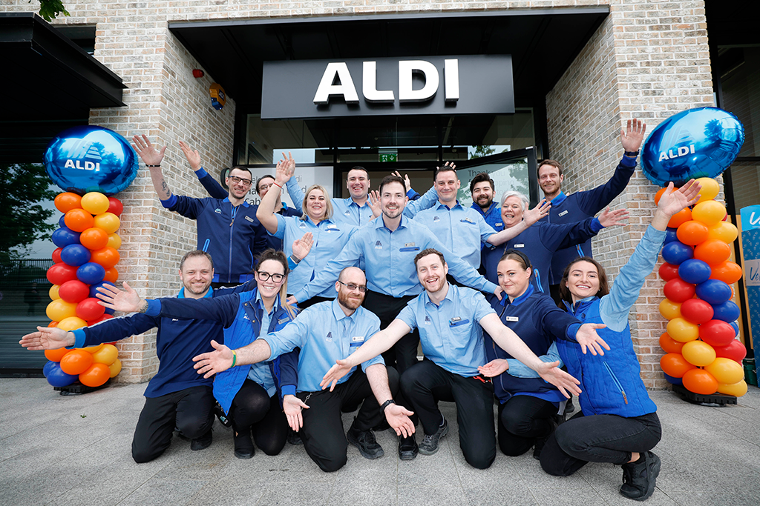
Employees
Recruited by a company to work in their business in return for a wage or salary. Employees with a variety of skills and qualifications will be needed across all areas of business operations.

Slide 7
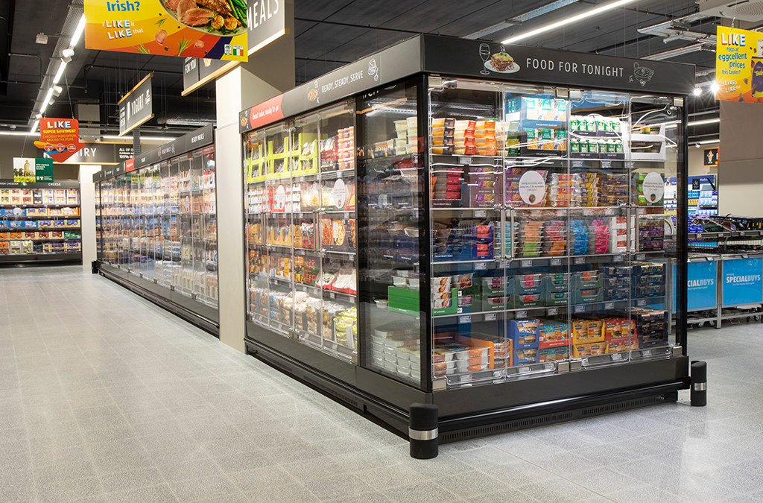
Consumers
The people who buy goods/services for their own use. Without consumers there would be no business. They want good quality at competitive prices. If a customer is satisfied with the product or service, this generates repeat custom and revenue for the business.

Slide 8

Government agencies
The government acts as a stakeholder on behalf of the public. Its main aim is to ensure businesses create employment.
All businesses must pay taxes, including corporation tax, and the government uses this revenue to improve or invest in infrastructure and services (schools, hospitals, etc.).
Businesses collect PAYE and VAT on behalf of the state.
Some state agencies, e.g. IDA Ireland, Enterprise Ireland and LEOs, provide businesses with finance, training and advice.

Slide 9
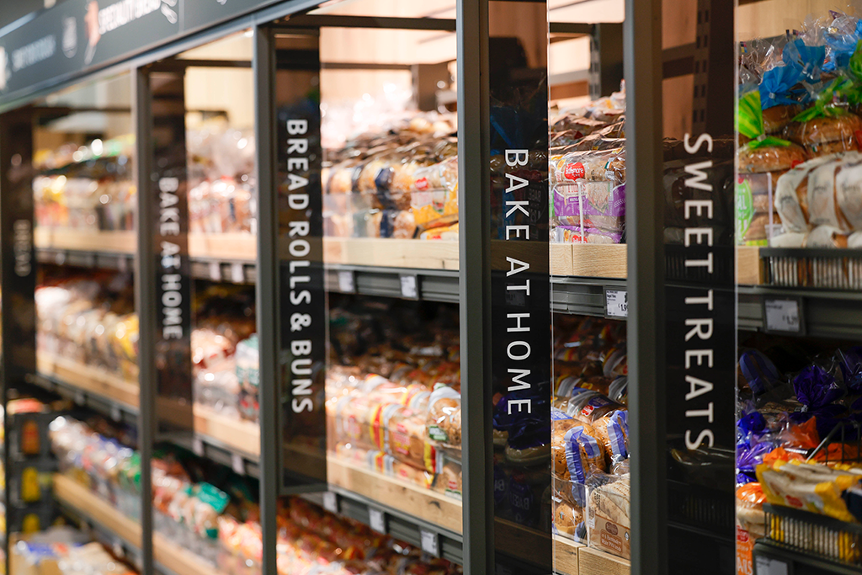
Suppliers
Provide raw materials and services, e.g. IT, electricity, that a business needs to produce their own product or service.
Suppliers and the firm work together to ensure a fair price and good-quality products or services supplied at the right time.

Slide 10
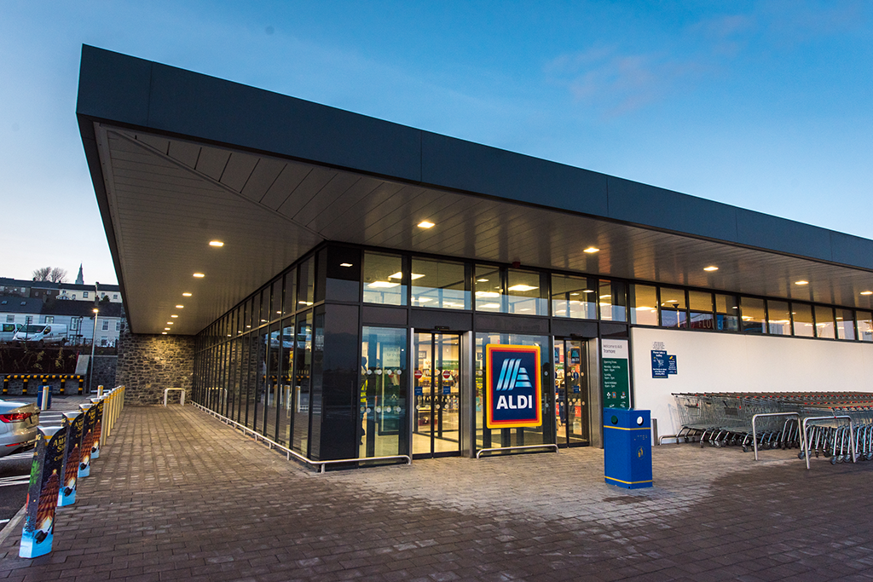
Local community
The individuals, households and organisations in the vicinity of the business. Businesses impact the local community in a huge way, for example creating employment, waste disposal, and sponsorship programmes.

Slide 11
Stakeholders
Stakeholder | What they bring to the business | What they want from the business
Entrepreneur | Ideas – the brains behind the business | Control, profit, independence
Investor | Finance | Return on investment, profit
Suppliers | Raw materials, essential services | Fast payment, loyalty
Consumers | Money (sales revenue), loyalty | Good-quality products/services at a reasonable price
Government | Legislation, advice, stability | Taxes collected, compliance with legislation
Local community | Customers, support | Social and environmental responsibility

Slide 12


Stakeholder relationships
Relationships between stakeholders are either co-operative or competitive.
Co-operative relationships (between stakeholders) are win-win. Stakeholders work together for their mutual benefit and towards a common goal.
Competitive relationships (between the business and stakeholders) are win-lose. Each stakeholder has different aims, and only one party can win, so the compete to gain commercial advantage.

Slide 13



Stakeholder relationships
Dynamic relationships: Constantly changing. Sometimes stakeholders co-operate, sometimes they compete.
Example: producers and consumers co-operate when producers make a product that consumers want.
Dependent relationships: The stakeholders need each other.
Example: entrepreneurs need support from state agencies and government bodies to start their business. The government needs entrepreneurs to set up new businesses to create jobs and provide tax revenue.
Interdependent relationships: Mutually beneficial. Stakeholders work together to get what they want, and help other stakeholders get what they want. They can accomplish more by working together than they can alone.

Slide 14
Stakeholder conflict
Conflict can be resolved in two ways:
Legislative: using existing laws or involving an outside agency.
Non-legislative: using negotiation, mediation, conciliation or arbitration, which do not rely on the law.

Slide 15

Stakeholder conflict
Conflict can be avoided by communicating and by active listening.
Both sides should:
Be open and honest
Clarify what the other party has said
Focus on what the other party is saying
Summarise what the other party has said and repeat it back to them
Share their thoughts with the other party.

Slide 16

Negotiation
Involves trying to resolve a dispute before it escalates.
A shop steward (union representative) may be involved.
The two sides may make offers and counter-offers, leading to a compromise.
Both sides must be happy with the outcome.
Example: An employee is looking for a wage increase. They negotiate with the HR manager to find a settlement that is acceptable to both parties.

Slide 17

Meditation
A mediator acts as a go-between to help two parties resolve their differences.
Mediation can involve conciliation or arbitration.

Slide 18

Conciliation
A third party, agreed to by both parties, listens to both sides. They encourage them to listen to one another and to reach an agreement.
A conciliator’s recommendations are not legally binding.
The Workplace Relations Commission (WRC) offers a conciliation service to employers and employees when industrial disputes occur.

Slide 19
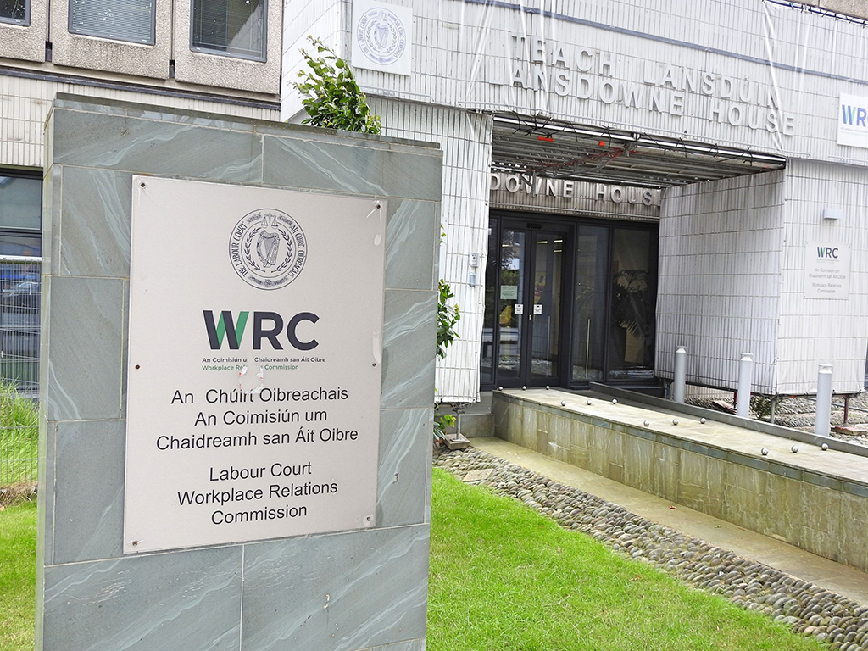
Arbitration
An arbitrator is impartial and independent. They make a recommendation on how a dispute should be resolved.
Before arbitration begins, both parties may agree that they will carry out the arbitrator’s decision.
The main type of dispute dealt with by arbitration is industrial relations issues between employers and trade unions (employees).

Slide 20

Stakeholder mapping
Stakeholder mapping means identifying, visualising and prioritising stakeholders in an organisation by examining their influence and interest in a particular project.
Some stakeholders have more power than others. The map looks at the power and level of interest of each stakeholder.

Slide 21
Power/interest grid
Power: How much a stakeholder can affect the outcome of a decision or project.
Interest: How much a stakeholder cares about the outcome of a project/decision.
Low interest/high power, e.g. government: Keep them satisfied. They could affect the outcome of projects.
Low interest/low power, e.g. customers who will not buy the company’s product: Keep monitoring them, but they will not require much attention.
Low power/high interest, e.g. existing customers: Keep them informed.
High power/high interest, e.g. investors: They have the greatest influence. Work closely with them.

Slide 22

How to do stakeholder mapping
Identify stakeholders
Grade their level of power and interest
Plot each stakeholder on a grid/matrix
Analyse the relationships between stakeholders
Develop strategies to engage different stakeholders
Implement the strategies, then monitor and evaluate them.

Slide 23
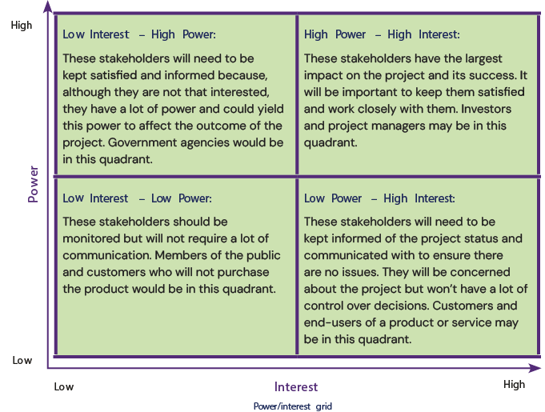
Power/influence grid
Stakeholders are grouped based on their level of power and their active involvement in the project (influence).

Slide 24
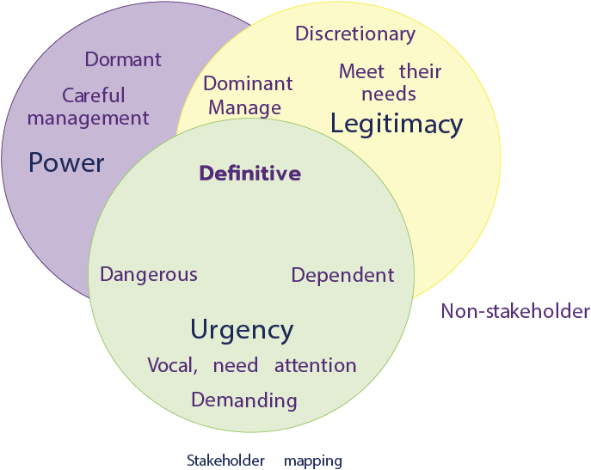
Salience model
Stakeholders are categorised based on their:
Power: Ability to affect the outcome – they have a lot of decision-making power.
Urgency: Which stakeholder’s needs should be prioritised.
Legitimacy: Their concerns and interest are reasonable.

Slide 25
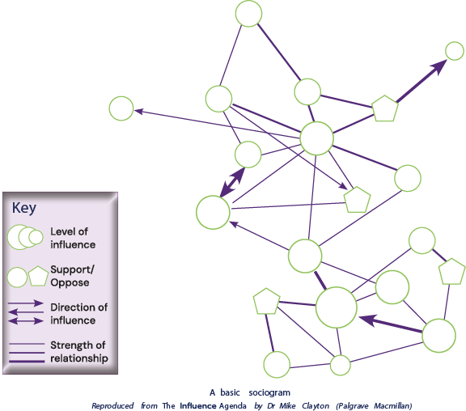
Sociogram
Represents the structure of stakeholder relationships. It shows:
Which stakeholders are connected
Who has more impact on others
Who is being impacted
The strength of that influence
Who supports the project and who is against it.

Slide 26
Benefits of stakeholder mapping
Makes best use of limited resources: Identifies the stakeholders with the most power and influence and where a company should spend the most time/resources.
Avoid conflict: Individual stakeholders can be managed more effectively, helping to avoid stakeholder conflict.
Builds trust: Stakeholders will be less resistant to change. The business will be able to progress projects and initiatives with less conflict.
Better-quality product or service: A better understanding of stakeholders’ needs means that the company will deliver a better-quality product/service, improving its reputation and increasing sales and profits.

Slide 27
Credit
Shutterstock

