Slide 1
Forms of Business

Slide 2

Forms of Business

Slide 3
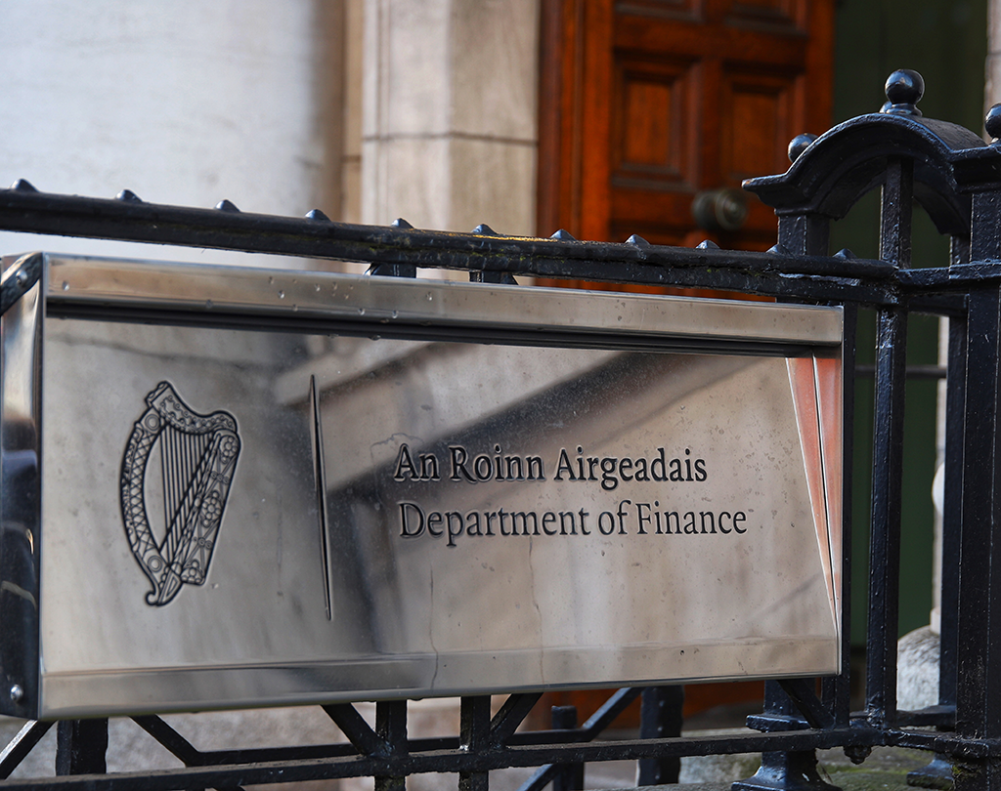
Public enterprises
Ownership: Government
Purpose: Providing essential and social services, e.g. HSE, schools, RTÉ, Irish Water
Profit: Either returned to the government or reinvested in the company
Regulation: Companies Act 2014
Management: Owned and run by the state. Under the aegis of a government minister.

Slide 4
Contribution of public/semi-state enterprises
Employment: Over 400,000 people are employed in the public sector. This reduces unemployment rate and expenditure on social protection. Higher employment leads to increased spending in local areas, and higher sales and profits for local businesses. This is called the multiplier effect.
Essential services: Public enterprises provide services that private enterprises would find commercially unviable, e.g. bus routes to rural areas. This is called a public services obligation.
Government revenue: Public enterprises provide revenue through taxes. This revenue is used to fund essential services, e.g. health and education, and local authorities, which use it to improve facilities and services e.g. parking and roads.

Slide 5

Private companies
Ownership: Private individuals or companies
Purpose: To maximise profits for their stakeholders and owners
Profit: Either reinvested in the company or paid to the shareholders as dividends
Regulations: Companies Act 2014
Management: Shareholders. A registered company must have a company secretary.

Slide 6
Contribution of private enterprise
Provides employment: This reduces unemployment and government spending on social protection. Employees spend their earnings locally, contributing to the growth of local business.
Innovation: Many companies invest in research and development (R&D) to develop new technologies.
Encourages enterprise: Successful private enterprises may encourage other entrepreneurs to set up new enterprises. This creates a positive enterprise culture, which encourages further economic growth.
Provides goods and services: Provides consumers with goods and services.

Slide 7
Not-for-profit enterprises
These include charities, social enterprises and non-governmental organisations (NGOs).
Ownership: No one person or group
Purpose: Focuses on a particular social cause
Profit: Goes back into running the company
Regulation: Charities Regulatory Authority (also called the Charities Regulator), which ensures that all charities comply with the Charities Act 2009
Management: Usually controlled by a board of members who are elected by members.

Slide 8
Social enterprises
Put people and community ahead of personal and private gain. Tackle social, economic and environmental issues.
Most profits are used to fund social programmes.
Obtain finance by selling goods and services.
Differ from charities in that they generate sustainable revenue.
Use as many volunteers as possible to keep wage costs low. Prioritise hiring workers on Jobseeker’s Allowance.
No specific company format. Can be a company limited by shares, a company limited by guarantee, or can have charitable status.
Constitution often based on what the founders of the enterprise decided was the best fit.

Slide 9
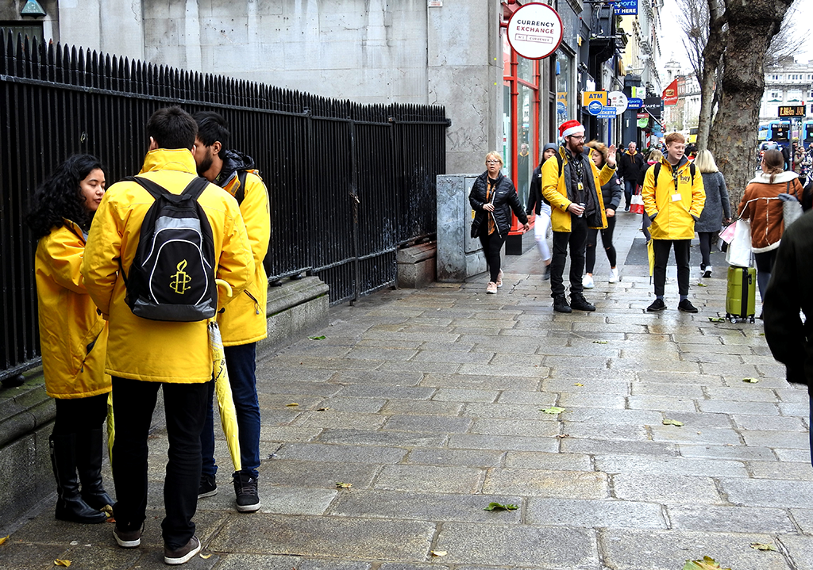
Non-governmental organisations (NGOs)
Fundamentally non-profit, comprising voluntary groups organised on a local or national level.
Steered by people who share a common interest and goal.
Carry out humanitarian work and represent people who face inequalities.
Most are established using the framework of a company limited by guarantee (CLG).
Must have a Memorandum of Association and Articles of Association.
Examples: National Youth Council of Ireland, National Women’s Council of Ireland, Irish Red Cross.

Slide 10
Companies limited by guarantee (CLG)
This form of company is used primarily for NGOs that require a legal personality.
There is no share capital in the company. The members are known as guarantors, not shareholders.
A guarantor has to pay a nominal amount, usually €1, towards the winding-up of the company.
No profits are distributed to the guarantors/members and the CLG can apply for charitable exemption from the government.

Slide 11

Charities
Set up to promote a charitable purpose.
They provide a public benefit and can only promote that particular charitable purpose.
They must register with the Charities Regulator.
They can range in size from small, local charities run by volunteers to large, national or international organisations.
There are four main types of charity: a CLG, an unincorporated association, a trust or a school.
Examples: schools, universities, hospitals, family resource centres, community centres.

Slide 12

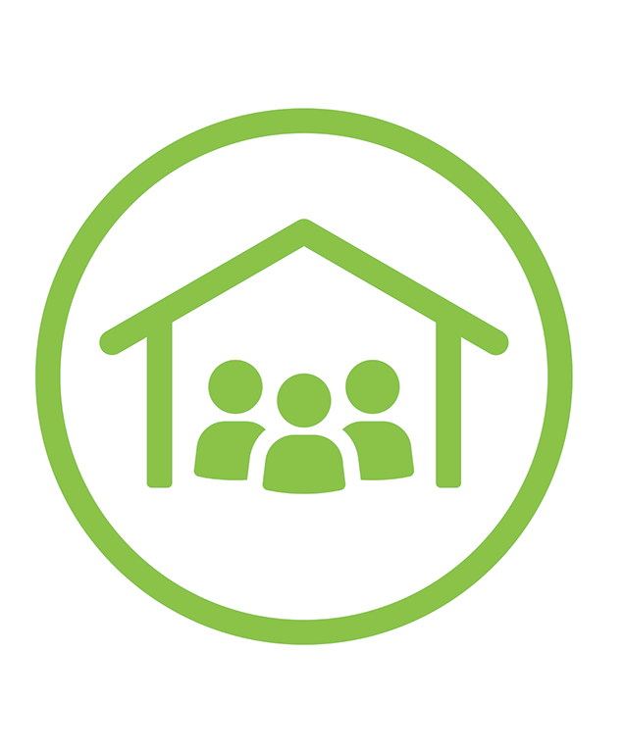

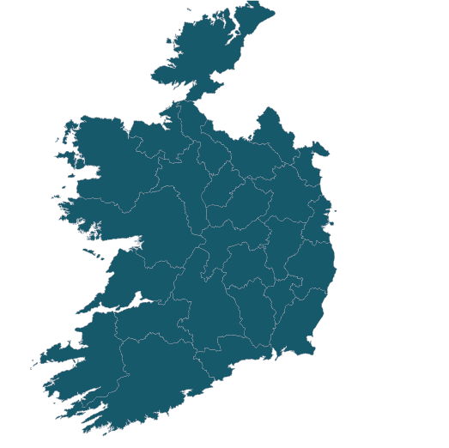
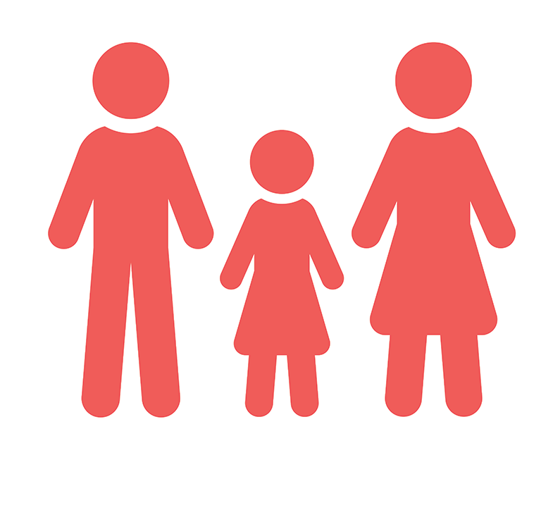
Charity test
An organisation that wants to register as a charity must pass a charity test:
It cannot be on the list of excluded bodies (e.g. a political party, trade union, chamber of commerce).
Its purpose(s) must be charitable and all its activities must promote charitable purposes.
It must provide a public benefit which should be recognisable to everyone.
It must operate in Ireland.
Charity
Not an excluded body
Charitable purpose only
All activities promote charitable purpose
Public benefit
Operates in Ireland

Slide 13
Types of ownership structure
Criteria for choosing an ownership structure:
Liability: How much personal responsibility the owners will have for business debts.
Access to capital: Will it be possible to raise finance when needed?
Control: How much control/influence will owners have on the day-to-day running of the company?
Taxation: Sole traders and limited companies have different tax liabilities.
Cost: A private limited company can be more costly and more legally complex to set up.
Expansion: Some structures make it easier for the company to expand.
Continuity: Whether the entrepreneur wants the company to continue to exist after their death.

Slide 14

Sole trader
A business owned and operated by one person.
No formalities required except registration of a business name if you are using a name other than your own.
Usually small businesses.
The most common type of business in Ireland.
Must register for self-assessed income tax (SAIT) and also for VAT, if sales exceed a certain value.

Slide 15
Sole trader
Benefits of sole trader |  | Drawbacks of sole trader
Set-up | Straightforward, few regulations (just registration), and it easier and cheaper than other ownership structures. | Risk | Because the owner has unlimited liability they carry all the risks involved with the business if it fails. This could potentially lead to the loss of personal assets.
Control | Owner has full control, doesn’t need to consult with other shareholders, makes all the decisions. | Finance | Potential shortage of capital and lack of financial expertise.
Profits | As the sole owner, the sole trader will receive all the profits. | Stress | A heavy workload and a lot of pressure on the owner. Having complete responsibility for all areas of the business can be overwhelming.

Slide 16

Private limited company (company limited by shares)
Registered with the Companies Registration Office and owned by investors called shareholders.
Finance can be raised by selling shares.
Shareholders have limited liability.
One share = one vote.
Dividend received is based on the number of shares held.
Tax paid at 12.5% (corporation tax).
No authorised share capital is required, so no limit on the number of shares a business can have at any one time.
Company dissolved through court order or bankruptcy.
Not obliged to hold an annual general meeting (AGM).

Slide 17

Private limited company
Benefits:
Continuity of existence
Access to capital (selling shares)
Limited liability
Corporation tax rate of 12.5%
Drawbacks:
Formation is time-consuming and complex
Documentation is expensive and time-consuming to prepare
Profits shared by all shareholders

Slide 18

Private limited company
Formation:
Rules set out in Companies Act 2014.
Form A1:
company name, directors, company secretary
statement of share capital including shareholders and the details of their shares
the activity the company is being registered to engage in.
Constitution:
company name
states that it is a company limited by shares
any other regulations the company may wish to include.

Slide 19

Designated activity company (DAC)
Appropriate for companies who want to outline their type of business in their constitution rather than having unlimited powers, as a limited (Ltd) would have.
Must hold an AGM.

Slide 20
Designated activity company (DAC)
Formation:
Form A1
Memorandum of Association (external rules of the company):
company name (with Ltd/Teo/Teoranta)
aims
statements of limited liability and authorised share capital
signatures/number of shares of each shareholder.

Slide 21
Designated activity company (DAC)
Articles of Association (internal rules of the company):
company name
share capital/equity
procedure for calling company meetings/the quorum
voting procedures
how profits are divided among shareholders
procedure for winding up the company.

Slide 22
Public limited company (PLC)
Formed when a private limited company or other business seeks a stock exchange listing or quotation.
Shares can be bought and sold by the general public.
All public listed companies have PLC after their name and must have at least seven shareholders.
Most Irish PLCs are listed on the Dublin Stock Exchange (bigger companies are listed on the New York or London stock exchanges).
Shareholders have limited liability.
Requires a Memorandum of Association and Articles of Association.
Has a trading certificate and certificate of incorporation from the Companies Registration Office (CRO).

Slide 23

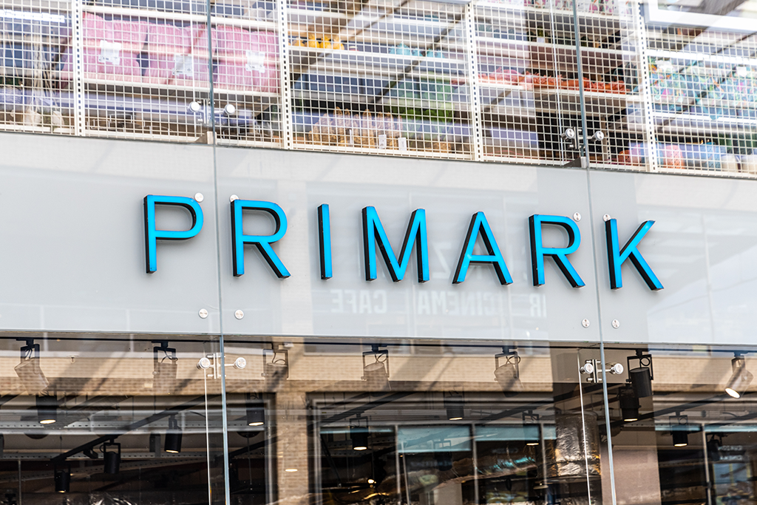
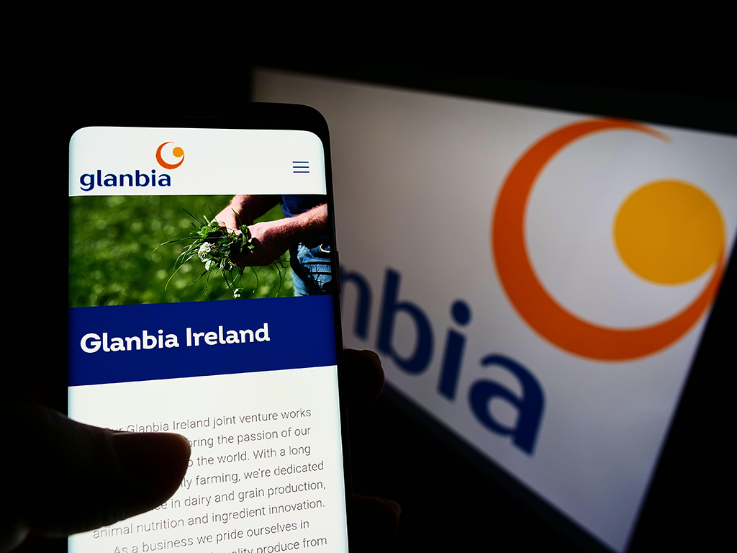
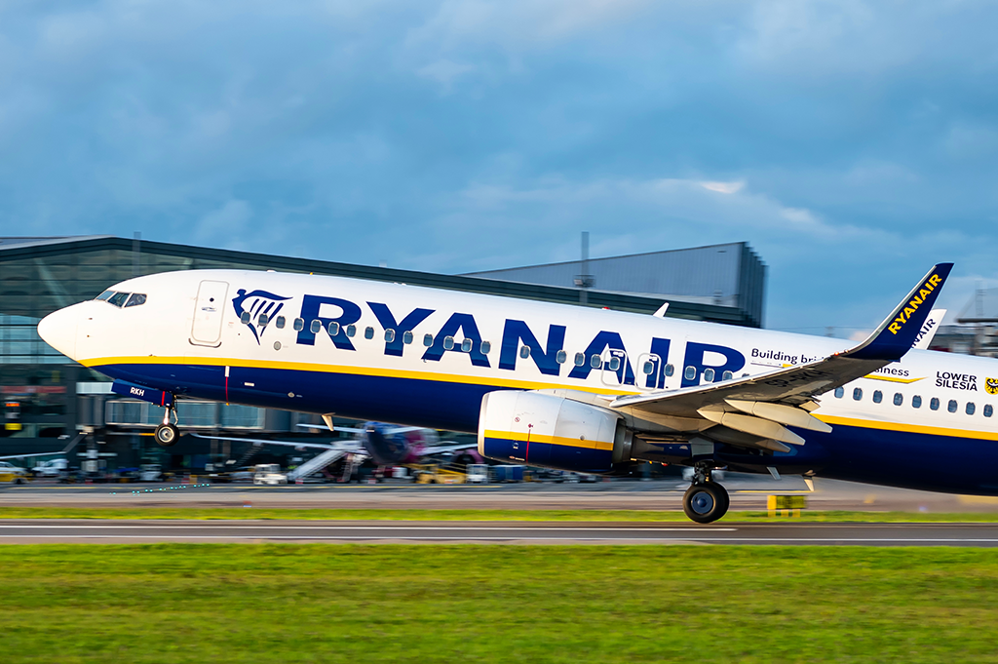
Public limited company (PLC)
Benefits:
Better market access due to size
Image: stock exchange listing seen as prestigious
Credit rating: seen as less risky and therefore attracts investors
Limited liability.
Drawbacks:
Expensive to set up
A lot of rules and regulations apply
Vulnerable to takeovers
Profits must be shared between stakeholders.

Slide 24
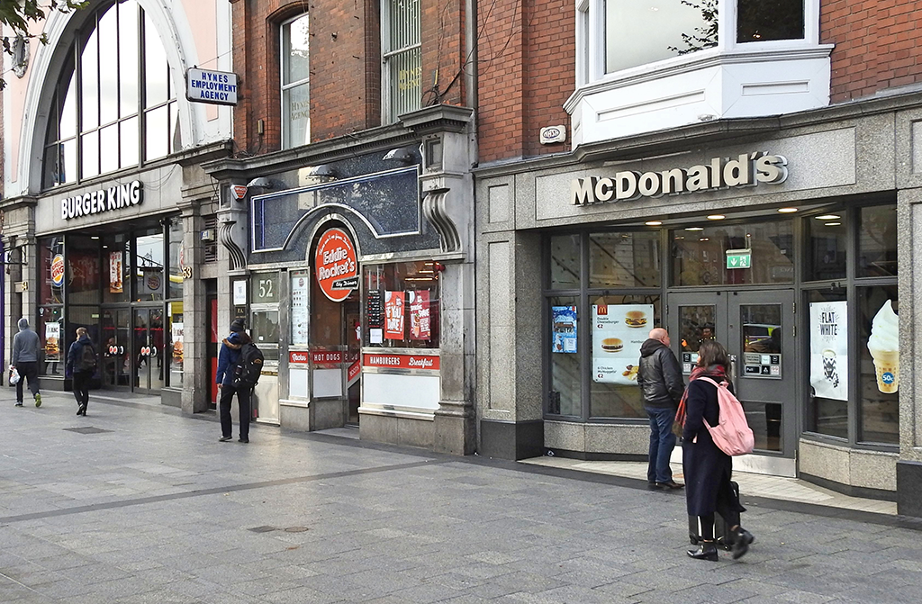
Franchise
A licensed, well-established, reputable business (the franchiser) rents a complete business idea, including name, logo and products, to someone else (the franchisee).
Examples: Eddie Rocket’s, McDonald’s, Bagel Factory

Slide 25
Franchise
Advantages for the franchiser:
Allows rapid expansion
Low capital investment
Low risk
Higher return on investment
Disadvantages for the franchiser:
Lower profits
Loss of control
Reputation can be damaged by a poor franchisee

Slide 26
Franchise
Advantages for the franchisee:
Recognised brand name
Support and training
Cost saving
Disadvantages for the franchisee:
Lower profits
Lack of overall control

Slide 27
Co-operatives
Businesses that are democratically owned and controlled by their members – the firm’s workers, suppliers or customers. They run the business for mutual benefit.
Types of co-op: producer co-ops, workers’ co-ops, consumer co-ops, financial co-ops (credit unions).
Must register with the Registrar of Friendly Societies as a co-operative and have a minimum of seven members.
Members are protected by limited liability.
A management committee is appointed to run the co-op.
Corporation tax is paid at 12.5% and co-ops must submit an annual audit and file annual returns.

Slide 28
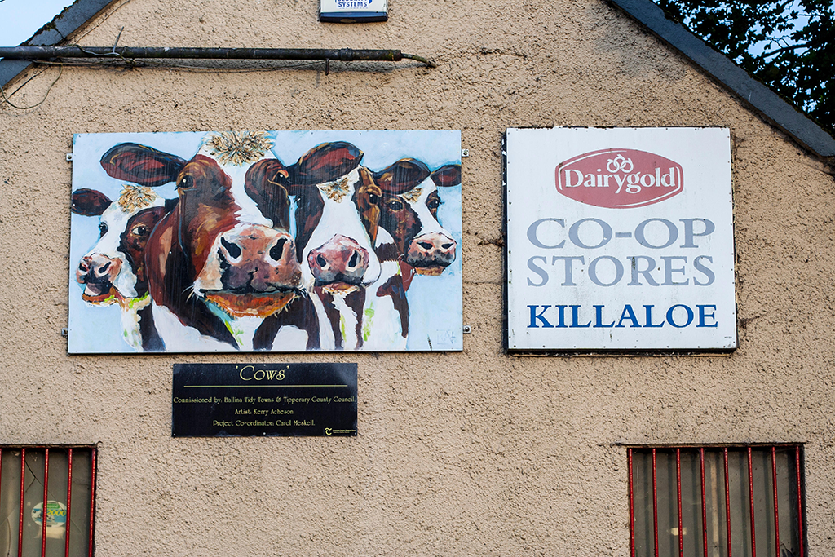
Co-operatives
Benefits:
Limited liability
12.5% taxation – lower than a sole trader
‘One member, one vote’
Drawbacks:
Registration can be complex and expensive
Profits are shared between members
Lack of capital – difficult to finance growth

Slide 29
Public sector organisations
Owned, funded or operated by the government.
Set up using special laws and known as statutory companies, or can be registered with the CRO, e.g. CIÉ, ESB, RTÉ.
Each company is responsible to a particular government department.
The minister appoints the board of directors.
The government provides start-up finance and may subsidise losses. It sometimes agrees to repay any loan required.
Profits may be reinvested or paid out in dividends to the government.
Any losses mean the taxpayer is losing money.
Mainly involved in transport (CIÉ), communications (RTÉ), energy (ESB), development (Industrial Development Agency (IDA).

Slide 30
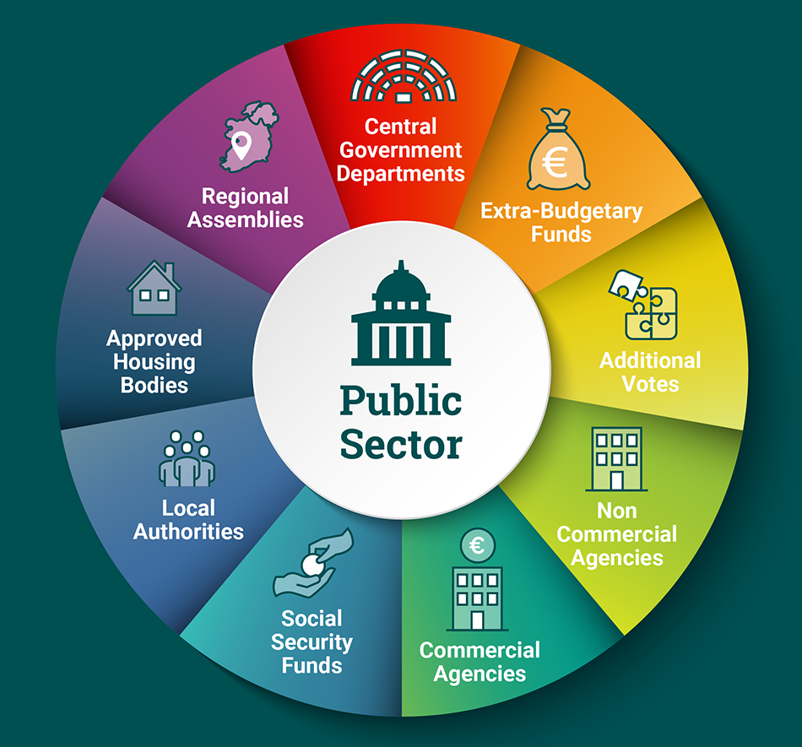
Public sector organisations
Benefits:
Employ almost 75,000 people
Provide essential services
Government receives income
Drawbacks:
Several are loss-making
Decisions made by government appointees who may not have relevant experience
Little incentive to run the company efficiently

Slide 31
Partnerships
Two or more people (up to 20, or 50 for a financial organisation) forms a business relationship.
Profits are shared equally or as in the deed of partnership.
All partners have unlimited liability.
Partners are likely to have access to larger amounts of capital.
The partnership can be terminated if one person dies or becomes bankrupt or if the partners agree to dissolve it or continue with a new partnership.
Must register with the Revenue Commissioners for tax.
It is advisable that the partners have their agreement in writing in case of conflict.

Slide 32

Partnerships
Benefits:
Easy to set up and run
Decisions shared between partners
Easier access to finance than for a sole trader
Drawbacks:
Unlimited liability
Decision-making can be slow; conflict possible
Profits shared between partners

Slide 33

Why business structures change
Reasons for changing legal structure:
Raising finance
Reducing risk
Bringing in new skills
Lower tax rates
To regain control
To help marketing

Slide 34
Privatisation and nationalisation
Privatisation: A state-owned firm is sold to private enterprise by a share flotation. Ownership and control are transferred from the government to private investors.
Benefits of privatisation:
Government received revenue from the sale
Can improve efficiency
Reduces political interference
Easier to expand.

Slide 35

Privatisation and nationalisation
Nationalisation: Transferring the ownership of a privately owned asset or company to the state. Ownership and control are transferred from private investors to the government.
Benefits of nationalisation:
Key public services are controlled by the state
Greater security for employees
Protection against monopolies
Government revenue.

Slide 36
Credits
Alamy
Shutterstock
CSO

