Slide 1
Key Economic Indicators

Slide 2

Key Economic Indicators

Slide 3

What is economics?
Economics is a social science. It studies how scarce resources are distributed to satisfy the needs and wants of consumers and businesses.
A need is something we need for survival, e.g. food, shelter.
A want is something that is not essential but something we would like to have.

Slide 4

What is economics?
An economy is a system that tries to solve the problem of infinite needs and wants and scarce resources.
Since resources are limited, decisions must be made about what type of goods and services are produced or provided. Who makes these decisions determines the type of economic system operating in a country.
Economic Continuum
Mixed Economy
Government and citizens control business
Centrally Planned Economy
(Command Economy)
Free Enterprise Economy
(Capitalist)
Pure Command
Pure Market
Government has complete control of the economy, businesses, jobs and goods.
Supply and demand rules. The people have complete control of the economy without government rules.

Slide 5
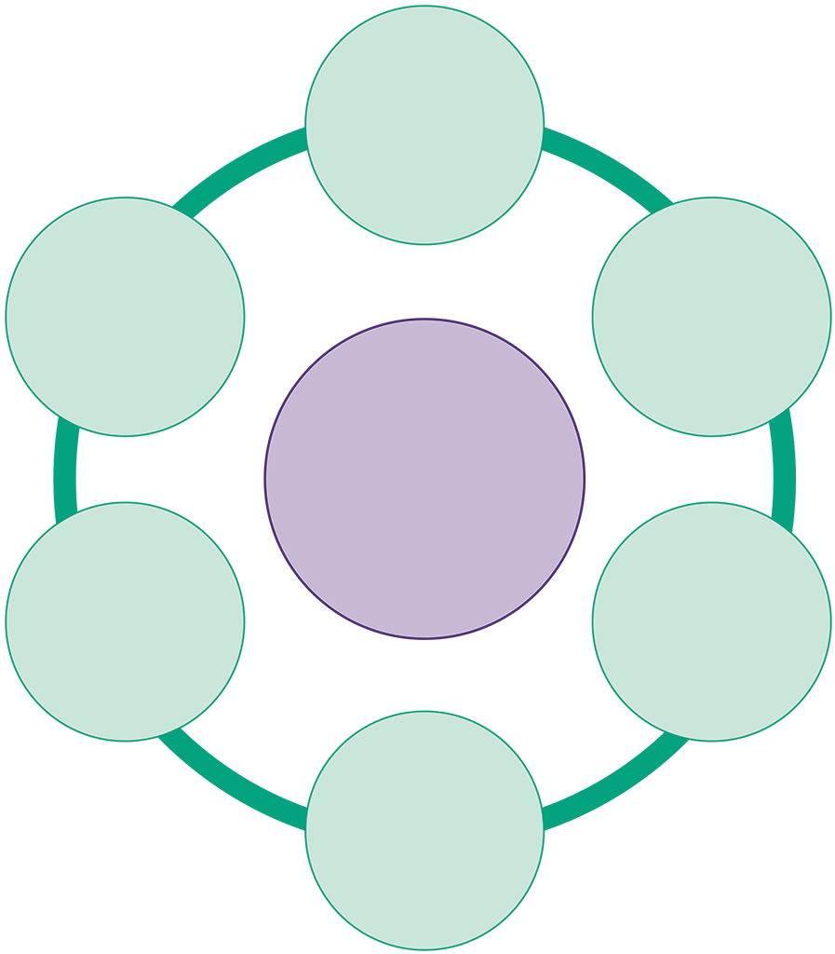

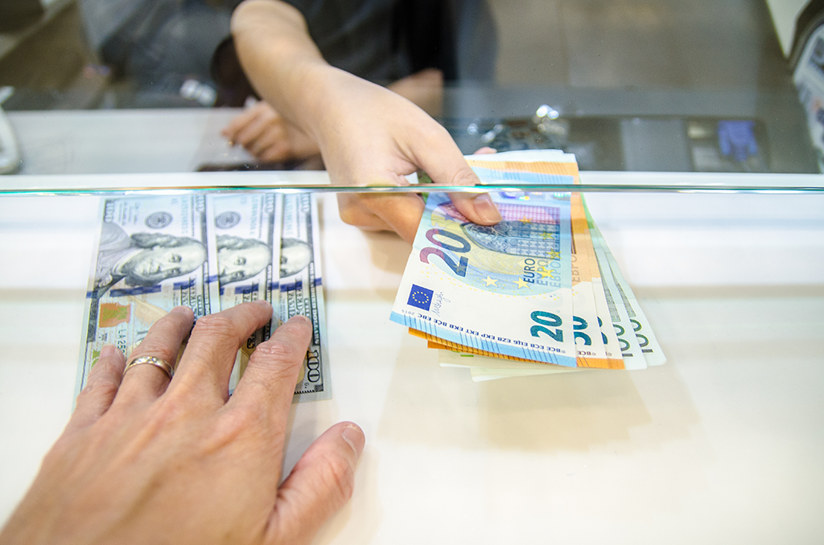
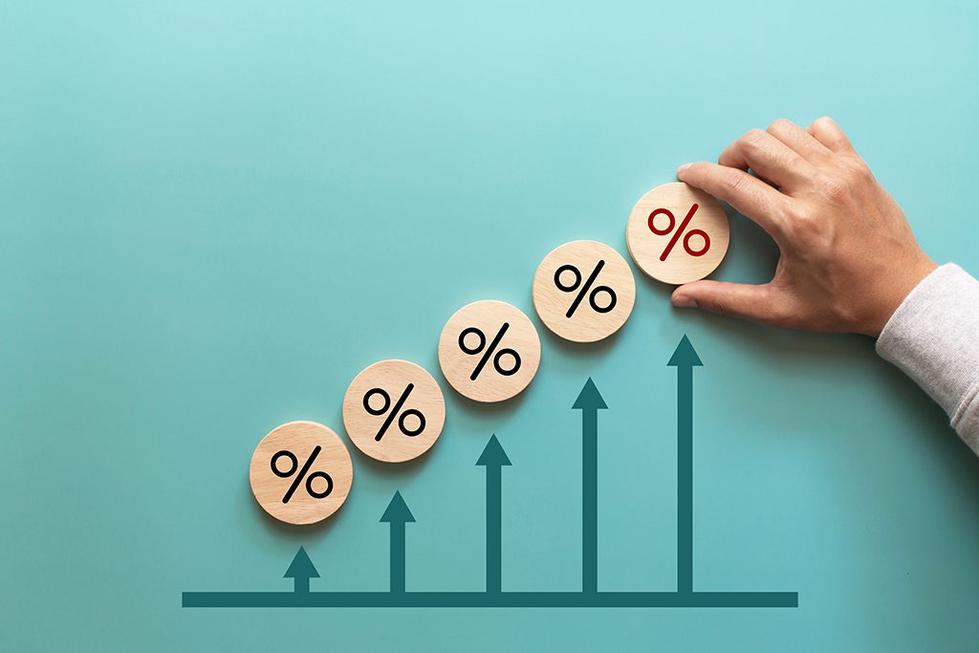
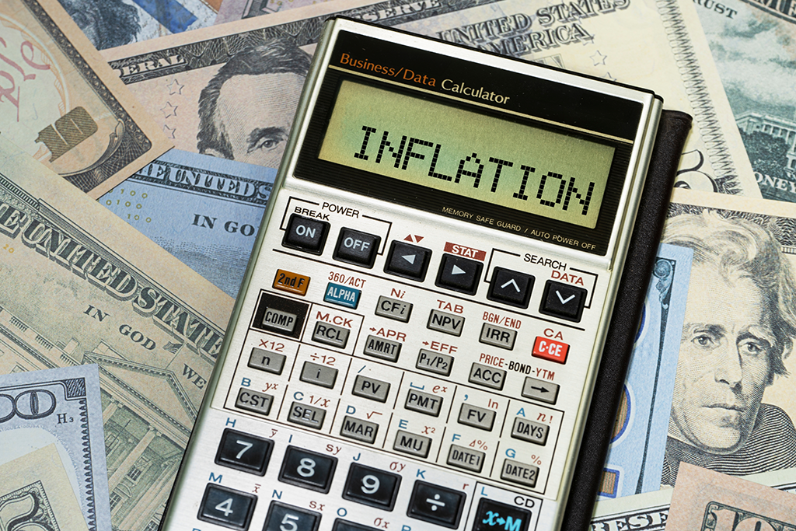


Economic indicators
An economic indicator is a statistic or piece of data that measures some element of an economy’s performance. These measurements or statistics can tell us if the economy is performing well or if an element in the economy is concerning and needs intervention.
The key economic indicators are:
Inflation
Employment
Interest rates
Economic growth and development
Exchange rates
Consumer confidence
Employment
Exchange
rates
Interest
rates
Key
Economic
Indicator
Inflation
Consumer
confidence
Economic
growth and
development

Slide 6
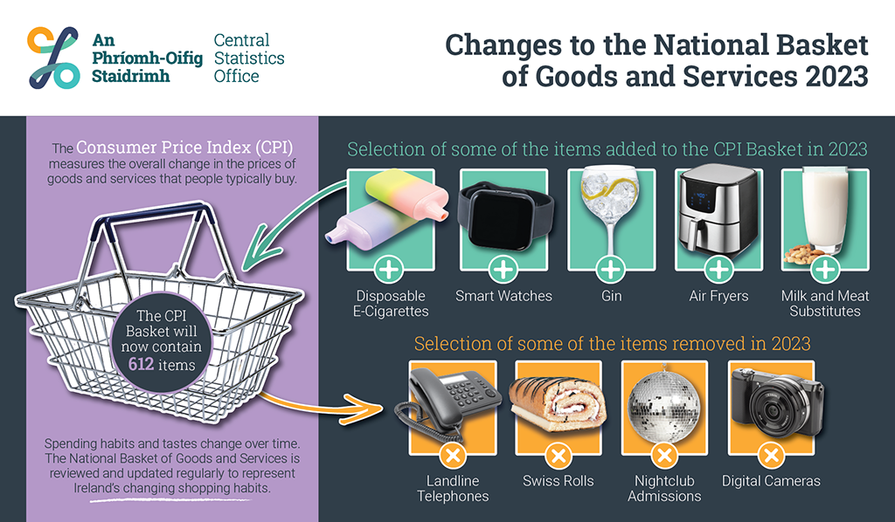
Inflation
Inflation is a sustained increase in the level of selling prices over a specified period. It reduces the buying power of each euro. It is measured by the Consumer Price Index (CPI).
The Central Statistics Office (CSO) measures the price of a regular basket of goods that an average consumer would spend their money on.
It records the price of these items every month and measures how they change. Each product is given a weight, which reflects its importance in the basket of goods. Some goods are ‘weighted’ more heavily than others because more of a consumers’ income is spent on them (e.g. energy).

Slide 7
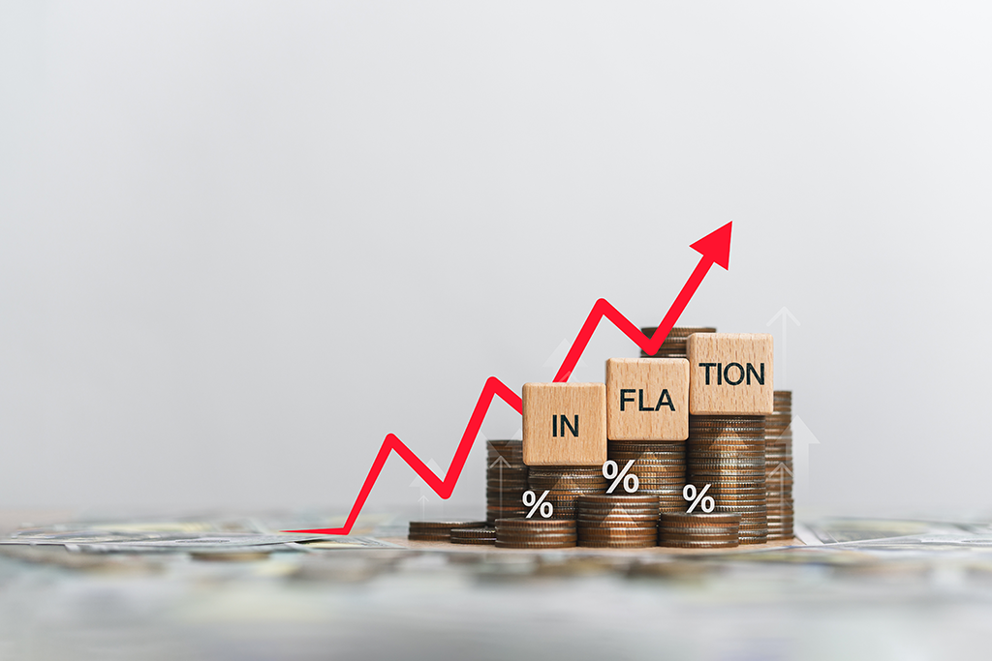
Inflation
Demand pull inflation occurs when there is an increase in the aggregate demand for goods and services. The demand for the good outweighs the supply of it. This is more likely when the economy is doing well.
Cost push inflation occurs when the cost of producing a good increases and pushes up the price of an item. Increases in electricity, oil and the minimum wage would cause cost push inflation.

Slide 8
Inflation
High inflation:
Higher costs of raw materials = higher selling price. Irish firms become less competitive (compared to imported foreign goods). Domestic sales may decrease and jobs may be lost.
Cheaper raw materials may be sourced from abroad. This can have an adverse effect on the balance of payments
The cost of living rises. Unions look for wage increases to match inflation. If this occurs, without any increase in productivity, it may lead to further inflation and will increase costs for businesses.

Slide 9
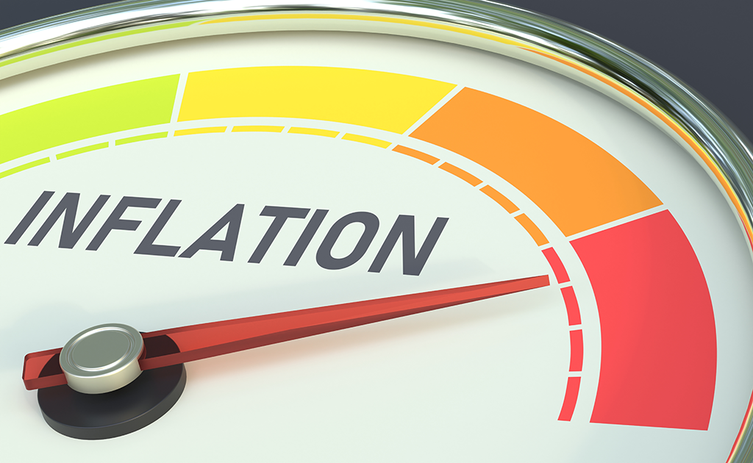
Inflation
High inflation:
Exports become less competitive. Irish products sold in foreign markets become more expensive and there may be a decline in export sales. This has a negative impact on the balance of trade.
The government may have to increase wages for public sector workers. This will create an opportunity cost and they may have to reduce spending on other services, e.g. transport.

Slide 10
Inflation
Low inflation:
Prices and wage increases are kept to a minimum.
Government spending is reduced.
Any price increases will be minimal, which will have a positive impact on business costs.
The cost of running expenses and sourcing raw materials will not increase too much.

Slide 11
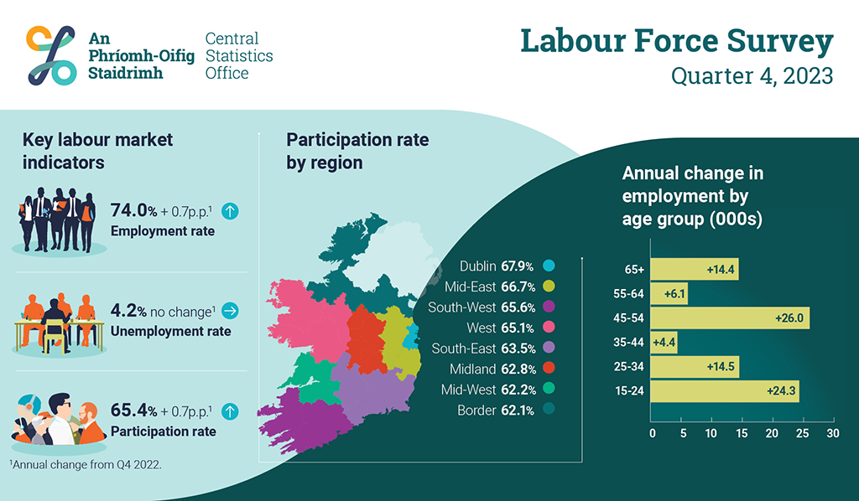
Employment
Labour force: Everyone between the ages of 16 and 65 who is working or available for work. It includes both unemployed people and those in the workforce.
Full employment: All those who are seeking work are employed at existing wage rates. In full employment, about 86 – 98% of the labour force is employed.
Unemployment: When people who are available for work and of employable age are out of work. The unemployment rate measures the percentage of the labour force who are currently unemployed (out of work).

Slide 12

Employment
High employment:
Higher tax revenue for the government from a range of taxes including PAYE, VAT and PRSI. This can be spent on improving infrastructure and government services.
Pushes wages up as firms have to compete to attract and retain skilled workers.
Increased aggregate demand – more money is spent on goods and services. This means increased sales and profits for firms, business expansion and further job increases.
May come with a cost to the environment – increased traffic congestion, noise pollution and disruption to the physical landscape.
Can make it difficult for firms to find suitable staff. Certain industries may experience labour shortages.

Slide 13
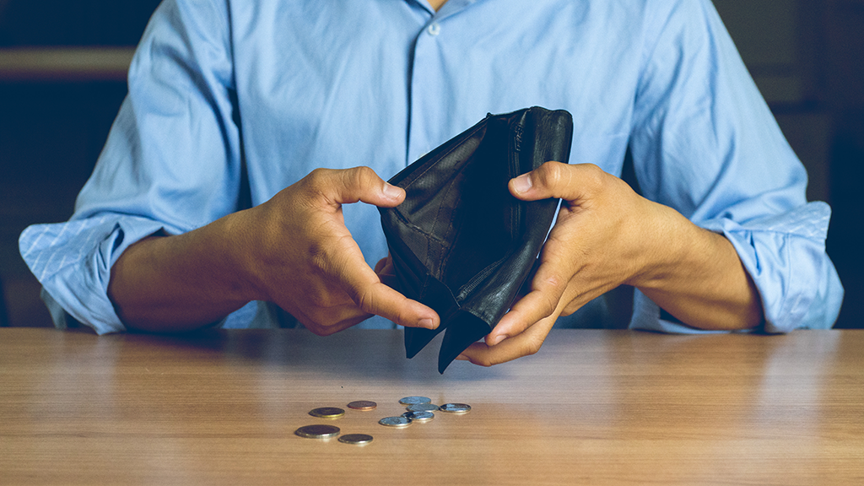
Unemployment
High unemployment:
Less government revenue from tax and increased government expenditure on social protection.
Consumers have less disposable income. They may reduce their spending, and firms may see a decrease in their sales and profits.
May lead to more anti-social behaviour and other social problems, e.g. increased crime rates.
Firms have a wider pool of skilled workers to recruit from.

Slide 14
Interest rates
Interest is the cost of borrowing money. The amount of interest charged by a bank or other financial institution for a loan is the price that the borrower must pay for the use of the money.
Interest is also the return for saving money.
It is expressed as a percentage of the amount borrowed or saved.
Ireland’s interest rates are set by the European Central Bank.

Slide 15
Impact of interest rates on businesses
High interest rates:
Consumers are less likely to borrow. There is lower demand for goods and services.
Less tax revenue (e.g. VAT).
Firms may postpone development plans. They may find it harder to source investment.
Higher rates for mortgage-holders reduces disposable income.

Slide 16
Impact of interest rates on businesses
Low interest rates:
Borrowing is cheaper. Higher demand for goods and services.
Encourages business to expand, leading to higher employment and higher tax revenue.
Repayments on loans are cheaper, meaning business costs are lower.
Lower rates for mortgage-holders increases disposable income.

Slide 17
Economic growth and development
Economic growth is an increase in gross national product (GNP) per head without any changes in the structure of society. In other words, an increase in the value of goods and services produced in an economy from one period to the next.
Economic development occurs when the standard of living (or GNP per person) in a country increases, along with a fundamental change in the structure of society.

Slide 18
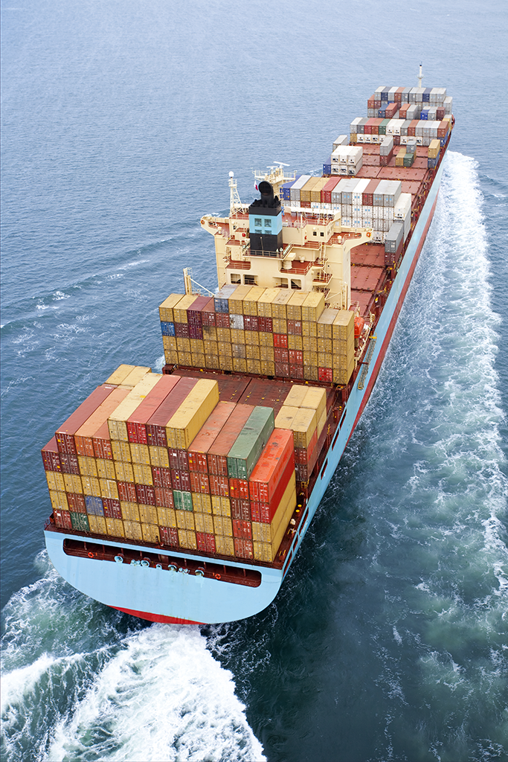
Economic growth and development
GNP (gross national product) measures the total value of goods and services produced by Irish citizens and businesses in Ireland and abroad.
GDP (gross domestic product) measures the total value of goods and services produced in Ireland. It includes the value of goods and services produced by foreign multinational corporations (MNCs). GDP is the most commonly used economic indicator.

Slide 19

Economic growth and development
High GDP suggests that the country has many productive industries producing goods, along with a well-developed service industry.
Low GDP suggests that the country has few industries and few services and therefore has a poor standard of living.

Slide 20
Economic growth and development
Economic activity changes over time. Times of economic prosperity and times of economic hardship occur in economic cycles.
A continuous period of economic growth is an economic boom, e.g. the Celtic Tiger years (1994-2006).
An economy that experiences negative economic growth for two consecutive quarters is said to be in a recession. Demand for goods and services falls, business profits are lower, and unemployment is higher. Ireland experienced a recession following the financial crisis of 2008.

Slide 21
Impact of economic growth
Higher employment: Increased demand for goods and services means an increased demand for workers to produce them.
Improved government finances: An increase in spending will mean an increase in indirect tax revenue (VAT) and direct tax revenue (PAYE). Spending on social protection should fall.
Higher standard of living: Economic growth will result in high incomes in the economy, meaning an improvement in standard of living. This may help to alleviate poverty for some citizens.
Higher business sales and profits: Consumers will increase spending, which will increase sales and profits for businesses.
Investment opportunities: Economic growth creates confidence in the market. This may encourage entrepreneurs to invest further, particularly in more sustainable and environmentally friendly technologies.

Slide 22
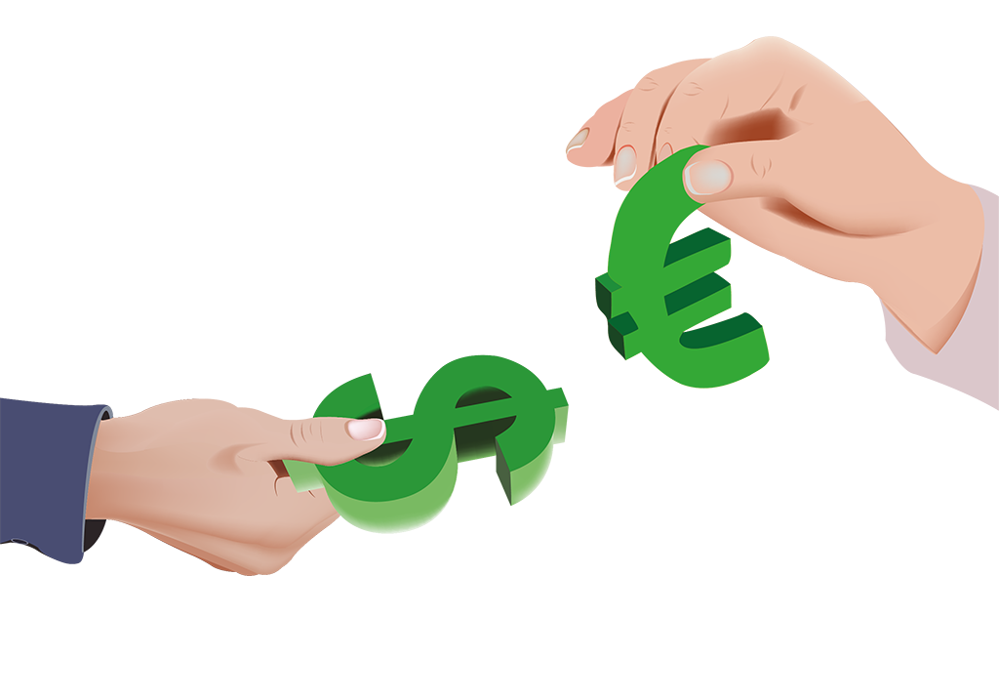
Exchange rates
The exchange rate is the price of one currency in terms of another currency, e.g. €1 = $1.25 means that one euro can purchase one US dollar and 25 cents. In simple terms, it determines how much your currency is worth in another country. For example, at the end of June 2024, the US$ to € exchange rate was 1.07. That means one euro could be exchanged for $1.07.
When converting € to a foreign currency, you multiply by the exchange rate.
When converting foreign currency to €, you divide by the exchange rate.

Slide 23


Impact of exchange rates on businesses
Impact of exchange rates on businesses
 | If the value of the home currency falls against other currencies, exports will become cheaper for foreign buyers, which could lead to an increase in demand. Businesses may have to recruit more staff. If the home currency increases in value, the firm’s products may become more expensive in foreign markets, which may reduce demand.
 | A fall in the value of the home currency will make imports more expensive. This will increase the costs for businesses that rely on foreign goods or raw materials. If the home currency increases, imports will be cheaper.
 | When the value of a currency falls in a home country, it makes the goods it produces cheaper on the global market, potentially increasing competitiveness. On the flip slide, some businesses may find it a lot harder to compete on an international scale because their goods and services have become more expensive.
Cost of exports
Cost of imports
Competitiveness

Slide 24

Consumer confidence
Consumer confidence is a statistical measure of consumers’ feelings about current and future economic conditions. It is used as an indicator of the overall state of the economy. It plays a huge role in each of the economic indicators.

Slide 25

Consumer confidence and economic indicators
Employment / unemployment
Low unemployment – people have more disposable income to spend on discretionary items, e.g. holidays.
High unemployment – more people have relatively small incomes to spend, which reduces overall demand.

Slide 26
Consumer confidence and economic indicators
Taxation
VAT increases lead to more expensive goods and services for the consumer, which causes demand to fall.
High PAYE income taxes reduce the amount of disposable income available to consumers, which reduces demand.
Low levels of income tax – consumers will have more disposable income to spend on goods and services.

Slide 27
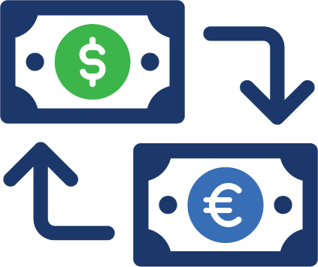
Consumer confidence and economic indicators
Exchange rates
An increase in the value of the euro – Irish people will have greater spending power when they are holidaying in non-eurozone countries.
A decrease in the value of the euro – imported goods are more expensive. People may buy more Irish goods.

Slide 28
The business economy in Ireland
All businesses require inputs or resources (e.g. raw materials, labour, packaging, capital), which they use to produce a product or service which they sell to make a profit.
Businesses provide numerous benefits to the local and national economy:
They create jobs.
They buy resources from other businesses.
They pay taxes.
Their employees spend their wages in other local businesses.

Slide 29
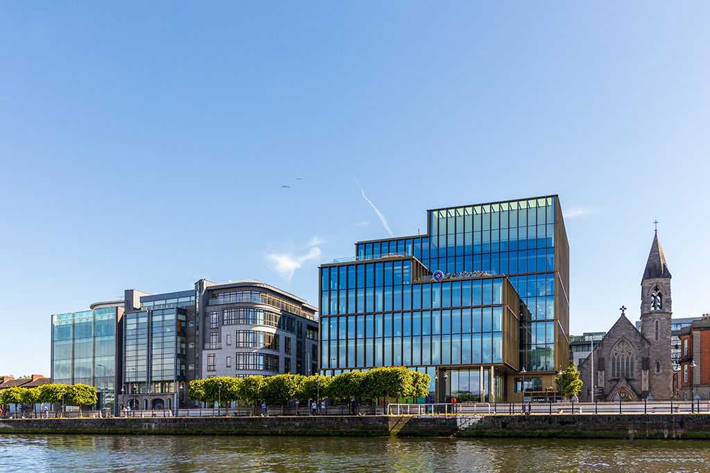
The business economy in Ireland
Businesses are categorised into a number of sectors:
Agriculture
Industry
Construction
Distributive trades (distribution, transport, hotels and restaurants)
Information and communication
Financial and insurance activities
Real estate activities
Professional, administration and support services
Public administration, education and health
Arts, entertainment and other services.

Slide 30
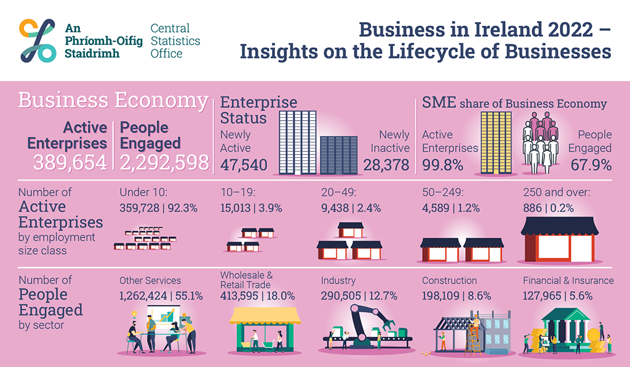
The business economy in Ireland
Turnover is the totals invoiced by the enterprise during the reference period, and this corresponds to market sales of goods or services supplied to third parties. It is the value of all sales a business makes.
Gross Value Added (GVA) is a measure that calculates the value that producers have added to the goods and services they bought. When a company sells a product (or service), its income should be greater than its costs. The value it adds is the difference between these two figures.

Slide 31
Analysing the business economy in Ireland
Employment: How many people are employed in each sector and the average number of people employed by each active enterprise.
Turnover: Total turnover for the business economy in Ireland, and which sectors contributed to it. For example, the services sector accounts for approximately 45% of business turnover in Ireland.
GVA: Indicates which businesses and sectors are making valuable contributions to the Irish economy. The SME sector accounts for approximately 35% of the total GVA in Ireland.

Slide 32
Credits
Shutterstock
CSO

