Slide 2
Variation
What is variation?
Variation means differences between members of the same species.
Example in humans:
Hair colour, skin colour, height
Example in plants:
Flower colour, leaf shape, size of thorns
What are the two types of variation?
Acquired variation
Inherited variation

Slide 3
Acquired variation
What is acquired variation?
Not genetically controlled.
Learned or developed during life.
Examples:
Speaking a language
Riding a bicycle
Using a computer

Slide 4
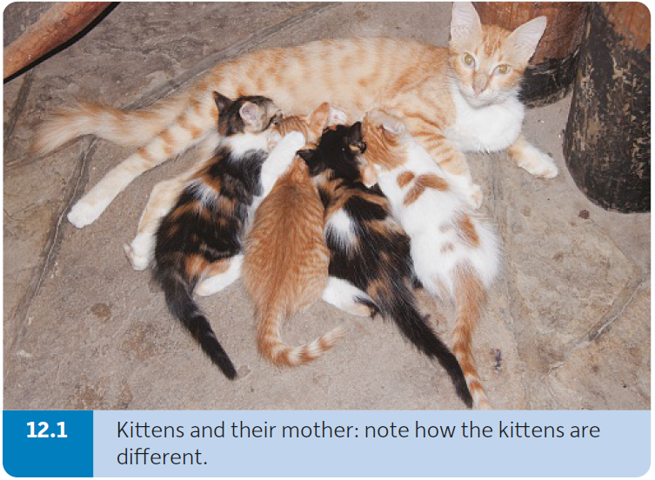
Inherited variation
What is inherited variation?
Genetically controlled.
Examples:
Blood groups
Eye/hair colour
Ear shape
What are the causes of inherited variations?
Sexual reproduction
Mutations

Slide 5
Inherited variation
How does sexual reproduction cause inherited variation?
Meiosis produces non-identical haploid sex cells (gametes – sperm and egg).
Offspring inherit half of their genes from each parent resulting in offspring having a different combination of genes compared to their parents.

Slide 6
Inherited variation
How do mutations cause inherited variation?
A mutation is a spontaneous (or sudden) change in the amount or structure of DNA.
If a gene is altered, the correct protein is no longer produced, which can sometimes result in a genetic disorder (e.g. cystic fibrosis).
Harmful mutations
Mutations can cause an increase in the rate of mitosis, resulting in a tumour.
Mutations in a gamete may give rise to genetic defects in the child.
Beneficial mutations
A small number of mutations can produce an even better protein than the original one, resulting in this organism being better adapted to survive and reproduce.
These mutations are a source of evolution.

Slide 7
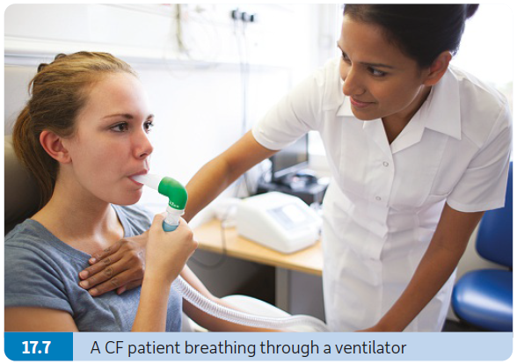
Mutations
What are the types of mutations?
Gene (or point) mutation
Chromosomal mutation
Gene mutations
A gene (or point) mutation is a change in a single gene.
Examples:
Cystic fibrosis (the inability to remove mucus from the lungs)
Haemophilia (the inability to form proper blood clots)
Albinism (lack of the skin pigment melanin)

Slide 8
Mutations
Chromosomal mutations
A chromosomal mutation is a large change in the structure or number of one or more chromosomes.
Examples:
Down syndrome
Changes in sex chromosomes

Slide 9
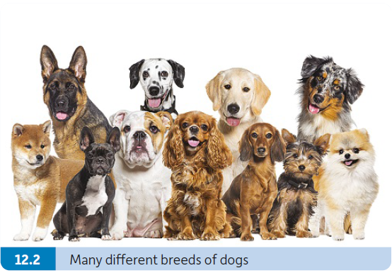
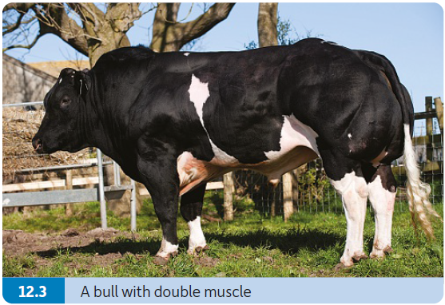
Artificial selection
What is artificial selection (selective breeding)?
Artificial selection involves choosing organisms with particular traits to breed together to produce offspring with more desirable traits.
Humans decide which traits are to be enhanced.
Examples:
Livestock, e.g. cattle now produce large quantities of high-quality milk or meat.
Dogs have been bred to have desirable traits such as good temperament and appearance.

Slide 10
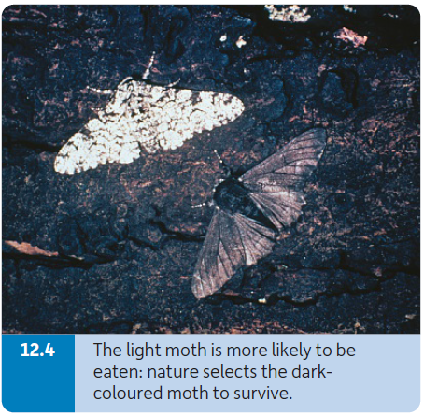
Natural selection
What is natural selection?
Natural selection is the process by which those organisms with genetically controlled characteristics that allow them to be well adapted to their environment will survive and reproduce to pass on their genes to following generations.
Nature (environment) decides which traits are to be passed on.
Example:
Animals that are well camouflaged tend to survive and reproduce better than animals that are not well camouflaged.

Slide 11
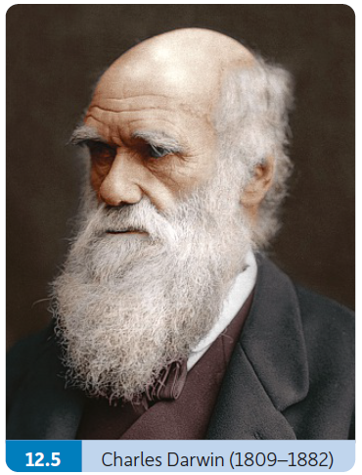
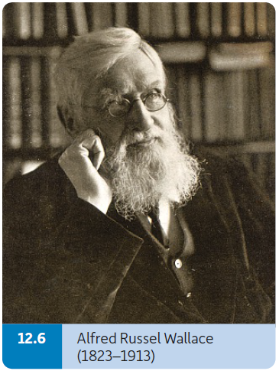
Evolution
What is evolution?
Evolution is the way in which living things change genetically to produce new forms of life over long periods of time.
Charles Darwin and Alfred Russel Wallace first suggested the theory of evolution by natural selection.

Slide 12
Theory of evolution by natural selection
Observation 1: Overbreeding
Organisms produce large numbers of offspring (high reproductive rate).
Example:
Trees produce thousands of seeds.
Observation 2: Population numbers remain constant
Population will increase until the environment can no longer support any more due to lack of resources such as food or water.
Conclusion 1: There is a struggle for existence
Competition for scarce resources.

Slide 13
Theory of evolution by natural selection
Observation 3: Inherited variations occur in populations
The organisms show genetic variation (inherited) due to sexual reproduction or mutations.
Conclusion 2: Natural selection
Those organisms that have variations that enable them to adapt better to their environment will survive and reproduce.
The better-adapted organisms pass on their advantageous variations to the next generation while the others do not survive.
Populations becomes better adapted to their environment with each generation.

Slide 14
Evidence for the theory of evolution by natural selection
What is the evidence for the theory of evolution by natural selection?
Embryology
Fossil records
Phylogeny
Comparative anatomy
Antibiotic resistance
Speciation

Slide 15
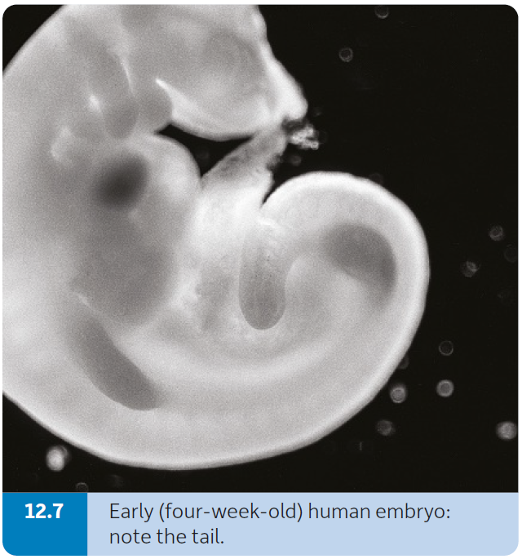
Evidence for the theory of evolution
Embryology
Embryology is the study of the development of the embryo and foetus.
The embryos of many organisms show similarities as they form, indicating that they have arisen from a common ancestor.

Slide 16
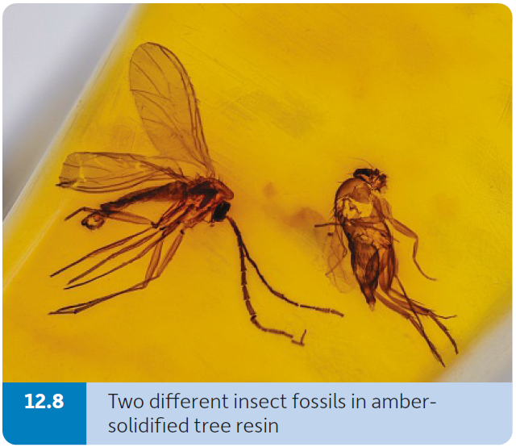
Evidence for the theory of evolution
Fossil records
A fossil is the remains of something that lived a long time ago (or some indication of something that lived a long time ago).
Examples:
Shells, bones, teeth, seeds, pollen grains.
How can fossils help explain evolution?
Fossils can be aged.
Fossils can be compared to modern organisms to show how living things have changed over long periods of time, indicating evolution.

Slide 17
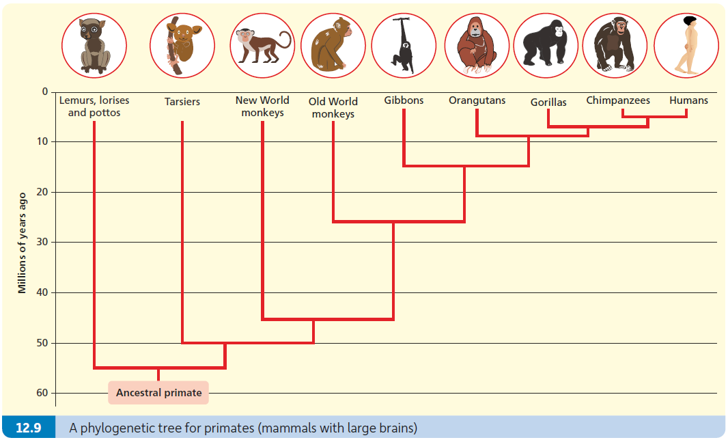
Evidence for the theory of evolution
Phylogeny
Phylogeny is the classification of organisms based on their evolutionary history.
Phylogeny shows possible relationships between species based on DNA, RNA and protein comparisons.

Slide 18
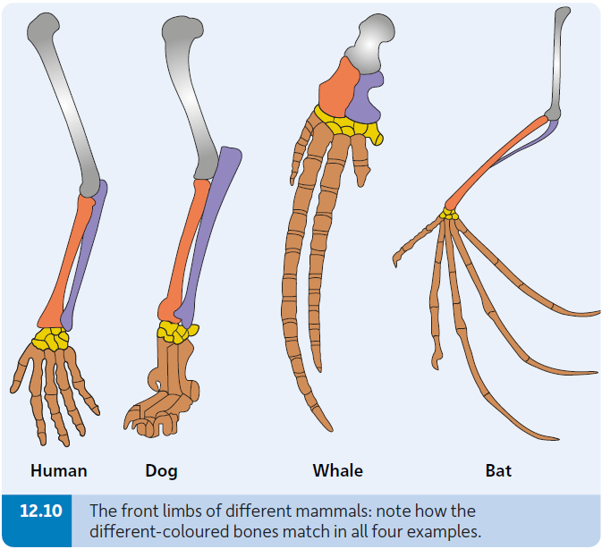
Evidence for the theory of evolution
Comparative anatomy
Comparative anatomy is the study of the similarities and differences in the body structures of different species.
The front limbs of humans, dogs, whales and bats have similar bone structures indicating that they have evolved from common ancestors.

Slide 19
Evidence for the theory of evolution
Antibiotic resistance
Some bacteria have mutated (evolved) to be resistant to almost all known antibiotics.
These bacteria are said to be multi-resistant.
The best-known ’superbug’ is MRSA.
What are antibiotics?
Antibiotics are chemicals produced by microorganisms to kill bacteria and fungi.
What has speeded up the evolution of resistant bacteria?
Overprescribing antibiotics.
Not finishing the full dose of antibiotics (which leads to reinfection and the use of more antibiotics).
The overuse of antibiotics in agriculture.

Slide 20
Evidence for the theory of evolution
Speciation
Speciation is the production of new species because of evolution.
If organisms can obtain more food or produce more offspring, then they will be ‘selected’ by nature and be able to pass on their genes.
In time, the accumulation of slight changes results in the formation of a new species.

Slide 21
The importance of the theory of evolution
Evolution is important because:
Evolution shows us how distinct species can develop from a common ancestor due to inherited changes (diversity).
It explains why living things share so many traits (unity) as they have descended from a common ancestor.
It allows us to make predictions in a wide range of biological areas, e.g. medicine, agriculture, conservation, disease control, biotechnology, human origins.

