Slide 2
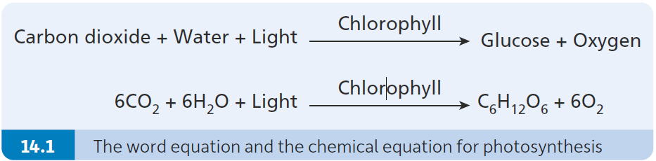
Photosynthesis as an anabolic process
Photosynthesis is the process by which plants produce glucose and oxygen using carbon dioxide and water in the presence of chlorophyll.
Photosynthesis is classified as an anabolic process because it uses (light) energy to convert smaller molecules (carbon dioxide and water) into larger molecules (glucose).

Slide 3
The sources of the reactants and of the products in photosynthesis
The reactants are the substances that are present at the start of a chemical reaction.
In photosynthesis the reactants are:
  Carbon dioxide
  Water
The products are the substances that are formed in a chemical reaction.
In photosynthesis the products are:
  Glucose
  Oxygen

Slide 4
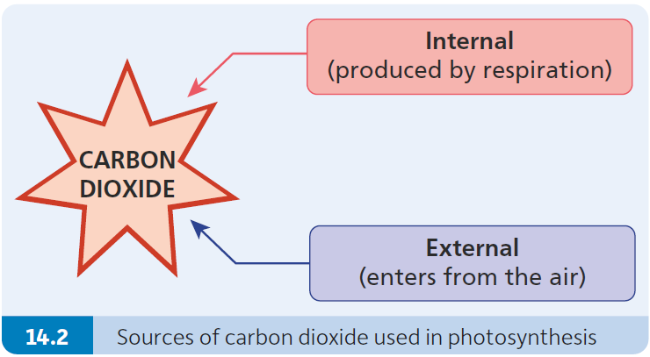
The sources of the reactants in photosynthesis
Carbon dioxide is sourced from:
The air – or surrounding water in the case of underwater (aquatic) plants
Carbon dioxide produced in respiration.
Water is sourced from:
The soil, absorbed by the roots.
Carbon from carbon dioxide forms glucose.
H⁺ ions from water also contribute to glucose formation.

Slide 5
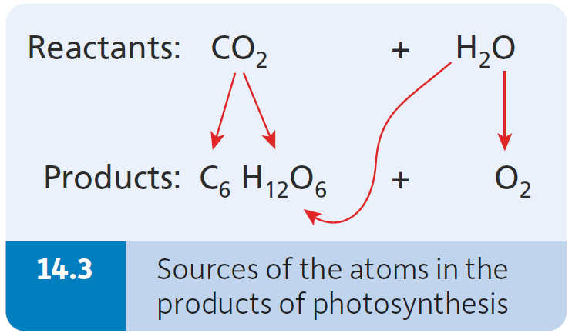
The sources of the products in photosynthesis
Glucose is formed when carbon and oxygen atoms (from carbon dioxide) combine with hydrogen atoms (from water).
Oxygen is formed when water is split.

Slide 6
The fate of the products of photosynthesis
Glucose produced in photosynthesis can be:
Used as a source of energy by plants during respiration
Stored in plants as starch
Converted to other biomolecules such as sucrose, cellulose, lipids and proteins.
Oxygen formed in photosynthesis can be:
Used directly in respiration
Released from the plant into the environment.

Slide 7
Photosynthesis as a carbon sink
A carbon sink is anything that absorbs more carbon than it releases.
Examples:
Forests
Oceans
Soil
Fossil fuels (such as turf, coal and oil)

Slide 8
Role of photosynthesis
Plants use photosynthesis to make food.
Animals get their food from plants.
Photosynthesis produces the oxygen that most living things need in order to obtain energy in respiration.

Slide 9
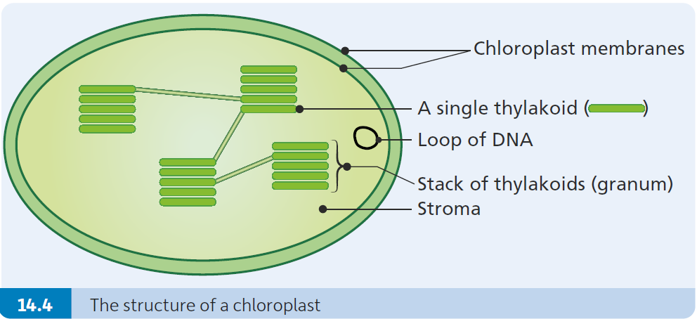
Cellular location of photosynthesis
Photosynthesis takes place in chloroplasts.
Chloroplasts are tiny organelles that contain the green pigment called chlorophyll.
Chlorophyll acts to trap sunlight.
The energy that is trapped in this way is used to make glucose.

Slide 10
Adaptations of leaves for photosynthesis
Most leaves have large leaf blades (to absorb as much light as possible).
They are thin (so that gases can easily pass from top to bottom and vice versa in leaves).
They have huge numbers of stomata (to allow maximum gas exchange).
Chloroplasts are concentrated in the upper parts of the leaf (to absorb maximum light).

Slide 11
The two-stage process of photosynthesis
Photosynthesis is a process that takes place in two stages.
The light-dependent reactions (light stage):
Depend on light (reactions cannot take place in darkness).
Energy provided by light allows the reactions to proceed.
Reactions occur so quickly that no enzymes are used.
The light-independent reactions (or dark stage):
Independent of light (reactions will take place in the light or in the dark)
Energy for the reactions is provided by ATP, which was made in the light stage.
Enzymes control the reactions (as a result temperature is a controlling factor).

Slide 12
Light-dependent reactions (the light stage)
The light-dependent reactions take place in stacks of flattened membranes, called thylakoids in the chloroplast.
Each stack is called a granum (plural: grana).
The events in the light independent reactions can be explained under these three headings:
Absorption of photons (single units) of light
Energy transferred to electrons
The flow of electrons along two pathways (a non-cyclic and a cyclic pathway).

Slide 13
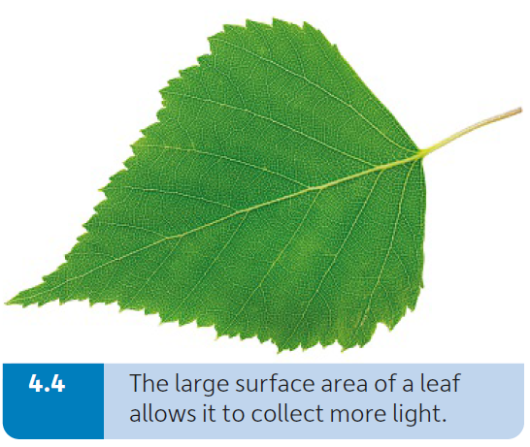
Absorption of photons of light
White light is composed of different wavelengths (colours) of light.
The thylakoids in a chloroplast contain a range of pigments, including chlorophyll. Each of these chloroplast pigments absorbs photons that represent different colours of light.
By having a range of pigments, plants can absorb a wider range of colours of light.
In general, plants absorb all the colours of white light, except green. Green light is normally reflected by plants.
This is why most plants are green.

Slide 14
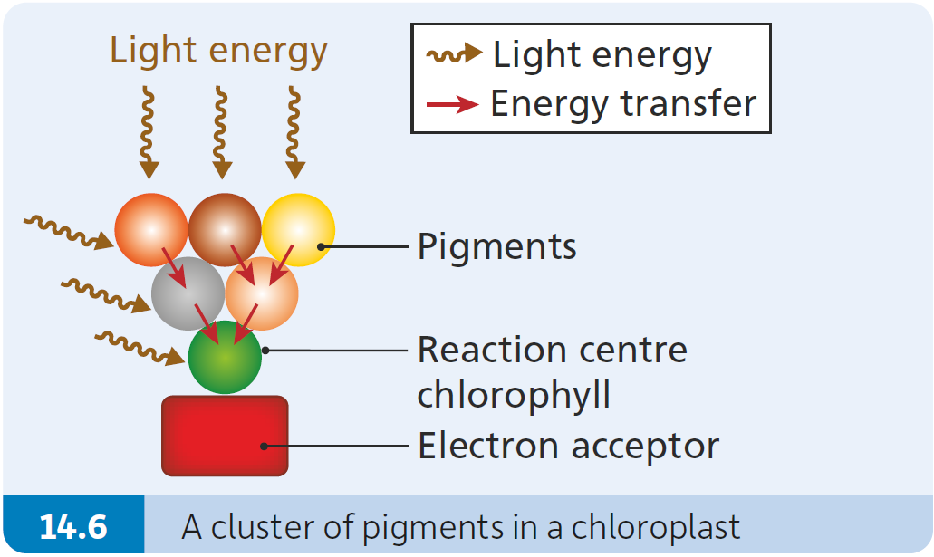
Energy is transferred to electrons
Each cluster of pigments consists of:
  A variety of pigments
  A strategically placed chlorophyll molecule
  An electron acceptor.
One chlorophyll molecule is strategically located beside an electron acceptor (the reaction centre chlorophyll).
The different pigments transfer the absorbed energy from one pigment to another until it reaches the reaction centre chlorophyll, associated with an electron acceptor.

Slide 15
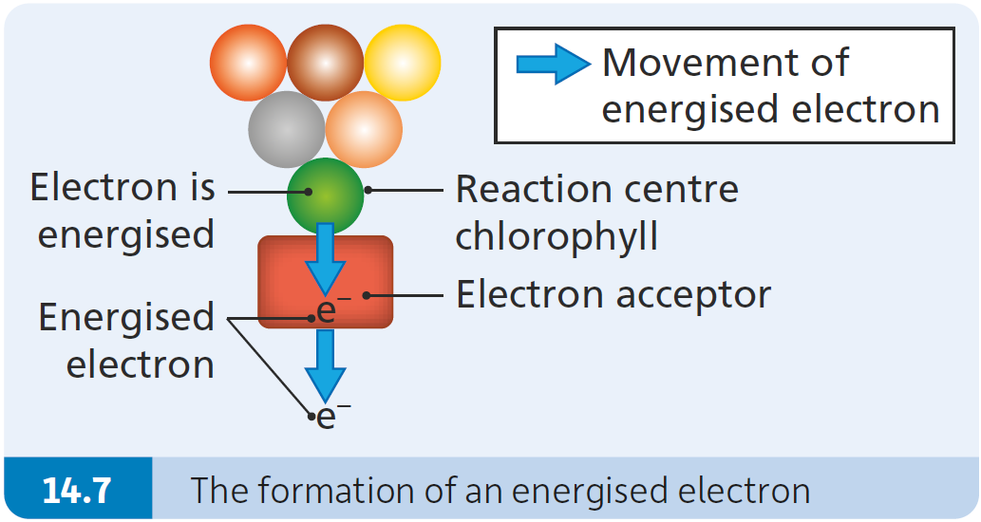
Energy is transferred to electrons
In the reaction centre chlorophyll, energy is transferred to electrons, causing them to become energised or high-energy electrons.
The energised electrons pass from the reaction centre chlorophyll to an electron acceptor.
The energised electrons then flow from the electron acceptor along one of two different pathways (called the non-cyclic and cyclic pathways).

Slide 16
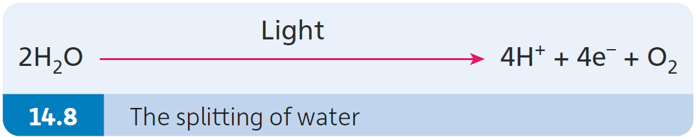
Electron flow: the non-cyclic pathway
Two high-energy electrons pass along a series of electron carriers located in the thylakoid membranes.
The electrons lose energy as they pass along the electron transport chain. This energy is used to form ATP by combining ADP and phosphate together.
The reaction centre chlorophyll is now short of electrons. The chlorophyll now gains new electrons when light splits water.
Photolysis is the splitting of water using light energy.
Water is split in the chloroplast, outside of the thylakoids.

Slide 17
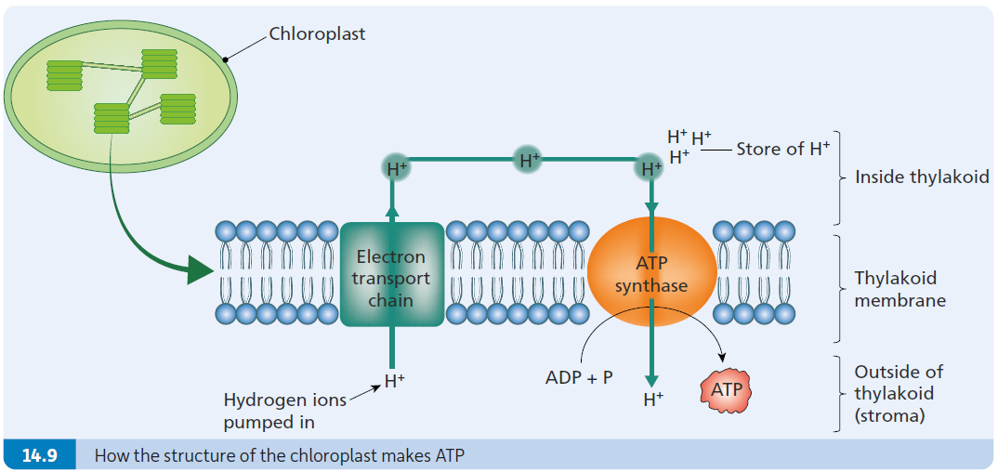
Electron flow: the non-cyclic pathway

Slide 18
Electron flow: the non-cyclic pathway
When two water molecules are split, they form four protons (or hydrogen ions, 4H⁺), four electrons (4e–) and oxygen (O₂ ).
Two of the electrons from the splitting of water replace the electrons lost by chlorophyll.
The protons formed by the splitting of water are pumped into the thylakoid.
The hydrogen ions (protons) flow along the concentration gradient and pass back out of the thylakoid.
The enzyme ATP synthase uses the energy from the flow of hydrogen ions to convert ADP and phosphate to ATP.

Slide 19
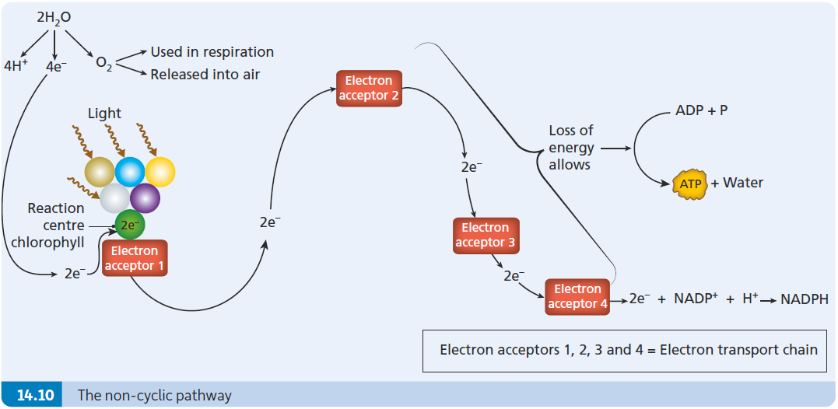
Electron flow: the non-cyclic pathway

Slide 20
Electron flow: the non-cyclic pathway
Oxygen gas formed by the splitting of water is used in one of two ways:
  Some is released out into the atmosphere.
  Some is used internally in the plant in respiration.
When the electrons reach the end of the electron transport chain, they combine with NADP⁺ and a hydrogen ion to form NADPH.

Slide 21
Why is it called a non-cyclic pathway?
In this pathway, the electrons start with water and end up in NADPH.
The electrons do not return or recycle back to water.
For this reason, this pathway is called a non-cyclic pathway.

Slide 22
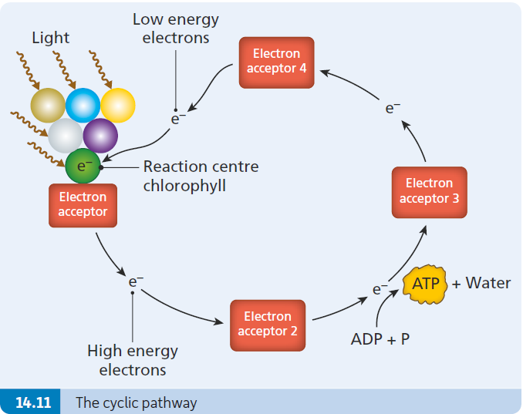
Electron flow: the cyclic pathway
The energised electrons pass from the electron acceptor to a series of other electron acceptors.
Eventually the electrons are passed back again to the chlorophyll molecule.
When the electrons travel in this way, they lose energy. The energy they release is trapped by ADP and a phosphate and is used to form ATP.

Slide 23
Why is it called a cyclic pathway?
This pathway is said to be cyclic, because the electrons flow from chlorophyll to the electron acceptors and back again to chlorophyll.
The end-products of the light-dependent reactions stage are:
  ATP
  NADPH
  Oxygen

Slide 24
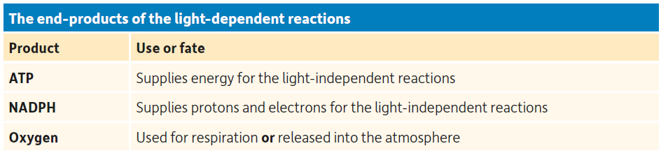
The end-products of the light-dependent reactions (light stage)

Slide 25
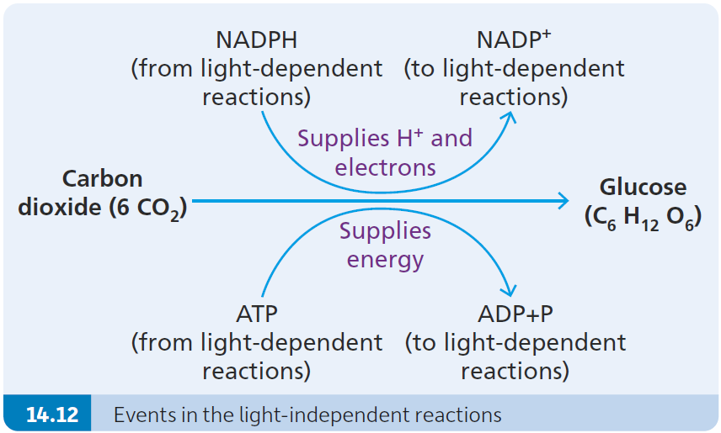
Light-independent reactions (the dark stage)
The light-independent reactions take place in the stroma of the chloroplast.
The light-independent reactions are controlled by enzymes. This means that they are affected by temperature.
Carbon dioxide enters the chloroplast (by diffusion).
Hydrogen ions (or protons, H⁺) and electrons are released from NADPH and used to reduce (convert) carbon dioxide to glucose.
The energy to form glucose comes from the conversion of ATP to ADP and phosphate.

Slide 26
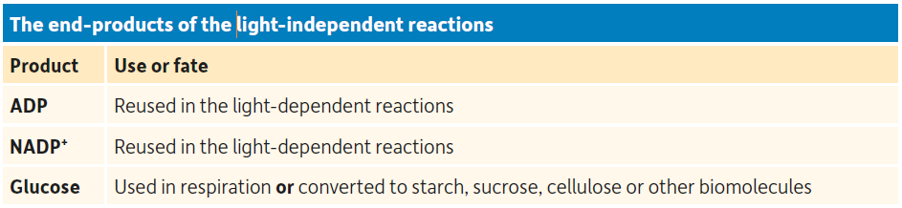
The end-products of the light-independent reactions (dark stage)
Once NADPH transfers protons (H⁺) and electrons into the dark stage, it returns to the light-dependent stage (light stage) as NADP⁺ to be reused.
Once ATP supplies energy to the dark stage to form glucose, ADP returns to the light-dependent stage (light stage) to be reused.

Slide 27
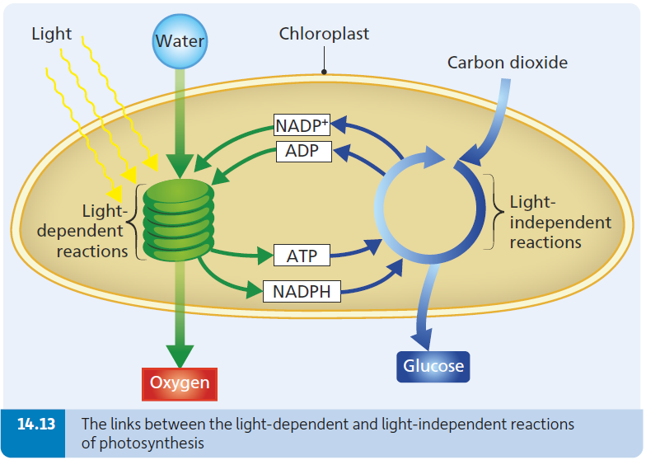
Connections between the light-dependent and light-independent reactions

Slide 28
The internal structure of a chloroplast facilitates photosynthesis
Chloroplasts are enclosed by a double membrane (which retains all the biomolecules needed for photosynthesis).
They have their own loop of DNA (to make necessary biomolecules).
They contain numerous flattened thylakoids. Each thylakoid has:
  A large surface area (to capture as much light as possible)
  Many pigment stacks (to trap light)
  Electron transport chains (to help produce ATP and NADPH)
  ATP synthase (to produce ATP using energy from the flow of protons).

Slide 29
Formation of ATP
The formation of ATP in a chloroplast depends on the following features of a chloroplast:
The electron transport chains are located in the membrane around the thylakoid. As electrons pass down the electron transport chains, the lose energy.
This energy is used to pump hydrogen ions across the membrane, into the thylakoid. When the hydrogen ions diffuse back out of the thylakoid, they pass through an enzyme complex (called ATP synthase) located in the thylakoid membrane.
This enzyme uses energy to speed up the conversion of ADP and phosphate to form ATP.

Slide 30
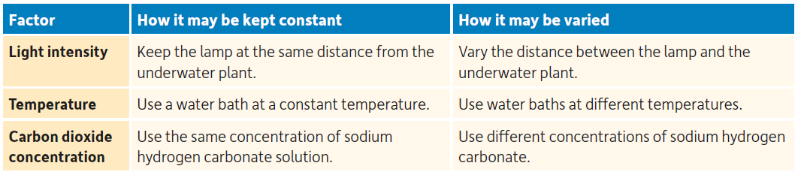
Factors that affect the rate of photosynthesis
The three main factors affecting the rate of photosynthesis are:
  Light intensity
  Temperature
  Carbon dioxide concentration.
In each of the following investigations, one of these factors is varied while the other two are kept constant.

Slide 31
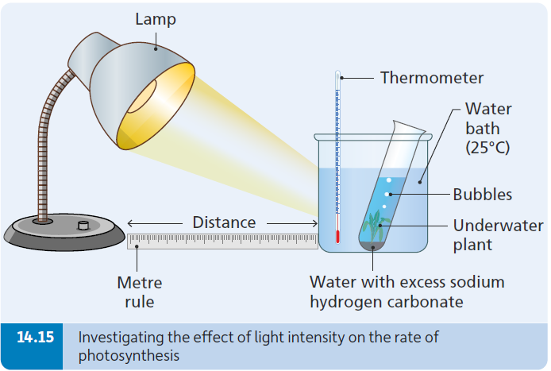
Investigation 5a: To investigate a factor
(light intensity) that affects the rate of photosynthesis
Independent variable: changing the light intensity by moving a light source closer or further away from the plant.
Dependent variable: counting the bubbles of oxygen per minute to indicate the rate of photosynthesis.
Control variables: temperature using a water bath, carbon dioxide concentration using sodium hydrogen carbonate.

Slide 32
Investigation 5a: To investigate a factor
(light intensity) that affects the rate of photosynthesis
Add excess sodium hydrogen carbonate solution to some water in a boiling tube and stir well.
Cut a section of pondweed at an angle and place the cut end upwards in the boiling tube.
Place the boiling tube containing the pondweed in a water bath at 25ºC.

Slide 33
Investigation 5a: To investigate a factor
(light intensity) that affects the rate of photosynthesis
Using a metre rule, position the lamp 1 metre away from the apparatus and switch on the lamp.
Before counting the bubbles of oxygen, allow the plant to adjust to the conditions for 5 minutes.

Slide 34
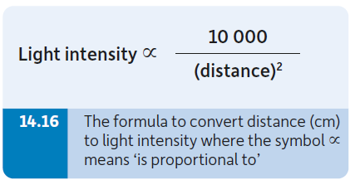
Investigation 5a: To investigate a factor
(light intensity) that affects the rate of photosynthesis
Using a stopwatch, count the number of oxygen bubbles per minute.
Repeat two more times and calculate the average number of oxygen bubbles produced per minute.
Repeat this procedure with the lamp at different distances from the apparatus (i.e. at 80 cm, 60 cm, 40 cm and 20 cm).
To calculate the light intensity for each distance, a light meter can be placed beside the water bath – or the equation shown can be used.

Slide 35
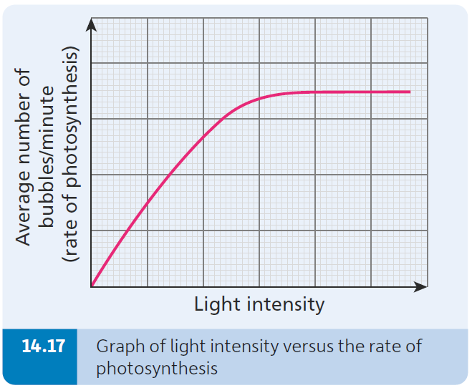
Investigation 5a: To investigate a factor
(light intensity) that affects the rate of photosynthesis
Conclusion
As light intensity increases (the lamp is moved closer), the rate of photosynthesis (bubble production) should increase.
However, at some point, the rate of photosynthesis (bubble production) ceases to increase. The plant is then said to be saturated with light.

Slide 36
Investigation 5a: To investigate a factor
(light intensity) that affects the rate of photosynthesis
Reasons for the following steps:
Using an aquatic plant (pondweed): to observe oxygen bubble production under the water so the rate of photosynthesis can be measured.
Cutting the pondweed at an angle: to improve the flow of bubbles.
Using a water bath: to keep the temperature constant.
Adding excess sodium hydrogen carbonate: to ensure constant concentration of CO₂.
Placing the lamp at different distances from the plant: to vary the light intensity.
Allowing the plant to adjust for 5 minutes: to ensure the bubbles of oxygen you count are a true reflection of that particular light intensity.
Counting the number of oxygen bubbles per minute: to measure the rate of photosynthesis.

Slide 37
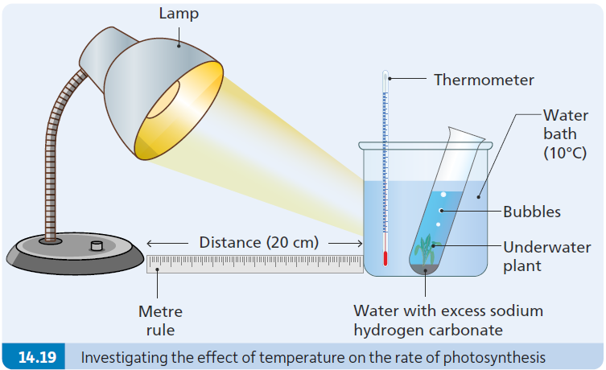
Investigation 5b: To investigate a factor (temperature) that affects the rate of photosynthesis
Independent variable: changing the temperature by using water baths at different temperatures.
Dependent variable: counting the bubbles of oxygen per minute to indicate the rate of photosynthesis.
Control variables: light intensity by keeping lamp source the same distance from plant, carbon dioxide concentration using sodium hydrogen carbonate.

Slide 38
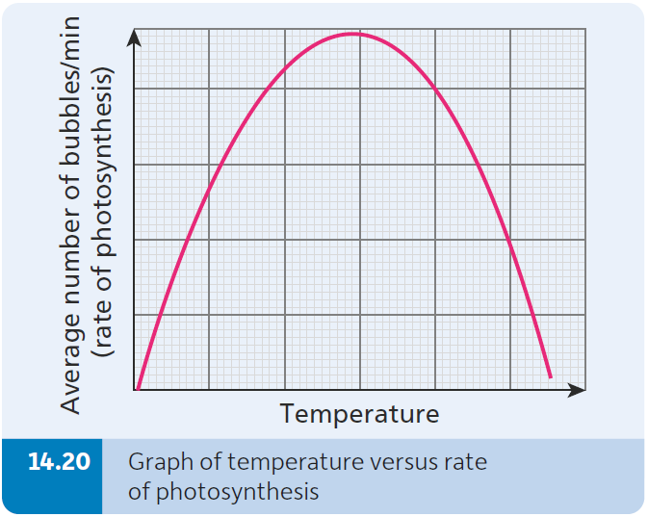
Investigation 5b: To investigate a factor (temperature) that affects the rate of photosynthesis
Conclusion
As the temperature increases, the rate of photosynthesis also increases up to the optimum temperature.
Once above the optimum temperature, the rate of photosynthesis then decreases.
Varying temperature impacts the rate of photosynthesis as the light-independent stage (dark stage) is controlled by enzymes.

Slide 39
Investigation 5c: To investigate a factor (carbon dioxide level or concentration) that affects the rate of photosynthesis
Independent variable: changing the carbon dioxide concentration by using different concentrations of sodium hydrogen carbonate.
Dependent variable: counting the bubbles of oxygen per minute to indicate the rate of photosynthesis.
Control variables: light intensity by keeping lamp source the same distance from plant, temperature using a water bath.

Slide 40
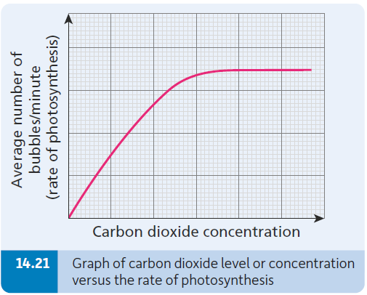
Investigation 5c: To investigate a factor (carbon dioxide level or concentration) that affects the rate of photosynthesis
Conclusion
As the carbon dioxide concentration increases, the rate of photosynthesis also increases up to a certain point.
Once the carbon dioxide concentration increases beyond this level, the rate of photosynthesis will not increase any further.

