Slide 2
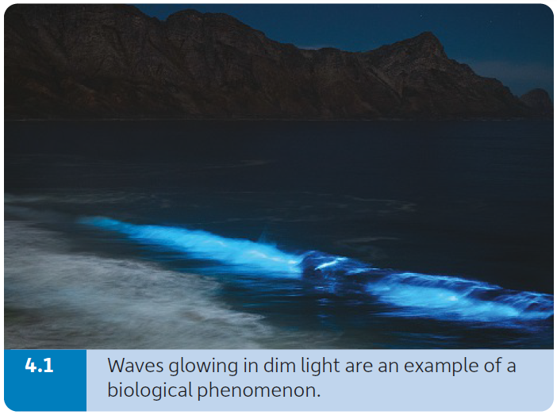
Phenomena
A phenomenon is something (such as an interesting fact or event) that can be observed and studied and that typically is unusual or difficult to understand or explain fully.
A biological phenomenon refers to when the phenomenon is associated with a living thing or process.
Examples:
Damaged skin cells repair themselves, but damaged brain cells do not repair.
Sometimes the sea glows in the dark.
Plants bend towards the light.
Some people get cramp more easily than others.

Slide 3
Models
Models are simplified representations of complex systems or phenomena.
Examples:
Word descriptions
Diagrams
Equations
Physical models
Simulations

Slide 4
Models
In science, models can be used to:
Describe and explain complex systems or phenomena.
Make predictions relating to a particular system or phenomenon.
Solve problems relating to a particular system or phenomenon.

Slide 5
Concepts used to explain biological phenomena
Systems
A system is a group of structures (often organs in biology) that work together to carry out a particular task.
A reductionist approach subdivides complex systems and processes into increasingly smaller parts.
Example:
Muscles can be studied by isolating individual muscle cells, then examining the structures found in each cell and finally investigating the role of chemicals found in these cellular structures.

Slide 6
Concepts used to explain biological phenomena
Systems
A systems approach examines the interactions among the different parts of a system (often a complex system). It considers a system as a network. This is a bottom-up approach.
Studying an entire system is a complex task and often involves the cooperation of scientists from many specialised areas of study (e.g. experimental scientists, data analysts, computer experts, mathematical modellers).
The systems studied can range in size from molecular (how DNA works), to a series of reactions (photosynthesis), to a bodily system (the digestive system), to an entire living thing (a mouse) and up to a global system (how carbon dioxide affects the planet).

Slide 7
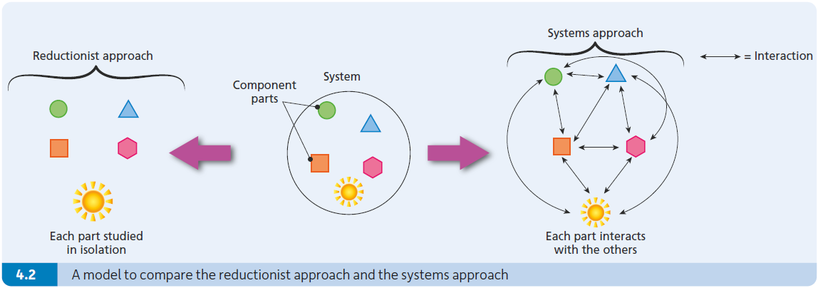
Concepts used to explain biological phenomena

Slide 8
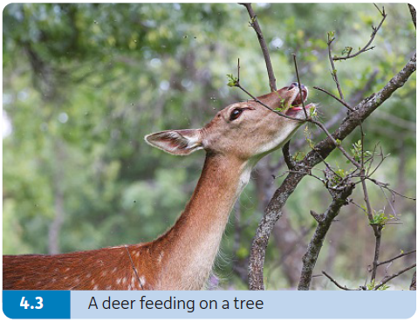
Concepts used to explain biological phenomena
Interdependence
Interdependence means that living things interact with and rely on each other and on their surroundings in order to survive.
Example:
Grass depends on the soil.
Flowers depend on insects to carry pollen.
Foxes depend on rabbits for food.

Slide 9
Concepts used to explain biological phenomena
Interdependence
Any change to a part of nature can have serious effects on other parts of nature.
Example:
When wolves became extinct in Ireland (around 1786), the deer population increased as there were no animals left to kill deer. In turn, the increase in deer numbers is causing damage to the woodlands because deer eat young trees.

Slide 10
Concepts used to explain biological phenomena
Unity of life
The unity of life means that living things share many features.
Example:
All life has DNA and RNA.
Animals such as bats, whales, gorillas and humans have similar bone structures in their wings, fins and arms.

Slide 11
Concepts used to explain biological phenomena
Diversity of life
The diversity of life means the variety of life on Earth.
The variety of life has arisen due to evolution. When two species arise from a common ancestor, each species undergoes different inherited changes to their genes.
Evolution is the reason for both the unity and diversity of life.

Slide 12
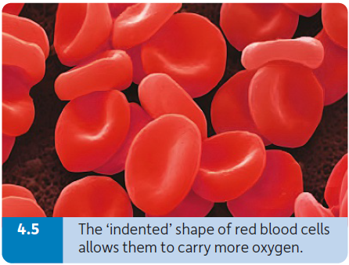
Concepts used to explain biological phenomena
Form fits function
Form fits function means that there is a relationship between the structure (form) and the role (function) of a biological object.
This is why biological objects are often described under the headings structure and function.
Example:
The shape of an enzyme is important in determining what molecules it will interact with.
The shape of a red blood cell allows it to absorb more oxygen.

Slide 13
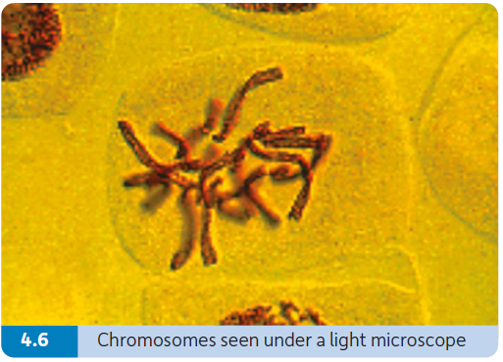
Concepts used to explain biological phenomena
Transfer of information
The transfer of information in biology relates to how genetic information is used within cells, passed from cell to cell and from generation to generation.
In biology, information is transferred by genes. Each chromosome in the nucleus of a cell contains sections of DNA called genes.
Genes have two main roles:
  They carry the instructions to allow the cell to make all the molecules it will need.
  They are passed from parents to their offspring (via the sperm and egg), transferring their information from one generation to the next, and are said to be the units of inheritance.

Slide 14
Concepts used to explain biological phenomena
Transfer of matter
Matter is anything that takes up space and has mass.
Matter is transferred from the environment into plants when they absorb chemicals from the air or from the soil.
This matter is transferred to animals when they eat plants (or other animals that have previously eaten plants).
Plant and animal matter is eventually returned to the environment when it is broken down by decomposers (mainly bacteria and fungi).
This allows matter to be taken in again and reused by plants (and later by animals).

Slide 15
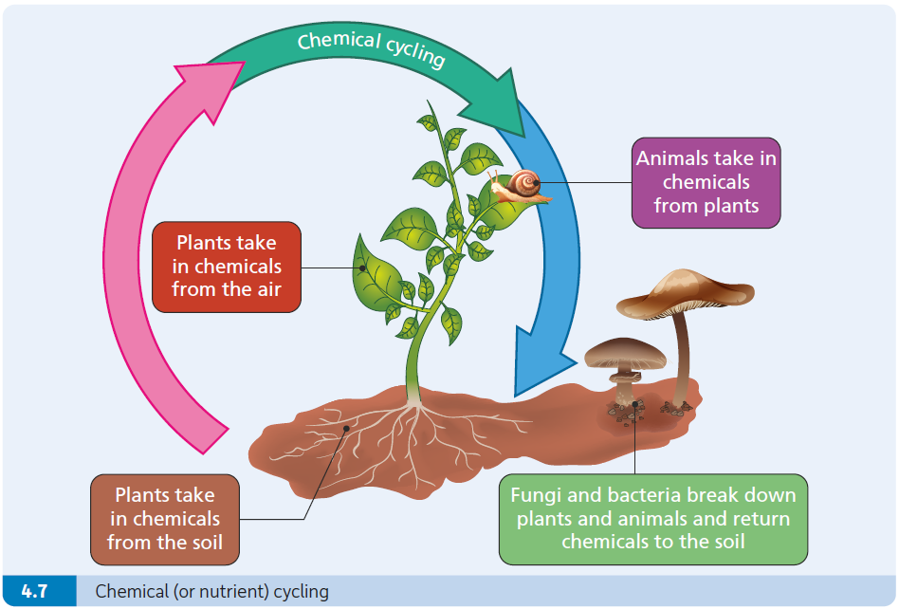
Concepts used to explain biological phenomena
Transfer of matter

Slide 16
Concepts used to explain biological phenomena
Transfer of energy
Energy is the ability to do work (which means make things move).
The green parts of plants absorb light energy, mostly from the sun.
They use this energy and the chemicals absorbed from the air and soil to make foods.
The chemical energy in plants is passed on to living things when they feed on plants.
Living things need energy for cell reactions, movement, growth, reproduction and a variety of other processes.
When living things use chemical energy to carry out a process, they lose some of the chemical energy to their surroundings as heat.

Slide 17
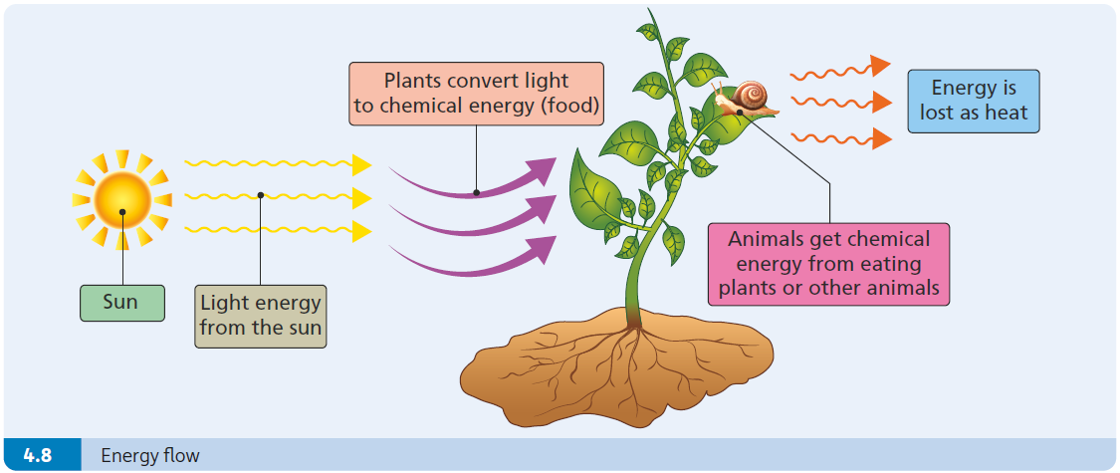
Concepts used to explain biological phenomena
Transfer of energy

