Slide 1

Webinar for the new Leaving Certificate Biology Teachers

Slide 2
Resources
Animations
3D Models
Chapter Quiz and Solutions
Chapter summary
PowerPoints
Interactive quiz / Flashcards
Investigation Videos
Knowledge Checklist
Mind Maps
Editable lesson plans

Slide 3
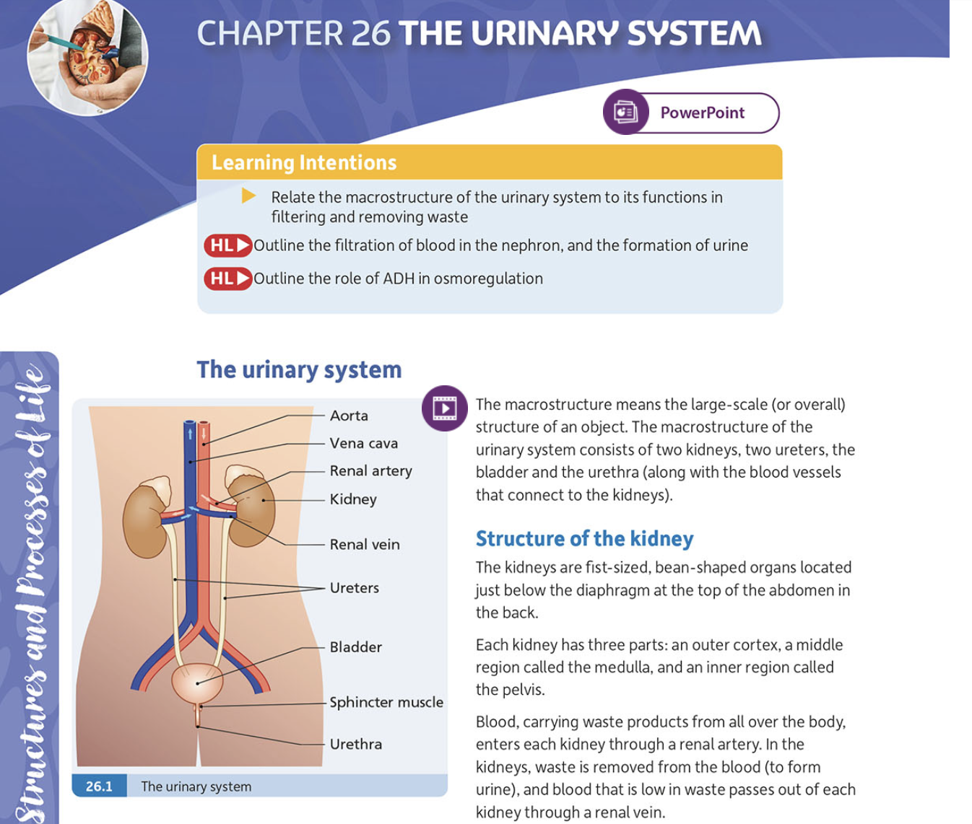
PowerPoint

Slide 4
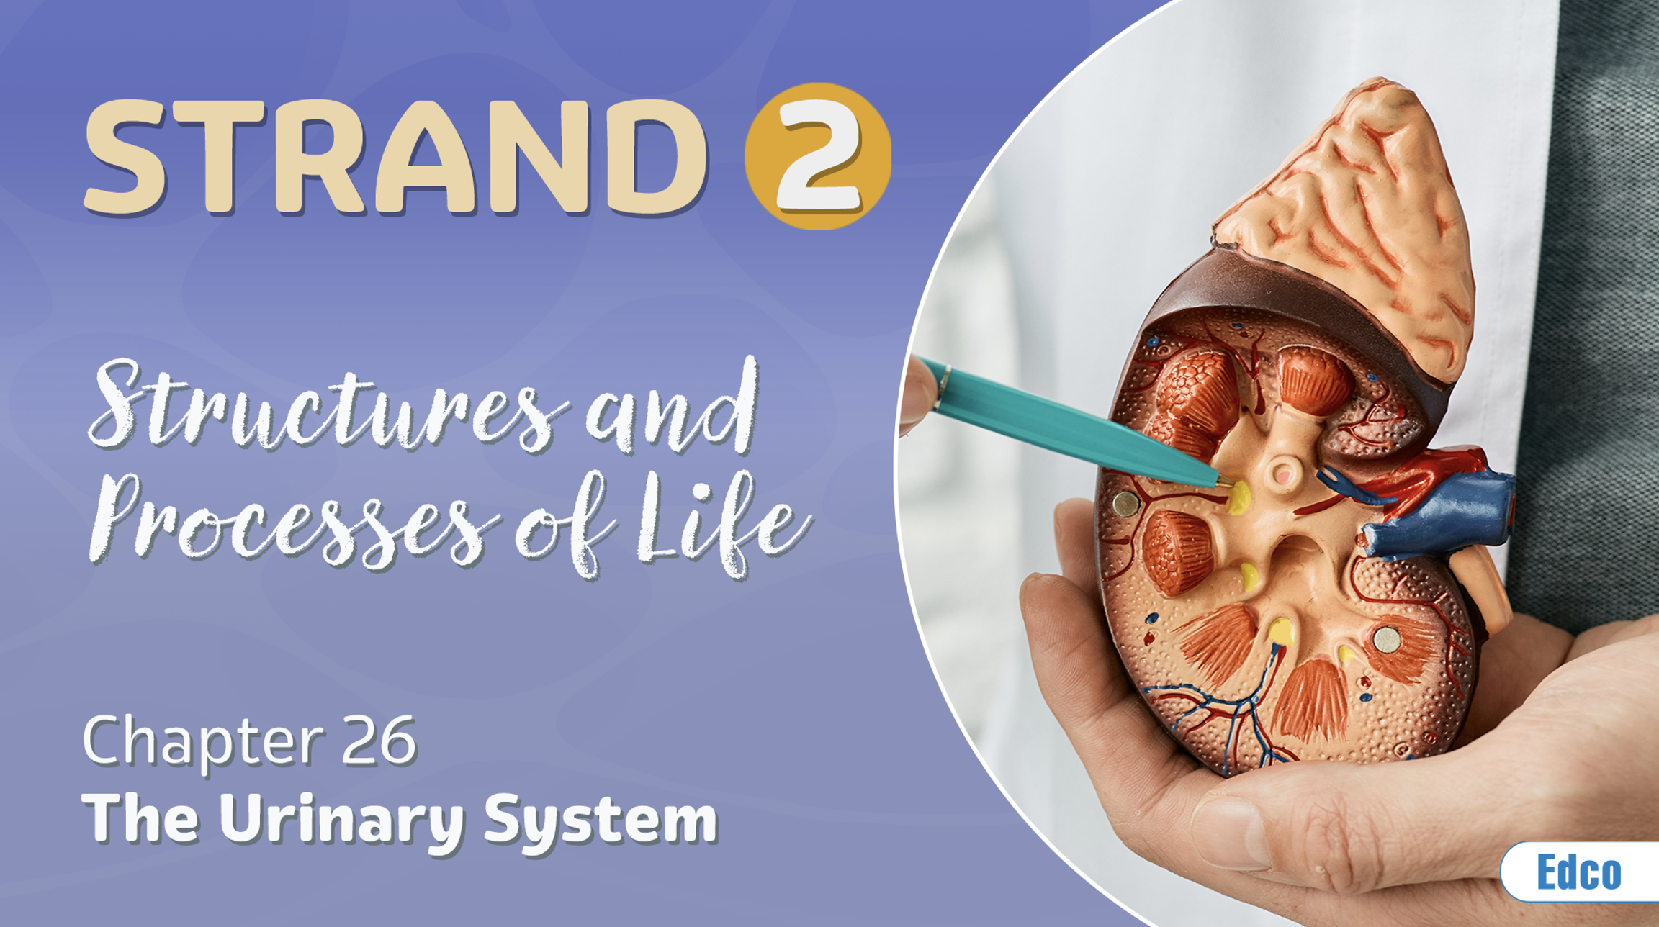
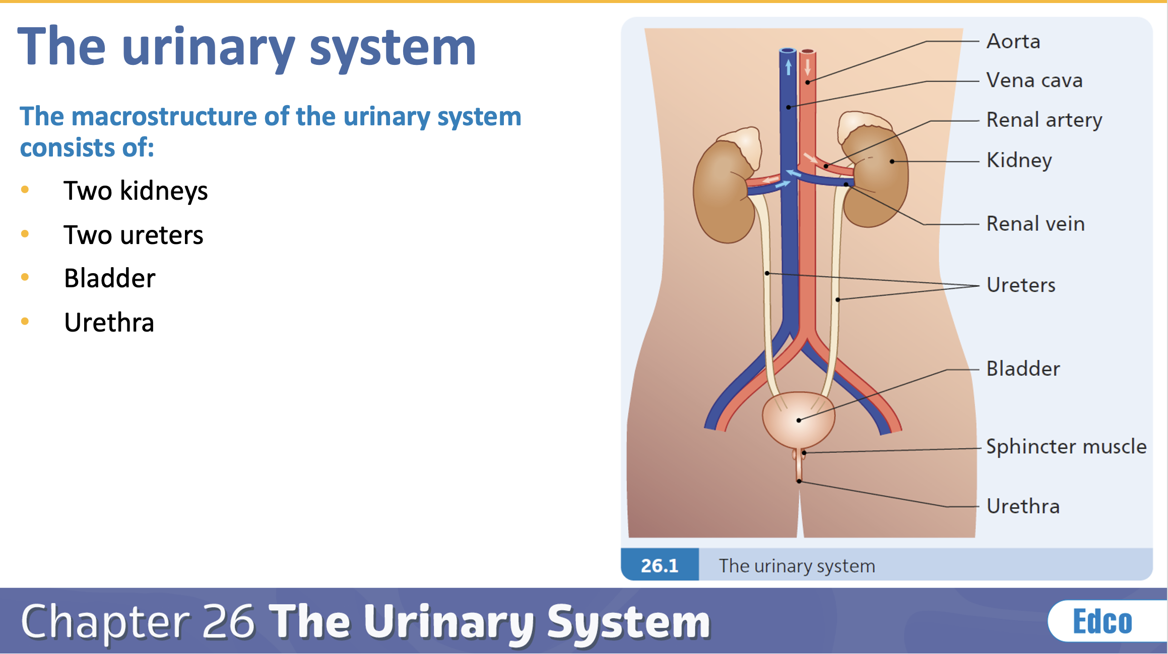
PowerPoints

Slide 5
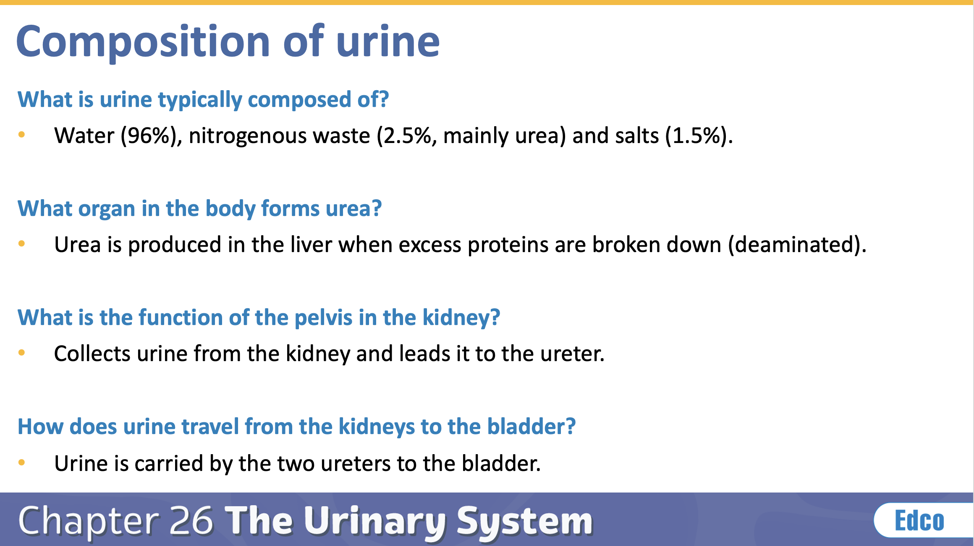
PowerPoints

Slide 6
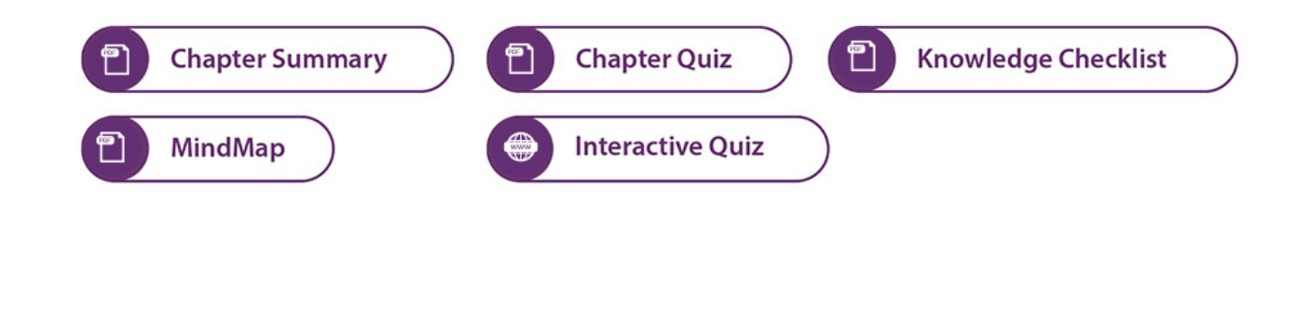
Resources

Slide 7
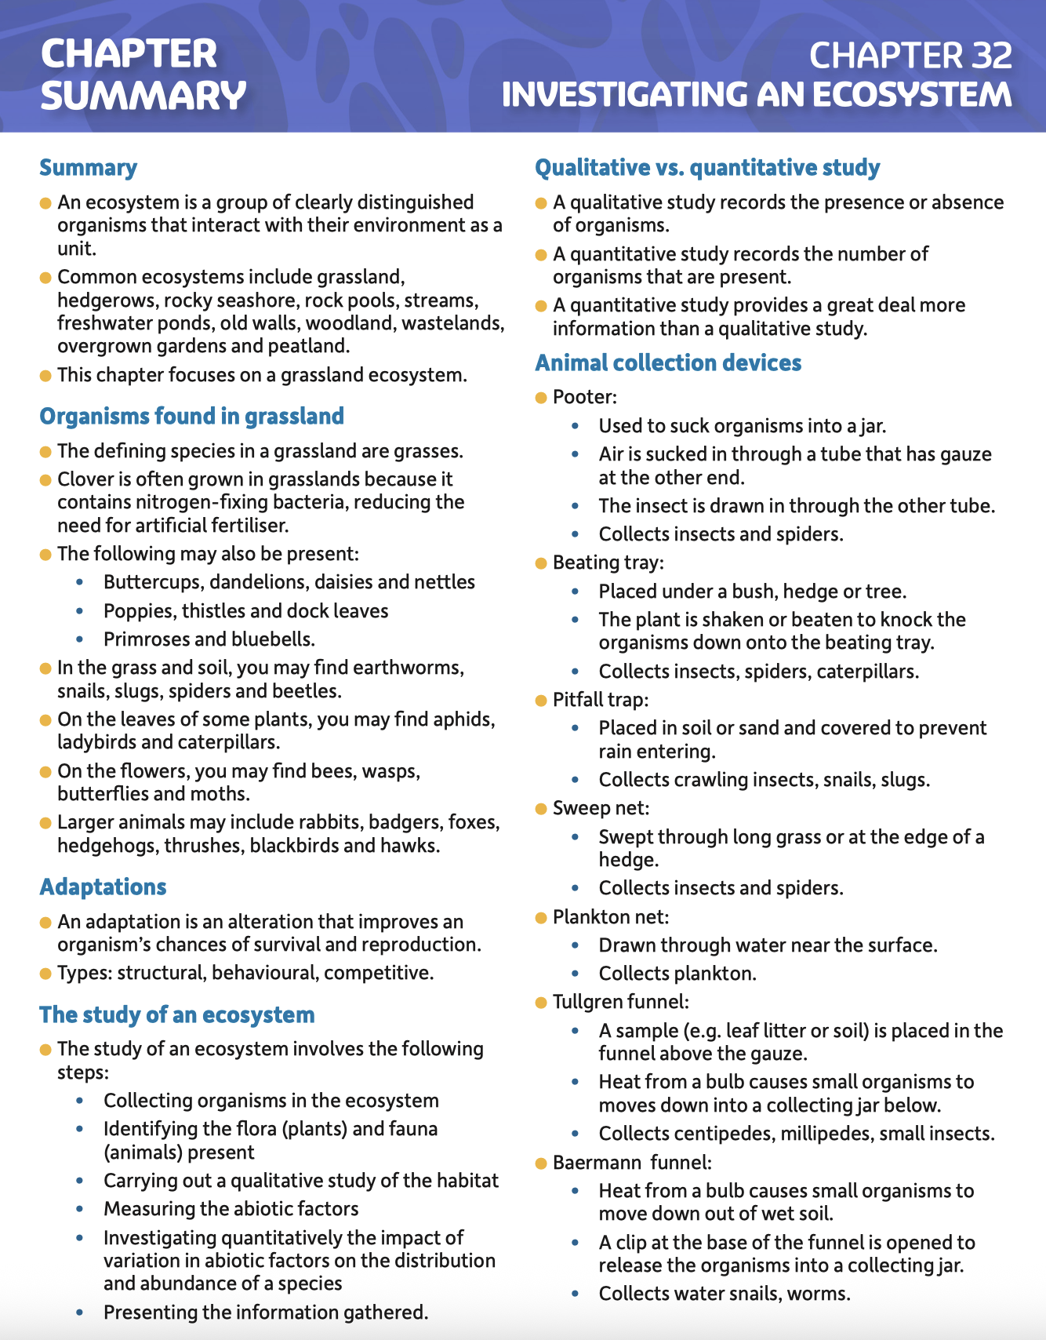
Chapter Summary

Slide 8
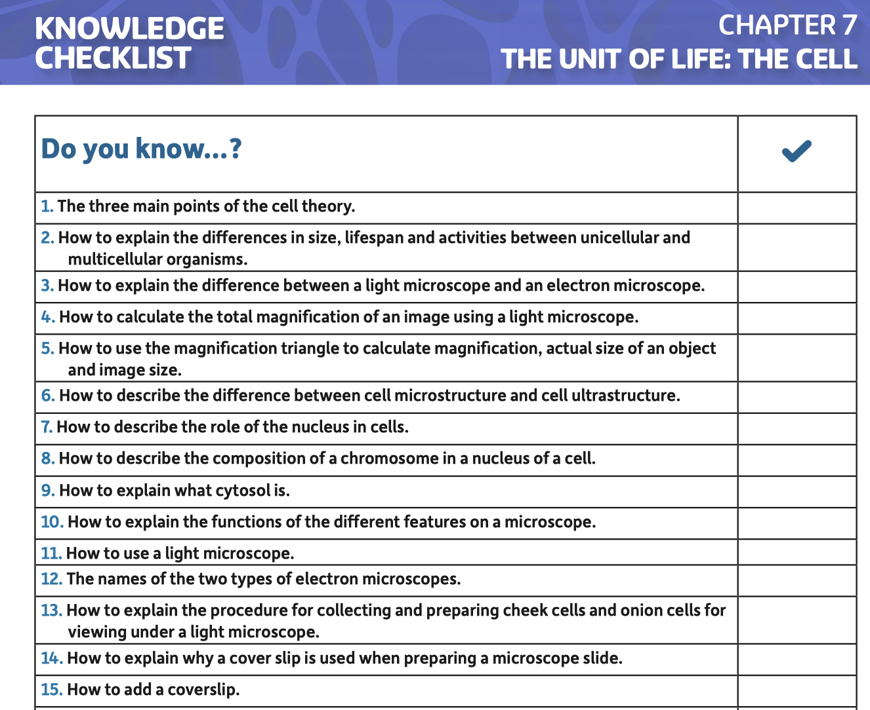
Knowledge Checklist

Slide 9
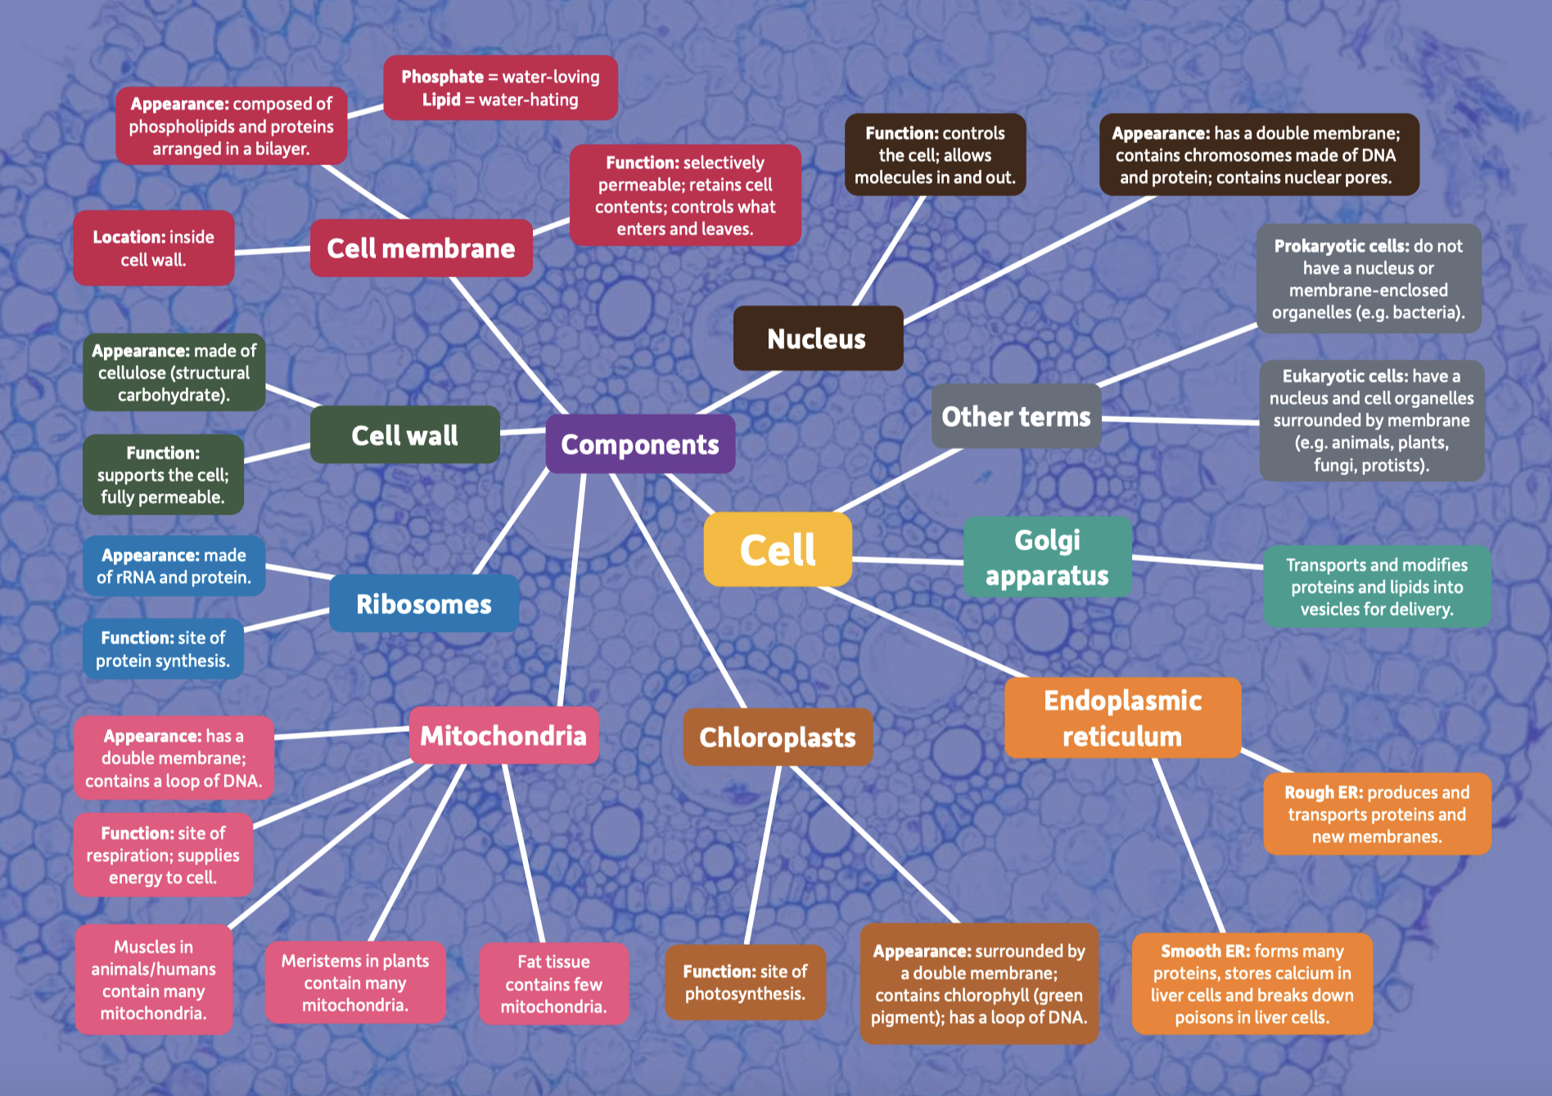

Slide 10
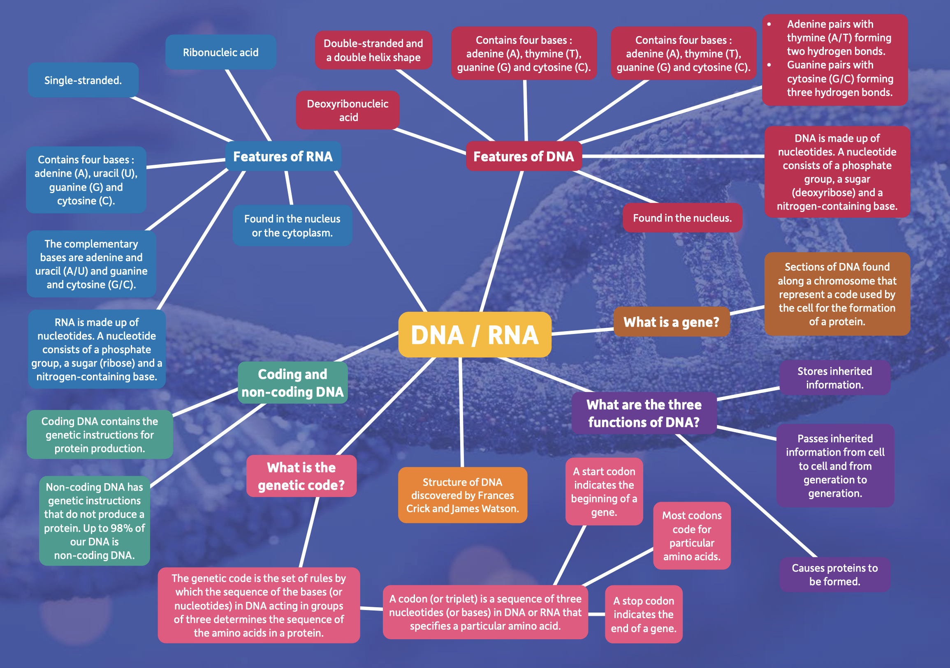

Slide 11
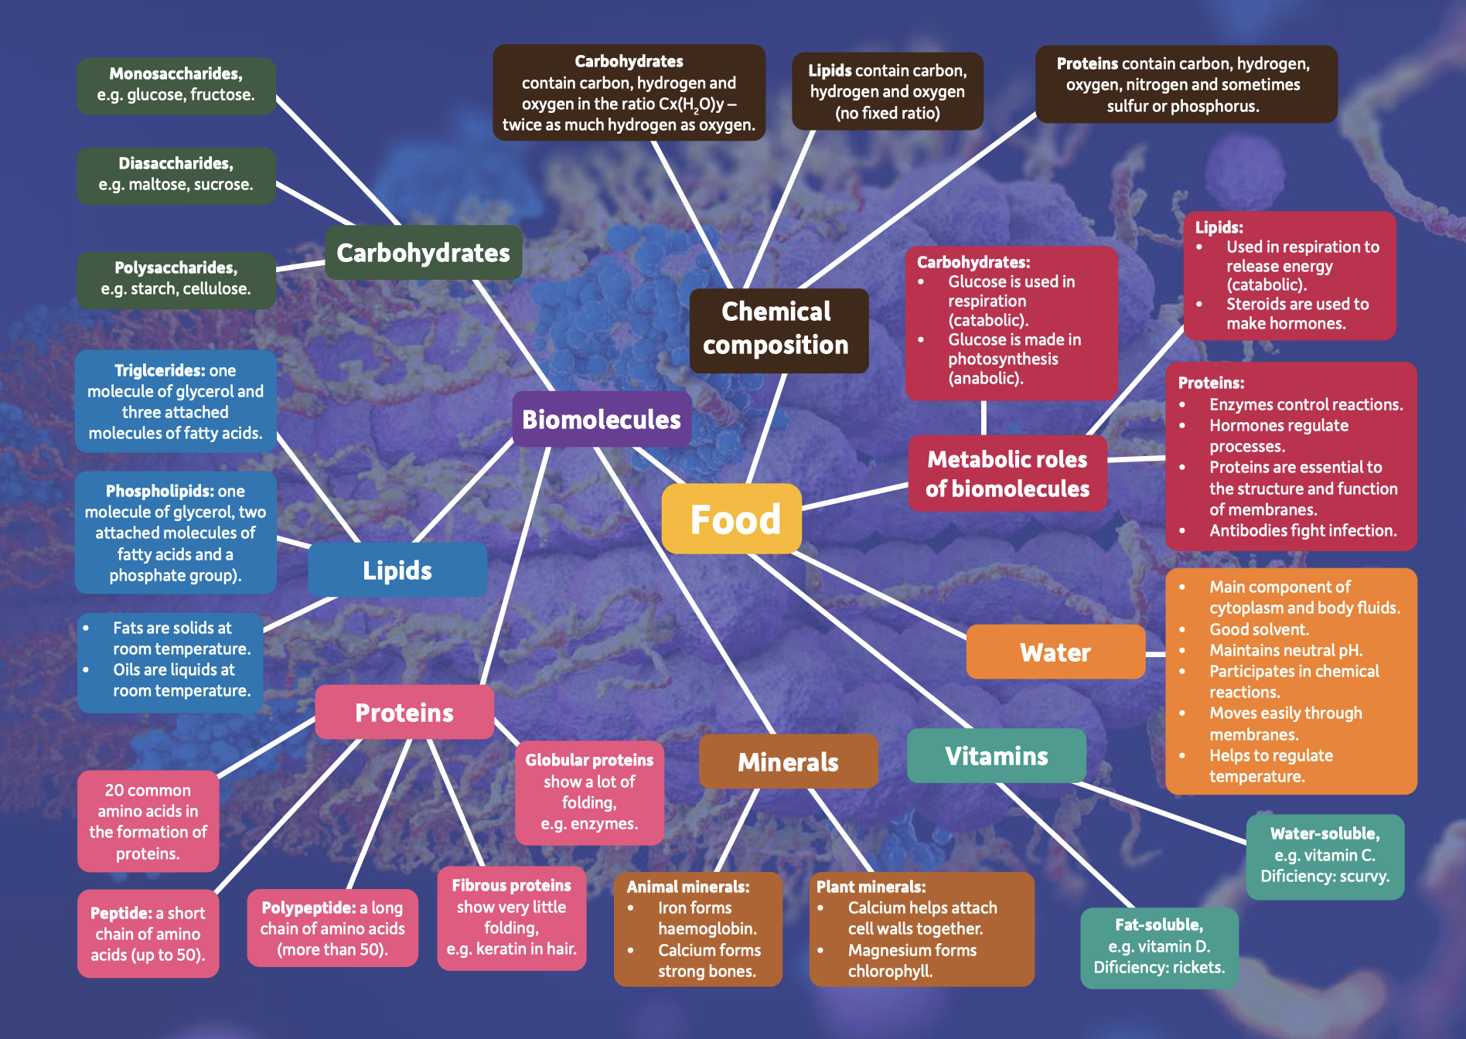

Slide 12
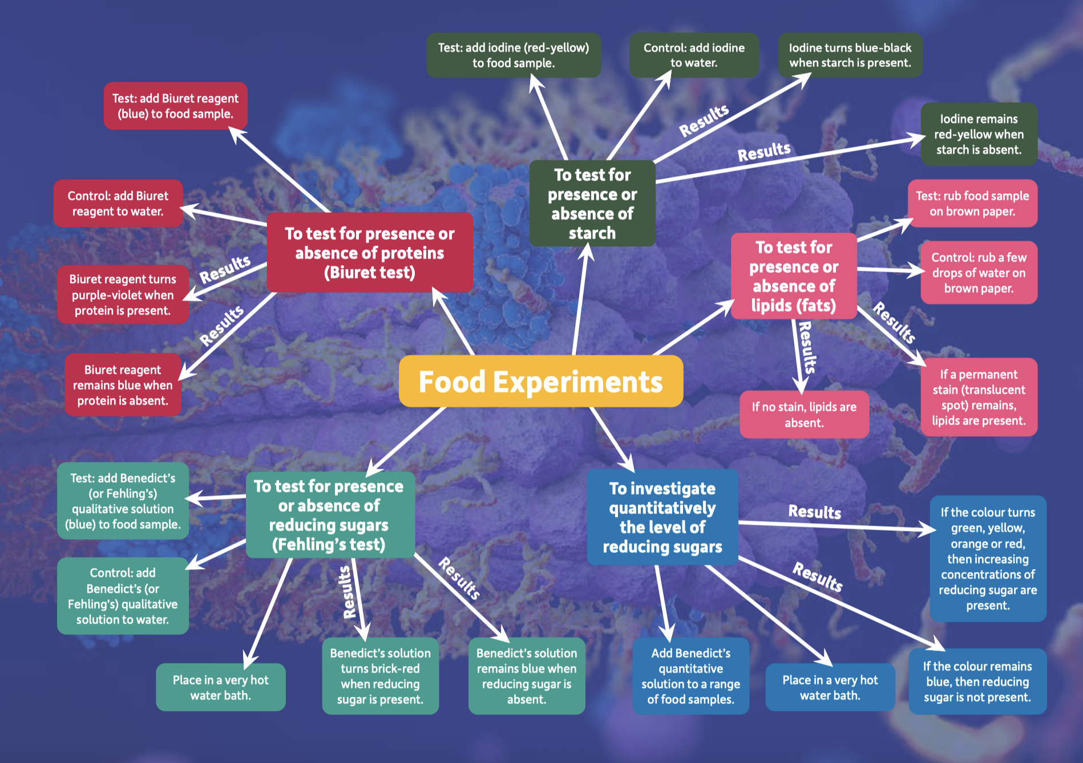

Slide 13
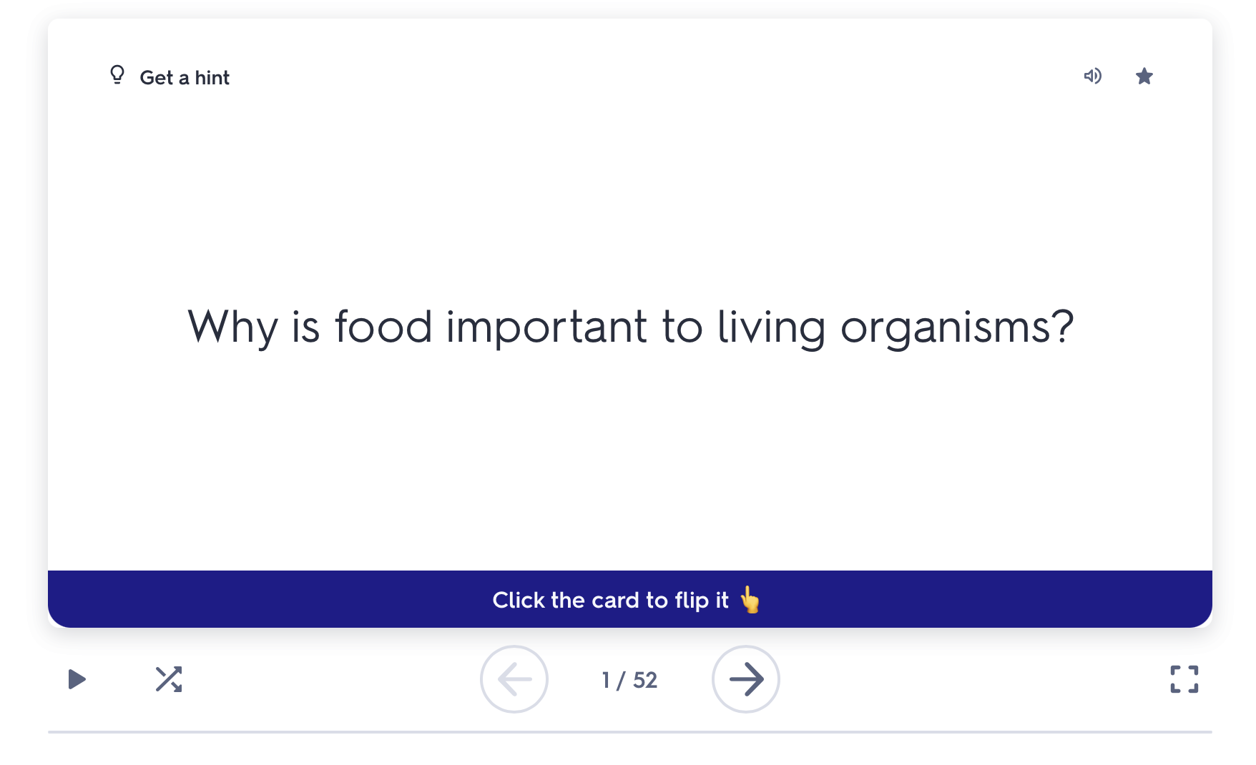
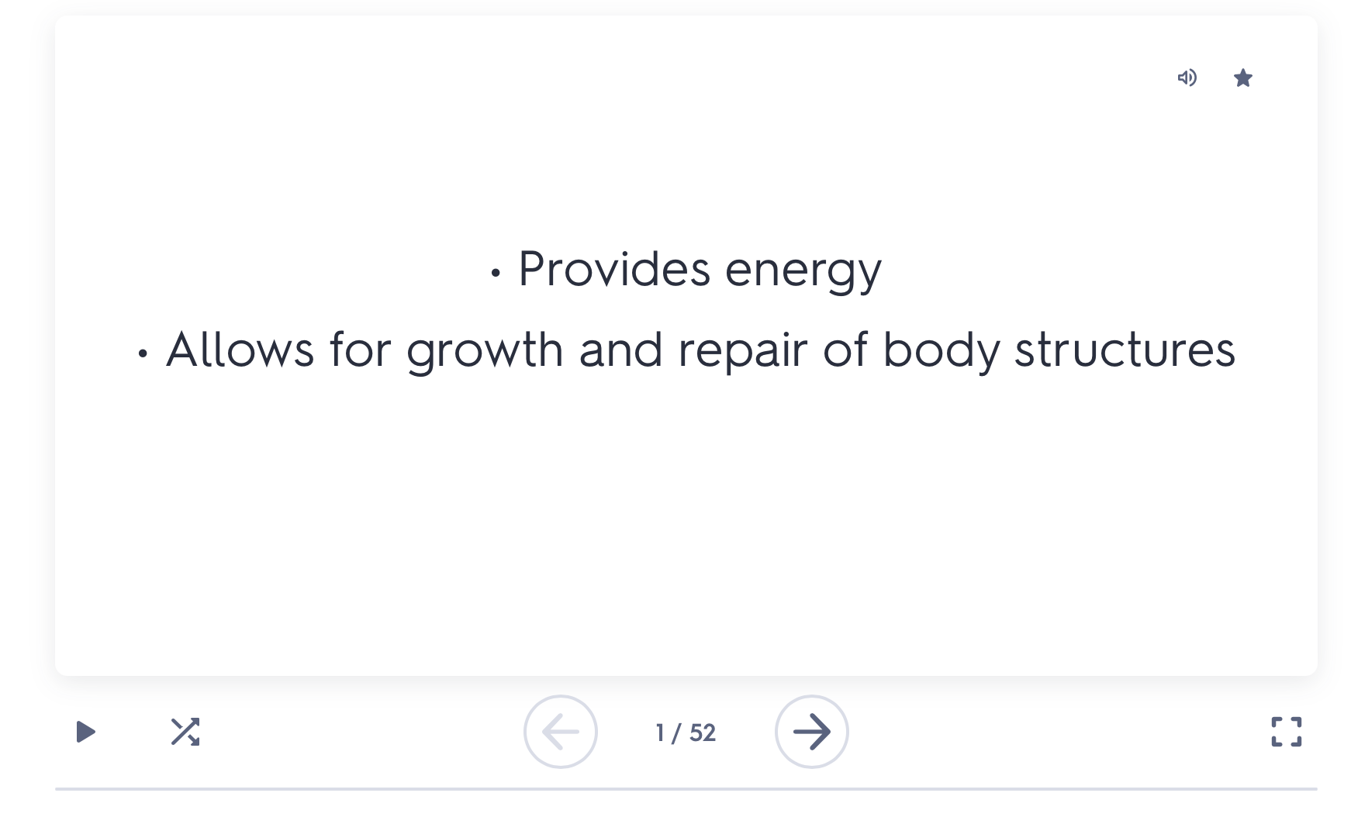
Flashcards / interactive quiz

Slide 14
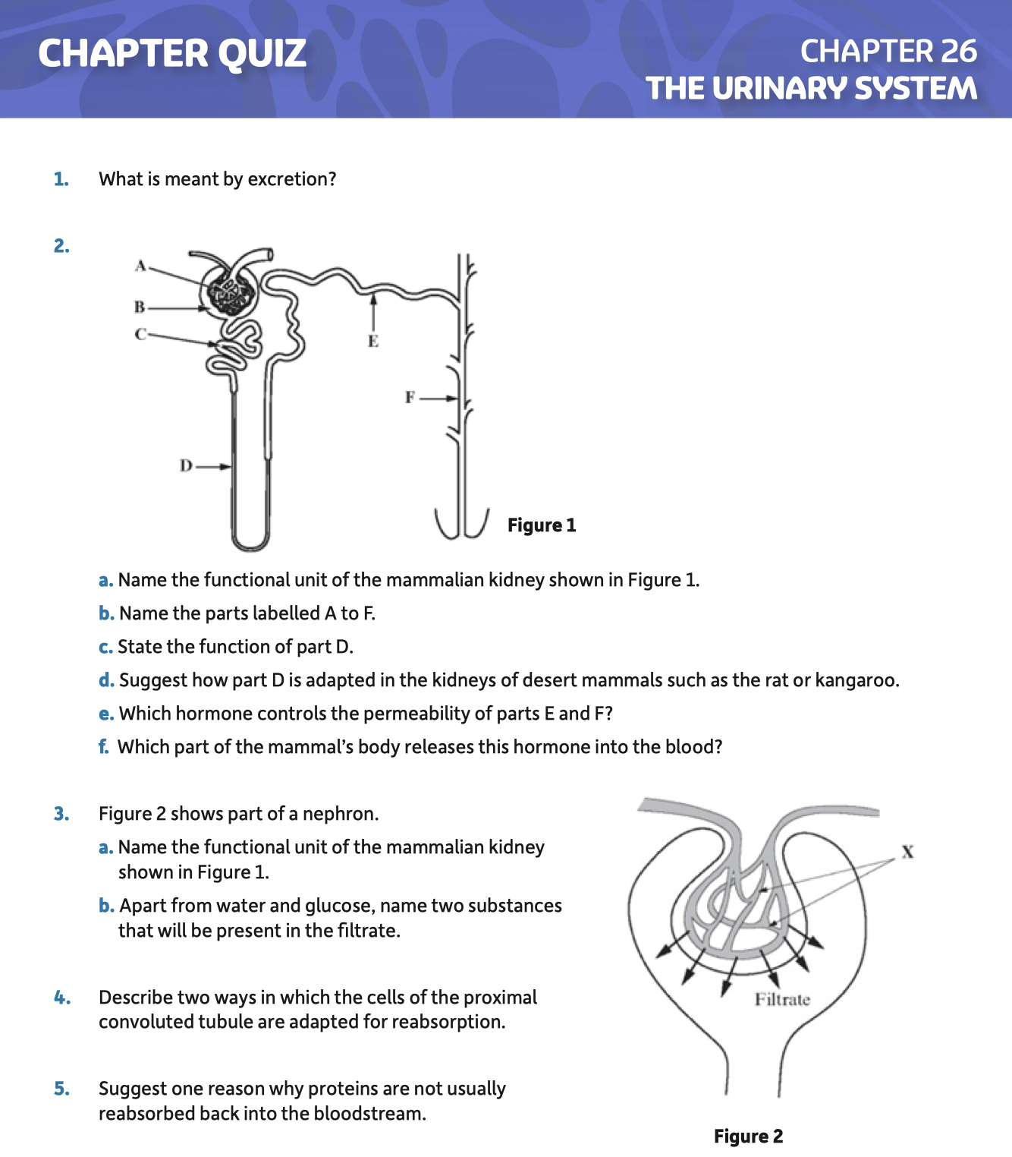
Chapter Quiz

Slide 15
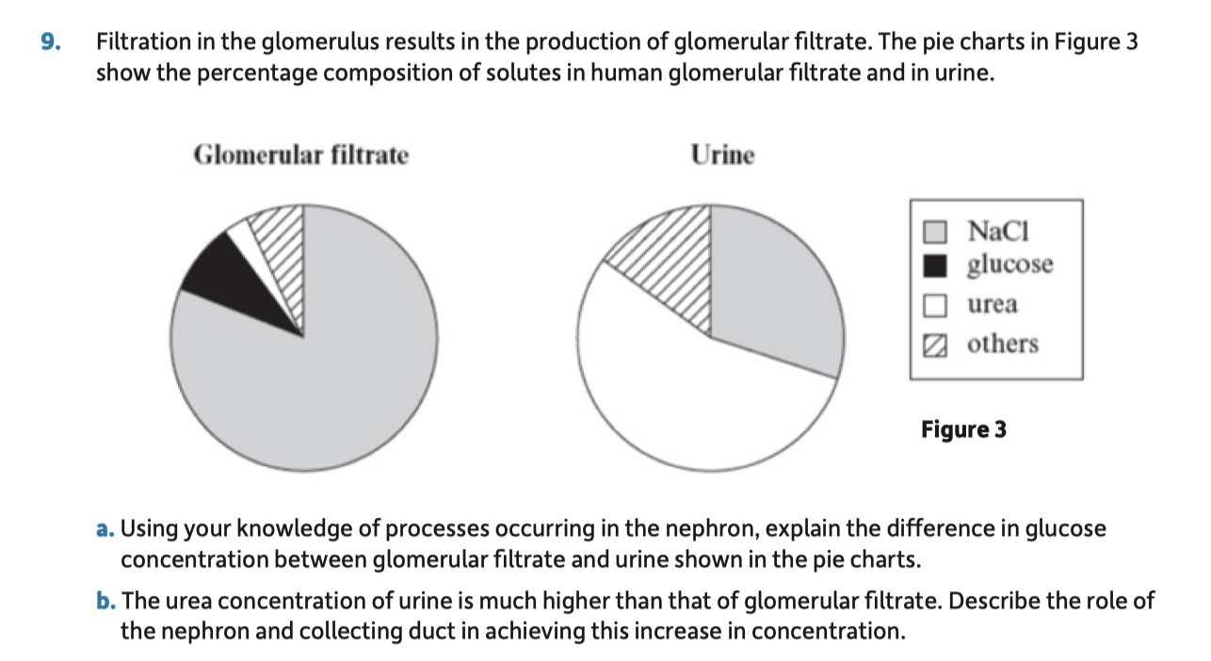
Chapter Quiz

Slide 16
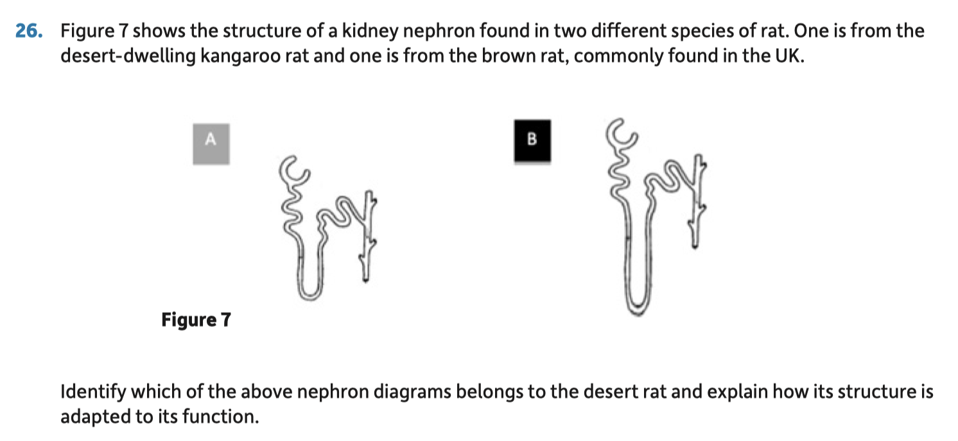
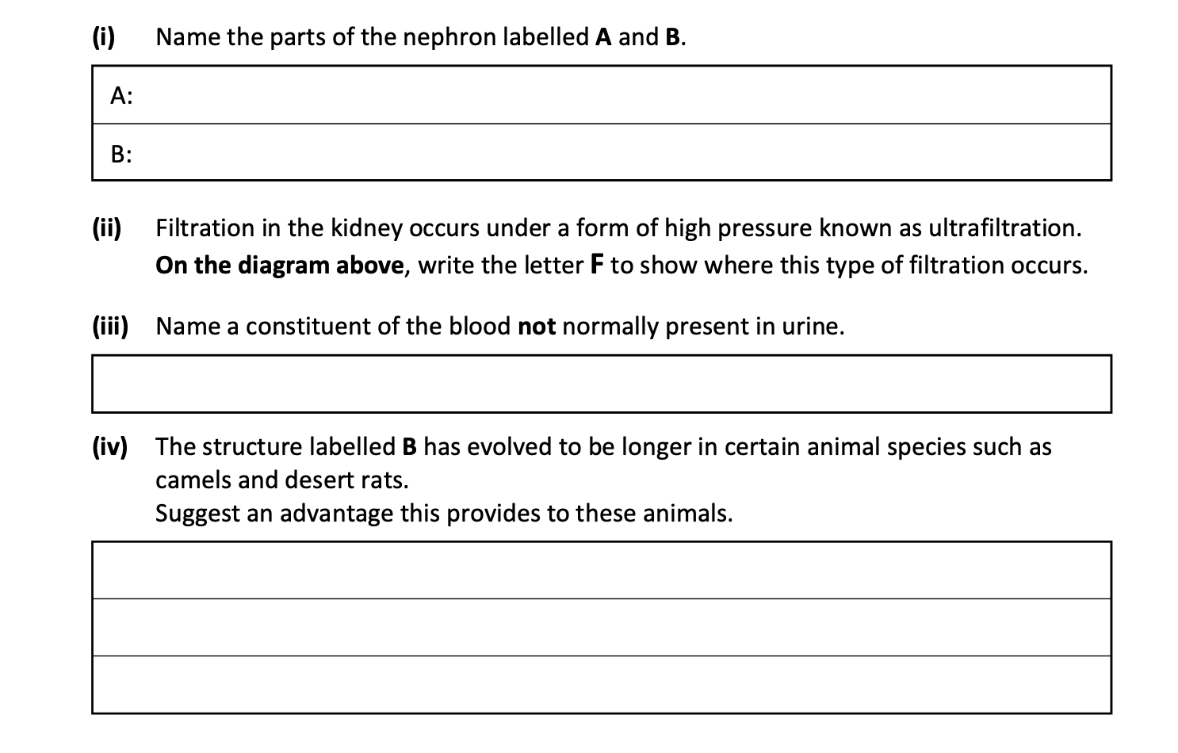
Chapter Quiz

Slide 17
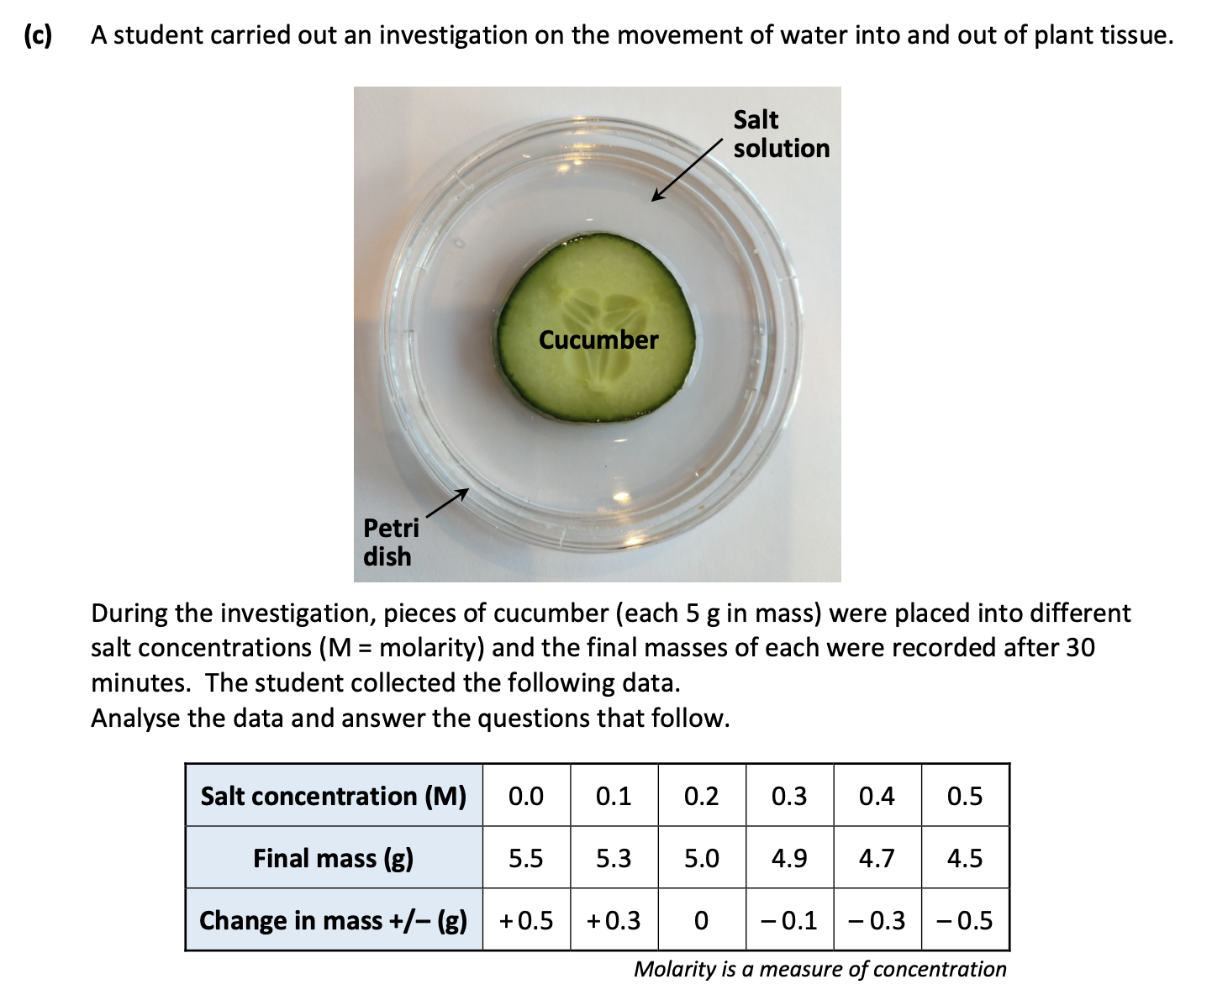
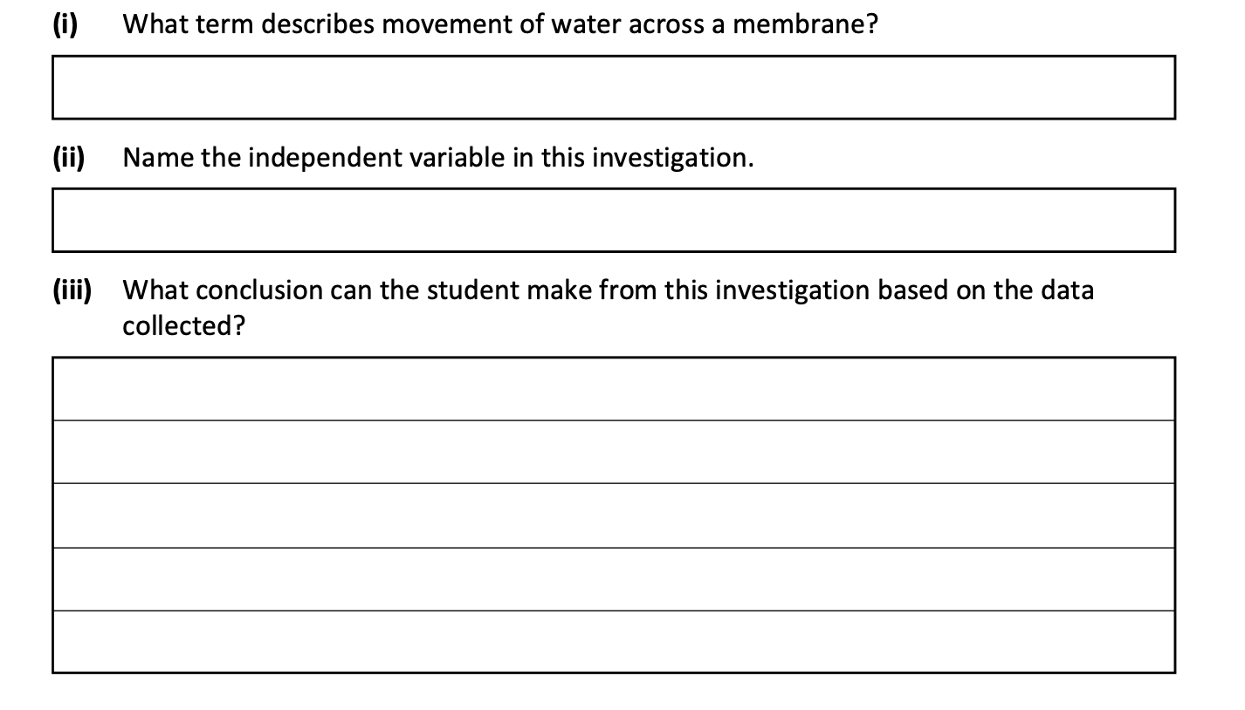

Slide 18
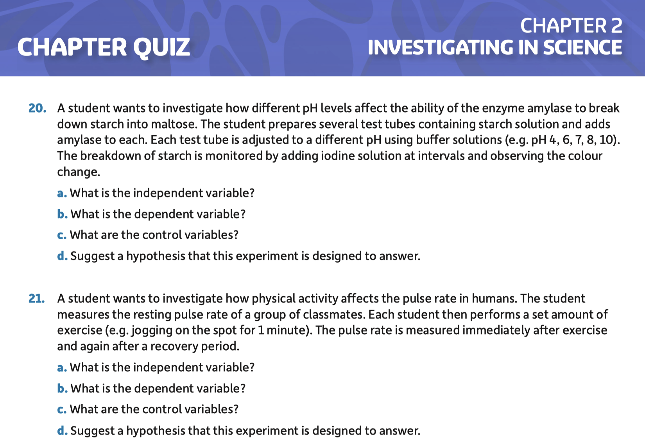

Slide 19
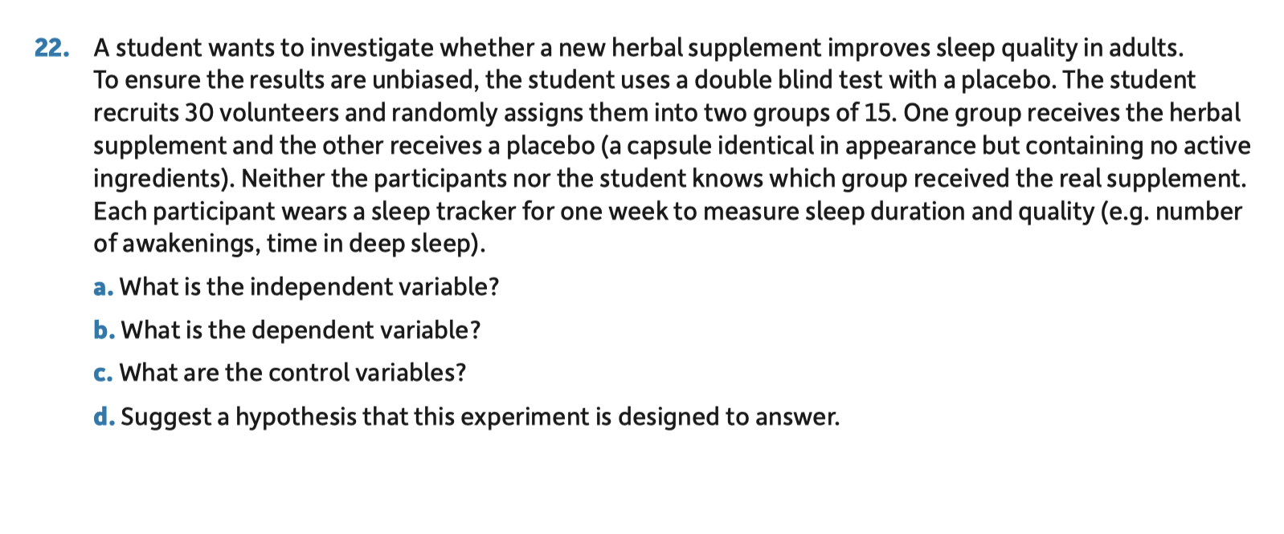
Chapter Quiz

Slide 20
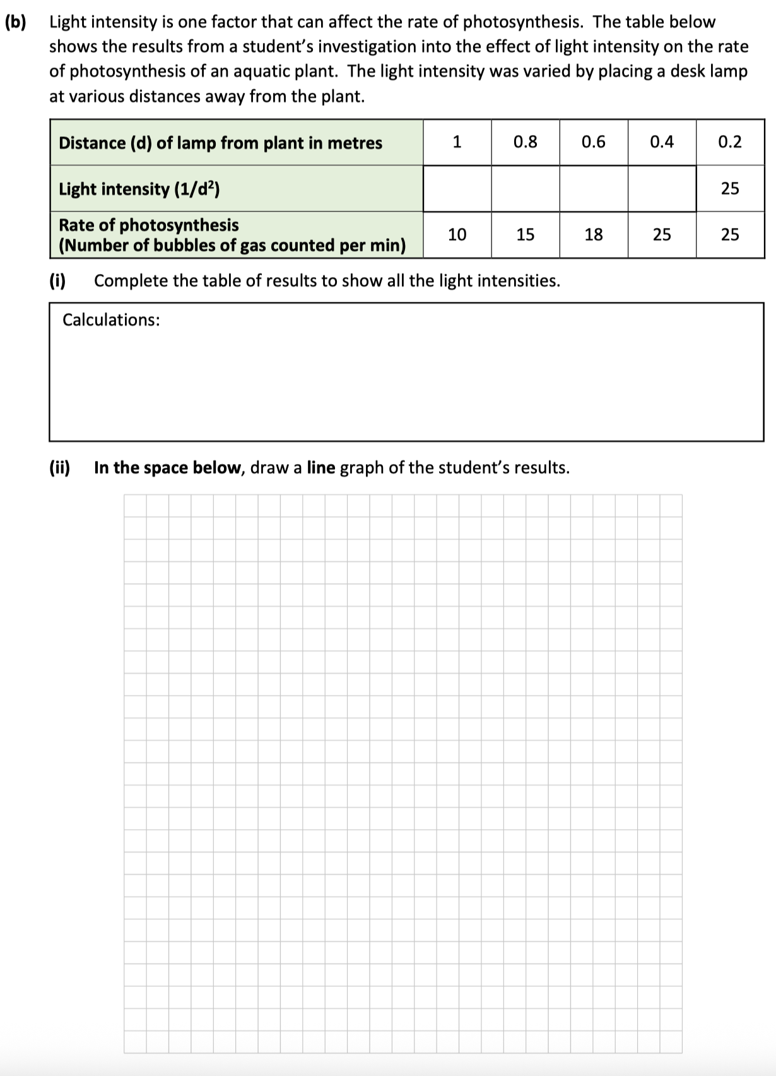
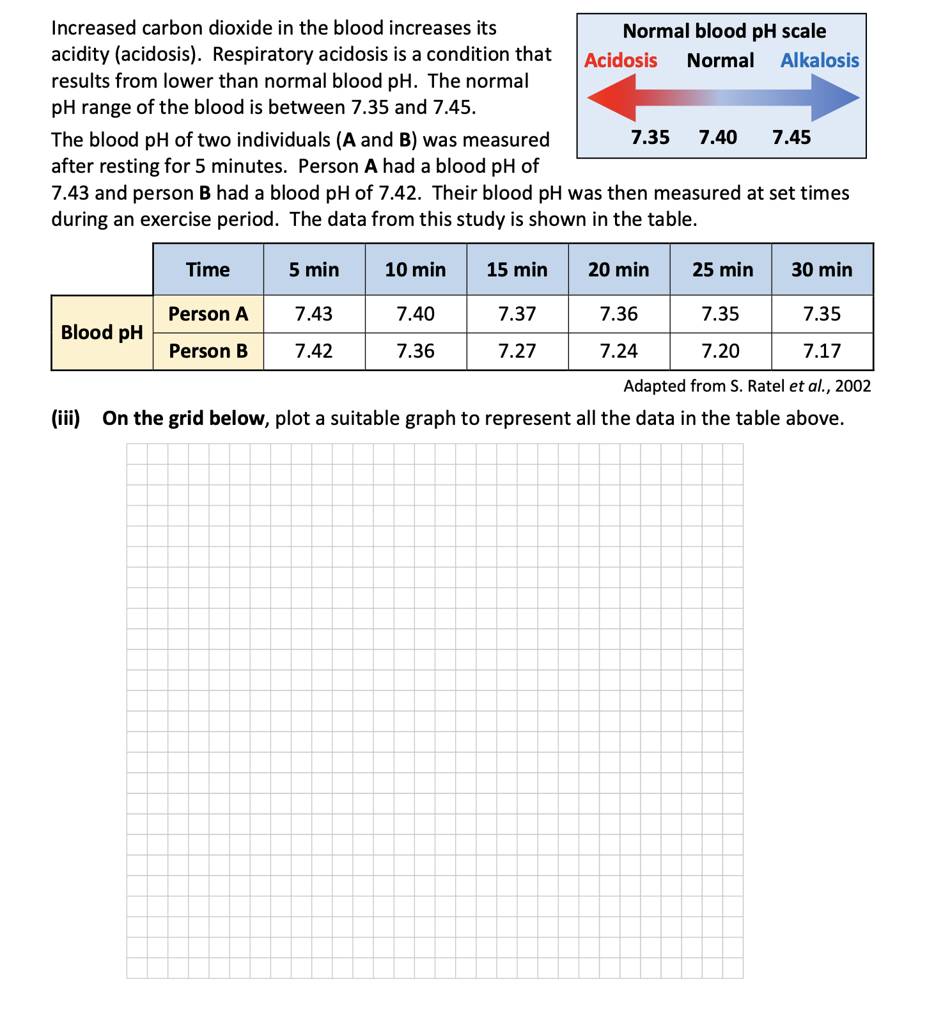

Slide 21
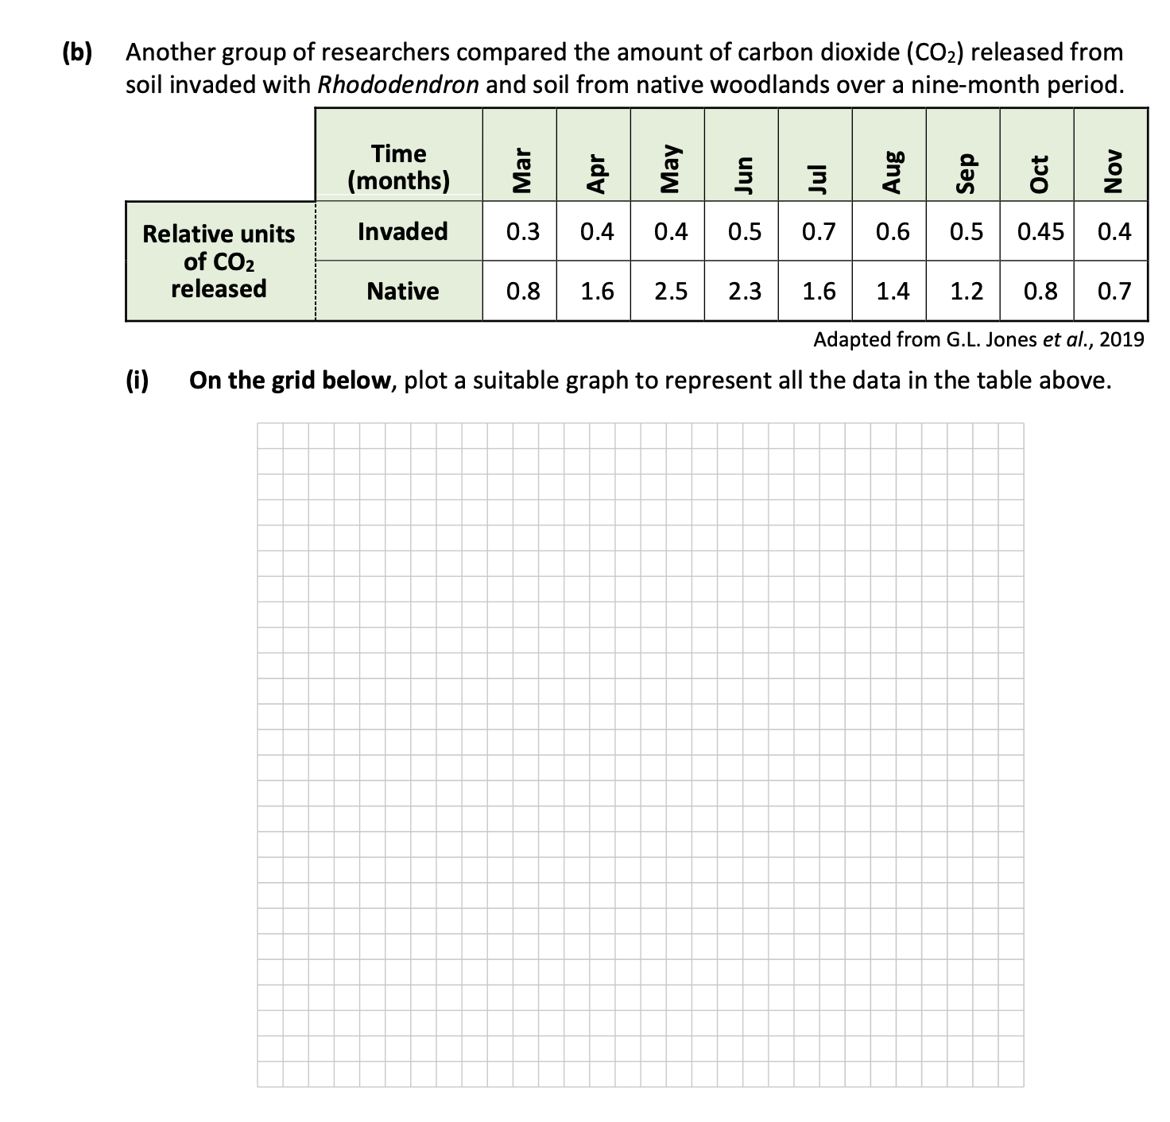

Slide 22
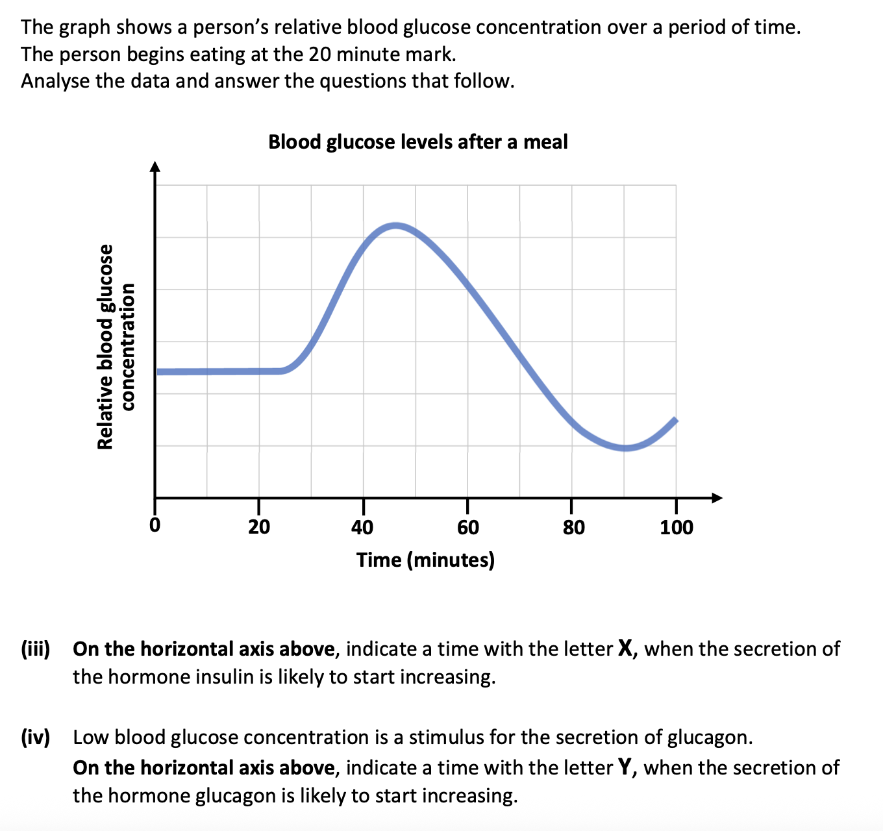
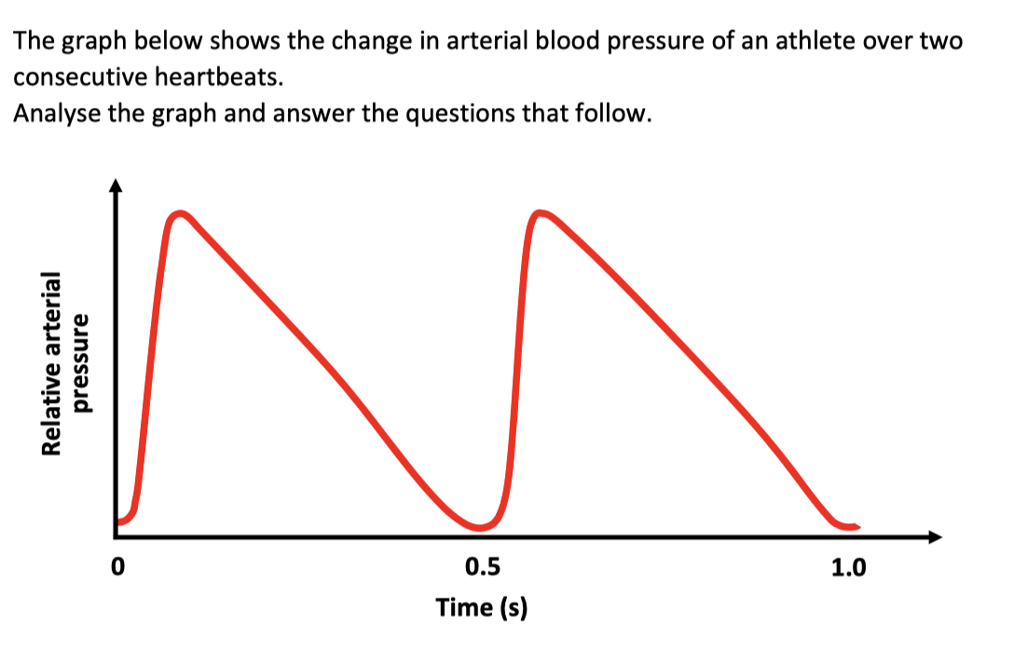

Slide 23
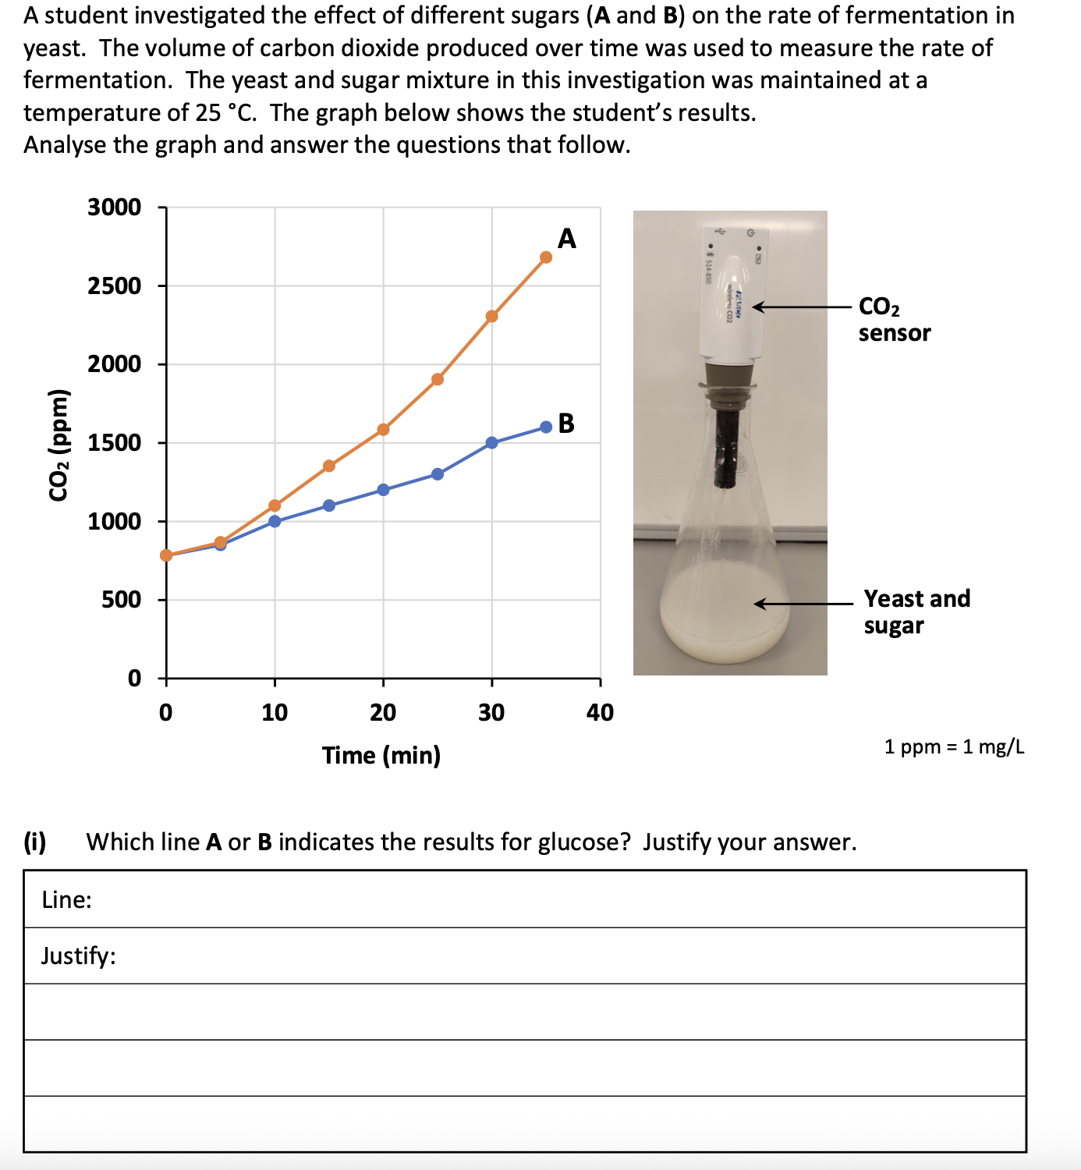
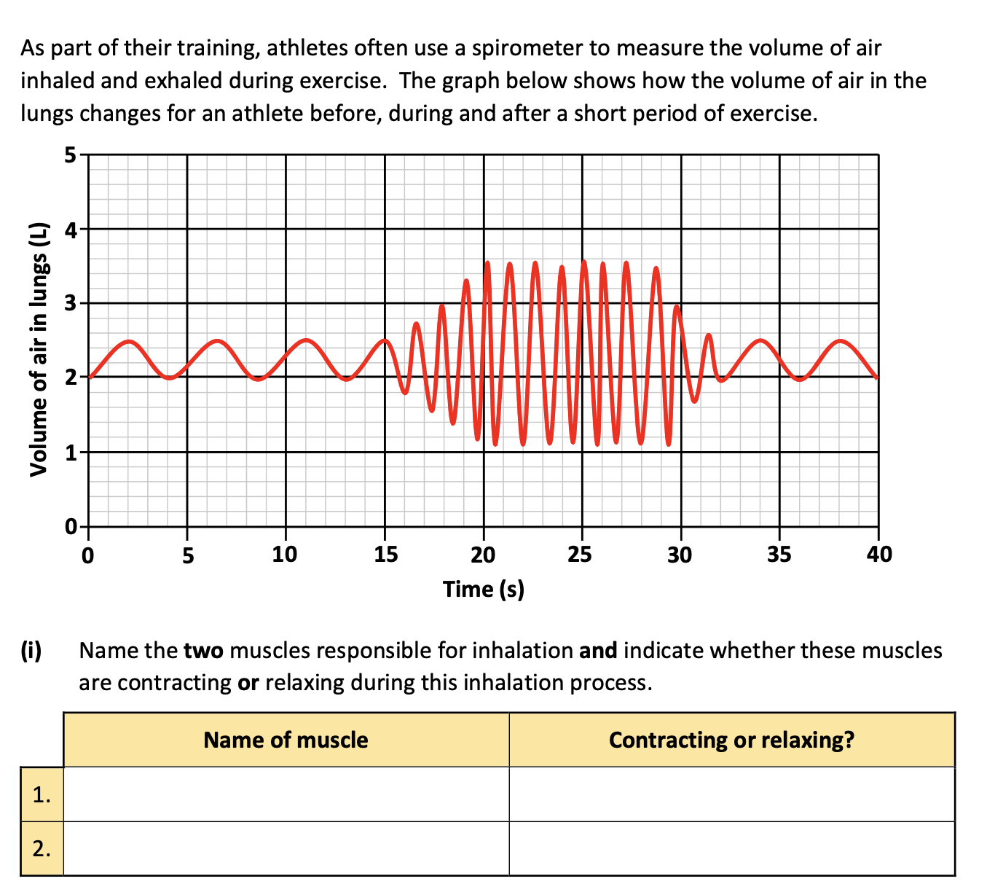

Slide 24
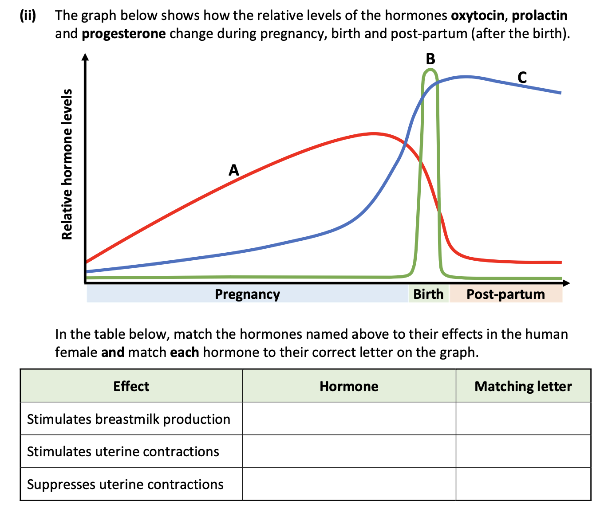
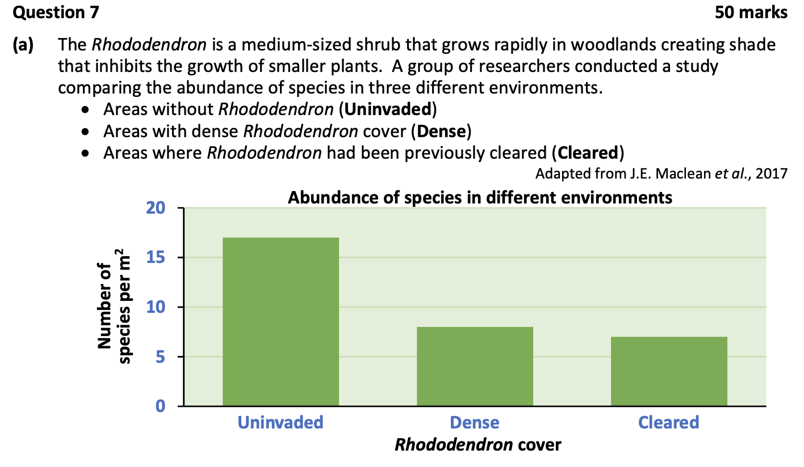

Slide 25
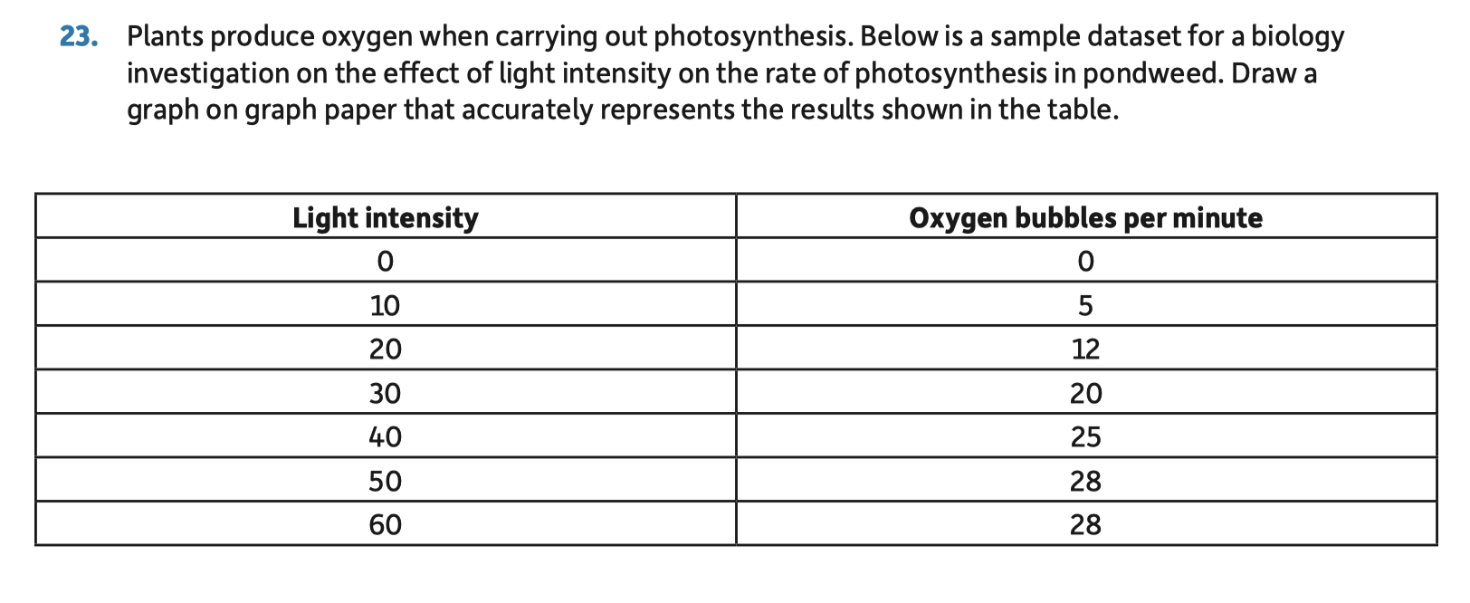
Graphs

Slide 26
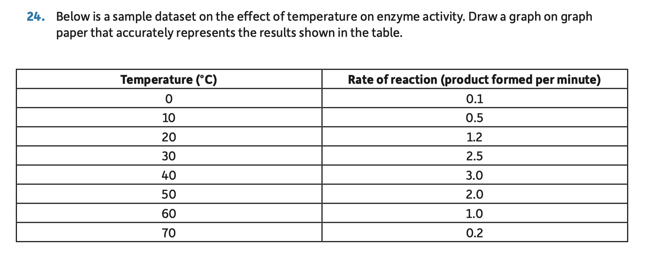
Graphs

Slide 27
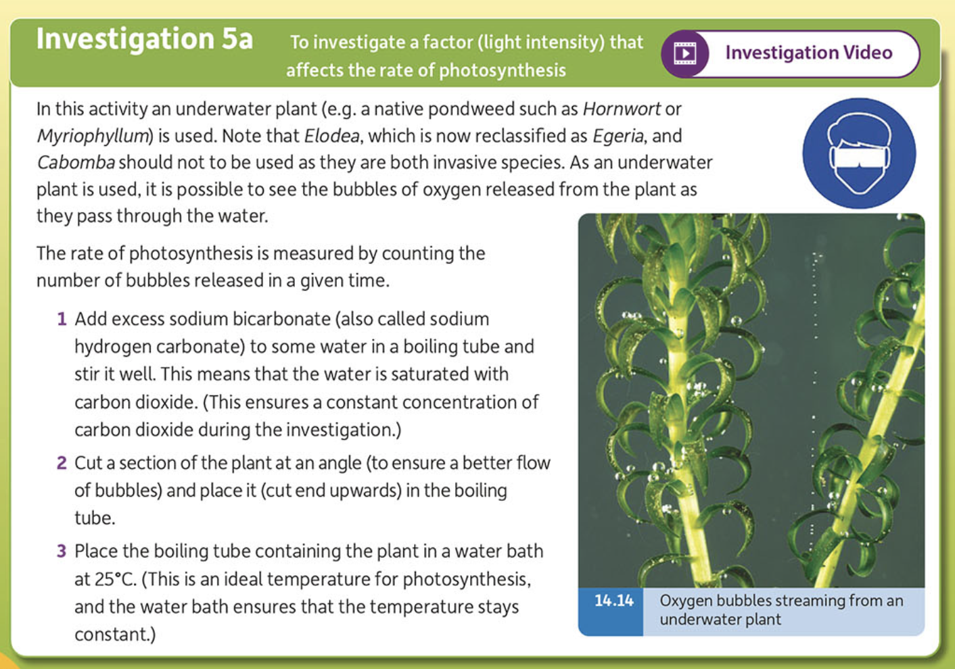
Investigation
Video

Slide 28
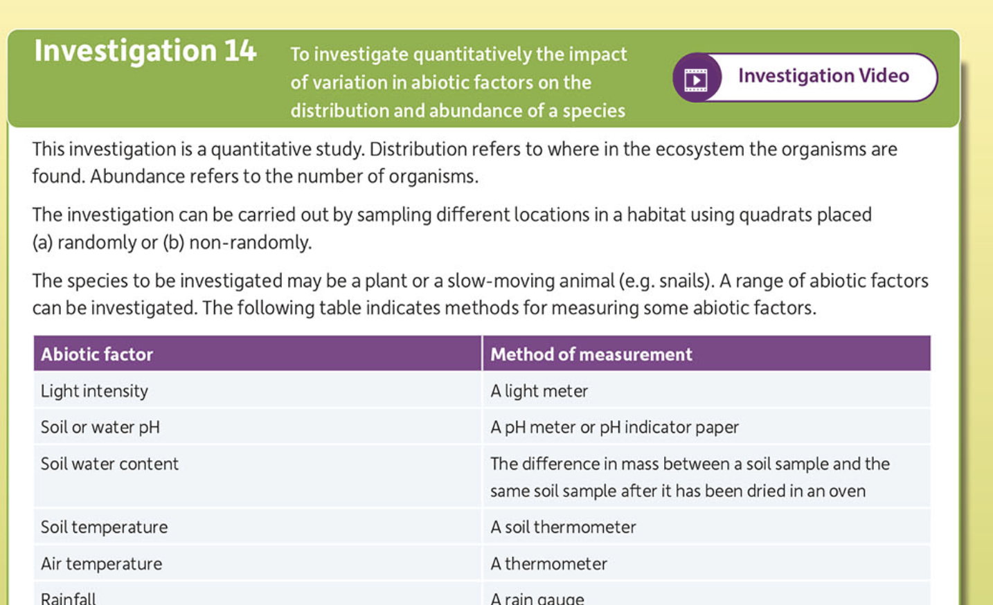
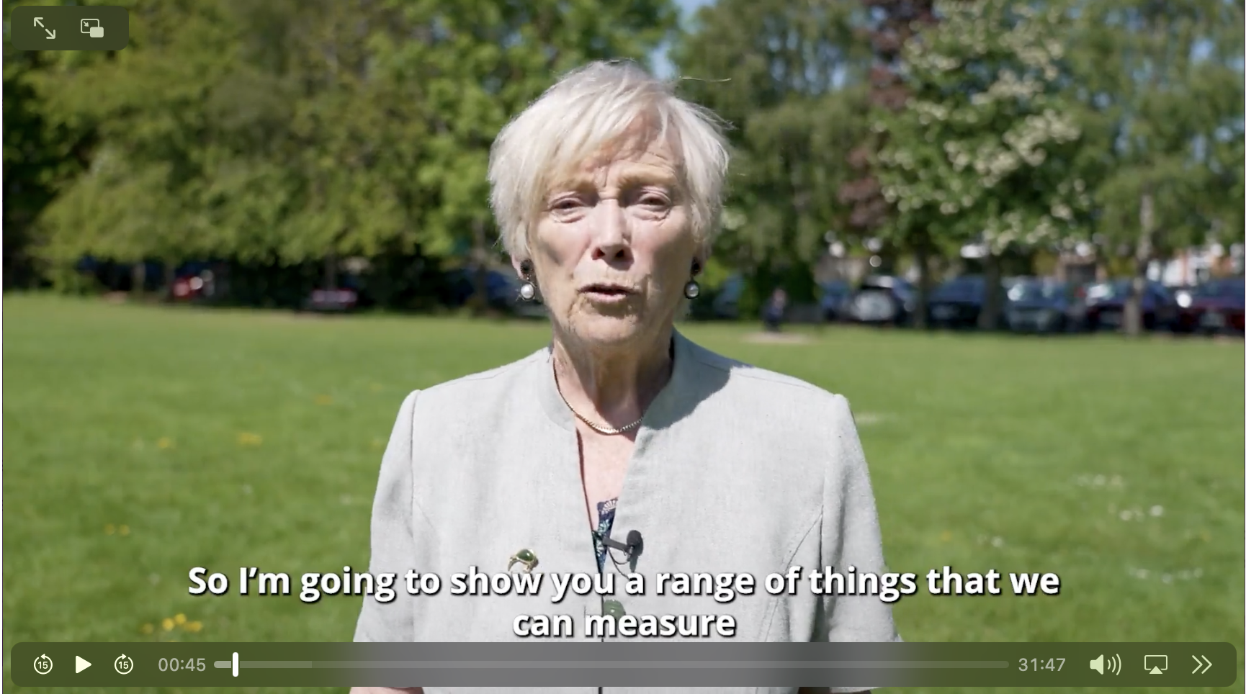
Investigation
Video

Slide 29
Topics no longer on the Leaving Certificate Biology Specification
The Senses (eye, ear, skin)
Tissue culture
Lymphatic System
Bone structure
Sexual reproduction in fungi
Gamete formation in plant reproduction
Vegetative propagation
Tropisms
Food storage in plant organs

Slide 30
Topics added to the Leaving Certificate Specification
Genome database
PCR (polymerase chain reaction)
DNA sequencing
Microbiome
Epigenetics
Artificial selection
Pyramid of biomass
J and S population curves
Biodiversity
Species Diversity Index (Simpson’s diversity index)

Slide 31
Topics added to the Leaving Certificate Specification
Endoplasmic reticulum / Golgi apparatus / detailed study of internal structure of mitochondria and chloroplast
Cancer prevention and cancer treatment
Endorphins and dopamine
Classification and Domains of Life

Slide 32
New investigations added to the Leaving Certificate Specification
To investigate patterns using a DNA profile
To investigate factors affecting the growth of microorganisms
To use classification systems to identify organisms in an ecosystem
To investigate factors affecting the rate of transpiration in plants
To investigate and compare the structures of insect-pollinated and wind-pollinated plants

Slide 33
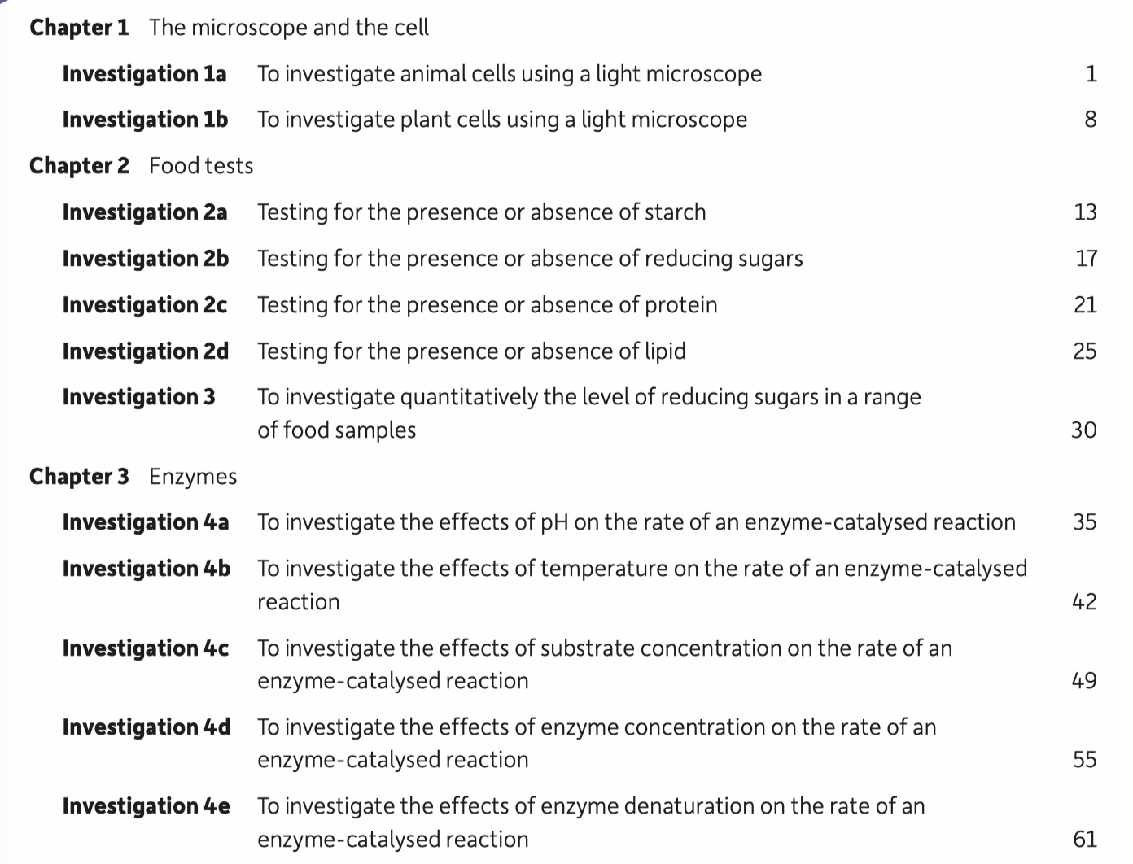

Slide 34
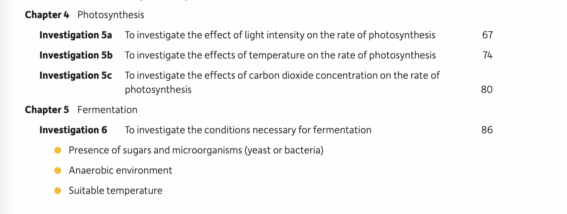
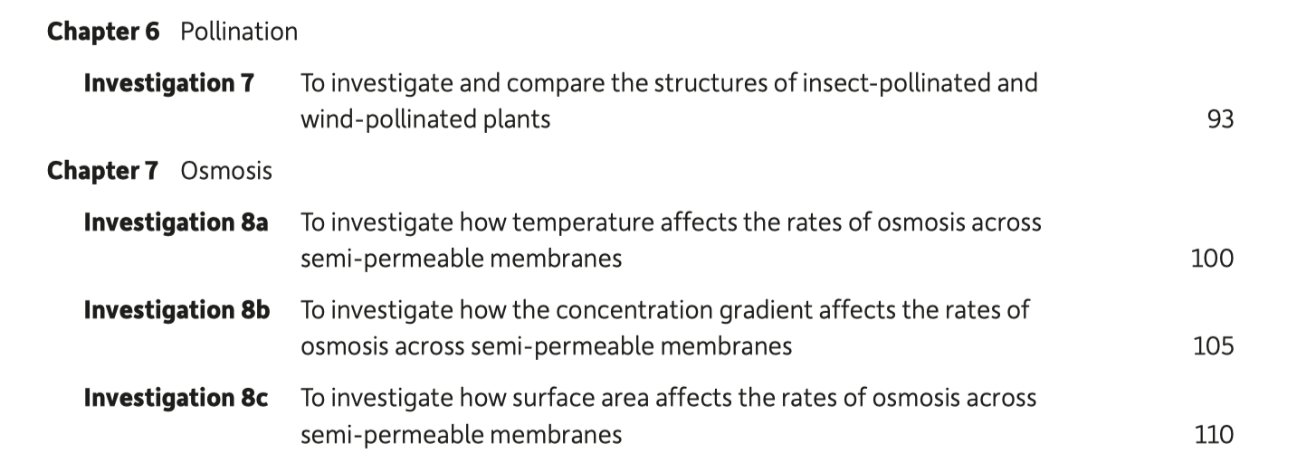

Slide 35
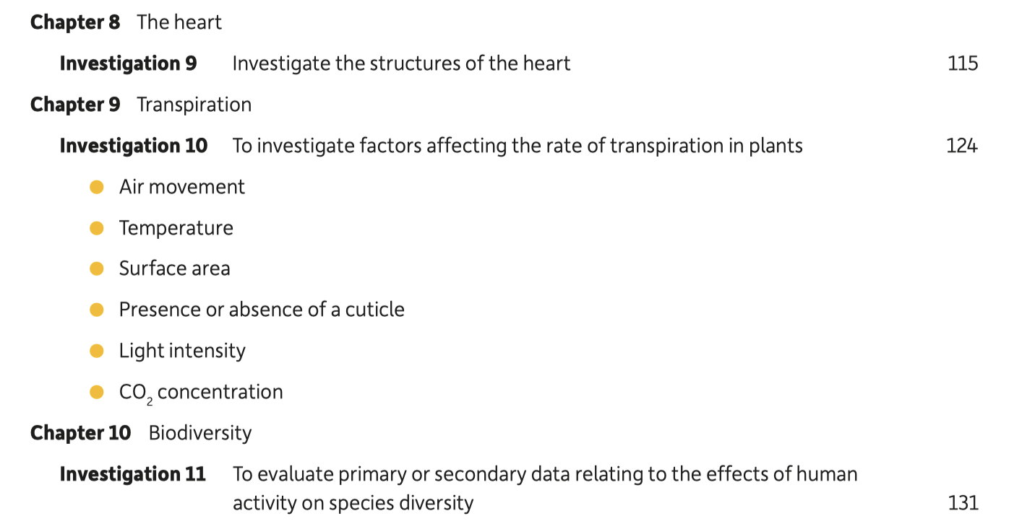

Slide 36
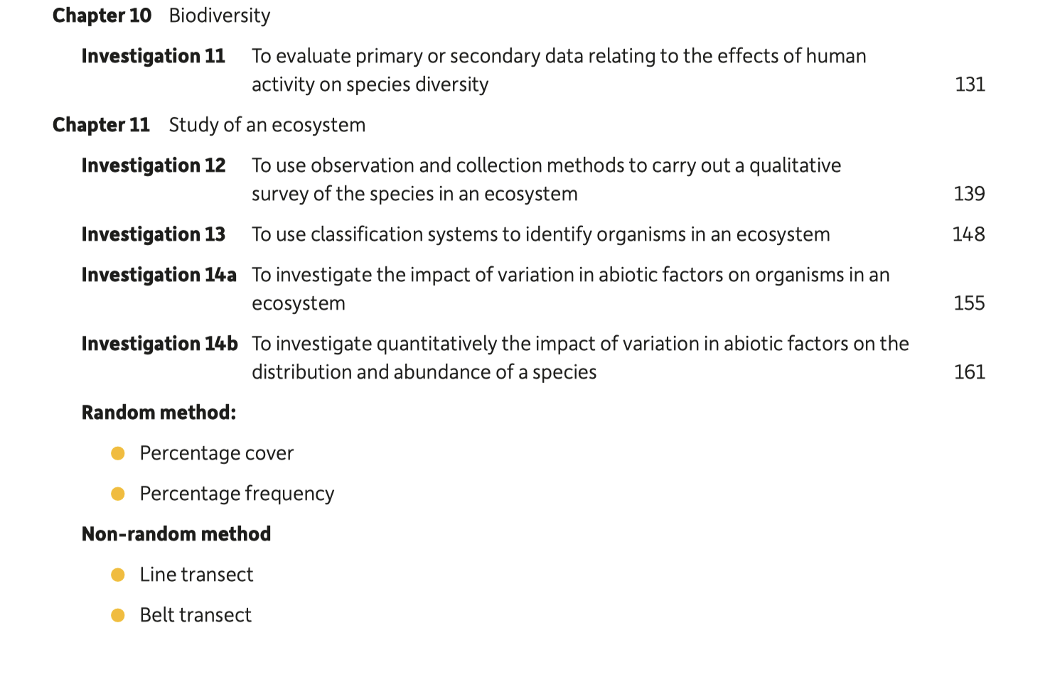

Slide 37
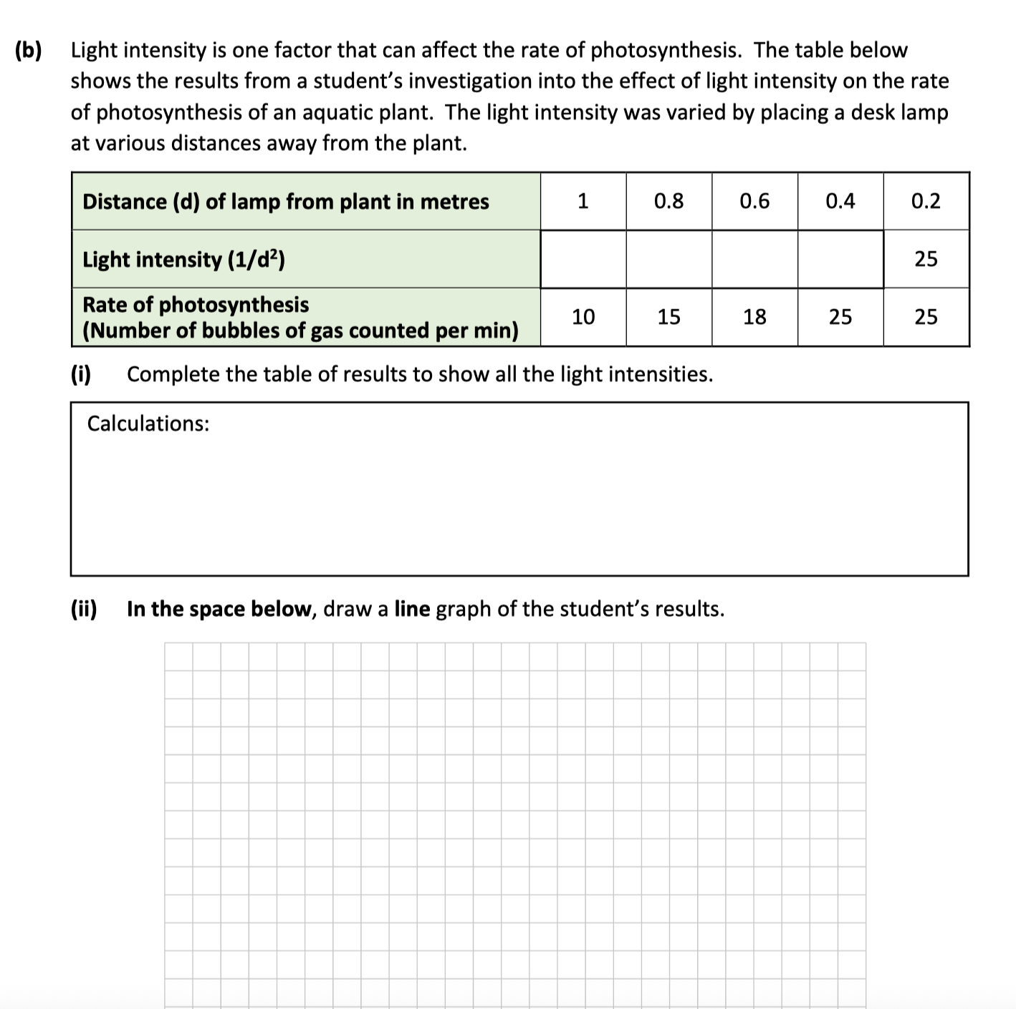
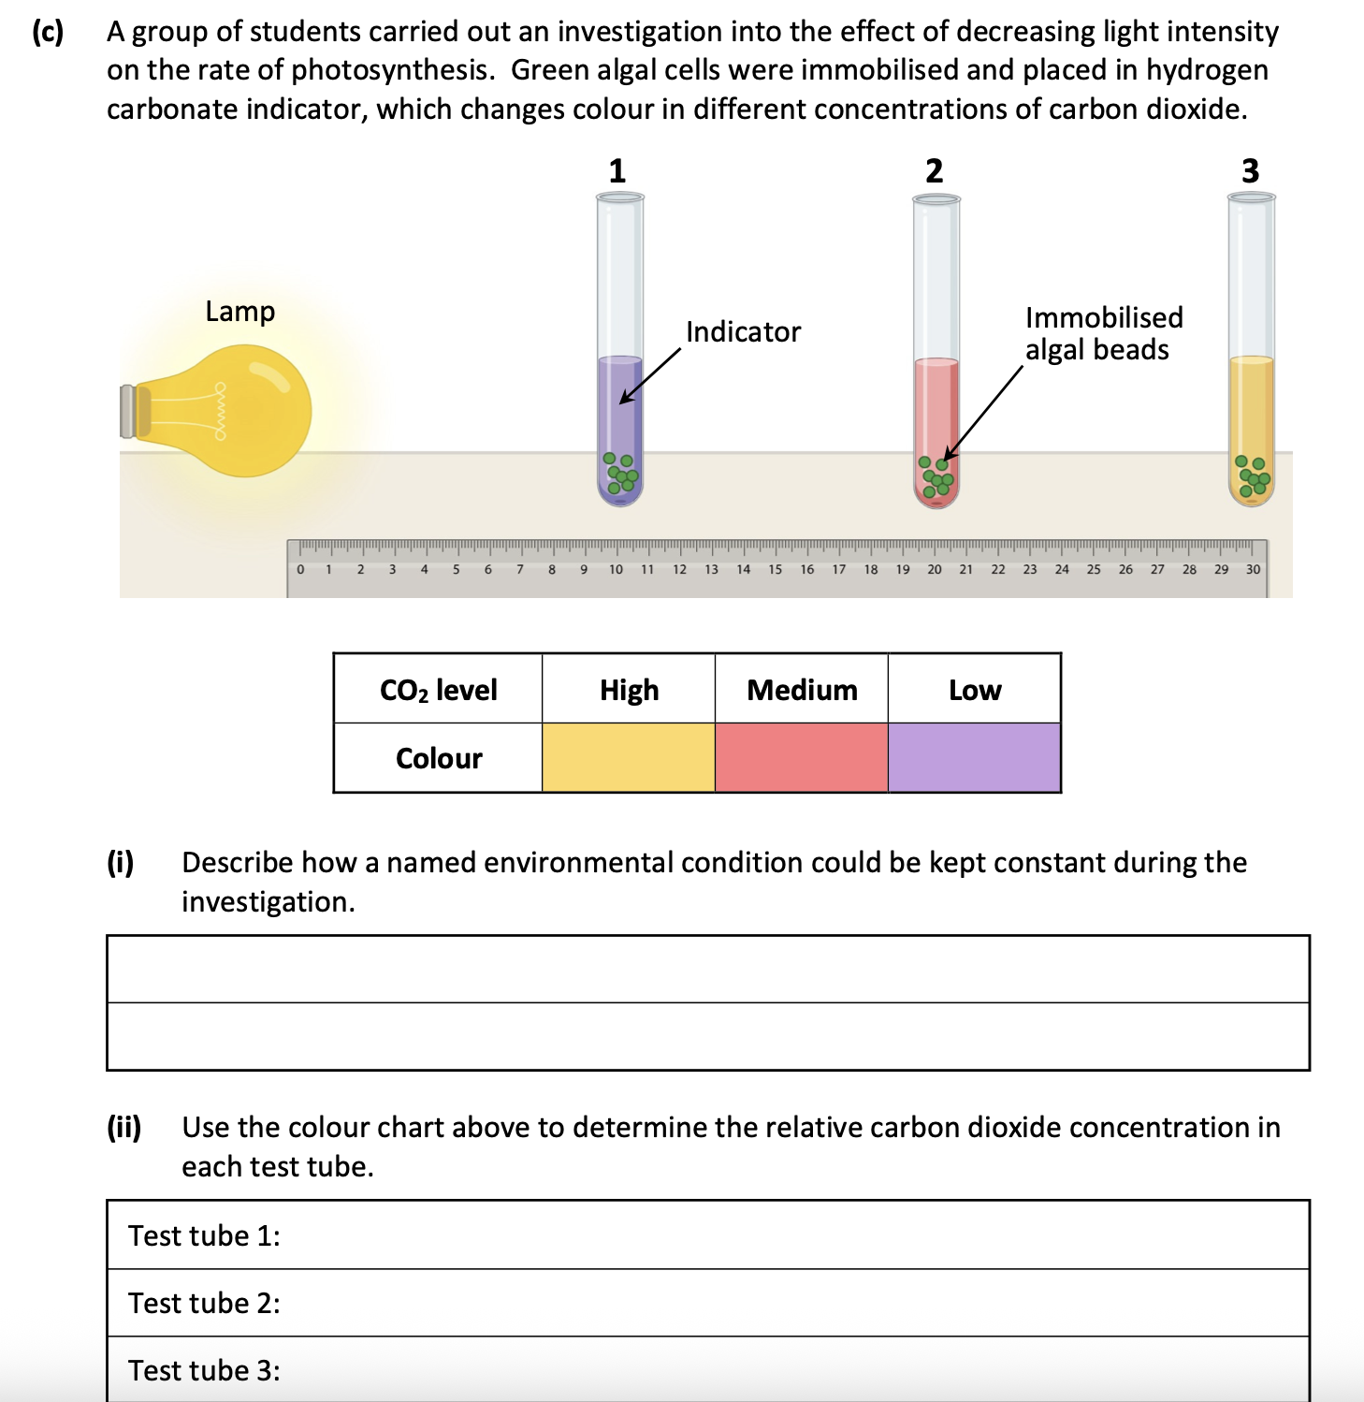

Slide 38
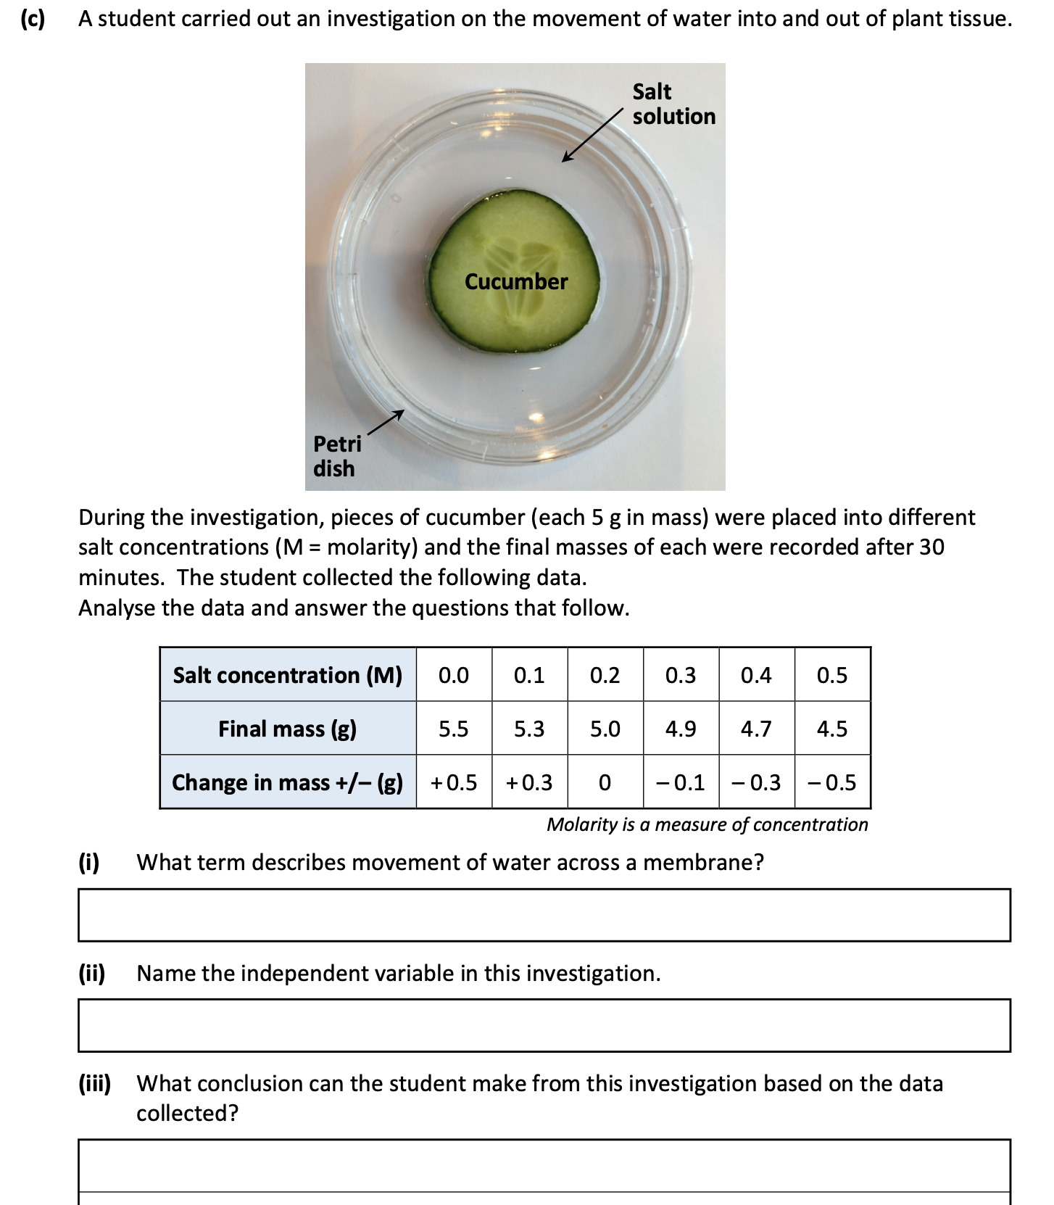

Slide 39
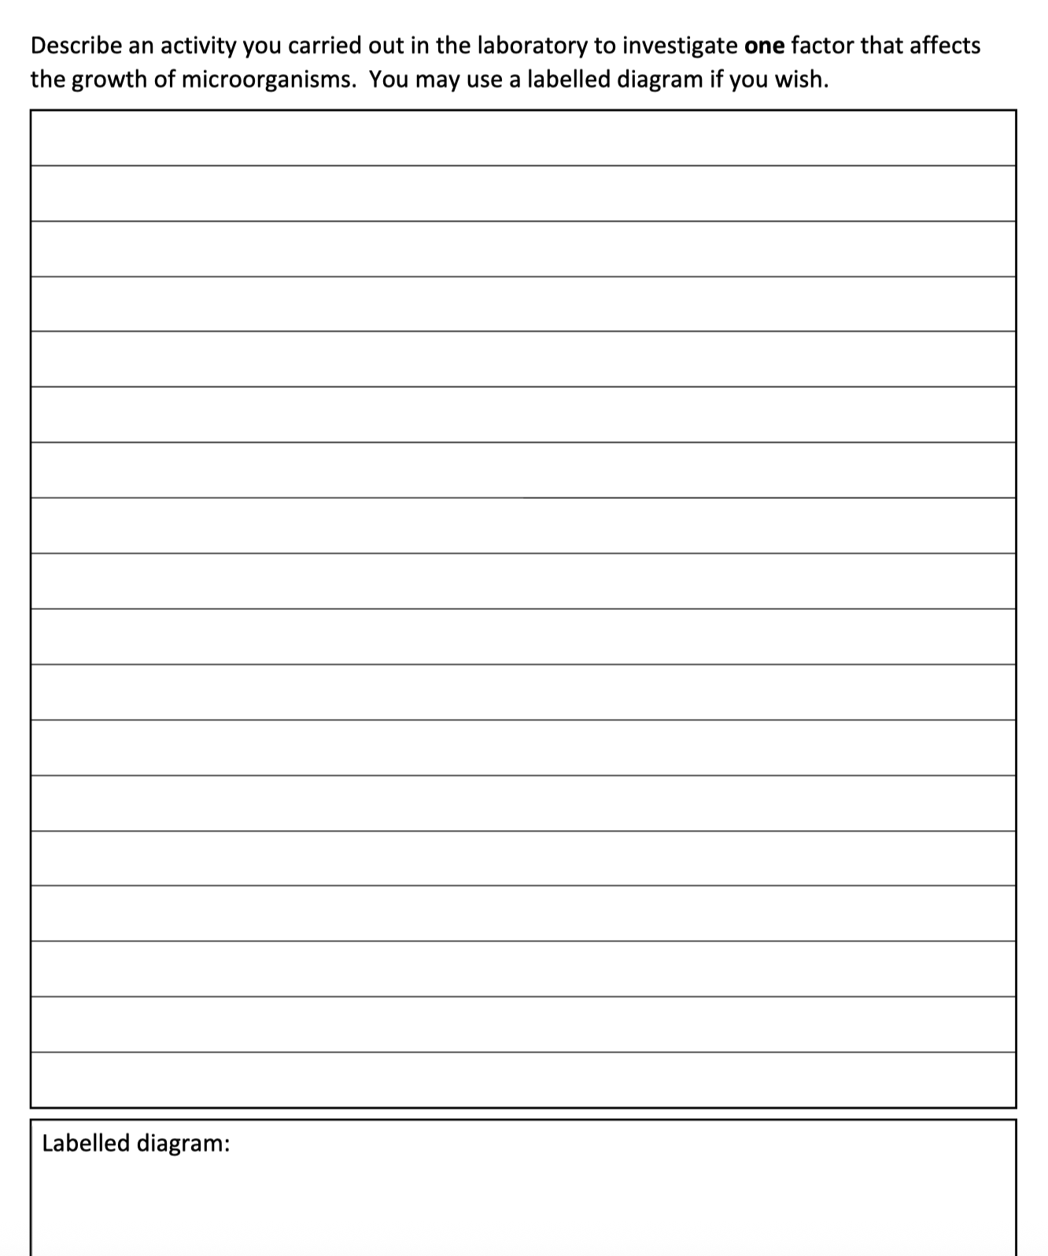

Slide 40
What chapters to study in 5th year?
September:
Scientific Method
Investigating in Science
The Characteristics of Life
The Unit of Life – The Cell
October:
Biomolecules of Life
Transport across membranes
Enzymes

Slide 41
What chapters to study in 5th year?
November:
Cell Division and Cancer
The Breathing System
The Digestive System
December:
The Circulatory System
Plant Structure and Transport
January:
Ecology / Ecosystems and Biodiversity
Photosynthesis
February
Homeostasis
The Nervous System
The Endocrine System

Slide 42
What chapters to study in 5th year?
March:
Microorganisms
The Musco-skeletal System
Urinary System
April:
Investigating an Ecosystem
Nutrient Cycling
May:
Plant Reproduction
Topics to cover in 6th year
Respiration
Viruses, Classification and the Domains of Life
DNA, RNA, protein synthesis and the Genetic Code
Genetic Inheritance
Evolution
Genetic Engineering
Immunity
Human Reproduction

Slide 43
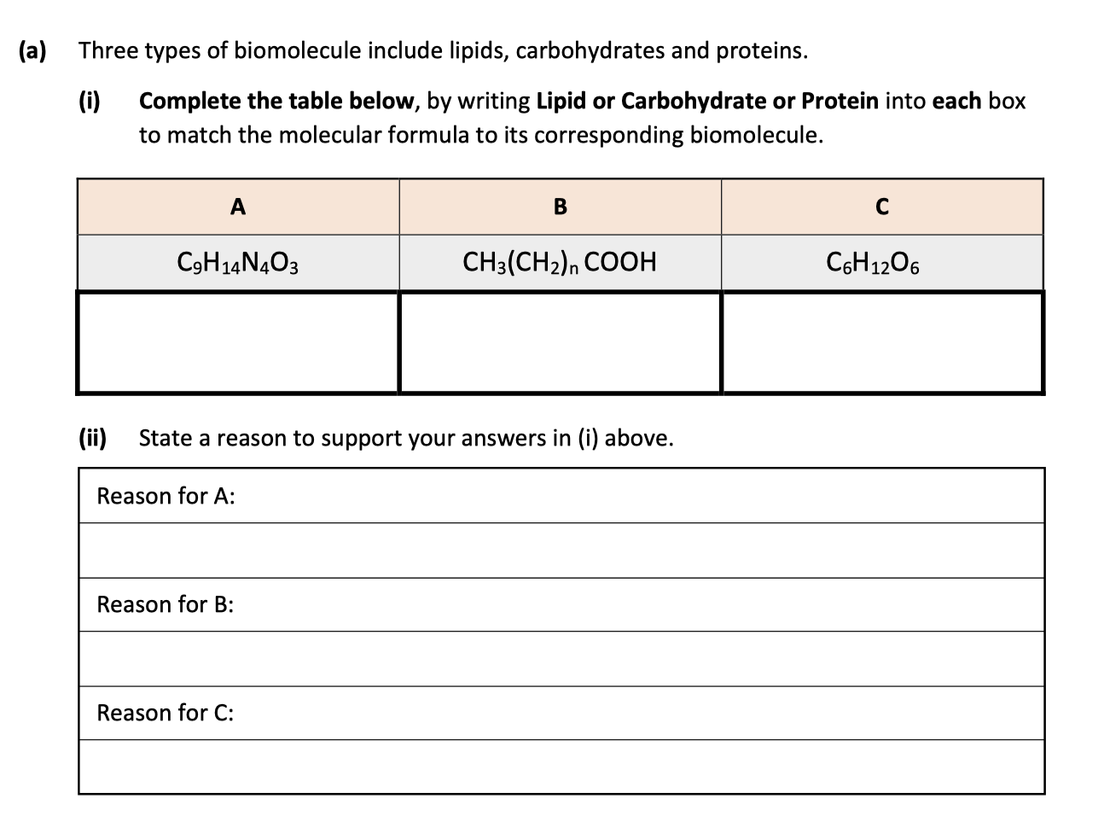

Slide 44
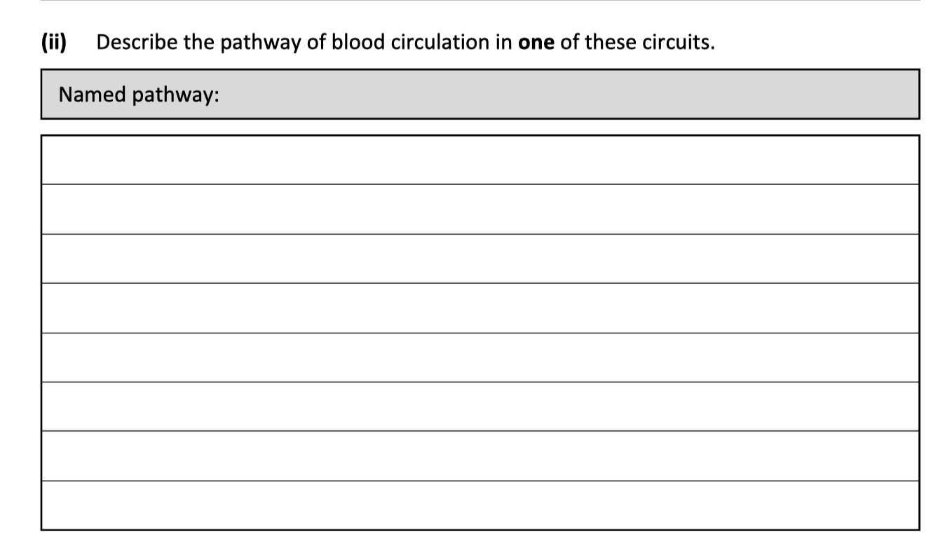
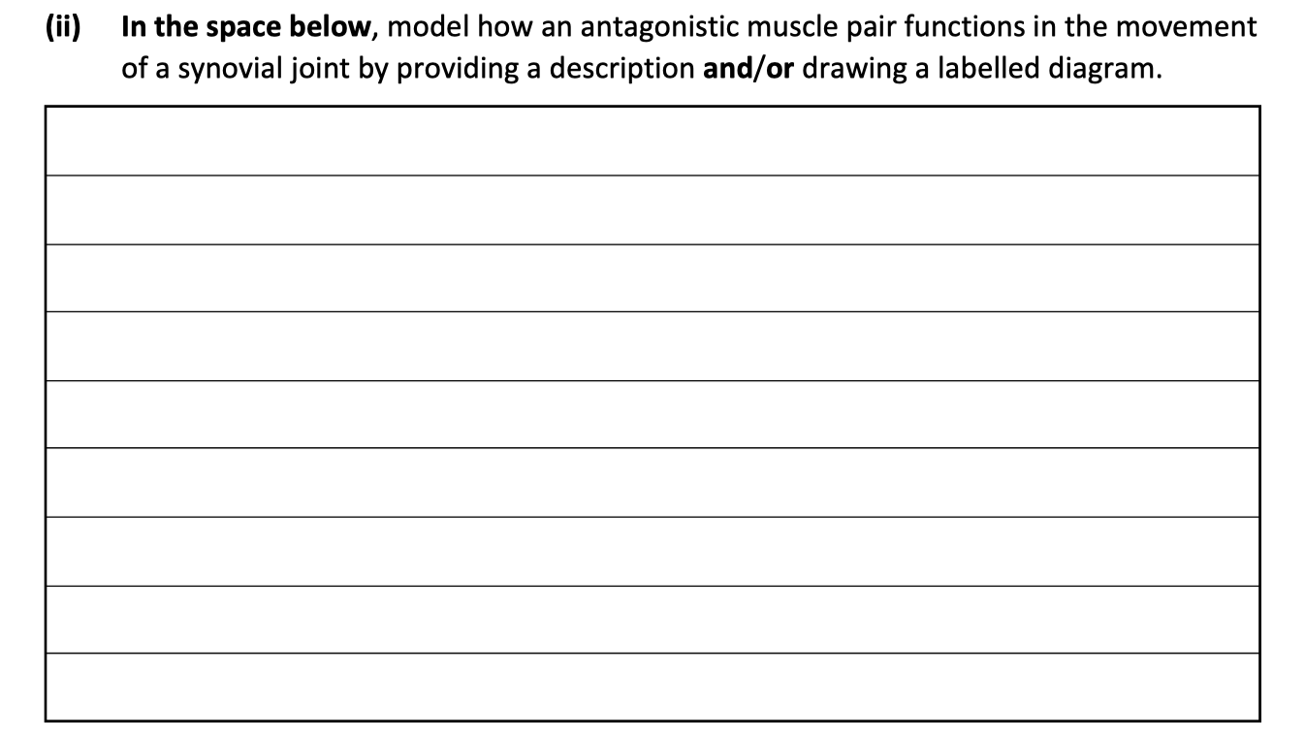

Slide 45
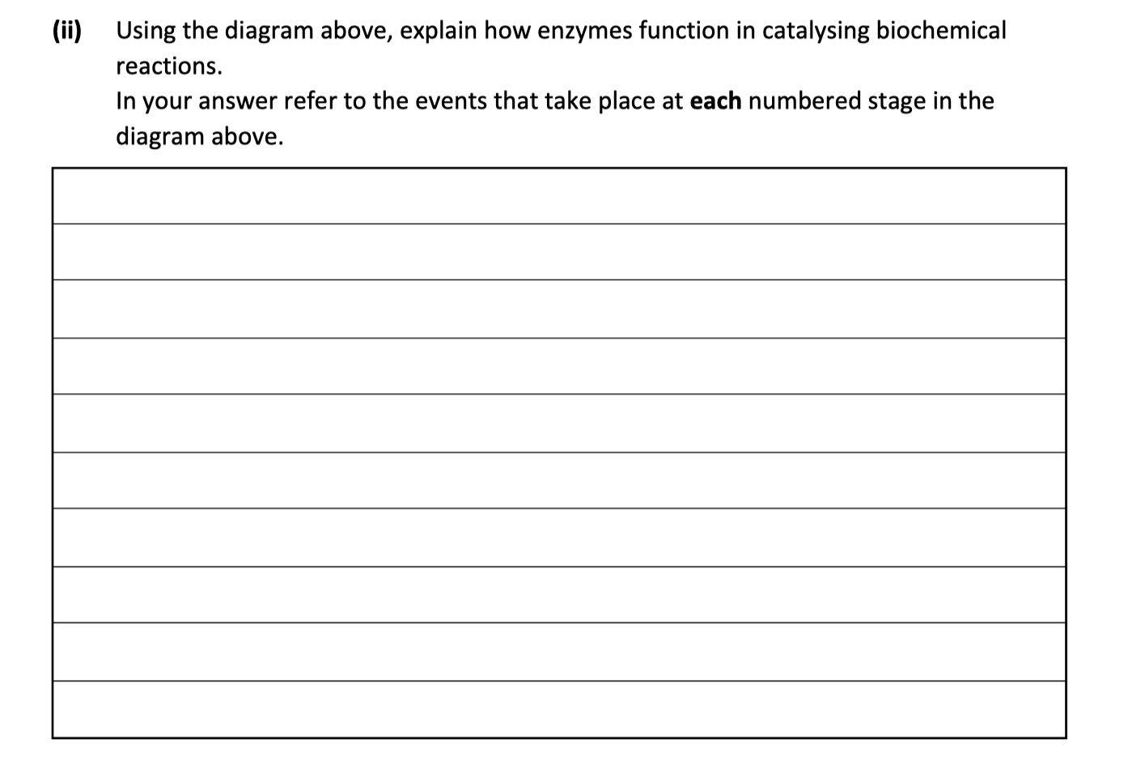
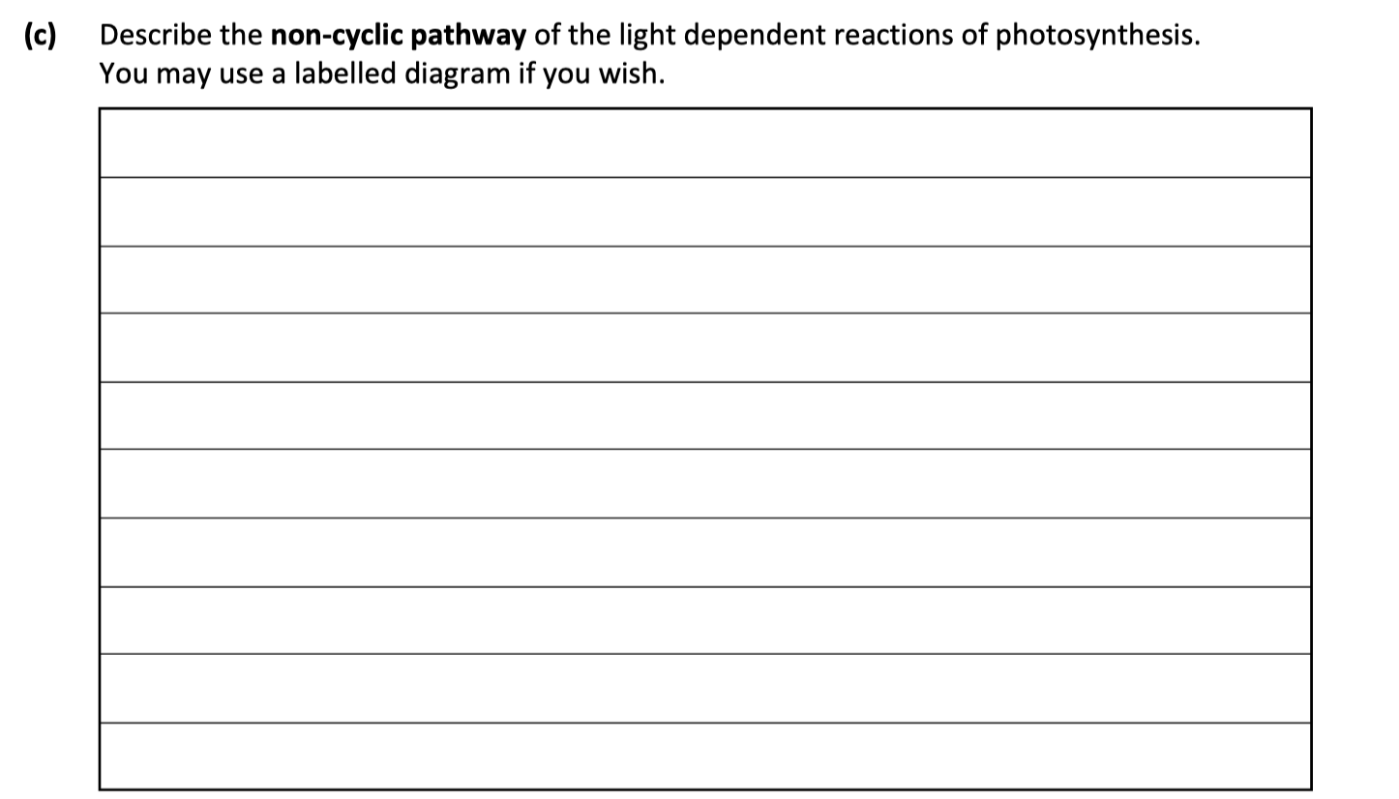

Slide 46
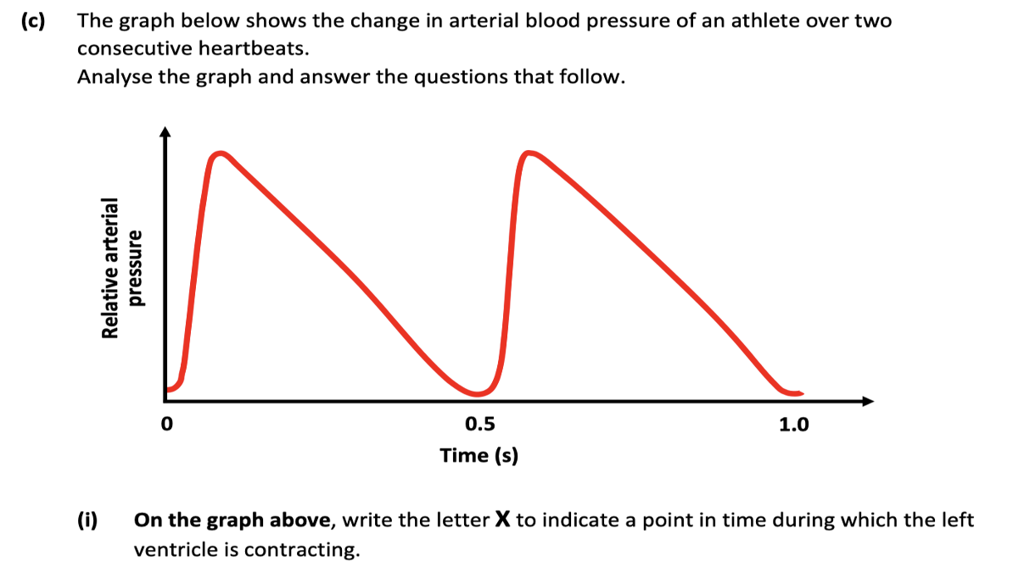


Slide 47

Link between chapters

