Slide 1
Biology Plus Webinar:
AAC Project Guide

Slide 2
The assessment of Leaving Certificate Biology comprises of two components:
1. Final written examination
2. Biology in Practice Investigation
The Biology in Practice Investigation is worth 200 marks, which is 40% of the overall marks for Leaving Certificate Biology. The remaining 300 marks (60%) are for the final written examination.
Coursework must be completed in full and strict compliance with the procedures and conditions outlined in this coursework brief and in the State Examinations Commission (SEC) Coursework Rules and Procedures.
The coursework must be carried out and submitted to the class teacher by 26th February 2027 and will then be submitted to the SEC

Slide 3
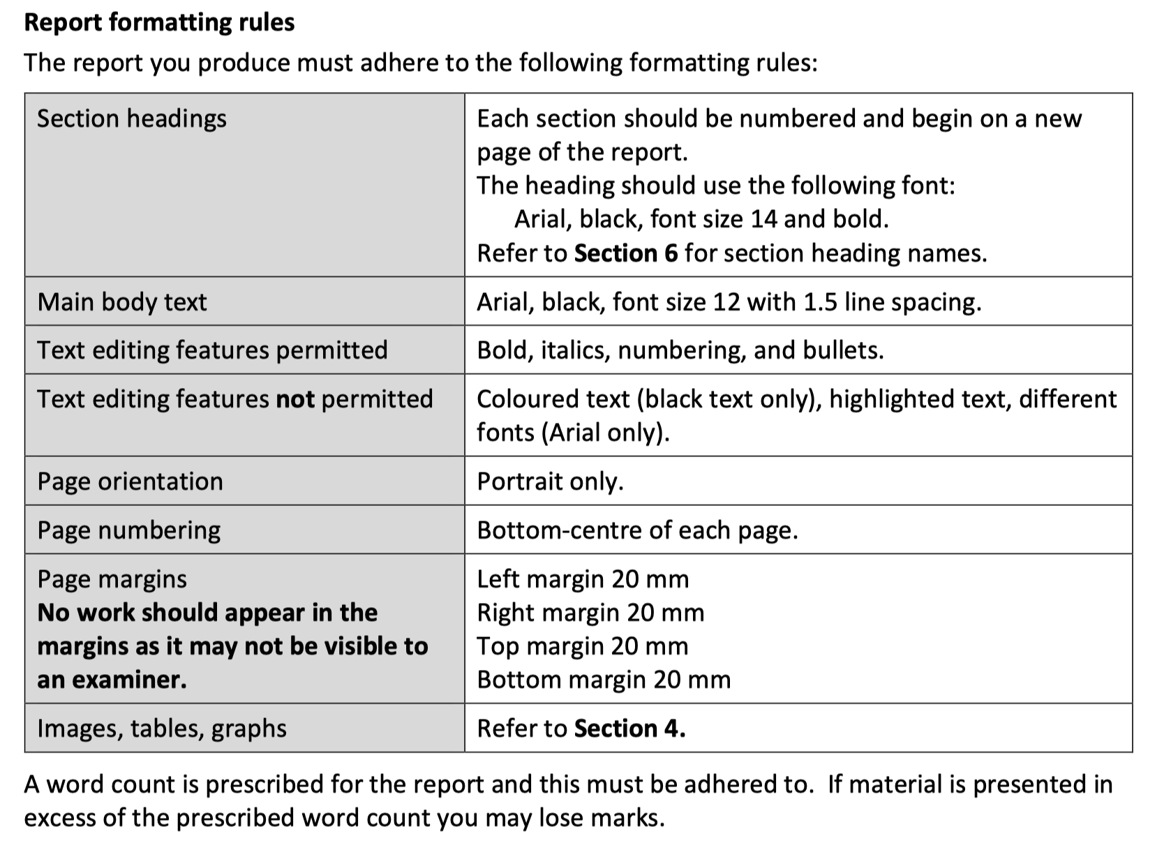

Slide 4
Note that your report will gain marks for communicating clearly and with skilful brevity, but that fewer marks will be awarded if your report loses coherence through unwarranted length.
Your report should contain no more than 1500 words. This word count does not include words used in references, in data tables, in formulae or equations, or as labels.
You may use appropriate images in your report to support your communication. Your report should contain no more than 20 images. The number of images permissible should be seen as a limit and not a target.
Images should be inserted where appropriate and with due regard to effective and relevant communication. Images should not be used as a means to include additional text. It is advisable not to use images where a person or persons in these images may be identifiable. The inclusion of videos is not allowed.
Graphs, diagrams, images, etc. may be produced using appropriate software, captured from secondary sources, photographed directly, or hand-drawn. These can be embedded in your report as photographs or partial screenshots.
Mathematical and scientific formulae and equations may be produced using appropriate software or handwritten, photographed or scanned and embedded in your report. To ensure fairness across the different methods, formulae and equations, whether produced using software or handwritten and photographed, will not be counted toward the image limit.

Slide 5
Engaging with your Biology in Practice Investigation
The brief for the Biology in Practice Investigation is designed to give you an opportunity to display evidence of your learning throughout your studies in Biology. When you have finished your investigation, you will submit a report on it to the SEC.
As you carry out your investigation, you are strongly encouraged to keep an investigative log. This can be used to keep a record of your thoughts on the investigation and reflect on how they change over time. It can also be used to keep a record of your research references and resources. Your log may be of use to you as you complete your investigation and your report.
You should not submit your log to the SEC.

Slide 6
Stages
Your Biology in Practice Investigation should involve the following six stages:
Stage 1: Initial Response to the Investigation Brief (1 – 2 hours)
Stage 2: Background Research (2 – 3 hours)
Stage 3: Designing and Planning the Experiment (2 – 3 hours)
Stage 4: Conducting the Experiment (2 – 3 hours)
Stage 5: Data Analysis and Conclusions (2 – 3 hours)
Stage 6: Finalising the Biology in Practice Investigation Report (4 hours)
Note – Some stages may take longer than the suggested times and this is why 20 hours is the recommended time for the Biology in Practice Investigation.
The conducting of your experiment, and the gathering of your primary data, must be fully completed under the direct supervision of your Biology teacher, and in a relevant, safe and supervised setting (school laboratory and/or other suitable setting, as appropriate to the investigation).

Slide 7
Descriptors of quality for the
Biology in Practice Investigation
 | Students demonstrating a high level of achievement | Students demonstrating a moderate level of achievement | Students demonstrating a low level of achievement
Knowledge and understanding | engage thoroughly with the concepts being investigated; explain clearly and accurately, using appropriate means, the biological phenomena involved; where applicable, pose a testable hypothesis that is underpinned by biological theory and clearly describe the purpose of the investigation | have a good engagement with the concepts being investigated; describe the biological phenomena involved; where applicable, pose a testable hypothesis and outline the purpose of the investigation. | have a limited engagement with the concepts being investigated; outline the biological phenomena involved; are provided with a testable hypothesis to investigate.
Demonstrate investigative skills (design and method) | use clear, thorough, and appropriate investigative design and methods to collect primary data, leading to high quality data, presentation, and analysis. | use clear and appropriate investigative design and methods to collect primary data, leading to good quality data, presentation, and analysis. | use unclear investigative design and methods to collect primary data, leading to limited data, presentation, and analysis
Demonstrate investigative skills (analysis and conclusions) | draw valid conclusions justified by the data and relating to any hypotheses made; thoroughly evaluate the investigation acknowledging sources of error in the investigative design | draw conclusions that relate to any hypotheses made, identify potential sources of error in the investigative design. | draw limited conclusions. Potential sources of error in the investigative design are not identified.
Relate their investigative work to the work of scientists in society | offer a considered reflection that locates the outcomes of the investigation within broader issues relating to the work of a scientist or science and society | reflect on how the outcomes of the investigation relate to the work of a scientist or science and society. | make limited links between the outcomes of the investigation and the work of a scientist or science and society.

Slide 8
Report structure for your Biology in Practice Investigation
Write your report using the following headings:
Title and Introduction
Background Research
Designing and Planning
Conducting the Experiment
Data and Data Analysis
Conclusions
References

Slide 9
Headings and Subheadings
Use clear headings and subheadings
1. Main Heading – Title and Introduction
Subheading – Title
Subheading – Introduction
2. Main Heading – Background research
Subheading – Research question
Subheading – Hypothesis
3. Main Heading - Designing and Planning
Subheading – Aim
Subheading – Variables (independent, dependent and control variables)
Subheading – Materials and Equipment
Subheading – Safety
4. Main Heading – Conducting the Experiment (include how reliability, accuracy and fairness were achieved also)
Include images for the method – make sure they’re clearly titled
5. Main Heading - Data and Data Analysis
Subheading - Experiment observations (tables that include primary data)
Subheading - Data Presentations
Subheading - Data Analysis: Explanation of patterns in the data
Subheading - Evaluating Results
6. Main Heading – Conclusion
7. Main Heading – References (Bibliography)

Slide 10
Suggestions for possible word count for each section
Section Approx. word count
Title 20 – 30
Introduction, Research Question, Hypothesis 150 – 200
Background Research 250 – 300
Design and Planning 100 – 150
Conducting the Experiment 200 – 250
Data (Results) / Data Analysis 350 – 450
Conclusion and Evaluation 250 – 350

Slide 11
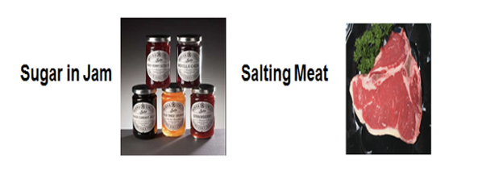
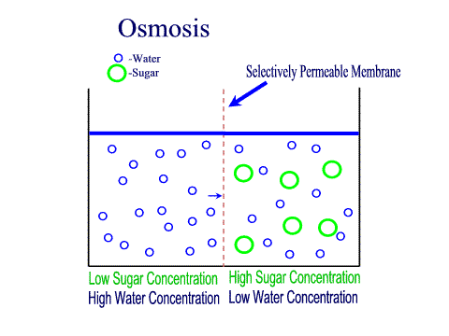
Background knowledge
What do you know already about osmosis and food preservation from the Leaving Certificate Biology course?
Salting meat causes microorganisms (e.g. bacteria) on the meat to lose water and die due to osmosis.
Examples of this principle:
Salting meat or fish
Sugaring fruits
Pickling
What is osmosis?
Osmosis is defined as the passive movement of water across a selectively permeable membrane from an area of high water concentration (low solute concentration) to an area of low water concentration (high solute concentration)
Note: It is very important that you are confident with scientific terminology used above such as low solute concentration, less concentrated, high solute concentration and more concentrated.

Slide 12
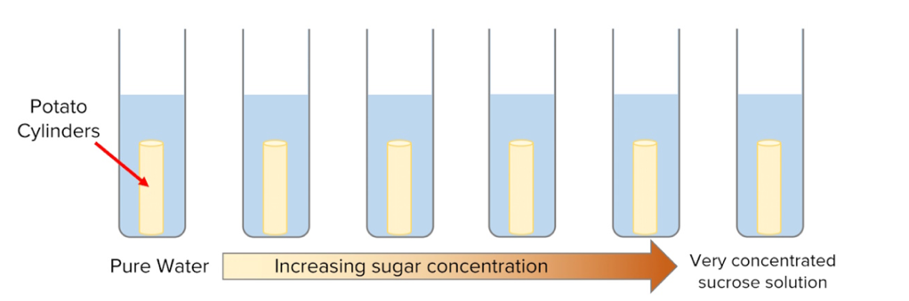
Background knowledge
What happens if the external solution outside the potato cylinders is less concentrated (higher water concentration)?
If the solution outside the potato cells has a higher water concentration (less concentrated) than inside the cells water moves into the potato cells by osmosis (from high water concentration to low water concentration, across the selectively permeable cell membrane).
The potato cube gains mass, becomes firmer/harder, and may increase slightly in size.
What happens if the external solution outside the potato cylinders equals the potato's internal solute concentration?
If the water concentration inside and outside the potato cells is equal there is no net movement of water in or out.
The potato cylinders show little to no change in mass. This is the concentration at which the external solution matches the potato cells' own concentration.
What happens if the external solution outside the potato cylinders is more concentrated (lower water concentration)?
If the solution outside the potato cells has a lower water concentration (more concentrated) than inside the cells water moves out of the potato cells by osmosis (from higher water concentration to lower water concentration, across the selectively permeable cell membrane).
The potato cube loses mass, becomes softer, and may decrease slightly in size.

Slide 13
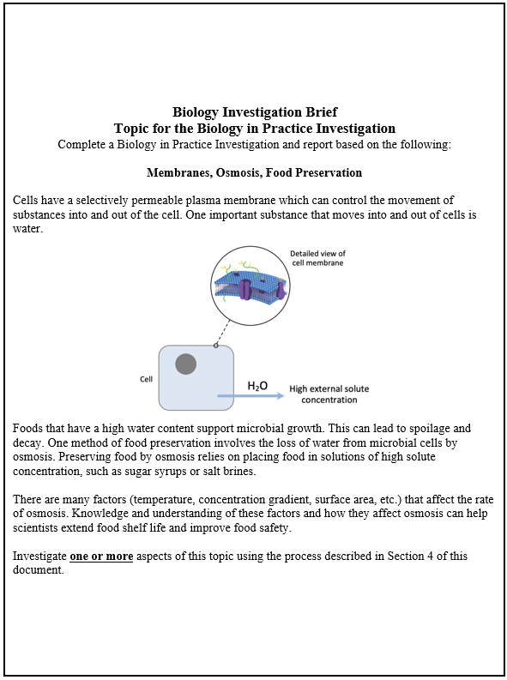
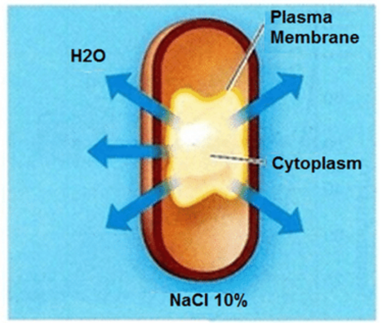
Biology Investigation Brief
What is the science behind it?
Cells (like microbial cells on food) have membranes that let water move in and out. When food is placed in a very high solute concentration / concentrated solution (like sugar syrup or salty brine), water moves out of microorganisms (like bacteria/fungi) by osmosis.
This dehydrates the microbes, stopping them from growing and spoiling the food. This is how salting or sugaring food helps preserve it and prevents food spoilage.

Slide 14
Ideas for the Biology Investigation Brief
What you actually need to do?
Pick one/two factors that affect the rate of osmosis — for example:
What factors affect the rate of osmosis in terms of food preservation?
Solute concentration
Temperature
Surface area
Time of immersion
Type of solute
What solutes might you use?
Salt (curing or brining)
Sugar or syrups (glucose, fructose, sucrose)
There are other solutes that can be used
In simple terms, this brief is asking you to:
Design and carry out your own experiment investigating osmosis, and link it to how it's used in food preservation.
Design an experiment to investigate how that factor affects osmosis (likely using something like potato or plant tissue, since real microbial cells are harder to work with practically), measuring things like change in mass or water loss under different conditions.
Link your findings back to why this matters for food preservation. Refer to how your results help explain why methods like salting or sugaring food work to stop microbial growth and preserve food for longer.

Slide 15
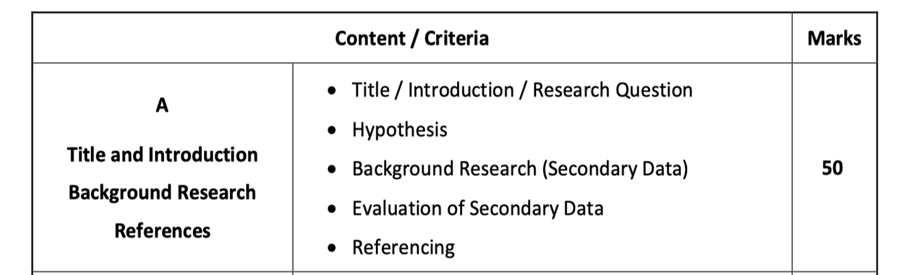
Mark Allocation - Part A

Slide 16
Part A - Main heading - Title and Introduction
Subheading - Title:
What makes a good title?
Clearly identifies independent variable (e.g., "temperature," "solute concentration”)
Clearly states the dependent variable (rate of osmotic water loss, percentage change in mass)
Identifies the organism/material being studied (e.g. potato cubes, yeast)
Uses correct scientific terminology and avoids vague wording
Is concise but complete
Example - An investigation into the effect of solute concentration and immersion time on the rate of osmotic water loss from plant tissue in relation to food preservation.
Example - Investigating how temperature affects the rate of osmosis in potato cells and its relevance to preserving food

Slide 17
Subheading - Introduction:
In simple terms:
The introduction is a brief overview that sets out the purpose of the investigation. It tells the reader what you are investigating and why, without going into great detail.
The introduction is a short opening section that tells the reader:
  What the investigation is about
  What you are trying to find out
  Why the investigation is important or relevant or interesting.
  What the overall scientific idea is (in simple terms)
Note: It sets the scene. It does not include detailed scientific theory. It provides just enough to understand the purpose of the investigation. Remember it must be short and direct.
Membranes / osmosis / food preservation
Try to refer back to how your investigation links to food preservation:
This investigation explores how varying salt concentration (or varying temperatures or varying surface areas) affects the rate of water loss from white radish tissue, as a model for understanding the mechanism behind osmotic food preservation.

Slide 18
Part A - Main heading - Background Research
Good background research is essential for a strong scientific investigation. It shows that you understand the science behind your experiment and that your research question is based on reliable evidence.
Some things that background research should include:
Definitions of key terms (osmosis, selectively permeable membrane, solute concentration)
Scientific theory and mechanisms (explains how and why the process you are investigating works)
Previous findings or known principles
Identify the gap or problem (e.g., we know solute concentration affects osmosis, but how does time interact with it?)
Real‑world applications (e.g., food preservation)
Example:
Understanding how temperature affects the rate of osmotic water loss is important for food preservation, since preservation methods such as salting or sugaring rely on intact, functioning cell membranes to draw water out of food tissue and microbial cells in a controlled way.
Diagrams - illustrate the science
References - support your explanation
Analyse at least four secondary sources and justify their inclusion.
Should lead logically into the research question

Slide 19
Part A - Main heading - Background Research
Remember:
Get the attention of the examiner. Make them excited about reading ahead.
Present it logically – there needs to be an order to the information. You don’t just copy and paste information from a website. Write in your own words.
Good background research explains:
  How your research helped you create your research question
  How your research helped you design your hypothesis
  How your research helped you design your method / equipment
  Why you chose certain variables
Try to incorporate the three cross-cutting themes (Health, sustainability and technology) in the background research. A few strong sentences linking these themes to your investigation is important.
Important to evaluate your secondary data for your background research.
  Have at least four/five background sources that you are going to use. Explain how this backs up your argument or how it is of relevance to the experiment. Compare or link ideas from different sources
  Don't over-rely on a single source. Use multiple credible sources (textbooks, educational websites like BBC Bitesize, peer-reviewed journals) to support your background research thoroughly.

Slide 20
Part A -Main heading - Background Research
Background research should mostly be your own explanation of the science. Quotes should be used only when:
  The wording is important
  You want to show a precise definition
Otherwise, paraphrase the information in your own words.
Avoid copying text directly wherever possible — paraphrase and explain in your own words instead.
Use reliable and credible sources
    Textbooks
    Scientific journals
    Newspaper articles
    Discussions with food scientists (or quality control technicians)
    TV programmes such as Jimmy’s Food Factory (BBC), Food Unwrapped (Channel 4), Science on the Ground – Food Preservation (BBC) and The History of Food (Apple TV)

Slide 21
Part A - Main heading - Background Research
Phrases to introduce background information
Relate research to research question and theme (how does my project relate to the brief).
Phrases to show connections
  This leads to the question of…
  This suggests that…
  In relation to this study…
Phrases to refer to scientific research
    According to [Author] (Year)
    Research conducted by… indicates that…
    Studies have demonstrated that…
    Previous studies have shown…

Slide 22
Part A - Main heading - Background Research
Phrases to highlight research gaps
If you want to show why your investigation matters, you can use:
    Despite extensive research…
    However, previous studies have not…
    There is limited research on…
    This study aims to address…
    This research aims to determine…
Remember for background research:
    Do not include unnecessary information. Every section should help explain your investigation.
    When finding and using useful resources make sure to evaluate these sources in your background research.

Slide 23
Suggestions for research:
BBC Bitesize
Royal Society of Biology
World Health Organisation
National Institutes of Health
Khan Academy
PLOS
American Chemical Society

Slide 24
Some examples of Scientific Articles:
Exploring osmotic dehydration for food preservation: Methods, Modelling, and Modern Applications.
Advanced osmotic dehydration techniques combined with emerging drying methods for sustainable food production.
Explains how osmosis draws water out of food in hypertonic solutions like sugar or salt, reducing moisture and helping preserve foods.
Osmotic dehydration - A clear overview of the process, how water moves out of food and what solutes are used (e.g., salt, sugar), with practical examples.
OD fruits – Process description (ITM International Ltd)
An applied industry webpage detailing osmotic dehydration of fruits and vegetables, explaining preservation benefits and how quality is retained.
Osmotic dehydration process for preservation of fruits and vegetables – Journal of food research
A scientific article explaining the process and advantages of osmotic dehydration in preserving fruit and veg, with more context on mechanisms and benefits.
https://ccsenet.org/journal/index.php/jfr/article/view/16751
“Obsessed with: pickles – why it’s crunch time on London’s culinary scene” — Explores the cultural and historical significance of pickling — a preservation method — and why it is gaining popularity. Obsessed with: pickles – Financial Times
“Save on food with traditional preservation techniques” — Discusses why traditional preservation techniques (like drying, salting, pickling) are useful for reducing spoilage and food waste. Save on food with traditional preservation techniques – Yahoo Lifestyle

Slide 25
Part A - Main heading - References
For referencing - Acknowledge the source in the text (in‑text citation). Always cite your source whenever you use a fact, idea, diagram, or data that isn't your own original work/knowledge.
This means you briefly show where the information came from right after you use it. Use Harvard style (most commonly used)
Example of in-text citation: Osmosis is the movement of water across a selectively permeable membrane (Smith, 2020).
You must then include the full reference in a bibliography or reference list at the end of your report. You must give the full details of the source so someone else could find it.
Example - Smith, J. (2020). Cell Biology Explained. London: Academic Press.
Example (website) - National Geographic (2023). What is Osmosis? Available at: www.nationalgeographic.com/osmosis (Accessed: 25 July 2026).
This shows you are not plagiarising and that your background research is based on reliable sources. It shows you actually understand the science, not just copied it

Slide 26
Suggestions for research:
BBC Bitesize
Royal Society of Biology
World Health Organisation
National Institute of Health
Khan Academy
PLOS
American Chemical Society

Slide 27
Suggestions for research:
Osmotic dehydration process for preservation of fruits and vegetables – Journal of food research
A scientific article explaining the process and advantages of osmotic dehydration in preserving fruit and veg, with more context on mechanisms and benefits.
https://ccsenet.org/journal/index.php/jfr/article/view/16751
Obsessed with: pickles – why it’s crunch time on London’s culinary scene” — Explores the cultural and historical significance of pickling — a preservation method — and why it is gaining popularity. Obsessed with: pickles – Financial Times
“Save on food with traditional preservation techniques” — Discusses why traditional preservation techniques (like drying, salting, pickling) are useful for reducing spoilage and food waste. Save on food with traditional preservation techniques – Yahoo Lifestyle

Slide 28
Subheading - Research Question
Research question should start with words ‘Could’ or ‘How does’ or ‘Should’ or ‘Can’ to gather interest
A good question clearly identifies independent and dependent variables
Steps involved in forming a good research question:
  Identify a specific factor (independent variable) you want to investigate within that topic
  Decide what you will measure (dependent variable) as a result
  Check it links to background research
Example: What is the effect of salt (sodium chloride) solution concentration on the percentage change in mass of potato cubes and how might this relate to microbial preservation methods?
Links directly to how salt brines are used in food preservation, using potato as a model for plant tissue.

Slide 29
Subheading - Aim
Make sure that the aim is associated with your title and hypothesis.
Example: To investigate how selected factors surface area or temperature, affects the rate of osmosis in plant tissue, in order to understand how osmotic dehydration contributes to food preservation.

Slide 30
Subheading - Hypothesis
How should a strong hypothesis be written?
Write it as a statement that is clear and testable.
A hypothesis should not be a question.
Based on existing knowledge
Outlines expected results
It should include the following:
  The independent variable (what you change)
  The dependent variable (what you measure)
Example - If the surface area of cucumber tissue exposed to a concentrated salt or sugar solution increases, then the rate of mass loss by osmosis will increase, due to a greater surface area available for water to move across the membrane

Slide 31
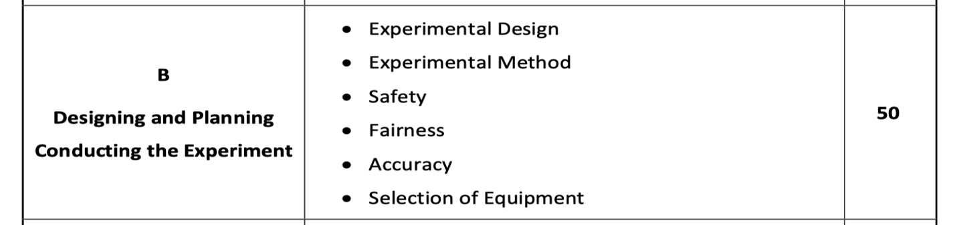
Mark Allocation - Part B

Slide 32
Part B – Main Heading - Designing and Planning
Subheading – Variables (independent, dependent and control variables)
Subheading – Materials and Equipment
Subheading – Safety

Slide 33
Subheading - Variables
Clearly state the independent, dependent and control variables.
Independent variable (what you change)
  Solute concentration
  Temperature
  Surface area
  Immersion Time
  Type of solute
Note: you should state the units when identifying your independent variable in a scientific report as this is considered good scientific practice.
When identifying your independent variable, include:
  What is being changed
  The specific values/range being tested
  The units those values are measured in
Dependent variable (what you measure)
  Rate of water loss from the plant tissue / The rate of mass loss (or percentage change in mass) of the cucumber tissue
Note: you should state the units for your dependent variable as this is also good scientific practice.
How might you measure the rate of water loss?
Change in mass (g)
Percentage mass change (%)
Mass lost per unit time (g/min)

Slide 34
Subheading - Variables
Control variables:
Include all controlled variables (what you keep the same)
Note: you should state the units for your controlled variables as well
Example of control variable -
Control variable - Volume of solution
How kept constant - 30 cm³ used in every dish
Unit - cm³
Control variable – Temperature
How kept constant - Kept at 20°C using a water bath
Unit - °C

Slide 35
Subheading - Materials and Equipment (or Selection of Equipment)
A good list of equipment in a scientific investigation tells exactly what materials and tools are needed so someone else can repeat the experiment accurately.
Subheading – Safety
Try to include safety precautions that link directly to your investigation
Describe how certain risks might be minimised
Some examples
  Always cut away from your body and fingers.
  A scalpel and cork borer were handled carefully to avoid injury.

Slide 36
Part B - Main Heading – Conducting the Experiment
What should you include in your procedure?
Clear step-by-step - write in a logical order using numbered steps. Each step should be easy to follow
Make sure to include a control experiment and explain why a control is used
Specific and detailed – include precise information such as measurements (e.g., 50 ml, 10 cm, 30°C), time intervals or equipment used.
Must be repeatable – no steps should be missing
Explain what you:
  Changed (independent variable)
  Measured (dependent variable)
  Kept the same (control variables)
Use correct style – try to avoid personal language like “I” or “we”
State how many times you repeat the experiment to improve accuracy
State and justify how you ensured accuracy
State and justify how you ensured precision
State and justify how you ensured reliability and reproducibility
State and justify how you ensured fairness
Include labelled diagram of apparatus used

Slide 37
Make sure to include the following in your design and planning section:
Control – explain why you have (or have not) used a control.
To improve accuracy: How close a measurement is to the true, real value
  Use a more precise digital balance. Make sure the balance was re-zeroed each time.
  Measure solution concentration precisely using volumetric flasks.
  Calibrate equipment correctly – e.g., zero the balance before weighing
To improve reliability: How consistent your results are if the experiment is repeated
  Increase the number of repeats and calculate a mean value.
  Large sample size
How do you keep experiments fair? A fair test means only the independent variable (surface area) changes between samples, while everything else is kept exactly the same
  Use a cork borer to ensure uniform size and diameter of tissue samples.
  Standardise blotting technique and blotting time.
  Use the same type/source of cucumber
Note:
  Include images for the method – make sure they’re clearly titled (you are allowed up to 20 images)
  Make sure you take pictures of your set up while carrying out the investigation in the school lab. You do not want to waste time having to set up the same investigation again for taking photos.

Slide 38
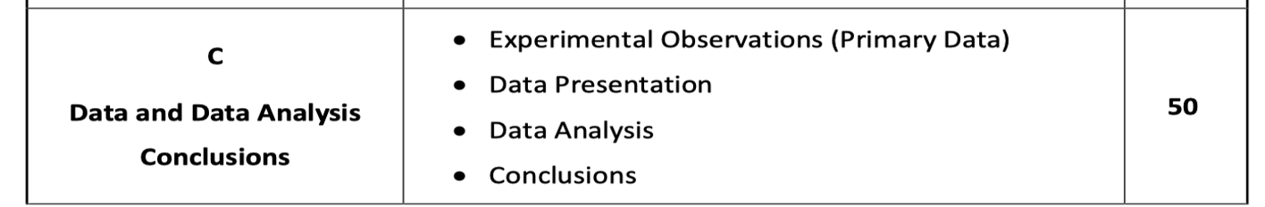
Part C: Data and Data Analysis / Conclusions

Slide 39
Part C: Main Heading Data and Data Analysis/Conclusions
Section | What it means? | What to include?
Experimental Observations (Primary Data) | The raw data you collected directly from the experiment. Nothing is processed or interpreted yet. | Measurements, readings, notes from the experiment (e.g., initial mass, final mass, temperature readings)
Data Presentation | Organising the raw data so it is clear and easy to understand. | Tables, graphs, charts, labelled diagrams showing the results
Data Analysis | Examining and processing the presented data to identify patterns or relationships. | Calculations (mean, % mass change, rate), trends, comparisons between treatments
Conclusions | The final statement explaining what the results mean and whether they support the aim or hypothesis | Summary of findings, explanation of what the results show about osmosis and the variables tested

Slide 40
Part C: Main Heading - Data and Data Analysis
Subheading - Experiment observations (tables that include primary data)
Subheading - Data Presentations
Subheading - Data Analysis: Explanation of patterns in the data
Subheading - Evaluating Results

Slide 41
Subheading - Experiment observations (primary data)
You should draw your table before carrying out your practical work and leave space for each piece of data you are planning to obtain, including repeats and a mean value if appropriate.
  Have you written the full heading at the top of each column?
  Have you included units at the top of each column?
  Does each value in the same column have the same number of decimal places?

Slide 42
Table 1 – Effect of solute concentration on the rate of osmosis
Solute concentration (M) | Immersion time (minutes) | Initial mass (g) | Final mass 1 (g) | Final mass 2 (g) | Final mass 3 (g) | Average final mass (g) | Average change in mass (g) | % change in mass | Rate of osmosis (g/min)

Slide 43
Table 3 - Effect of temperature on the rate of osmosis (0.4M solution)
Temperature (ºC) | Initial mass (g) | Final mass 1 (g) | Final mass 2 (g) | Final mass 3 (g) | Average final mass (g) | Average change in mass (g) | % change in mass | Rate of osmosis (g/min)

Slide 44
Subheading - Calculations
Below are some possible calculations you may decide to carry out.
Calculations 1 – How to calculate the average (or mean) final mass?
Add the three final mass results and divide by three
Calculation 2 – average change in mass
Average change in mass = Final mass – initial mass
Calculation 3 – Percentage change in mass
Percentage change in mass = (Change in mass ÷ Initial mass) × 100
Calculation 4 – Rate of osmosis
Rate of osmosis = Change in mass ÷ Immersion Time

Slide 45
Subheading - Data Presentations
Graphs (generated by excel, GeoGebra or hand drawn)
  Have you drawn the correct type of graph? Line graph, bar chart, scatter plot, histogram
  Have you put the independent variable on the horizontal x‐axis and the dependent variable on the vertical y‐axis?
  Have you used appropriate regular scales so that your graph fills at least half of your graph paper?
  Have you labelled each axis with the variable and the units?
  Have you plotted your points or bars accurately?
  If you have drawn a line graph, have you drawn a line of best fit that ignores any anomalous results and goes through as many of your points as possible?

Slide 46
Subheading - Data Presentations
For the following factors, what type of graph would you draw to represent results on rate of osmosis on plant tissue:
  Temperature – line graph
  Concentration gradient - line graph
  Surface area – line graph
  Immersion time – line graph
  Type of solute – bar chart (since solute type is a category, not a numerical scale, you compare discrete groups)

Slide 47
Subheading - Data Analysis: trends and patterns in the data
Data analysis should include:
Note: Make it very clear to the examiner what you discovered.
Explain WHAT the results show
Example - “As temperature increased, the rate of osmosis increased”
Example - “Higher solute concentration caused greater mass loss”
Clear description of the trend/pattern
Compare variables - Explain the relationship between the variables (e.g. how solute concentration affected the rate of osmosis)
Example: As solute concentration increased from 5% to 20%, the percentage mass loss also increased.
State what the data shows in words, describe the overall trend (increase, decrease, plateau, optimum, etc.)
Reference specific numerical values from your results/graphs, not just a vague trend (e.g. % change in mass decreased from +12% at 10°C to -22% at 30°C
Identify any anomalies in the data and acknowledge them (Explain possible reasons for them (e.g. measurement error, contamination)
Note: Anomalous results are caused by random error such as wrongly recording a measurement, spilling some of the reaction mixture etc. Writing that an anomalous result is caused by ‘human error’ is too vague and will not gain marks.
Comment on consistency
Mention repeated trials and averages to show reliability

Slide 48
Subheading - Data Analysis: trends and patterns in the data
Some possible phrases to use – Describing the trend
  "As temperature increased..."
  "The results show that..."
  "There was a clear increase/decrease in..."
  "Percentage change in mass rose from... to..."
  "A positive/negative correlation was observed between..."
  "The data indicates a steady increase up until...“
  "The graph shows a peak at..."
  "The data collected indicates that…"
  "The data collected confirms that…"
  "It is obvious from the data that there is a relationship between the independent variable (name it) and the dependent variable (name it) as…"

Slide 49
Subheading - Data Analysis: trends and patterns in the data
Explaining scientifically
  "This can be explained by..."
  "This is likely due to..."
  "This occurs because..."
  "A possible reason for this is..."
  "This suggests that..."
  "This is consistent with the theory that..."
Referring to anomalies
  "One result did not fit the overall trend..."
  "The reading at [X]°C appeared anomalous, possibly because..."
  "This unexpected result may be due to..."

Slide 50
Subheading - Evaluating Results
(How good was the experiment?)
Limitations - What limitations have you recognised in the experiment?
Sources of error
  Example:
  Incorrect measurement of mass — balance not zeroed or readings taken too quickly.
Strengths of the investigation
  Repetition increased reliability
  Control used?
Extensions (Extensions are new directions or additional investigations that go beyond the scope of your original investigation — new questions, variables, or areas you didn't originally test, but which would build on/complement your findings)
"To extend this investigation further, I could also investigate..."
Refinements (improvements to the existing investigation)
  Use a cork borer to ensure uniform size and diameter of tissue samples.
  Use a more precise digital balance (±0.001 g)
"To improve this investigation, I would..."

Slide 51
Subheading - Reflections
What you found challenging
What you learned
What you enjoyed
What surprised you

Slide 52
Part C - Main Heading – Conclusion
A conclusion in a biology investigation should clearly summarise your findings and reflect on their significance. A conclusion should try to include the following:
Restate the hypothesis (or aim) of the investigation
Briefly remind the reader what the investigation was trying to find out.
Summary of key results by highlighting most important findings from data.
Link to hypothesis - State whether your hypothesis was supported or not, and explain briefly why.
Explain what the results mean in a biological context, using scientific reasoning. (osmosis, membranes, food preservation). Explain why this trend occurred, using relevant scientific theory.
Can you link your findings back to your initial background research?
Compare your primary data (from experiment) to secondary data you might have found during your research (helping make your results valid)
Relate findings to food preservation:
  Link findings to the real-world context of food preservation
  State a specific, practical recommendation based on the findings (e.g., Explain how controlling temperature slows osmosis and helps maintain food quality)
Have you stated how this investigation relates to science in society. Have you stated how your investigation relates to the cross-cutting themes (health, sustainability and technology).

Slide 53
Part C - Main Heading – Conclusion
Some possible phrases to use –
Linking to hypothesis
  "These findings support/do not support the hypothesis, as..."
  "This confirms the prediction that..."
  "This partially supports the original hypothesis because..."
Linking to food preservation
  "This has significance for food preservation because..."
  "These results suggest that..."
  "In terms of real-world application, this indicates that..."

Slide 54
Part A - Main Heading - References
Referencing
Referencing is one of the sections that makes up the first 50 marks in the brief. Poor referencing or references that are missing will result in loss of marks in section A and may also lower the coherence or communication marks in section D for the marks allocation.
What style of referencing is used mostly in Ireland? Harvard style of referencing.
Important guidelines for the referencing process
  You need to reference both within the report (in-text citation) and in the reference section at the end of the report.
  You should use an in-text citation whenever you use statistics, or wherever you quote, paraphrase or summarise research and ideas that are not your own.
Note: Remember for every in-text citation in your report, you must have a corresponding reference in the list of references section at the end of report.
Bibliography
References should be put into alphabetical order.

Slide 55
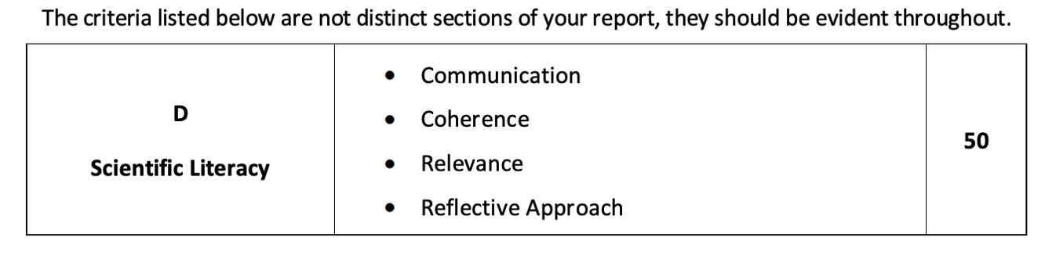
Part D - Main Heading – Scientific Literacy
Scientific literacy will be a very important aspect in your written investigation report. It is essential you structure your writing and reflect on how clearly you communicate scientific ideas. The key features (communication, coherence, relevance and reflective approach) have to be incorporated throughout the entire written report.

Slide 56
Communication
To achieve high marks for communication, scientific ideas must be clearly and accurately expressed.
How to achieve good communication throughout the report?
  Use language that is clear and concise (make sure to avoid unnecessary complexity).
  Use essential scientific terminology that is required to explain your investigation. Examples may include - osmosis, solute, solvent concentration gradient, water potential, selectively permeable membrane, cell membrane, microbial growth.
  Present all of your data in clear graphs, tables and images that are titled and well laid out.
  Use diagrams that are clearly labelled.
  Use correct units and symbols

Slide 57
Coherence
To achieve marks for coherence, your written investigative report should follow a logical flow so the examiner can easily follow the investigation.
How to achieve coherence throughout the report?
Your written report needs to follow a certain scientific structure:
  Title
  Introduction
  Research Question
  Background research and evaluation of this research
  Hypothesis
  Experimental design (e.g variables, safety, selection of equipment)
  Experimental method
  Results (primary data)
  Data analysis
  Conclusion
  Evaluation
  References

Slide 58
Headings and Subheadings
Use clear headings and subheadings
1. Main Heading – Title and Introduction
Subheading – Title
Subheading – Introduction
2. Main Heading – Background research
Subheading – Research question
Subheading – Hypothesis
3. Main Heading - Designing and Planning
Subheading – Aim
Subheading – Variables (independent, dependent and control variables)
Subheading – Materials and Equipment
Subheading – Safety
4. Main Heading – Conducting the Experiment (include how reliability, accuracy and fairness were achieved also)
Include images for the method – make sure they’re clearly titled
5. Main Heading - Data and Data Analysis
Subheading - Experiment observations (tables that include primary data)
Subheading - Data Presentations
Subheading - Data Analysis: Explanation of patterns in the data
Subheading - Evaluating Results
6. Main Heading – Conclusion
7. Main Heading – References (Bibliography)

Slide 59
Relevance
To achieve high marks for relevance it is important you only include information that directly relates to your research question, hypothesis and the investigation.
How to achieve relevance throughout the report?
  Only include data that is related to the variables and link it back to the hypothesis
  For data and analysis only include explanations related to the variables
  When interpreting results, clearly link them back to the scientific concept being investigated
  Avoid unnecessary background research information

Slide 60
Reflective approach
It is important you demonstrate critical thinking throughout the written report.
How might you achieve a reflective approach in your written investigation?
  Try to evaluate the reliability and validity of the results.
  Suggest possible improvements (extensions) to the method
  Make it clear on whether the evidence supports or rejects the hypothesis and why.
  Try to identify sources of error or limitations in the investigation.

Slide 61
Final steps
  Applied formatting rules to the document
  Ensured the official SEC coursework page is completed and placed before the digital report
  Converted the file to PDF format
  Printed the report
  Submitted the proofread digital file to the teacher

Slide 63
THANK YOU
A link to this webinar will be uploaded to:
https://edcopublications.ie/biologyplus
If you have adopted Biology Plus in your school, you can access your Biology in Practice Investigation Guidelines Booklet PDF via your Edco Learning account.
Your Certificate of Attendance for your CPD hours will be automatically delivered
After this webinar, eligible attendees will automatically receive their certificate — no need to request it separately.
For any other queries, you can email us at info@edcolearning.ie

